Slide 1
THE BOOK OF REVELATION
FOR THE MODERN READER
Lesson One
Notes:
THE BOOK OF REVELATION
FOR THE MODERN READER
In Four Lessons
First
This is intended as a four lesson course on the book of the New Testament commonly known as The Book of Revelation. The first lesson deals with the introduction to the concepts, origins and history of the text itself. The following three lessons, two, three and four, deal with the text itself. The intention is that this study be undertaken along with your reading of the text, starting after you have finished this first lesson. In this way, you will be able to encounter these scriptures directly. These as with all parts of the Bible, can be read for textual study and as an aid in life. The textual study will bring understanding and one hopes enlightenment. When read with a life challenge in mind, one will discover in scriptural texts, new meaning, that will help in dealing with the challenge at hand. This final section of the New Testament, above all others was written to those facing great and often fatal challenges in life.

Slide 2
The Revelation to John
The Official Name from the Oxford Annotated Introduction

Slide 3
THE BOOK OF REVELATION
FOR THE MODERN READER
Five lesson course on The Book of Revelation.
  1. concepts, origins and history of the text itself.
  2. Out Line Organization Seven Letters and
  3. Outline of the Visions
  4. Memorable images
  5. Relevance to Modern Life
Home Work - After you have finished this first lesson you should start to read the Book through the Seven Letters.
This final section of the New Testament, above all others was written to those facing great challenges in life.
Notes:
THE BOOK OF REVELATION
FOR THE MODERN READER
In Five Lessons
First
This is intended as a five lesson course on the book of the New Testament commonly known as The Book of Revelation. The first lesson deals with the introduction to the concepts, origins and history of the text itself. The following three lessons, two, three and four, deal with the text itself. The intention is that this study be undertaken along with your reading of the text, starting after you have finished this first lesson. In this way, you will be able to encounter these scriptures directly. These as with all parts of the Bible, can be read for textual study and as an aid in life. The textual study will bring understanding and one hopes enlightenment. When read with a life challenge in mind, one will discover in scriptural texts, new meaning, that will help in dealing with the challenge at hand. This final section of the New Testament, above all others was written to those facing great and often fatal challenges in life.

Slide 4
Lesson one
  1. concepts, origins and history of the text itself.
Notes:
1. concepts, origins and history of the text itself.
2. Out Line Organization Seven Letters and
3. Outline of the Visions
4. Memorable images
5. Relevance to Modern Life

Slide 5
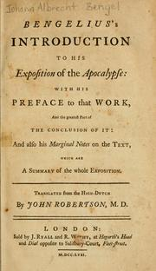
Visual and Memorable
The Book of Revelation is one of the more often quoted and least understood books of the New Testament.
The language is vivid, memorable, and confusing.
It has been controversial from the beginning and was not in some of the original canons of scripture in the early Church.
The text has daunted many readers – THE John Wesley Said:
“These, it is evident, we cannot consider too much; but the intermediate parts [of Revelations] I did not study at all for many years; as utterly despairing of understanding them, after the fruitless attempts of so many wise and good men: and perhaps I should have lived and died in this sentiment, had I not seen the works of the great Bengelius.”
Notes:
The Book of Revelation is one of the more often quoted and least understood books of the New Testament. Much of its language is vivid, memorable, and confusing. It represents the last book in those writings we Christians call the Bible. The question of whether this book even should have been included in the canon of scripture has been controversial from the beginning. To start with, the entire book was not even contained in some of the original canons of scripture in the early Church. It was ultimately included and for many it has been a source of inspiration during difficult times. Just reading Revelation is daunting for most. If that has held you back from reading Revelations you should not feel alone. No less a person than John Wesley, felt this same reluctance. Wesley in his opening comments on the Book of Revelation said of the middle portions of the book as follows:
These, it is evident, we cannot consider too much; but the intermediate parts [of Revelations] I did not study at all for many years; as utterly despairing of understanding them, after the fruitless attempts of so many wise and good men: and perhaps I should have lived and died in this sentiment, had I not seen the works of the great Bengelius.
Bengel, John Albert: Jo Albertus Bengelius 1787-1752 noted writer on APOCALYPTIC literature

Slide 6
Introduction
Some parts of Revelation may have been written before the fall of Jerusalem in 70 AD.
The balance of the book was written towards the close of the reign of Emperor Domitian (81 AD to 96 AD) an emperor to be addressed as “Lord and God.”
Refusing this form of address caused many Christians to be put to death or like John exiled.
This persecution is one reason for the author to couch his teaching in mysterious figures and extraordinary metaphors was to prevent the imperial police from recognizing that this book is a trumpet call to the persecuted.
Notes:
Introduction to The Revelation to John from the Oxford Annotates Bible, 1996 Edition.
The book of Revelation, or Apocalypse, is a fitting close to the Scriptures of the Old and New Testaments, for its final chapters depict the consummation toward which the whole biblical message of redemption is focused. It may be described as an inspired picture-book that, by an accumulation of magnificent poetic imagery, makes a powerful appeal to the reader’s imagination. Many of the details of its pictures are intended to contribute to the total impression, and are not to be isolated and interpreted with wooden literalism.
Through the centuries the Apocalypse has been the object of widely divergent systems of interpretation. It can be best understood when one takes into account the following considerations. (1) This book comprises the substance of real visions that repeat with kaleidoscopic variety certain great principles of God’s just and merciful government of the whole creation. By centering attention on these principles, the church in all ages has been encouraged and sustained despite the fiercest antagonisms of both human and demonic foes. (2) The book is written in apocalyptic style, a recognized literary genre (see “Introduction to the Apocalyptic Literature”). It contains other elements as well, such as the seven letters in Revelation 2 and Revelation 3 and the several prophetic utterances scattered here and there throughout its pages, but its difficulty will be found to arise largely from our unfamiliarity with apocalyptic writings. (3) As an apocalypse, the message of the book is couched in symbolism, involving numbers, strange beasts, and other typical apocalyptic features. Throughout one must recognize that the author’s descriptions are descriptions of the symbols, not of the reality conveyed by the symbol. (4) Although the key for understanding some of the symbols has been lost, in other cases a comparison with the prophetic symbolism of the Old Testament sheds light on the intended meaning. This is understandable in view of the author’s frequent allusion to the Greek Septuagint translation of the Hebrew Scriptures; of the 404 verses in Revelation, some 275 include one or more allusions to passages in the Old Testament. (5) The structure of the book involves a series of parallel and yet ever-progressing sections; these bring before the reader, over and over again, but in climacteric form, the struggle of the church, and its victory over the world in the providence of God Almighty. There are probably seven of these sections, though only five are clearly marked. The plan of the whole is, then, something like the following: Prologue; Revelation 1.1–8; seven parallel sections divided at Revelation 3.22; Revelation 8.1; Revelation 11.19; Revelation 14.20; Revelation 16.21; and Revelation 19.21; Epilogue, Revelation 22.6–21.
Although parts of the book (e.g. Revelation 11) may have been reduced to writing before the fall of Jerusalem in a.d. 70, it is probable that the author, whose name is John (Revelation 1.1; Revelation 1.4; Revelation 1.9; Revelation 22.8), put the book in its present form toward the close of the reign of the Emperor Domitian (a.d. 81 - 96). It was then that Domitian began to demand that his subjects address him as “Lord and God” and worship his image. For refusing to do so, many Christians were put to death (Revelation 6.9; Revelation 13.15); others, like John (Revelation 1.9), were exiled, and all were threatened. One reason for the author’s couching his teaching in mysterious figures and extraordinary metaphors was to prevent the imperial police from recognizing that this book is a trumpet call to the persecuted, assuring them that, despite the worst that the Roman Empire could do, God reigns supreme, and Christ, who died and is alive forevermore (Revelation 1.18), has the power to overcome all evil. And therefore John closes his book with the prayer, “Come, Lord Jesus!” (Revelation 22.20).

Slide 7
The Era
Not all scholars agree that there was a general persecution although the date has been set since Irenaeus a well known early scholar in 180 AD.
The death of Emperor Nero in 68 AD by suicide and the civil wars that followed, evoked a belief by many of the time that Nero was actually still alive and would return to power with a army from the East.
The Antichrist image of Nero was based on the belief that Nero would or had returned from the dead.
There were at times after the death of Nero as many as four emperors all at war.
Vespasian and his sons Titus and Domitian had been popular administrators from the Roman province of Asia who came to power.
Notes:
Oxford Annotated Companion to the Bible Article on the Book of Revelation.
Situation and Date. Irenaeus (ca. 180 ce), who came from Asia and had known Polycarp, bishop of Smyrna (ca. 70–150 ce), and others of his generation, dated the book of Revelation toward the end of the reign of Domitian (81–96 ce; cf. Against the Heresies 5.30.3, as usually interpreted). The picture of the Antichrist reflects popular belief that Nero, who had stabbed himself in the throat, would return from the dead (Revelation 13.3; Revelation 13.12; Revelation 13.14), and many scholars see Revelation as a response to the enforcement on Christians of Domitian’s demand for worship as “Lord and God.” But the evidence that he persecuted the church, as opposed to a few individuals who may or may not have been Christians, dissolves on inspection, and the letters to the churches reveal no state persecution, only Jewish “slander” (Revelation 2.9; Revelation 3.9). The only martyr mentioned is Antipas (Revelation 2.13—referring to a past event), and the general picture is of affluence and complacency.
On the other hand, Nero’s mysterious death evoked immediate rumors that he was still alive, and would return with an army from the east; and the civil wars that followed his death (68–69 ce, the Year of Four Emperors), coinciding with the Jewish War (66–70 ce), seem to lie behind the breakup of the Roman world depicted in Revelation 6–18. Consequently, some scholars date Revelation about 68–70 ce: the intensity of hatred against Rome (Revelation 17.6; Revelation 18.24; Revelation 19.2) does at first seem to demand a date close to the fire at Rome (64 ce) and Nero’s massacre of Christians (Tacitus Annals 15.44). Irenaeus’s date is open to question.
There is an apparent clue to the date in the interpretation of the beast’s seven heads as emperors, “of whom five have fallen” (Revelation 17.7–11), but in fact there is no telling which emperor the series starts with, and seven is probably again symbolic. The seven heads represent the empire as a whole, and the beast that “ascends from the bottomless pit” is “an eighth, but belongs to the seven”; it is the quintessence of imperial power, latent now but soon to be revealed in its true colors.
But this is not yet. The present is a time when the beast-like character of the empire is out of sight. In the Roman province of Asia, the Flavian emperors (Vespasian and his sons, Titus and Domitian) were popular, being efficient and generous administrators. Inscriptions hail them as “savior,” “benefactor,” “son of God,” and there was a local zeal for the emperor cult. So Irenaeus’s date in fact fits the evidence from the letters well: a time of patriotic enthusiasm, expressed in terms of religious veneration, from which Christians were not holding aloof. There was as yet no state compulsion for ordinary people to take part in the emperor cult, as long as they kept clear of law courts and the taking of oaths. Pliny’s letter to the Emperor Trajan (ca. 112 ce; Letters 10.96), about people being accused of being Christians in the neighboring province of Bithynia, shows the danger; once accused they had the choice either of cursing Christ, worshiping the gods, and praying to the emperor’s statue, or of cruel execution. Trajan agreed, but said they should not be sought out. So if Christians did not provoke their neighbors by active witness and by nonparticipation in the ordinary social and patriotic decencies, then they would come to no harm. But in John’s view they would be buying temporal safety at the cost of eternal loss (Revelation 14.9–11). The chief threat to the church was not physical danger, as at Smyrna, but social, economic, and religious temptation. Its chief need was discernment: “let anyone who has an ear listen to what the Spirit is saying to the churches” (Revelation 2.7; Revelation 2.11; Revelation 13.9).

Slide 8
The Author
Irenaeus and most later writers assumed that the author was the John who wrote the Gospel and letters, and that he was the son of Zebedee.
Some ancient scholars like Dionysius of Alexandria in the third century and the majority of modern scholars question this identification because of differences of thought, style, and language.
Dionysius relied on hints that there had been two writers named John in Ephesus an elder as well as the John the Apostle.
Another possibility is that Revelation is pseudonymous.
Notes:
Oxford Annotated Companion to the Bible Article on the Book of Revelation.
Author and Sources. Irenaeus and most later writers assumed that the author was the John who wrote the Gospel and letters, and that he was the son of Zebedee. But some, like Dionysius of Alexandria (third century), anticipated the majority of modern scholars by questioning this identification because of differences of thought, style, and language. Dionysius relied on hints that there had been two writers named John in Ephesus; and Papias (ca. 140 ce) mentions a John who was an elder, as well as the apostle.
Another possibility is that Revelation is pseudonymous, claiming a great figure of the past as author, like much other apocalyptic literature. There is a later tradition that the apostle John was martyred as his brother James had been (Acts 12.2; cf. Mark 10.39; Matthew 20.23, which may be the source of the tradition); as one of the inner circle, associated as he was with Jesus at the Transfiguration and on the Mount of Olives (Mark 13.3), he would have been a good figurehead for an apocalypse calling Christians to face martyrdom. If it was published ca. 95 ce, its later acceptance as genuine could have given rise to the widely held belief that John lived to a great age in Ephesus.
But the evidence for John’s martyrdom is flimsy, and if “John” is a fiction, it is odd that no capital is made out of it; the author is simply “your brother,” and mentions the twelve apostles of the Lamb (Revelation 21.14) without hint that he is one of them. The only status he claims is, by implication, that of prophet (Revelation 1.3; Revelation 22.9). This tells also against genuinely apostolic authorship, but not decisively; and Dionysius’s comment concerning differences in thought and style may be due to differences in situation and genre; there are also many marks of Johannine theology and expression. John’s language is indeed extraordinary, breaking all sorts of grammatical rules—but not out of incompetence; he can write correct and powerful Greek. He seems to be echoing Hebrew constructions, perhaps to give a biblical feel to the book.
The whole book purports to be what John has seen and heard, but it is clear that his visionary experience has been shaped both by canonical and apocalyptic writings like Enoch and by the Gospels (or the traditions on which they depend)—so much so that some see the book as a scriptural meditation, based perhaps on the Sabbath readings from the Law and the Prophets (See Lectionaries, article on Jewish Tradition), which has been cast in visionary form. Probably it is a mixture of genuine experience and literary elaboration. Biblical metaphors and images—dragon, lamb, harlot, bride—come to new life in his imagination. There are allusions to or echoes of practically every book in the Hebrew Bible. Daniel and Ezekiel are particularly formative; Isaiah, Jeremiah, Zechariah, and the Psalms are pervasive influences; so too are the stories of creation and Exodus, and of the return from Babylon and rebuilding of Jerusalem, which Isaiah depicted as a new Exodus and act of creation. Revelation is a rereading of biblical tradition in the light of the death of Jesus, and though no doubt Jewish, the author is also a citizen of the Greco-Roman world and knows its myths and astrology (see, for example, commentaries on Revelation 12.1–6).
John Sweet

Slide 9
The Audience
The original audience understood its message and could easily interpret its symbols and meaning.
It was mysterious only to the Roman authorities.
Jewish people were conversant with the language of Revelation. The influx of Non-Jewish people in the Church ended the ability to easily interpret these writings until much of the meaning was lost.
Some have unsuccessfully tried to treat it as a cryptogram.
  aligning the symbols with some modern circumstances and from that to make a prediction.
  The predictions are then wrong then misinterpretation is claimed.
The book was written because it had something important to say to the Church and it was written to people who easily understood its meaning.
Notes:
So, if you have been reluctant to dive into the Book of Revelation for fear that you would not be able to make sense of the thing, join the club. You now have something in common with John Wesley, founder of the Methodist Church and himself a noted preacher and scholar.
In order to begin our understanding it is important to note that the book was written to an audience that understood its message and could easily interpret its symbols and meaning. It was written to be mysterious only to the Roman authorities. The early church contained many Jewish people who were conversant in the type of literature and the language used in Revelation. The rapid expansion of the Church to Non-Jewish people, gradually robbed the community of its ability to easily interpret these writings until much of the meaning was lost. The meaning is being re-discovered today through modern Biblical study methods. Many have tried unsuccessfully to treat the symbolism and text as a cryptogram. This method seeks to align the symbols with some modern circumstances and from that to make a prediction. When the predictions are wrong, the calculation is blamed and not the method. This type of use has led to a great deal of mischief. The book was written because it had something important to say to the Church and it was written to people who easily understood its meaning.

Slide 10
Unknown German Master
Vision of St John the Evangelist, c. 1450
Oil on oak panel, 132,3 x 161,5 cm, Wallraf-Richartz-Museum, Cologne
The Almighty is seated upon a throne crowned with a stone canopy in front of which are seven burning lamps. God is surrounded by four winged creatures covered with eyes: a lion, a bull, an eagle and a man. Between the two rainbows are seated 24r elders ‘robed in white and wearing gold crowns.’ They are playing the viol and the harp while the lamb is about to clasp the sealed book between its forefeet. All this is a literal though simplified rendering of Revelation 4:2-7. At bottom left sits John the Evangelist on the Island of Patmos and to the right the donors, Hermann Scherfgin, councillor and burgomaster of Cologne, and his wife Bela Hirsch, are witnessing the vision.
The work was probably intended for St Laurenz's Church in Cologne, where the principals had a priedieu.

Slide 11
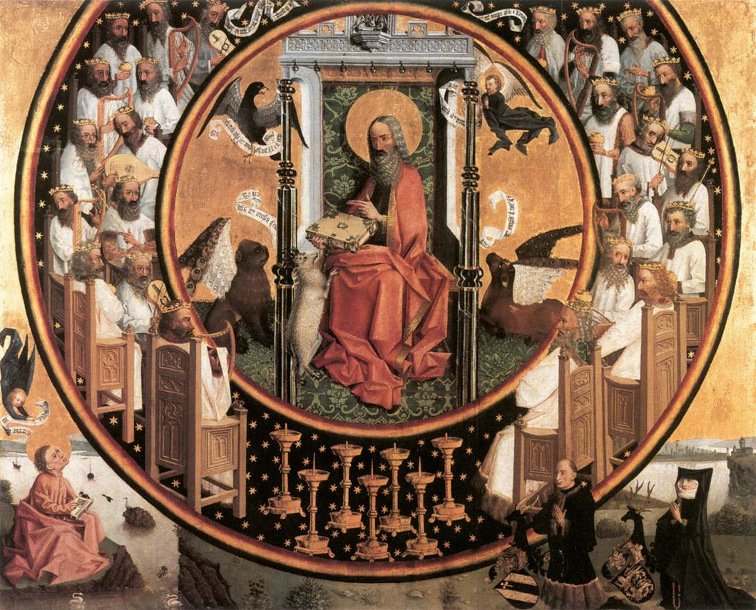

Slide 12
APOCALYPTIC LITERATURE
The word apocalypse is derived from the Greek word apokalypsis, meaning Disclosure, Unveiling, or Revelation.
Apocalyptic revelations are of two kinds:
  (1) symbolic visions (e.g. Daniel 7:12; Revelation) and
  (2) otherworldly journeys (parts of 1 Enoch; 2 Enoch; 3 Baruch).
One of the apocalyptic characteristics is dualism -things are good or bad. God/Satan.
Revelation is unique as it was written by a known contemporary to a known group of churches.
Notes:
Revelation is an example of a type of literature known as apocalyptic. By way of definition, [t]he word apocalypse is derived from the Greek word apokalypsis, meaning disclosure, unveiling, or revelation. Apocalyptic revelations are of two kinds: (1) symbolic visions (e.g. Daniel 7:12; Revelation) and (2) otherworldly journeys (parts of 1 Enoch; 2 Enoch; 3 Baruch). The Book of Revelation is only one of a number of such examples in the Bible. There are other parts of the New Testament that do contain apocalyptic themes, but Revelation is the chief example of such literature in the New Testament. One of the characteristics that mark such literature is its dualism, that tends to understand things as either good or bad. The existence of Good, represented by God and opposed by evil, represented by the Earth or Satan. In contrast to other such writings this book was written by a known contemporary to a known group of churches.

Slide 13
Other Examples Of Apocalyptic Literature
Old Testament
  the second half of the book of Daniel (Daniel 712) [Different types of Beasts with human and animal parts] has long been recognized as apocalyptic in genre.
  Isaiah 24:27 (the apocalypse of Isaiah)
  Ezekiel 38:9, depicting the final victory over eschatological enemies by God’s people;
  Joel 2 and Zechariah 9
New Testament
  Revelation
  Mark 13
  Matthew 24 and
  Luke 12.
Notes:
Some other examples of apocalyptic literature from the Old Testament are listed in The New Oxford Annotated Bible, 1996 by Oxford University Press, Inc. New Oxford Annotated Bible, Version 2.0 for Windows, - Introduction to Apocalyptic Literature: In the Old Testament the second half of the book of Daniel (Daniel 712) [Different types of Beasts with human and animal parts] has long been recognized as apocalyptic in genre. Other Old Testament writings also contain passages that resemble the eschatological symbolism of the apocalypses: e.g. Isaiah 24:27 (the apocalypse of Isaiah), a very late addition to the Isaianic collection; Ezekiel 38:9, depicting the final victory over eschatological enemies by Gods people; Joel 2 and Zechariah 914. In the New Testament the leading example of apocalyptic genre is the book of Revelation; but apocalyptic materials are present also in Mark 13 and its parallels in Matthew 24 and Luke 12.

Slide 14
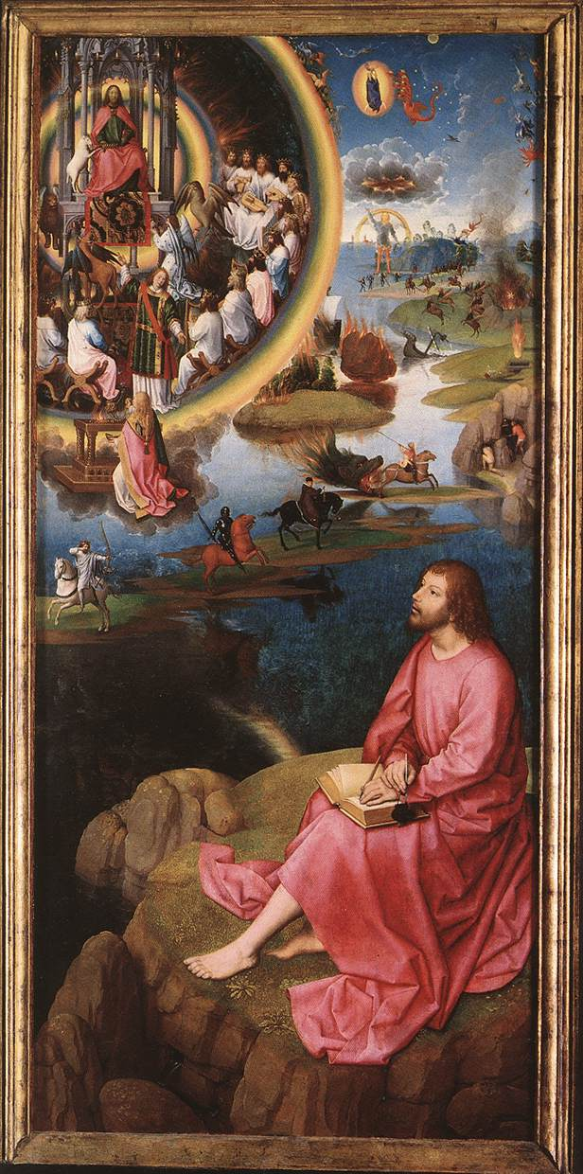
Hans Memling
St John Altarpiece (right wing)
1474-79
Oil on oak panel, 176 x 78,9 cm
Memlingmuseum, Sint-Janshospitaal, Bruges

Slide 15
Mark
Mark 13 - The Destruction of the Temple Foretold.
13 As he came out of the temple, one of his disciples said to him, Look, Teacher, what large stones and what large buildings! 2 Then Jesus asked him, Do you see these great buildings? Not one stone will be left here upon another; all will be thrown down.
Notes:
The following are some of the other New Testament examples of Apocalyptic Literature:
Excerpt from Mark 13 - The Destruction of the Temple Foretold.
13 As he came out of the temple, one of his disciples said to him, Look, Teacher, what large stones and what large buildings! 2 Then Jesus asked him, Do you see these great buildings? Not one stone will be left here upon another; all will be thrown down.

Slide 16
Matthew the ‘little apocalypse.’
Excerpt from Matthew 24. The Destruction of the Temple Foretold
24 As Jesus came out of the temple and was going away, his disciples came to point out to him the buildings of the temple. 2 Then he asked them, You see all these, do you not? Truly I tell you, not one stone will be left here upon another; all will be thrown down.
Signs of the End of the Age
“3 When he was sitting on the Mount of Olives, the disciples came to him privately, saying, Tell us, when will this be, and what will be the sign of your coming and of the end of the age
Notes:
This is a part of the Gospel of Matthew commonly called the ‘little apocalypse.’
Excerpt from Matthew 24. The Destruction of the Temple Foretold
24 As Jesus came out of the temple and was going away, his disciples came to point out to him the buildings of the temple. 2 Then he asked them, You see all these, do you not? Truly I tell you, not one stone will be left here upon another; all will be thrown down.
Signs of the End of the Age
“3 When he was sitting on the Mount of Olives, the disciples came to him privately, saying, Tell us, when will this be, and what will be the sign of your coming and of the end of the age? 4 Jesus answered them, Beware that no one leads you astray. 5 For many will come in my name, saying, I am the Messiah and they will lead many astray. 6 And you will hear of wars and rumors of wars; see that you are not alarmed; for this must take place, but the end is not yet. 7 For nation will rise against nation, and kingdom against kingdom, and there will be famines and earthquakes in various places: 8 all this is but the beginning of the birth pangs.
Persecutions Foretold
“9 Then they will hand you over to be tortured and will put you to death, and you will be hated by all nations because of my name. 10 Then many will fall away, and they will betray one another and hate one another. 11 And many false prophets will arise and lead many astray. 12 And because of the increase of lawlessness, the love of many will grow cold. 13 But the one who endures to the end will be saved. 14 And this good news of the kingdom will be proclaimed throughout the world, as a testimony to all the nations; and then the end will come.
The Desolating Sacrilege
15 So when you see the desolating sacrilege standing in the holy place, as was spoken of by the prophet Daniel (let the reader understand), 16 then those in Judea must flee to the mountains; 17 the one on the housetop must not go down to take what is in the house; 18 the one in the field must not turn back to get a coat. 19 Woe to those who are pregnant and to those who are nursing infants in those days! 20 Pray that your flight may not be in winter or on a Sabbath. 21 For at that time there will be great suffering, such as has not been from the beginning of the world until now, no, and never will be. 22 And if those days had not been cut short, no one would be saved; but for the sake of the elect those days will be cut short. 23 Then if anyone says to you, Look! Here is the Messiah or There he is do not believe it. 24 For false messiahs and false prophets will appear and produce great signs and omens, to lead astray, if possible, even the elect. 25 Take note, I have told you beforehand. 26 So, if they say to you, Look! He is in the wilderness, do not go out. If they say, Look! He is in the inner rooms, do not believe it. 27 For as the lightning comes from the east and flashes as far as the west, so will be the coming of the Son of Man. 28 Wherever the corpse is, there the vultures will gather.
The Coming of the Son of Man
29 Immediately after the suffering of those days
the sun will be darkened,
and the moon will not give its light;
the stars will fall from heaven,
and the powers of heaven will be shaken.
30 Then the sign of the Son of Man will appear in heaven, and then all the tribes of the earth will mourn, and they will see the Son of Man coming on the clouds of heaven with power and great glory. 31 And he will send out his angels with a loud trumpet call, and they will gather his elect from the four winds, from one end of heaven to the other.

Slide 17
Matthew the ‘little apocalypse.’
4 Jesus answered them, Beware that no one leads you astray. 5 For many will come in my name, saying, I am the Messiah and they will lead many astray. 6 And you will hear of wars and rumors of wars; see that you are not alarmed; for this must take place, but the end is not yet. 7 For nation will rise against nation, and kingdom against kingdom, and there will be famines and earthquakes in various places: 8 all this is but the beginning of the birth pangs.
Notes:
This is a part of the Gospel of Matthew commonly called the ‘little apocalypse.’
Excerpt from Matthew 24. The Destruction of the Temple Foretold
24 As Jesus came out of the temple and was going away, his disciples came to point out to him the buildings of the temple. 2 Then he asked them, You see all these, do you not? Truly I tell you, not one stone will be left here upon another; all will be thrown down.
Signs of the End of the Age
“3 When he was sitting on the Mount of Olives, the disciples came to him privately, saying, Tell us, when will this be, and what will be the sign of your coming and of the end of the age? 4 Jesus answered them, Beware that no one leads you astray. 5 For many will come in my name, saying, I am the Messiah and they will lead many astray. 6 And you will hear of wars and rumors of wars; see that you are not alarmed; for this must take place, but the end is not yet. 7 For nation will rise against nation, and kingdom against kingdom, and there will be famines and earthquakes in various places: 8 all this is but the beginning of the birth pangs.
Persecutions Foretold
“9 Then they will hand you over to be tortured and will put you to death, and you will be hated by all nations because of my name. 10 Then many will fall away, and they will betray one another and hate one another. 11 And many false prophets will arise and lead many astray. 12 And because of the increase of lawlessness, the love of many will grow cold. 13 But the one who endures to the end will be saved. 14 And this good news of the kingdom will be proclaimed throughout the world, as a testimony to all the nations; and then the end will come.
The Desolating Sacrilege
15 So when you see the desolating sacrilege standing in the holy place, as was spoken of by the prophet Daniel (let the reader understand), 16 then those in Judea must flee to the mountains; 17 the one on the housetop must not go down to take what is in the house; 18 the one in the field must not turn back to get a coat. 19 Woe to those who are pregnant and to those who are nursing infants in those days! 20 Pray that your flight may not be in winter or on a Sabbath. 21 For at that time there will be great suffering, such as has not been from the beginning of the world until now, no, and never will be. 22 And if those days had not been cut short, no one would be saved; but for the sake of the elect those days will be cut short. 23 Then if anyone says to you, Look! Here is the Messiah or There he is do not believe it. 24 For false messiahs and false prophets will appear and produce great signs and omens, to lead astray, if possible, even the elect. 25 Take note, I have told you beforehand. 26 So, if they say to you, Look! He is in the wilderness, do not go out. If they say, Look! He is in the inner rooms, do not believe it. 27 For as the lightning comes from the east and flashes as far as the west, so will be the coming of the Son of Man. 28 Wherever the corpse is, there the vultures will gather.
The Coming of the Son of Man
29 Immediately after the suffering of those days
the sun will be darkened,
and the moon will not give its light;
the stars will fall from heaven,
and the powers of heaven will be shaken.
30 Then the sign of the Son of Man will appear in heaven, and then all the tribes of the earth will mourn, and they will see the Son of Man coming on the clouds of heaven with power and great glory. 31 And he will send out his angels with a loud trumpet call, and they will gather his elect from the four winds, from one end of heaven to the other.

Slide 18
Matthew the ‘little apocalypse.’
Persecutions Foretold
“9 Then they will hand you over to be tortured and will put you to death, and you will be hated by all nations because of my name. 10 Then many will fall away, and they will betray one another and hate one another. 11 And many false prophets will arise and lead many astray. 12 And because of the increase of lawlessness, the love of many will grow cold. 13 But the one who endures to the end will be saved. 14 And this good news of the kingdom will be proclaimed throughout the world, as a testimony to all the nations; and then the end will come.
Notes:
This is a part of the Gospel of Matthew commonly called the ‘little apocalypse.’
Excerpt from Matthew 24. The Destruction of the Temple Foretold
24 As Jesus came out of the temple and was going away, his disciples came to point out to him the buildings of the temple. 2 Then he asked them, You see all these, do you not? Truly I tell you, not one stone will be left here upon another; all will be thrown down.
Signs of the End of the Age
“3 When he was sitting on the Mount of Olives, the disciples came to him privately, saying, Tell us, when will this be, and what will be the sign of your coming and of the end of the age? 4 Jesus answered them, Beware that no one leads you astray. 5 For many will come in my name, saying, I am the Messiah and they will lead many astray. 6 And you will hear of wars and rumors of wars; see that you are not alarmed; for this must take place, but the end is not yet. 7 For nation will rise against nation, and kingdom against kingdom, and there will be famines and earthquakes in various places: 8 all this is but the beginning of the birth pangs.
Persecutions Foretold
“9 Then they will hand you over to be tortured and will put you to death, and you will be hated by all nations because of my name. 10 Then many will fall away, and they will betray one another and hate one another. 11 And many false prophets will arise and lead many astray. 12 And because of the increase of lawlessness, the love of many will grow cold. 13 But the one who endures to the end will be saved. 14 And this good news of the kingdom will be proclaimed throughout the world, as a testimony to all the nations; and then the end will come.
The Desolating Sacrilege
15 So when you see the desolating sacrilege standing in the holy place, as was spoken of by the prophet Daniel (let the reader understand), 16 then those in Judea must flee to the mountains; 17 the one on the housetop must not go down to take what is in the house; 18 the one in the field must not turn back to get a coat. 19 Woe to those who are pregnant and to those who are nursing infants in those days! 20 Pray that your flight may not be in winter or on a Sabbath. 21 For at that time there will be great suffering, such as has not been from the beginning of the world until now, no, and never will be. 22 And if those days had not been cut short, no one would be saved; but for the sake of the elect those days will be cut short. 23 Then if anyone says to you, Look! Here is the Messiah or There he is do not believe it. 24 For false messiahs and false prophets will appear and produce great signs and omens, to lead astray, if possible, even the elect. 25 Take note, I have told you beforehand. 26 So, if they say to you, Look! He is in the wilderness, do not go out. If they say, Look! He is in the inner rooms, do not believe it. 27 For as the lightning comes from the east and flashes as far as the west, so will be the coming of the Son of Man. 28 Wherever the corpse is, there the vultures will gather.
The Coming of the Son of Man
29 Immediately after the suffering of those days
the sun will be darkened,
and the moon will not give its light;
the stars will fall from heaven,
and the powers of heaven will be shaken.
30 Then the sign of the Son of Man will appear in heaven, and then all the tribes of the earth will mourn, and they will see the Son of Man coming on the clouds of heaven with power and great glory. 31 And he will send out his angels with a loud trumpet call, and they will gather his elect from the four winds, from one end of heaven to the other.

Slide 19
Matthew the ‘little apocalypse.’
The Desolating Sacrilege
15 So when you see the desolating sacrilege standing in the holy place, as was spoken of by the prophet Daniel (let the reader understand), 16 then those in Judea must flee to the mountains; 17 the one on the housetop must not go down to take what is in the house; 18 the one in the field must not turn back to get a coat. 19 Woe to those who are pregnant and to those who are nursing infants in those days! 20 Pray that your flight may not be in winter or on a Sabbath. 21 For at that time there will be great suffering, such as has not been from the beginning of the world until now, no, and never will be. 22 And if those days had not been cut short, no one would be saved;
Notes:
This is a part of the Gospel of Matthew commonly called the ‘little apocalypse.’
Excerpt from Matthew 24. The Destruction of the Temple Foretold
24 As Jesus came out of the temple and was going away, his disciples came to point out to him the buildings of the temple. 2 Then he asked them, You see all these, do you not? Truly I tell you, not one stone will be left here upon another; all will be thrown down.
Signs of the End of the Age
“3 When he was sitting on the Mount of Olives, the disciples came to him privately, saying, Tell us, when will this be, and what will be the sign of your coming and of the end of the age? 4 Jesus answered them, Beware that no one leads you astray. 5 For many will come in my name, saying, I am the Messiah and they will lead many astray. 6 And you will hear of wars and rumors of wars; see that you are not alarmed; for this must take place, but the end is not yet. 7 For nation will rise against nation, and kingdom against kingdom, and there will be famines and earthquakes in various places: 8 all this is but the beginning of the birth pangs.
Persecutions Foretold
“9 Then they will hand you over to be tortured and will put you to death, and you will be hated by all nations because of my name. 10 Then many will fall away, and they will betray one another and hate one another. 11 And many false prophets will arise and lead many astray. 12 And because of the increase of lawlessness, the love of many will grow cold. 13 But the one who endures to the end will be saved. 14 And this good news of the kingdom will be proclaimed throughout the world, as a testimony to all the nations; and then the end will come.
The Desolating Sacrilege
15 So when you see the desolating sacrilege standing in the holy place, as was spoken of by the prophet Daniel (let the reader understand), 16 then those in Judea must flee to the mountains; 17 the one on the housetop must not go down to take what is in the house; 18 the one in the field must not turn back to get a coat. 19 Woe to those who are pregnant and to those who are nursing infants in those days! 20 Pray that your flight may not be in winter or on a Sabbath. 21 For at that time there will be great suffering, such as has not been from the beginning of the world until now, no, and never will be. 22 And if those days had not been cut short, no one would be saved; but for the sake of the elect those days will be cut short. 23 Then if anyone says to you, Look! Here is the Messiah or There he is do not believe it. 24 For false messiahs and false prophets will appear and produce great signs and omens, to lead astray, if possible, even the elect. 25 Take note, I have told you beforehand. 26 So, if they say to you, Look! He is in the wilderness, do not go out. If they say, Look! He is in the inner rooms, do not believe it. 27 For as the lightning comes from the east and flashes as far as the west, so will be the coming of the Son of Man. 28 Wherever the corpse is, there the vultures will gather.
The Coming of the Son of Man
29 Immediately after the suffering of those days
the sun will be darkened,
and the moon will not give its light;
the stars will fall from heaven,
and the powers of heaven will be shaken.
30 Then the sign of the Son of Man will appear in heaven, and then all the tribes of the earth will mourn, and they will see the Son of Man coming on the clouds of heaven with power and great glory. 31 And he will send out his angels with a loud trumpet call, and they will gather his elect from the four winds, from one end of heaven to the other.

Slide 20
Matthew the ‘little apocalypse.’
but for the sake of the elect those days will be cut short. 23 Then if anyone says to you, Look! Here is the Messiah or There he is do not believe it. 24 For false messiahs and false prophets will appear and produce great signs and omens, to lead astray, if possible, even the elect. 25 Take note, I have told you beforehand. 26 So, if they say to you, Look! He is in the wilderness, do not go out. If they say, Look! He is in the inner rooms, do not believe it. 27 For as the lightning comes from the east and flashes as far as the west, so will be the coming of the Son of Man. 28 Wherever the corpse is, there the vultures will gather.
Notes:
This is a part of the Gospel of Matthew commonly called the ‘little apocalypse.’
Excerpt from Matthew 24. The Destruction of the Temple Foretold
24 As Jesus came out of the temple and was going away, his disciples came to point out to him the buildings of the temple. 2 Then he asked them, You see all these, do you not? Truly I tell you, not one stone will be left here upon another; all will be thrown down.
Signs of the End of the Age
“3 When he was sitting on the Mount of Olives, the disciples came to him privately, saying, Tell us, when will this be, and what will be the sign of your coming and of the end of the age? 4 Jesus answered them, Beware that no one leads you astray. 5 For many will come in my name, saying, I am the Messiah and they will lead many astray. 6 And you will hear of wars and rumors of wars; see that you are not alarmed; for this must take place, but the end is not yet. 7 For nation will rise against nation, and kingdom against kingdom, and there will be famines and earthquakes in various places: 8 all this is but the beginning of the birth pangs.
Persecutions Foretold
“9 Then they will hand you over to be tortured and will put you to death, and you will be hated by all nations because of my name. 10 Then many will fall away, and they will betray one another and hate one another. 11 And many false prophets will arise and lead many astray. 12 And because of the increase of lawlessness, the love of many will grow cold. 13 But the one who endures to the end will be saved. 14 And this good news of the kingdom will be proclaimed throughout the world, as a testimony to all the nations; and then the end will come.
The Desolating Sacrilege
15 So when you see the desolating sacrilege standing in the holy place, as was spoken of by the prophet Daniel (let the reader understand), 16 then those in Judea must flee to the mountains; 17 the one on the housetop must not go down to take what is in the house; 18 the one in the field must not turn back to get a coat. 19 Woe to those who are pregnant and to those who are nursing infants in those days! 20 Pray that your flight may not be in winter or on a Sabbath. 21 For at that time there will be great suffering, such as has not been from the beginning of the world until now, no, and never will be. 22 And if those days had not been cut short, no one would be saved; but for the sake of the elect those days will be cut short. 23 Then if anyone says to you, Look! Here is the Messiah or There he is do not believe it. 24 For false messiahs and false prophets will appear and produce great signs and omens, to lead astray, if possible, even the elect. 25 Take note, I have told you beforehand. 26 So, if they say to you, Look! He is in the wilderness, do not go out. If they say, Look! He is in the inner rooms, do not believe it. 27 For as the lightning comes from the east and flashes as far as the west, so will be the coming of the Son of Man. 28 Wherever the corpse is, there the vultures will gather.
The Coming of the Son of Man
29 Immediately after the suffering of those days
the sun will be darkened,
and the moon will not give its light;
the stars will fall from heaven,
and the powers of heaven will be shaken.
30 Then the sign of the Son of Man will appear in heaven, and then all the tribes of the earth will mourn, and they will see the Son of Man coming on the clouds of heaven with power and great glory. 31 And he will send out his angels with a loud trumpet call, and they will gather his elect from the four winds, from one end of heaven to the other.

Slide 21
Matthew the ‘little apocalypse.’
The Coming of the Son of Man
29 Immediately after the suffering of those days
the sun will be darkened,
and the moon will not give its light;
the stars will fall from heaven,
and the powers of heaven will be shaken.
30 Then the sign of the Son of Man will appear in heaven, and then all the tribes of the earth will mourn, and they will see the Son of Man coming on the clouds of heaven with power and great glory. 31 And he will send out his angels with a loud trumpet call, and they will gather his elect from the four winds, from one end of heaven to the other.
Notes:
This is a part of the Gospel of Matthew commonly called the ‘little apocalypse.’
Excerpt from Matthew 24. The Destruction of the Temple Foretold
24 As Jesus came out of the temple and was going away, his disciples came to point out to him the buildings of the temple. 2 Then he asked them, You see all these, do you not? Truly I tell you, not one stone will be left here upon another; all will be thrown down.
Signs of the End of the Age
“3 When he was sitting on the Mount of Olives, the disciples came to him privately, saying, Tell us, when will this be, and what will be the sign of your coming and of the end of the age? 4 Jesus answered them, Beware that no one leads you astray. 5 For many will come in my name, saying, I am the Messiah and they will lead many astray. 6 And you will hear of wars and rumors of wars; see that you are not alarmed; for this must take place, but the end is not yet. 7 For nation will rise against nation, and kingdom against kingdom, and there will be famines and earthquakes in various places: 8 all this is but the beginning of the birth pangs.
Persecutions Foretold
“9 Then they will hand you over to be tortured and will put you to death, and you will be hated by all nations because of my name. 10 Then many will fall away, and they will betray one another and hate one another. 11 And many false prophets will arise and lead many astray. 12 And because of the increase of lawlessness, the love of many will grow cold. 13 But the one who endures to the end will be saved. 14 And this good news of the kingdom will be proclaimed throughout the world, as a testimony to all the nations; and then the end will come.
The Desolating Sacrilege
15 So when you see the desolating sacrilege standing in the holy place, as was spoken of by the prophet Daniel (let the reader understand), 16 then those in Judea must flee to the mountains; 17 the one on the housetop must not go down to take what is in the house; 18 the one in the field must not turn back to get a coat. 19 Woe to those who are pregnant and to those who are nursing infants in those days! 20 Pray that your flight may not be in winter or on a Sabbath. 21 For at that time there will be great suffering, such as has not been from the beginning of the world until now, no, and never will be. 22 And if those days had not been cut short, no one would be saved; but for the sake of the elect those days will be cut short. 23 Then if anyone says to you, Look! Here is the Messiah or There he is do not believe it. 24 For false messiahs and false prophets will appear and produce great signs and omens, to lead astray, if possible, even the elect. 25 Take note, I have told you beforehand. 26 So, if they say to you, Look! He is in the wilderness, do not go out. If they say, Look! He is in the inner rooms, do not believe it. 27 For as the lightning comes from the east and flashes as far as the west, so will be the coming of the Son of Man. 28 Wherever the corpse is, there the vultures will gather.
The Coming of the Son of Man
29 Immediately after the suffering of those days
the sun will be darkened,
and the moon will not give its light;
the stars will fall from heaven,
and the powers of heaven will be shaken.
30 Then the sign of the Son of Man will appear in heaven, and then all the tribes of the earth will mourn, and they will see the Son of Man coming on the clouds of heaven with power and great glory. 31 And he will send out his angels with a loud trumpet call, and they will gather his elect from the four winds, from one end of heaven to the other.

Slide 22
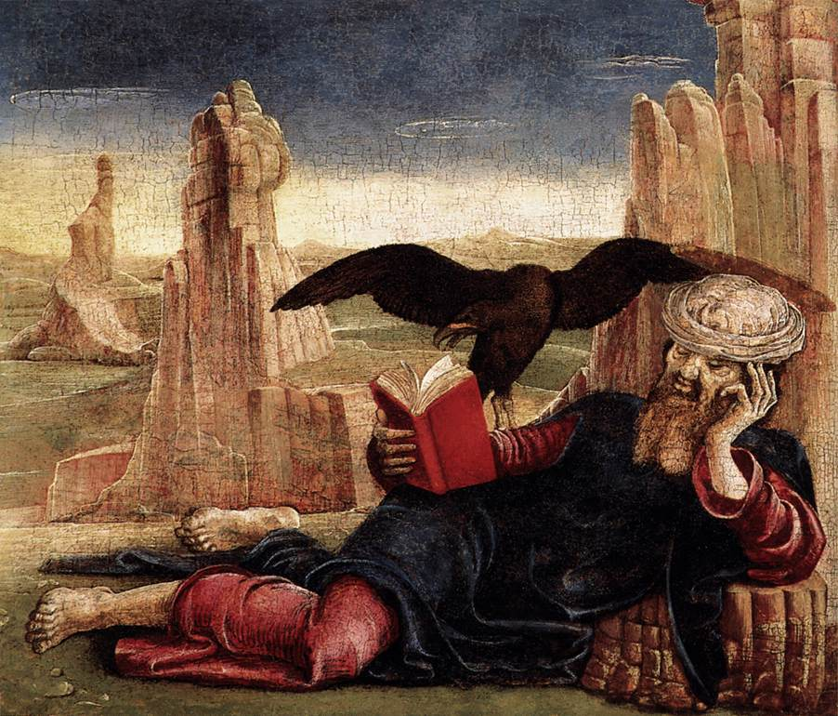
Cosmè Tura
St John the Evangelist on Patmos, c. 1470
Tempera on panel, 27 x 32 cm, Museo Thyssen-Bornemisza, Madrid

Slide 23
Prophecy
Prophets in Old Testament
  reminds Israel of his past deeds [such as Exodus]
  warns against current unfaithfulness and
  if they continue with their unfaithfulness God will do bad things to you.
  BUT if you repent God will do good things
The part we usually think of as a forecast is not a prediction at all but a conditional statement of what God intends to do based on free will or choice
Notes:
To review then The Book of Revelation is an apocalyptic type of literature. This type of literature was well known to its readers in the early Church and to the Apostles. In modern terms this type of literature is often thought to be a prophesy or a forecast of the literal future. But to those in the early Church that was not its meaning at all. In Biblical times the word prophesy had a different meaning. It is a forth telling not a foretelling e.g. the Prophet tells what message God is sending. The Lord though the prophets in Old Testament writings generally reminds Israel of his past deeds [such as freeing them from Egypt], warns them of current unfaithfulness and states that if they continue with their unfaithfulness this is what God will do to you.... but if you repent this is what God will do for [you will be protected and then be as great as your ancestors.] The part we usually think of as a forecast is not a prediction at all. It is a conditional statement of what God intends to do with Israel’s free will or choice being the determining factor. The trick then will be to relate the meaning of the Book of Revelation to our daily lives, and lively faith, rather than try to figure out which team will win the world series next year or a theme for a talk radio show. That is just what we will try to do next week start to do in the next installment.
The Oxford Dictionary of The Christian Church, Second Edition Revised, Oxford University Press, 1983. Page 1183. See also The Catholic Encyclopedia, Volume I Copyright © 1907 by Robert Appleton Company Online Edition Copyright © 2003 by K. Knight. The Article entitled Apocalypse, relates that there was doubt as the authenticity of its apostolic authorship and it was left out of some of the early lists “St. Cyril of Jerusalem does not name it among the canonical books (Catech. IV, 33-36); nor does it occur on the list of the Synod of Laodicea, or on that of Gregory of Nazianzus. Perhaps the most telling argument against the apostolic authorship of the book is its omission from the Peshito, the Syrian Vulgate.”
To the extent that there is an official list, there are a commonly accepted lists within various denominations, but not necessarily official lists of the literature that is the Bible.
John Wesley, Commentaries, Notes on the Whole Bible, The New Testament, The Ages Digital Library, 1999
The Message of the Book of Revelation, Charles T. Chapman, Jr., The Liturgical Press, Collegeville, Minnesota, By the Order of St. Benedict, Inc., 1995. Page 6
See New Testament Writings, Timothy Luke Johnson, Page 513.
The New Oxford Annotated Bible, 1996 by Oxford University Press, Inc. New Oxford Annotated Bible, Version 2.0 for Windows, Introduction to The Book of Revelation, Apocalyptic Literature.
The New Oxford Annotated Bible, 1996 by Oxford University Press, Inc. New Oxford Annotated Bible, Version 2.0 for Windows, Introduction to The Book of Revelation, Apocalyptic Literature. There are two opposing personified forces in the universe, one good and the other evil. Yahweh is, of course, the supreme God. In Jewish Apocalypticism the archangel Michael often functions as Gods agent. Opposed to him is Belial, or Satan. The opposition of these supernatural figures is most clearly drawn in certain treatises among the Dead Sea Scrolls.
See Johnson, Luke Timothy and Todd C. Penner , New Testament Writings, An Interpretation, Second Revised Edition, Page 516, Augsburg Fortress Press, 1999.
The New Oxford Annotated Bible, 1996 by Oxford University Press, Inc. New Oxford Annotated Bible, Version 2.0 for Windows, Notes from Article - Introduction to Apocalyptic Literature.
The New Oxford Annotated Bible, 1996 by Oxford University Press, Inc. New Oxford Annotated Bible, Version 2.0 for Windows, The Gospel of Mark, Chapter 13.
The New Oxford Annotated Bible, 1996 by Oxford University Press, Inc. New Oxford Annotated Bible, Version 2.0 for Windows, The Gospel according to Matthew, Chapter 24.
The Message of the Book of Revelation, Charles T. Chapman, Jr., The Liturgical Press, Collegeville, Minnesota, By the Order of St. Benedict, Inc., 1995. Page 4.

Slide 24
Review
Revelation is apocalyptic literature.
well known to its readers in the early Church and to the Apostles.
Modern people see a prophesy or a forecast of the literal future.
In Biblical times the word prophesy had a different meaning a Forth telling not a foretelling e.g. the Prophet tells what message God is sending.
Notes:
To review then The Book of Revelation is an apocalyptic type of literature. This type of literature was well known to its readers in the early Church and to the Apostles. In modern terms this type of literature is often thought to be a prophesy or a forecast of the literal future. But to those in the early Church that was not its meaning at all. In Biblical times the word prophesy had a different meaning. It is a forth telling not a foretelling e.g. the Prophet tells what message God is sending. The Lord though the prophets in Old Testament writings generally reminds Israel of his past deeds [such as freeing them from Egypt], warns them of current unfaithfulness and states that if they continue with their unfaithfulness this is what God will do to you.... but if you repent this is what God will do for [you will be protected and then be as great as your ancestors.] The part we usually think of as a forecast is not a prediction at all. It is a conditional statement of what God intends to do with Israel’s free will or choice being the determining factor. The trick then will be to relate the meaning of the Book of Revelation to our daily lives, and lively faith, rather than try to figure out which team will win the world series next year or a theme for a talk radio show. That is just what we will try to do next week start to do in the next installment.
FOOTNOTES FROM WRITTEN MATERIALS
The Oxford Dictionary of The Christian Church, Second Edition Revised, Oxford University Press, 1983. Page 1183. See also The Catholic Encyclopedia, Volume I Copyright © 1907 by Robert Appleton Company Online Edition Copyright © 2003 by K. Knight. The Article entitled Apocalypse, relates that there was doubt as the authenticity of its apostolic authorship and it was left out of some of the early lists “St. Cyril of Jerusalem does not name it among the canonical books (Catech. IV, 33-36); nor does it occur on the list of the Synod of Laodicea, or on that of Gregory of Nazianzus. Perhaps the most telling argument against the apostolic authorship of the book is its omission from the Peshito, the Syrian Vulgate.”
To the extent that there is an official list, there are a commonly accepted lists within various denominations, but not necessarily official lists of the literature that is the Bible.
John Wesley, Commentaries, Notes on the Whole Bible, The New Testament, The Ages Digital Library, 1999
The Message of the Book of Revelation, Charles T. Chapman, Jr., The Liturgical Press, Collegeville, Minnesota, By the Order of St. Benedict, Inc., 1995. Page 6
See New Testament Writings, Timothy Luke Johnson, Page 513.
The New Oxford Annotated Bible, 1996 by Oxford University Press, Inc. New Oxford Annotated Bible, Version 2.0 for Windows, Introduction to The Book of Revelation, Apocalyptic Literature.
The New Oxford Annotated Bible, 1996 by Oxford University Press, Inc. New Oxford Annotated Bible, Version 2.0 for Windows, Introduction to The Book of Revelation, Apocalyptic Literature. There are two opposing personified forces in the universe, one good and the other evil. Yahweh is, of course, the supreme God. In Jewish Apocalypticism the archangel Michael often functions as Gods agent. Opposed to him is Belial, or Satan. The opposition of these supernatural figures is most clearly drawn in certain treatises among the Dead Sea Scrolls.
See Johnson, Luke Timothy and Todd C. Penner , New Testament Writings, An Interpretation, Second Revised Edition, Page 516, Augsburg Fortress Press, 1999.
The New Oxford Annotated Bible, 1996 by Oxford University Press, Inc. New Oxford Annotated Bible, Version 2.0 for Windows, Notes from Article - Introduction to Apocalyptic Literature.
The New Oxford Annotated Bible, 1996 by Oxford University Press, Inc. New Oxford Annotated Bible, Version 2.0 for Windows, The Gospel of Mark, Chapter 13.
The New Oxford Annotated Bible, 1996 by Oxford University Press, Inc. New Oxford Annotated Bible, Version 2.0 for Windows, The Gospel according to Matthew, Chapter 24.
The Message of the Book of Revelation, Charles T. Chapman, Jr., The Liturgical Press, Collegeville, Minnesota, By the Order of St. Benedict, Inc., 1995. Page 4.

Slide 25
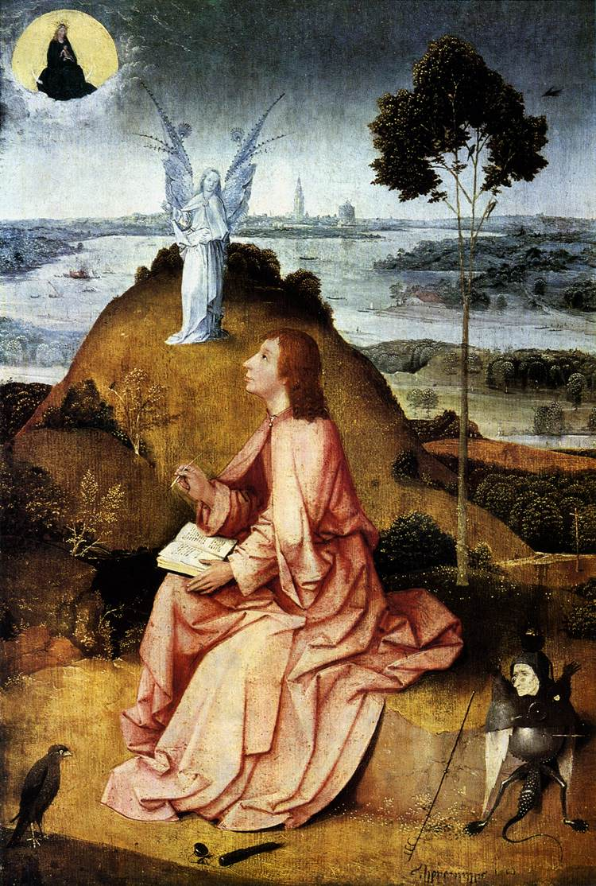
Hieronymus Bosch
St John the Evangelist on Patmos, 1504-05
Oil on oak panel, 63 x 43,3 cm
Staatliche Museen, Berlin
From the hill the view extends across a river landscape reminiscent of the Lower Rhine, but meant to be the island of Patmos, where John received the Revelation of the Apocalypse. An angel points towards the sky, where the Woman of the Apocalypse has appeared. Since the Middle Ages this heavenly vision has been identified with the Madonna. The bird at the bottom left is a falcon - a reference to the symbolic animal of the Evangelist, the eagle. The bird guards its master's writing tools, which a demon is trying to steal.

