Slide 1
THE BOOK OF REVELATION
FOR THE MODERN READER
Lesson two
Notes:
THE BOOK OF REVELATION
FOR THE MODERN READER
In Five Lessons
First
This is intended as a five lesson course on the book of the New Testament commonly known as The Book of Revelation. The first lesson deals with the introduction to the concepts, origins and history of the text itself. The following three lessons, two, three and four, deal with the text itself. The intention is that this study be undertaken along with your reading of the text, starting after you have finished this first lesson. In this way, you will be able to encounter these scriptures directly. These as with all parts of the Bible, can be read for textual study and as an aid in life. The textual study will bring understanding and one hopes enlightenment. When read with a life challenge in mind, one will discover in scriptural texts, new meaning, that will help in dealing with the challenge at hand. This final section of the New Testament, above all others was written to those facing great and often fatal challenges in life.

Slide 2
The Revelation to John
The Official Name from the Oxford Annotated Introduction

Slide 3
Lesson Two
  2. Out Line Organization Seven Letters
Notes:
1. concepts, origins and history of the text itself.
2. Out Line Organization Seven Letters
3. Outline of the Visions
4. Memorable images
5. Relevance to Modern Life

Slide 4
Review
In the first lesson we discussed the general nature of this type of writing known as Apocalyptic Literature.
Keep these few points in mind:
First, while the book seems to be coded, its intended audience knew the code well for a 1st/ 2nd Century audience,
Second it is remarkable and still has a message for us today
Third the book’s symbols may be found used extensively in the Old Testament.
Fourth the intended audience knew that the book was an intentional and direct communication written by a person known by that audience - murky only to the Romans
Notes:
THE BOOK OF REVELATION
FOR THE MODERN READER
In Four Lessons
Second
This the second of a five lesson course on the book of the New Testament commonly known as The Book of Revelation. The first lesson dealt with the introduction to the concepts, origins and history of the text itself. This and the two remaining lessons will deal with the text itself. The intention is that this study be undertaken along with your reading of the text, starting after you have finished the first lesson. In this way, you will be able to encounter these scriptures directly. These, as with all parts of the Bible, can be read for textual study and as an aid in life. The textual study will bring understanding and one hopes enlightenment. When read with a life challenge in mind, one will discover in scriptural texts, new meaning, that will help in dealing with the challenge at hand. This final section of the New Testament, above all others was written to those facing great and often fatal challenges in life.
This is the second lesson dealing with The Revelation to John in the first lesson we discussed the general nature of this type of writing known as Apocalyptic Literature. As we now work though the text, and you start or finish your personal review of the book, we need to keep a few pints in mind. First, while the book seems to be coded, its intended audience knew the code well. The book was written to be relevant to a 1st/ 2nd Century audience, but it is most remarkable in that it still has a message for us today as well. The audience was familiar with this type writing and the book’s symbols may be found used extensively in the Old Testament. While the origins of the book and its author may seem mysterious to us, the intended audience knew that the book was an intentional and direct communication written by a person known by that audience. Again, book was intended to be murky only to the Roman authorities of the second century.

Slide 5
Outline Organization
The Book of Revelation is divided, into two basic sections.
  First is a series of letters to the Seven Churches of Asia.
  Second a series of seven mysterious and vivid visions.
  Third the last vision has seven parts and a final postlude.
Scholars and religious groups see the structure as divided into seven sections each with seven parts. But not all divisions are in the same places.
There is some very good support for dividing the text into seven sections.
This neat seven sided structure is not readily apparent.
The number seven denotes perfection in the Bible and is significant in the Book of Revelation.
Notes:
Now we will consider the actual content of the Book of Revelation. This is a topic that one approaches with some fear and trembling. There are a number of entire books on Revelation and we are not going to spend that sort of time in this undertaking. The Book of Revelation is divided, into two basic sections. The first is a series of letters to the Seven Churches of Asia which is then followed by a series of seven mysterious and vivid visions; the last vision itself is composed of seven parts with a final postlude. There are a number of scholars and religious groups that see in the Book of Revelation a structure as divided into seven sections each with seven parts. Which organization sounds good until you realize that these divisions as between these scholars and religious groups are not all in the same places. There is some very good support for dividing the text into seven sections. However, a person perusing the Book of Revelation for the first time will find that this neat seven sided structure is not readily apparent. The impetus for ‘divining’ such a structure is that the number seven denotes perfection in Biblical terms and has much significance in the Book of Revelation.
The Message of the Book of Revelation, Charles T. Chapman, Jr., The Liturgical Press, Collegeville, Minnesota, By the Order of St. Benedict, Inc., 1995. Page 9. And See The Oxford Dictionary of The Christian Church, Second Edition Revised, Oxford University Press, 1983. Page 1182. Please note in deference to Rev Chapman’s greater learning that the divisions hereafter listed were not taken from his work and any inaccuracies or mistakes are mine and not the Rev Chapman’s.

Slide 6
The Seven Letters
The letter comments are critical and in other ways offer praise.
None are completely positive
The general message is endurance and resistance to the world/culture.
Note that the contemporary readers of this book were aware of and familiar with these churches and the cities named.
Each has a strict four stage pattern.
  A command given to the seer to compose the letter.
  Jesus named by a series of epithets.
  The third section of each then describes the current situation in the particular church.
  The fourth and final section then issues an exhortation and a promise to the particular church.
Notes:
The Seven Letters
The First section is a series of letters to the Seven Churches of Asia Ephesus, Smyrna, Pergamum, Thyatira, Sardis, Philadelphia, and Laodicea. The letters are in some ways critical and in other ways offer praise. None of the Churches are seen in a completely positive light. The general message is endurance and resistance to the enticements of the world and culture around them such as materialism, infantilism, eroticism, hedonism and idols. Please keep in mind that the contemporary readers of this book were aware of and familiar with these churches and the cities named. “These letters – or more formally, decrees, or edicts – follow a strict four stage pattern. . . “ The letters each with the command given to the seer to compose the letter. The next section then identifies Jesus by a series of epithets. The third section of each then describes the current situation in the particular church. The fourth and final section then issues an exhortation and a promise to the particular church.
Johnson, Luke Timothy and Todd C. Penner , New Testament Writings, An Interpretation, Second Revised Edition, Page 585, Augsburg Fortress Press, 1999.
See Johnson, Luke Timothy and Todd C. Penner, New Testament Writings, An Interpretation, Second Revised Edition, Page 585-586, Augsburg Fortress Press, 1999..

Slide 7
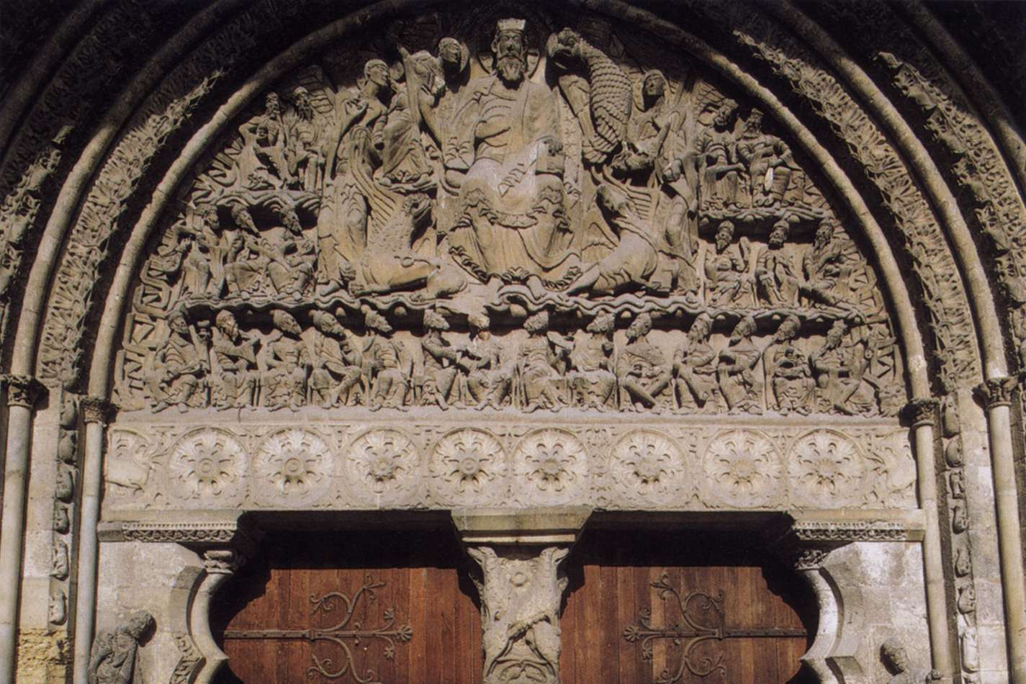
French Romanesque Sculptor, Apocalypse
South Portal, Church of St. Pierre, Moissac, France
1120-35
Stone

Slide 8
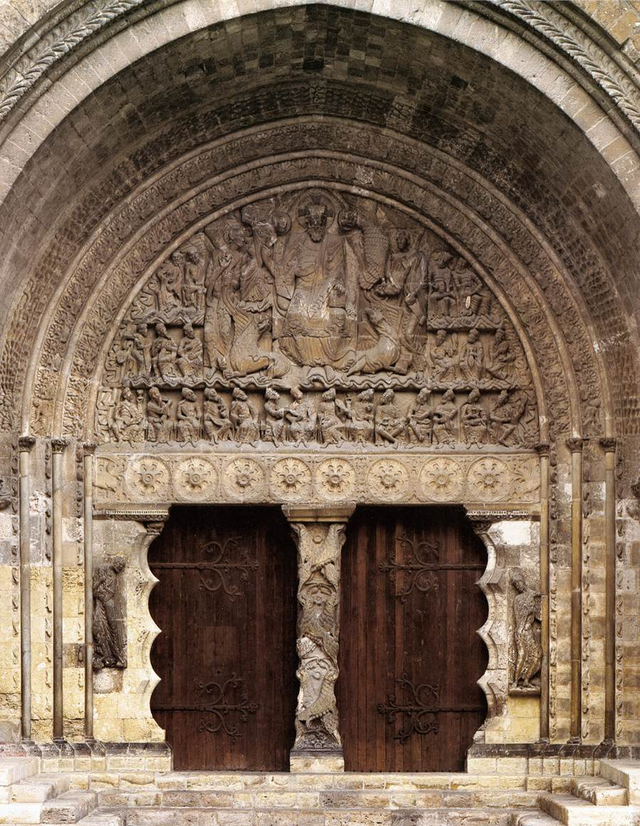

Slide 9
Ephesus
Ephesus - The letter praises this Church for its patience, endurance and the fact that it refuses to tolerate evil doers. But they are criticized because they have lost their Love.
Ephesus was the most important city of proconsular Asia. Second only to Rome in the first and second century.
Paul labored here in the 60s for two years and three months.
Nicolaitans, are mentioned in both this letter and that to Pergamum. Nothing is known about this group except that John of Patmos, did not like their teachings.
Notes:
Ephesus - The letter praises this Church for its patience, endurance and the fact that it refuses to tolerate evil doers. But they are criticized because they have lost their Love.
Revelation 2, V2 ‘Ephesus’ ‘2 ‘I know your works, your toil and your patient endurance. I know that you cannot tolerate evildoers; you have tested those who claim to be apostles but are not, and have found them to be false. 3 I also know that you are enduring patiently and bearing up for the sake of my name, and that you have not grown weary. 4 But I have this against you, that you have abandoned the love you had at first.
Nicolaitans, are mentioned in both this letter and that to Ephesus. Nothing is known about this group [there is speculation that they allowed the eating of temple meat] or its beliefs other than the fact they were not purely local and the author, John of Patmos, did not like their teachings.
Wikipedia Roman period
When Augustus became emperor in 27 BC, he made Ephesus the capital of proconsular Asia (which covered western Asia Minor) instead of Pergamum. Ephesus then entered an era of prosperity, becoming both the seat of the governor and a major center of commerce. According to Strabo, it was second in importance and size only to Rome.^{[20]} Ephesus has been estimated to be in the range of 400,000 to 500,000 inhabitants in the year 100, making it the largest city in Roman Asia and of the day. Ephesus was at its peak during the 1st and 2nd century AD.
The city was famed for the Temple of Artemis (Diana),^{[21]} who had her chief shrine there, the Library of Celsus, and its theatre, which was capable of holding 25,000 spectators.^{[22]} This open-air theater was used initially for drama, but during later Roman times gladiatorial combats were also held on its stage, with the first archaeological evidence of a gladiator graveyard found in May 2007.^{[23]} The population of Ephesus also had several major bath complexes, built at various points while the city was under Roman rule. The city had one of the most advanced aqueduct systems in the ancient world, with multiple aqueducts of various sizes to supply different areas of the city, including 4 major aqueducts. They fed a multiple set of water mills, one of which has been identified as a sawmill for marble.

Slide 10
Smyrna
Smyrna - The writer states that he is aware or their affliction and poverty even though they are rich. They are warned of an ordeal to come that will last for 10 days. Perhaps they are materially rich and spiritually poor.
This was a town noted for its loyalty to Rome and later would build a Temple to “dea Roma” in 195 AD. There was tension between Christians and Jews in the city. The Jews or governor may have been accusing the Christians of crimes.
Notes:
Smyrna - The writer states that he is aware or their affliction and poverty even though they are rich. They are warned of an ordeal to come that will last for 10 days. Perhaps they are materially rich and spiritually poor.
Revelation 2 , V 8, Smyrna 8 And to the angel of the church in Smyrna write: These are the words of the first and the last, who was dead and came to life:
9 I know your affliction and your poverty, even though you are rich. I know the slander on the part of those who say that they are Jews and are not, but are a synagogue of Satan. 10 Do not fear what you are about to suffer. Beware, the devil is about to throw some of you into prison so that you may be tested, and for ten days you will have affliction. Be faithful until death, and I will give you the crown of life.
Harper Collin- Page 1032-1033 This was a town noted for its loyalty to Rome with a Temple to “dea Roma” built in 195 AD. There was tension between Christians and Jews in the city. The Jews or governor may have been accusing the Christians of crimes.

Slide 11
Pergamum
Pergamum - The Church is praised because even though they are living in the midst of the enemy they have not denied their faith, but some of them have worshiped idols, or slipped away.
The Governor of the Province held court there in the first century. The Governor had the right of capital punishment and the sharp two-edged sword of Christ may be a contrast to the governor’s power of capital punishment the Satan's throne comment may be because this city was a prominent center of the imperial cult.
Notes:
Pergamum - The Church is praised because even though they are living in the midst of the enemy they have not denied their faith, but some of them have worshiped idols, or slipped away. Nicolaitans, are mentioned in both this letter and that to Ephesus. Nothing is known about this group [there is speculation that they allowed the eating of temple meat] or its beliefs other than the fact they were not purely local and the author, John of Patmos, did not like their teachings.
Revelation 2, V 2 - Pergamum 12 And to the angel of the church in Pergamum write: These are the words of him who has the sharp two-edged sword:
13 I know where you are living, where Satan’s throne is. Yet you are holding fast to my name, and you did not deny your faith in me even in the days of Antipas my witness, my faithful one, who was killed among you, where Satan lives. 14 But I have a few things against you: you have some there who hold to the teaching of Balaam, who taught Balak to put a stumbling block before the people of Israel, so that they would eat food sacrificed to idols and practice fornication. 15 So you also have some who hold to the teaching of the Nicolaitans. 16 Repent then. If not, I will come to you soon and make war against them with the sword of my mouth. NOTE Balaam is the famous wizard from the OT with the troublesome mule who was called to curse the Israelites for King Balak against the wishes if God. The sword was a judgment symbol from Hebrews 4:12.
The Message of the Book of Revelation, Charles T. Chapman, Jr., The Liturgical Press, Collegeville, Minnesota, By the Order of St. Benedict, Inc., 1995. General Information at Pages 20 and 25. In New Testament Writings, Timothy Luke Johnson, the author speculates that this was a group that allowed the eating of temple meat.
Harper Collins Page 828 thus was a city closely associated with Rome It was elevated by Augustus to a Senatorial Province with a Gov of high rank. The Governor of the Province no longer resided there but still held court there in the first century. The Governor had the right of capital punishment and the sharp two-edged sword of Christ may be a contrast to the governor’s power of capital punishment the Satan's throne comment may be because this city was a prominent center of the imperial cult.

Slide 12
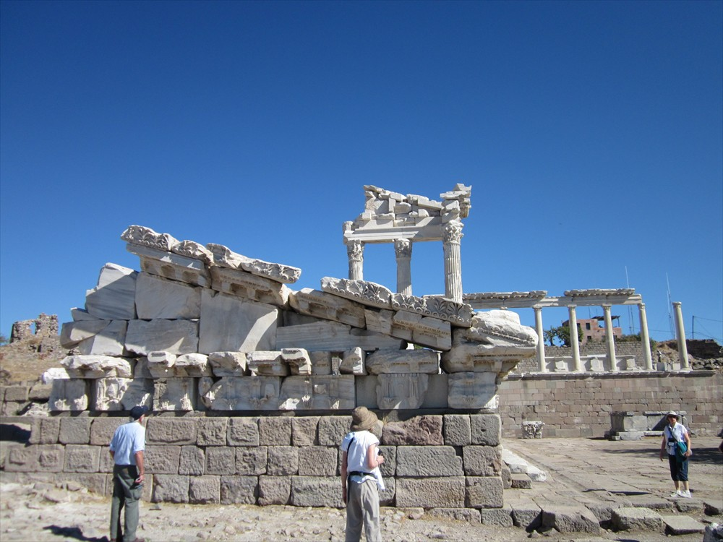
Pergamun

Slide 13
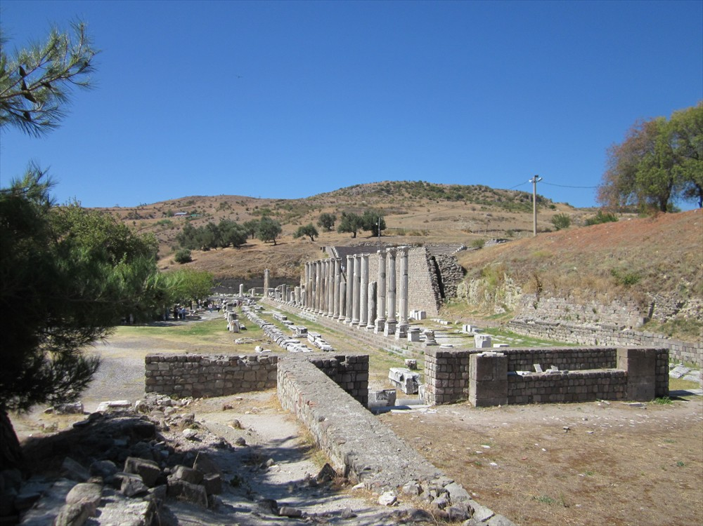
Pergamun

Slide 14
Thyatria
Thyatira - This Church is praised for its love, faith, service, and patient endurance, but criticized for its tolerance of Jezebel. This is a person apparently leading some of them astray. Thyatira was a commercial center renowned for its many trade guilds, which periodically sponsored idolatrous feasts. Lydia, one of Paul’s converts, was a dealer in purple cloth from Thyatira.
Jezebel was the wife of King Ahab she tried to introduce idol worship and was killed.
The reference to the eyes like a flame and feet like burnished bronze may allude to the local god, Tyrimmos, identified with the Greek sun god, Helios and Apollo
Notes:
Thyatira - This Church is praised for its love, faith, service, and patient endurance, but criticized for its tolerance of Jezebel. This is a person apparently leading some of them astray.
. Jezebel was the wife of King Ahab she tried to introduce idol worship and was killed.
Revelation 2, V 18 Thyatira -18 And to the angel of the church in Thyatira write: These are the words of the Son of God, who has eyes like a flame of fire, and whose feet are like burnished bronze: 19 I know your works your love, faith, service, and patient endurance. I know that your last works are greater than the first. 20 But I have this against you: you tolerate that woman Jezebel, who calls herself a prophet and is teaching and beguiling my servants to practice fornication and to eat food sacrificed to idols. 21 I gave her time to repent, but she refuses to repent of her fornication. 22 Beware, I am throwing her on a bed, and those who commit adultery with her I am throwing into great distress, unless they repent of her doings; 23 and I will strike her children dead.
Harper Collins Bible Dictionary Page 1148 The reference to the eyes like a flame and feet like burnished bronze may allude to the local god, Tyrimmos, identified with the Greek sun god, Helios and Appolo. No further reference to tyrimmos can be found.
Wikipedia In early Christian times, Thyateira was home to a significant Christian church, mentioned as one of the seven Churches of the Book of Revelation in the Book of Revelation.^{[6]} According to Revelation, a woman named Jezebel (who called herself a prophetess) taught and seduced the Christians of Thyateira to commit sexual immorality and to eat things sacrificed to idols.

Slide 15
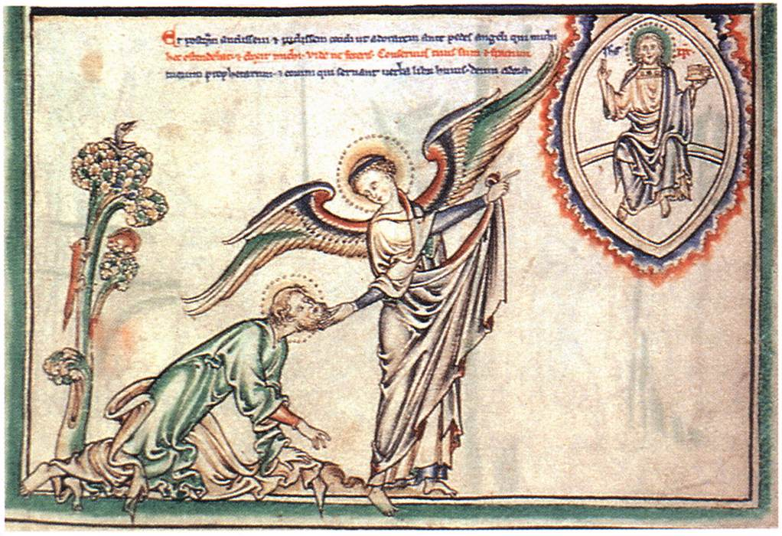
English Miniaturist, English Apocalypse, c. 1250
Illumination on parchment, 272 x 195 mm (entire page)
The Morgan Library and Museum, New York

Slide 16
Sardis
Sardis - This Church was praised for its good works in the past but now it is dead. Apparently works without enthusiasm are seen as a problem.
In Roman times Sardis was the center of the imperial cult in the region which was administered by a provincial council.
They are told to start over.
Notes:
Sardis - This Church was praised for its good works in the past but now it is dead. Apparently, even perfect works without enthusiasm are seen as a problem.
Revelation 3, V3 Sardis 3 And to the angel of the church in Sardis write: These are the words of him who has the seven spirits of God and the seven stars:
I know your works; you have a name of being alive, but you are dead. 2 Wake up, and strengthen what remains and is on the point of death, for I have not found your works perfect in the sight of my God. 3 Remember then what you received and heard; obey it, and repent.
Harper Collins Bible Dictionary Page 973. In Roman time Sardis was the center of the imperial cult in the region which was administered by a provincial council.
Wikipedia
Sardis or Sardes (Lydian: Sfard; Greek: Σάρδεις, Sardeis; Persian: سارد, Sārd) was an ancient city at the location of modern Sart (Sartmahmut before 19 October 2005) in Turkey's Manisa Province. Sardis was the capital of the ancient kingdom of Lydia,^{[1]} one of the important cities of the Persian Empire, the seat of a proconsul under the Roman Empire, and the metropolis of the province Lydia in later Roman and Byzantine times. As one of the Seven churches of Asia, it was addressed by the author of the Book of Revelation in terms which seem to imply that its population was notoriously soft and fainthearted. Its importance was due, first to its military strength, secondly to its situation on an important highway leading from the interior to the Aegean coast, and thirdly to its commanding the wide and fertile plain of the Hermus.
Sardis synagogue
Main article: Sardis Synagogue
A recent view of the Sardis Synagogue
Since 1958, both Harvard and Cornell Universities have sponsored annual archeological expeditions to Sardis. These excavations unearthed perhaps the most impressive synagogue in the western diaspora yet discovered from antiquity, yielding over eighty Greek and seven Hebrew inscriptions as well as numerous mosaic floors. (For evidence in the east, see Dura Europos in Syria.) The discovery of the Sardis synagogue has reversed previous assumptions about Judaism in the later Roman empire. Along with the discovery of the godfearers/theosebeis inscription from the Aphrodisias, it provides indisputable evidence for the continued presence of Jewish communities in Asia Minor and their integration into general Roman life at a time when many scholars previously assumed that Christianity had eclipsed Judaism.^{[citation needed]}
The synagogue was a section of a large bath-gymnasium complex, that was in use for about 450 – 500 years. In the beginning, middle of the 2nd century AD, the rooms the synagogue is situated in were used as changing rooms or resting rooms. The complex was destroyed in 616 AD by the Sassanian-Persians.^{[citation needed]}
Sardis and the Hebrew Sepharad may have been one and the same.

Slide 17
Philadelphia
Philadelphia - This Church is praised for its patient endurance which has been such that due to it they will be protected from a potential trial.
Philadelphia was a small town in ancient Lydia. In 17 AD it was destroyed by earthquake and was rebuilt by Tiberius and helped by Caligula.
One point of note this Church receives nothing but praise.
Notes:
Philadelphia - This Church is praised for its patient endurance which has been such that due to it they will be protected from a potential trial.
Revelation 3, V 10 Philadelphia 10 Because you have kept my word of patient endurance, I will keep you from the hour of trial that is coming on the whole world to test the inhabitants of the earth.
Wikipedia
Roman Philadelphia
Philadelphia was in the administrative district of Sardis (Pliny NH 5.111). In AD 17, the city suffered badly in an earthquake, and the emperor Tiberius relieved it of having to pay taxes (Tacitus Annales 2.47, cf. Strabo 12.8.18, 13.4.10, John Lydus de mensibus 4.115). in response, the city granted honors to Tiberius. Evidence from coinage reveals that Caligula helped the city; under Vespasian, Philadelphia received his cognomen, Flavia. Under Caracalla, Philadelphia housed an imperial cult; its coins bore the word Neokoron (literally, "temple-sweeper"--caretaker of the temple). A small theater located at the northern edge of Toptepe Hill is all that remains of Roman Philadelphia.
[edit] Philadelphia in the Book of Revelation
Although several ancient cities bore the name of Philadelphia, this is definitely the one listed among the seven churches by John in the Book of Revelation.^{[2]} Philadelphia is the sixth church of the seven.(Revelation 1:11). A letter specifically addressed to the Philadelphian church is recorded in (Revelation 3:7-13). According to this letter, the Philadelphian Christians were suffering persecution at the hands of the local Jews, whom Revelation calls "the synagogue of Satan" (Revelation 3:9). The city's history of earthquakes may lie behind the reference to making her church a temple pillar (Revelation 3:12). Permanency would have been important to the city's residents.
Philadelphia shares with Smyrna the distinction of receiving nothing but praise from Christ. This explains why modern Protestant churches sometimes use "Philadelphia" as a component in the local church's name as a way of emphasizing its faithfulness.

Slide 18
Laodicea
Laodicea - This Church is criticized for being neither to hot nor to cold. This church is then mediocre.
Laodicea was a proud and wealthy city near Colossae.
The nearby town of Hierapolis had a famous hot spring for its water supply. The spring fed aqueduct to Laodicea was not hot.
Notes:
Finally, Laodicea - This Church is criticized for being neither to hot nor to cold. This church is then mediocre.
Revelation 3 V 15 Laodicea - 15 I know your works; you are neither cold nor hot. I wish that you were either cold or hot. 16 So, because you are lukewarm, and neither cold nor hot, I am about to spit you out of my mouth.
Harper Collins Bible Dictionary Page 591 According to Col 4:16 they received a letter from Paul that has been lost. The rebuke of this church may have been related to its water supply. The nearby town of Hierapolis has a famous hot spring. The spring fed aqueduct to Laodicea was not hot.

Slide 19
Review of the Seven Letters
Some obvious observations that can be made about these letters.
The letters are a call for endurance for the community of the faithful in the face of adversity.
The author may be pointing out that in the various ways that these communities have dealt with adversity and the pit falls of that way.
These letters seem to deal with the matter of balance of group integrity against tolerance against the need for love.
Notes:
There are some obvious observations that can be made about these letters. First the letters are a call for endurance for the community of the faithful in the face of adversity. It also appears that the author may be pointing out that in the various ways that these communities have dealt with adversity, that there are pit falls. Another way to view these letters is in the matter of balance of group integrity against tolerance and the need for love. In all this even Laodicea, which is neither too hot nor too cold, however, is apparently not just right. The New Testament author Luke Timothy Johnson, sees the letters as similar to Old Testament classic prophetic statement in that these communities are warned of a situation in need of attention and then told of the consequence of failure to remedy the situation and with the promise of the benefit of following God’s lead. The choice to accept this is one for that of the community.

Slide 20
Review of the Seven Letters
In all this even Laodicea, which is neither too hot nor too cold, however, is apparently not just right.
Luke Timothy Johnson, sees the letters as similar to Old Testament classic prophetic statement in that these communities are warned of a situation in need of attention and then told of the consequence of failure to remedy the situation and with the promise of the benefit of following God’s lead. The choice to accept the suggestion is for the community to decide.
Notes:
There are some obvious observations that can be made about these letters. First the letters are a call for endurance for the community of the faithful in the face of adversity. It also appears that the author may be pointing out that in the various ways that these communities have dealt with adversity, that there are pit falls. Another way to view these letters is in the matter of balance of group integrity against tolerance and the need for love. In all this even Laodicea, which is neither too hot nor too cold, however, is apparently not just right. The New Testament author Luke Timothy Johnson, sees the letters as similar to Old Testament classic prophetic statement in that these communities are warned of a situation in need of attention and then told of the consequence of failure to remedy the situation and with the promise of the benefit of following God’s lead. The choice to accept this is one for that of the community.

Slide 21
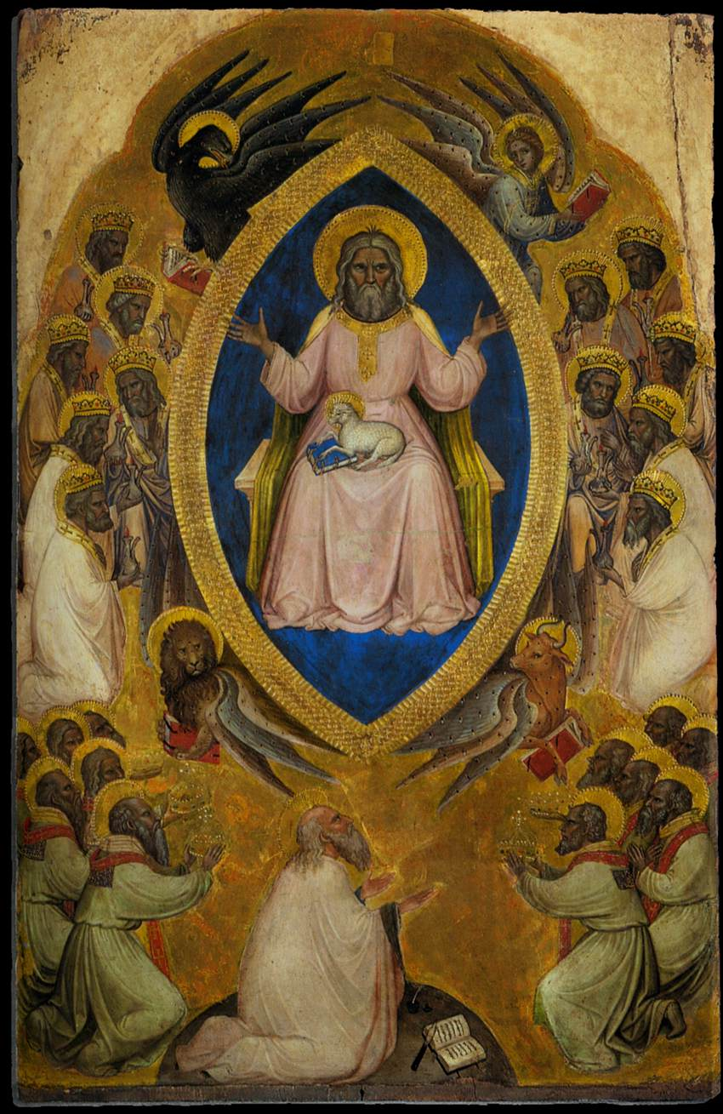
Jacobello Alberegno,
Polyptych of the Apocalypse (central panel)
1360-90
Tempera on panel, 95 x 61 cm
Gallerie dell'Accademia, Venice

Slide 22
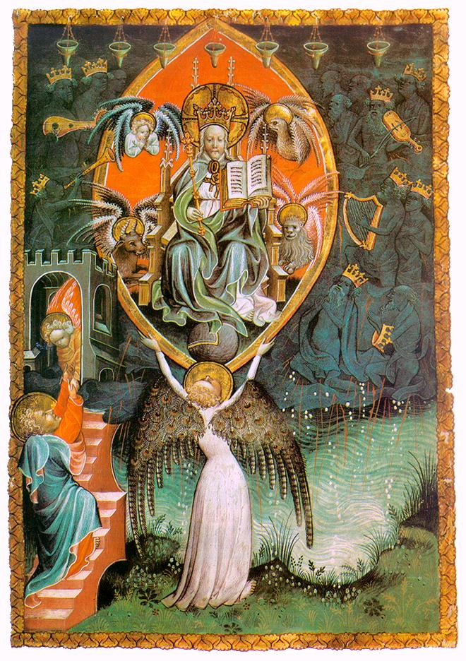
French Miniaturist,
Vision of the Throne of the Lord (The Paris Apocalypse) c. 1400
Vellum, 27,5 x 18,5 cm
Bibliothèque Nationale, Paris

Slide 23
Next week The visions

