Slide 1
THE BOOK OF REVELATION
FOR THE MODERN READER
Lesson three
Notes:
THE BOOK OF REVELATION
FOR THE MODERN READER
In Four Lessons
First
This is intended as a four lesson course on the book of the New Testament commonly known as The Book of Revelation. The first lesson deals with the introduction to the concepts, origins and history of the text itself. The following three lessons, two, three and four, deal with the text itself. The intention is that this study be undertaken along with your reading of the text, starting after you have finished this first lesson. In this way, you will be able to encounter these scriptures directly. These as with all parts of the Bible, can be read for textual study and as an aid in life. The textual study will bring understanding and one hopes enlightenment. When read with a life challenge in mind, one will discover in scriptural texts, new meaning, that will help in dealing with the challenge at hand. This final section of the New Testament, above all others was written to those facing great and often fatal challenges in life.

Slide 2
The Revelation to John
The Official Name from the Oxford Annotated Introduction

Slide 3
Lesson THREE
  3. Outline of the Visions
Notes:
1. concepts, origins and history of the text itself.
2. Out Line Organization Seven Letters
3. Outline of the Visions
4. Memorable images
5. Relevance to Modern Life

Slide 4
Review
Revelation is apocalyptic literature.
The author and churches addressed were well known to its readers in the early Church.
The seven letters conveyed a message of hope and a call for endurance.
In Biblical times the word prophesy had a different meaning a Forth telling not a foretelling e.g. the Prophet tells what message God is sending.
This week that for which the ‘endurance’ will be needed!

Slide 5
The Visions
Notes:
The Visions
The next element of Revelation deals with a series of Visions that ultimately lead to the establishment of the New Jerusalem. The letters may have been intended for individual groups with the section of visions to follow meant for the entire community of Christians. These visions of course are hard for the casual reader to grasp. While dividing the visions into seven parts has theological significance, it can also have some practical value. This division breaks the text into manageable topics, allows one to more easily ponder them or in a group to discuss the meaning. Try to visualize the text sections as a written description of a video presentation or a scene in a movie. Some of the scenes are short, some long some simple and some complicated. Like a standard Christmas Pageant with different characters marching into place until there is a complete ensemble in costume. The author of Revelation sequentially describes various elements that are added together to form a whole picture. We will break out the visions into seven separate visions and some apparent interludes, with the last vision itself divided into seven parts. This division is according to this author and no other serious scholar. For an alternate, and more orthodox division, than that we will discuss see Appendix One to these Lessons.
For discussion purposes the visions can be seen as being made up of Seven Visions, consisting of six scenes followed by a seventh Vision that is itself a series of seven sequential scenes that as a group depict the resolution of good and evil or of God with the world. The text is divided as follows:
First Vision - Revelation 4:1-5:11
Second Vision - Revelation 6:1-6:17
Third Vision - Revelation 7:1-7:17
Fourth Vision - Revelation 8:1-9:21
Fifth Vision - Revelation 10:1-10:11 and interlude or postscript at Revelation 11:1-11:14.
Sixth Vision - Revelation 11:15-11:19
Seventh Vision - This is a sequence of seven scenes followed by a final vision of the resolution.
Scene 1- Revelation 12:1-12:17
Scene 2- Revelation 12:18-13:10
Scene 3- Revelation 13:11-13:18
Scene 4- Revelation 14:1-14:12 -
Interlude 14:13
Scene 5- Revelation Is a three part vision 14:14-17:18 and S6- 18:1 - 18:24 and at 19:1-19:10
Scene 6- Revelation 19:11-20:15
Scene 7- Revelation 21:1-22:5
The book ends with a Post log 22:6-21.
Synopsis of these Visions:
Vision 1 - 4:1-5:11 - Twenty Four Elders before the Throne with a scroll only Christ can open. The four living creatures also appear
Vision 2 - 6:1-6:17 - Four horsemen, white, black, red and green who are then sent out to do wrathful things.
Vision 3 - 7:1-7:17 - The appearance of people robed in white engage in perpetual worship.
Vision 4 - 8:1-9:21 - Upon the opening of the seventh seal, various woes are sent out to 1/3 of parts of the world. But people still did not stop the worship of idols.
Vision 5 - 10:1-10:11 - The writer is told not to write this one down. An interlude or postscript 11:1-11:14 - in the interlude, the 2nd and 3rd woes and two witnesses are killed and after three days rise.
Vision 6 - 11:15-11:19 - The twenty four elders worship with a song amid thunder peals
Vision 7 - This is a sequence of seven scenes followed by a final vision of resolution.
S1- 12:1-12:17 - A red dragon tries to devour the newborn infant of a woman clothed with the sun. The child is snatched away to God. There is war in heaven and the dragon is thrown out - and then purses the woman’s other children who keep the commandments and testimony of Christ.
S2- 12:18-13:10 - The red dragon gives up power to an injured, seven headed leopard that does great signs and fools the earth and marks its followers on hand or head.
S3- 13:11-13:18 - The mark of the beast 666 and those without it cannot buy or sell.
S4- 14:1-14:12 - Three angels tell of the torment of Babylon before 144 thousand singing virgins as a call for endurance of the saints.
Interlude 14:13 - the blessed dead in the Lord.
S5- Is a three part vision: 14:14-17:18 and S6- 18:1 - 18:24 and at 19:1-19:10 -
First The son of man comes on a white cloud, as angels emerge from a temple reaping with sickles, sending seven plagues - bowls of wrath the 6th angel dries the river Euphrates and seven foul spirit demons gather kings at Harmagedon to prepare for battle, then the 7th angel splits Babylon into 1/3's - shown as the whore of Babylon the mother of Earths abominations.
Second - 18:1 - 18:24 - Those on earth mourn the loss and tell about the effect on the economy of the greed of the great city for sailors and suppliers of goods.
Third - 19:1-19:10 - Those in Heaven rejoice at the loss.
S6- 19:11-20:15 - The Word slays the army of evil and the Beast and False Prophet are thrown into a lake of fire. The dragon is chained for 1000 years while those headed for belief Rule. Upon release the dragon gathers evil forces that surround the camp of the Saints, but the besiegers are consumed by fire from heaven forever, including the Beast and False Prophet. Then all are judged according to what they have done those not in the Book of Life suffer the 2nd death and are thrown into a lake of fire.
Post log S7- 21:1-22:5 - Now the old heaven and earth are replaced with a new heaven and earth, where God will be with his people and the same angels that loosed the bowls of wrath show the New Jerusalem [1500X1500X1500 miles] with nothing unclean and where the water of life from the throne of God with the Lamb flows in the city and where the tree of life is now with 12 kinds of fruit.
The book ends with the writer’s assurance that the book is true and that the Lord is coming soon.
Another unity in the text is that within these visions, no matter how one views or divides them there are a number of repeating themes or characters. Some of these will be discussed in the next lesson. For now, using the above outline, pick one of the Visions and read the text indicated for that vision, using the outline to give a reference point to the whole.
As an exercise, you may want to try the following procedure, to test your understanding. Visualize some unfortunate incident of note in your experience from the past. Using a section of the text of the Book of Revelation, or any other part of the New Testament, just as it presents itself to you, do you see any parallel? Is there anything in the text that perhaps affirms or explains what happened in your incident? Is there anything in the text that helps put the incident into perspective, now that some time has gone past. Depending on the incident you choose and the text to which you related it, you may or may not find answers to the questions posed. If not pick a different vision and see if the incident brings any answers to these questions. Scriptures are intended to be encountered in a community rather than as an individual. One way to guard against this is to discuss your reading and conclusions with others. Individual interpretations can lead at times to misunderstandings. Other people will provide a sounding board and a community for support.
By J B Cross
The Message of the Book of Revelation, Charles T. Chapman, Jr., The Liturgical Press, Collegeville, Minnesota, By the Order of St. Benedict, Inc., 1995. Page 9. And See The Oxford Dictionary of The Christian Church, Second Edition Revised, Oxford University Press, 1983. Page 1182. Please note in deference to Rev Chapman's greater learning that the divisions hereafter listed were not taken from his work and any inaccuracies or mistakes are mine and not the Rev Chapman's.
Johnson, Luke Timothy and Todd C. Penner , New Testament Writings, An Interpretation, Second Revised Edition, Page 585, Augsburg Fortress Press, 1999.
See Johnson, Luke Timothy and Todd C. Penner, New Testament Writings, An Interpretation, Second Revised Edition, Page 585-586, Augsburg Fortress Press, 1999.
Revelation 2, V2 ‘Ephesus’ ‘2 ‘I know your works, your toil and your patient endurance. I know that you cannot tolerate evildoers; you have tested those who claim to be apostles but are not, and have found them to be false. 3 I also know that you are enduring patiently and bearing up for the sake of my name, and that you have not grown weary. 4 But I have this against you that you have abandoned the love you had at first.
Revelation 2 , V 8, Smyrna 8 And to the angel of the church in Smyrna write: These are the words of the first and the last, who was dead and came to life:
9 I know your affliction and your poverty, even though you are rich. I know the slander on the part of those who say that they are Jews and are not, but are a synagogue of Satan. 10 Do not fear what you are about to suffer. Beware, the devil is about to throw some of you into prison so that you may be tested, and for ten days you will have affliction. Be faithful until death, and I will give you the crown of life.
Revelation 2, V 2 - Pergamum 12 And to the angel of the church in Pergamum write: These are the words of him who has the sharp two-edged sword:
13 I know where you are living, where Satan’s throne is. Yet you are holding fast to my name, and you did not deny your faith in me even in the days of Antipas my witness, my faithful one, who was killed among you, where Satan lives. 14 But I have a few things against you: you have some there who hold to the teaching of Balaam, who taught Balak to put a stumbling block before the people of Israel, so that they would eat food sacrificed to idols and practice fornication. 15 So you also have some who hold to the teaching of the Nicolaitans. 16 Repent then. If not, I will come to you soon and make war against them with the sword of my mouth. NOTE Balaam is the famous wizard from the OT with the troublesome mule who was called to curse the Israelites for King Balak against the wishes if God. The sword was a judgment symbol from Hebrews 4:12.
The Message of the Book of Revelation, Charles T. Chapman, Jr., The Liturgical Press, Collegeville, Minnesota, By the Order of St. Benedict, Inc., 1995. General Information at Pages 20 and 25. In New Testament Writings, Timothy Luke Johnson, the author speculates that this was a group that allowed the eating of temple meat.
. Jezebel was the wife of King Ahab she tried to introduce idol worship and was killed.
Revelation 2, V 18 Thyatira -18 And to the angel of the church in Thyatira write: These are the words of the Son of God, who has eyes like a flame of fire, and whose feet are like burnished bronze: 19 I know your works your love, faith, service, and patient endurance. I know that your last works are greater than the first. 20 But I have this against you: you tolerate that woman Jezebel, who calls herself a prophet and is teaching and beguiling my servants  to practice fornication and to eat food sacrificed to idols. 21 I gave her time to repent, but she refuses to repent of her fornication. 22 Beware, I am throwing her on a bed, and those who commit adultery with her I am throwing into great distress, unless they repent of her doings; 23 and I will strike her children dead.
Revelation 3, V3 Sardis 3 And to the angel of the church in Sardis write: These are the words of him who has the seven spirits of God and the seven stars:
I know your works; you have a name of being alive, but you are dead. 2 Wake up, and strengthen what remains and is on the point of death, for I have not found your works perfect in the sight of my God. 3 Remember then what you received and heard; obey it, and repent.
Revelation 3, V 10 Philadelphia 10 Because you have kept my word of patient endurance, I will keep you from the hour of trial that is coming on the whole world to test the inhabitants of the earth.
Revelation 3 V 15 Laodicea - 15 I know your works; you are neither cold nor hot. I wish that you were either cold or hot. 16 So, because you are lukewarm, and neither cold nor hot, I am about to spit you out of my mouth.
See Johnson, Luke Timothy and Todd C. Penner, New Testament Writings, An Interpretation, Second Revised Edition, Pages 585-586, Augsburg Fortress Press, 1999.
The Oxford Dictionary of The Christian Church, Second Edition Revised, Oxford University Press, 1983. Page 1183.
The time frame is God’s own, which like Noah’s wait for the doves return may seem a long time to us.

Slide 6
Jan van Eyck, The Ghent Altarpiece (wings open), 1432
Oil on wood, 350 x 461 cm
Cathedral of St Bavo, Ghent

Slide 7
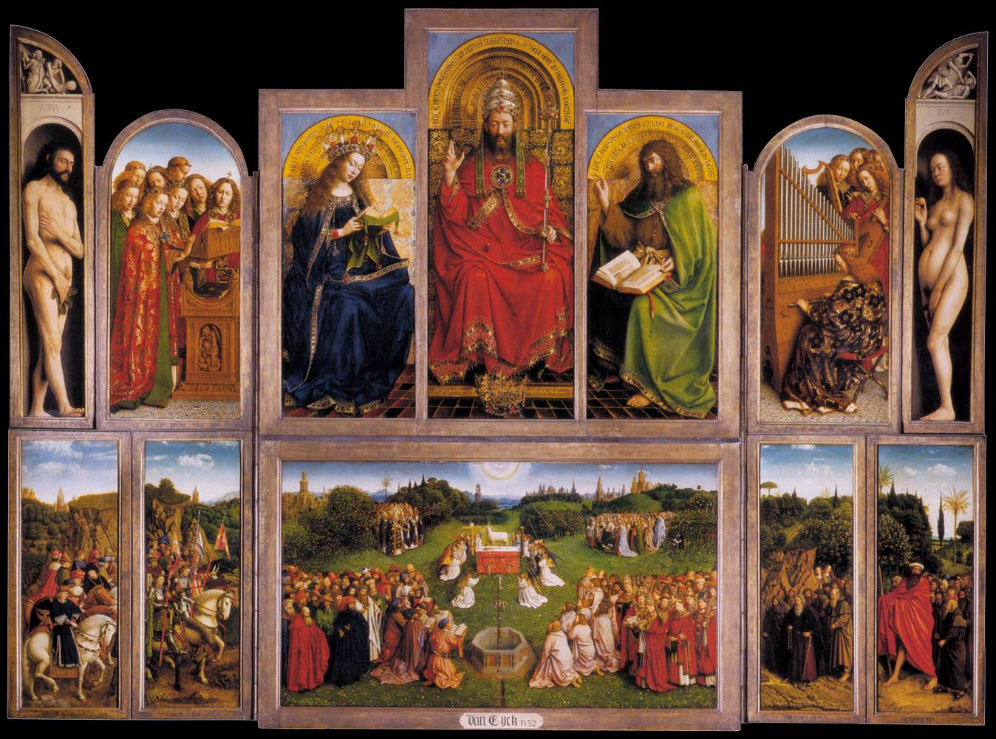

Slide 8
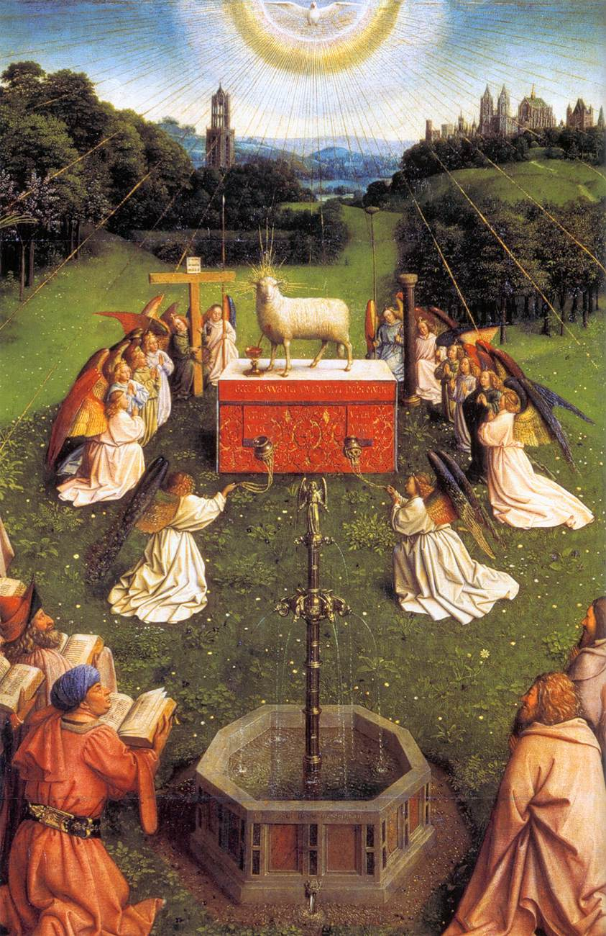

Slide 9
The Visions
Next a series of Visions that ultimately lead to the establishment of the New Jerusalem.
The letters may have been intended for individual groups with the section of visions to follow meant for the entire community of Christians.
Division into Seven:
  Theological Significance: Seven is a complete number.
  Practical Significance. Breaks the text into manageable topics.
Notes:
The Visions
The next element of Revelation deals with a series of Visions that ultimately lead to the establishment of the New Jerusalem. The letter may have been intended for individual groups with the section of visions to follow meant for the entire community of Christians. These visions of course are hard for the casual reader to grasp. While dividing the visions into seven parts has theological significance, it can also have some practical value. This division breaks the text into manageable topics, allows one to more easily ponder them or in a group to discuss the meaning.
The Oxford Dictionary of The Christian Church, Second Edition Revised, Oxford University Press, 1983. Page 1183.

Slide 10
Christmas Pageant
Visualize the text sections as a written description of a video presentation or a scene in a movie.
Some of the scenes are short, some long, some simple and some complicated.
Each Vision is built up like a Christmas Pageant with different characters marching into place until there is a complete ensemble in costume. Baby, Animals, Shepherds, Kings, Angels.
The author of Revelation sequentially describes various elements that are added together to form a whole picture.
Notes:
The next element of Revelation deals with a series of Visions that ultimately lead to the establishment of the New Jerusalem. 14 The letter may have been intended for individual groups with the section of visions to follow meant for the entire community of Christians. These visions of course are hard for the casual reader to grasp. While dividing the visions into seven parts has theological significance, it can also have some practical value. This division breaks the text into manageable topics, allows one to more easily ponder them or in a group to discuss the meaning. Try to visualize the text sections as a written description of a video presentation or a scene in a movie. Some of the scenes are short, some long some simple and some complicated. Like a standard Christmas Pageant with different characters marching into place until there is a complete ensemble in costume. The author of Revelation sequentially describes various elements that are added together to form a whole picture. We will break out the visions into seven separate visions and some apparent interludes, with the last vision itself divided into seven parts. This division is according to this author and no other serious scholar. For an alternate, and more orthodox division, than that we will discuss see Appendix One to these Lessons.
See Johnson, Luke Timothy and Todd C. Penner, New Testament Writings, An Interpretation, Second Revised Edition, Pages 585-586, Augsburg Fortress Press, 1999.
The Oxford Dictionary of The Christian Church, Second Edition Revised, Oxford University Press, 1983. Page 1183.

Slide 11
Seven Visions
Visions are in seven separate sets with interludes and some with separate scenes.
Warning – I made these divisions up no serious scholar advances them. For an alternate, and more orthodox division - see Appendix One to these Lessons.
As a group these visions depict the resolution of good and evil or of God’s reconciliation of the world.
Notes:
We will break out the visions into seven separate visions and some apparent interludes, with the last vision itself divided into seven parts. This division is according to this author and no other serious scholar. For an alternate, and more orthodox division, than that we will discuss see Appendix One to these Lessons.
For discussion purposes the visions can be seen as being made up of Seven Visions, consisting of six scenes followed by a seventh Vision that is itself a series of seven sequential scenes that as a group depict the resolution of good and evil or of God with the world. The text is divided as follows:

Slide 12
The First Six Visions
First Vision - Revelation 4:1-5:11
Second Vision - Revelation 6:1-6:17
Third Vision - Revelation 7:1-7:17
Fourth Vision - Revelation 8:1-9:21
Fifth Vision - Revelation 10:1-10:11 and interlude or postscript at Revelation 11:1-11:14.
Sixth Vision - Revelation 11:15-11:19
Notes:
The text is divided as follows:
First Vision - Revelation 4:1-5:11
Second Vision - Revelation 6:1-6:17
Third Vision - Revelation 7:1-7:17
Fourth Vision - Revelation 8:1-9:21
Fifth Vision - Revelation 10:1-10:11 and interlude or postscript at Revelation 11:1-11:14.
Sixth Vision - Revelation 11:15-11:19

Slide 13
The Seventh ‘Visions’
Seventh Vision - This is a sequence of seven scenes followed by a final vision of the resolution.
Scene 1- Revelation 12:1-12:17
Scene 2- Revelation 12:18-13:10
Scene 3- Revelation 13:11-13:18
Scene 4- Revelation 14:1-14:12 -
Interlude 14:13
Scene 5- Revelation Is a three part vision 14:14-17:18 and S6- 18:1 - 18:24 and at 19:1-19:10
Scene 6- Revelation 19:11-20:15
Scene 7- Revelation 21:1-22:5
The book ends with a Post log 22:6-21.
Notes:
Seventh Vision - This is a sequence of seven scenes followed by a final vision of the resolution.
Scene 1- Revelation 12:1-12:17
Scene 2- Revelation 12:18-13:10
Scene 3- Revelation 13:11-13:18
Scene 4- Revelation 14:1-14:12 -
Interlude 14:13
Scene 5- Revelation Is a three part vision 14:14-17:18 and S6- 18:1 - 18:24 and at 19:1-19:10
Scene 6- Revelation 19:11-20:15
Scene 7- Revelation 21:1-22:5
The book ends with a Post log 22:6-21.

Slide 14
Synopsis of these Visions

Slide 15
Visions One to Four
Vision 1 - 4:1-5:11 - Twenty Four Elders before the Throne with a scroll only Christ can open. The four living creatures also appear
Vision 2 - 6:1-6:17 - Four horsemen, white, black, red and green who are then sent out to do wrathful things.
Vision 3 - 7:1-7:17 - The appearance of people robed in white engaged in perpetual worship.
Vision 4 - 8:1-9:21 - Upon the opening of the seventh seal, various woes are sent out to 1/3 of parts of the world. But people still did not stop the worship of idols.
Notes:
Vision 1 - 4:1-5:11 - Twenty Four Elders before the Throne with a scroll only Christ can open. The four living creatures also appear
Vision 2 - 6:1-6:17 - Four horsemen, white, black, red and green who are then sent out to do wrathful things.
Vision 3 - 7:1-7:17 - The appearance of people robed in white engage in perpetual worship.
Vision 4 - 8:1-9:21 - Upon the opening of the seventh seal, various woes are sent out to 1/3 of parts of the world. But people still did not stop the worship of idols.

Slide 16
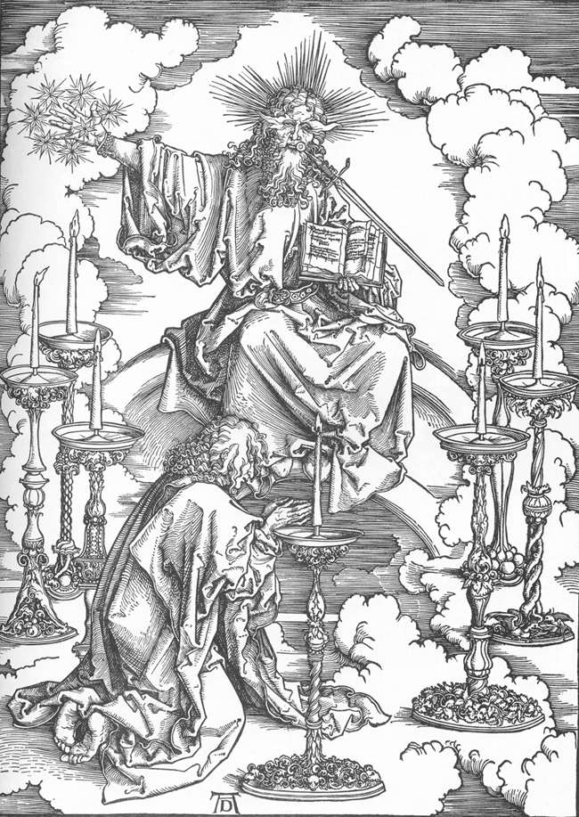
Albrecht Durer,
The Revelation of St John: 2. St John's Vision of Christ and the Seven Candlesticks
1497-98
Woodcut, 39 x 28 cm
Staatliche Kunsthalle, Karlsruhe

Slide 17
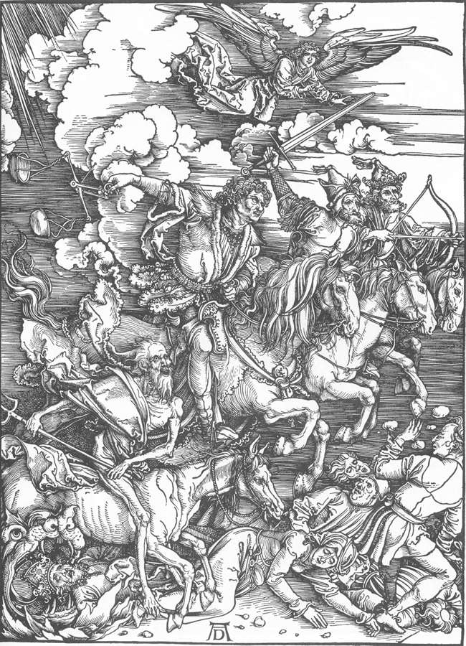
Albrecht Durer,
The Revelation of St John: 4. The Four Riders of the Apocalypse
1497-98
Woodcut, 399 x 286 mm
Kupferstichkabinett, Staatliche Kunsthalle, Karlsruhe

Slide 18
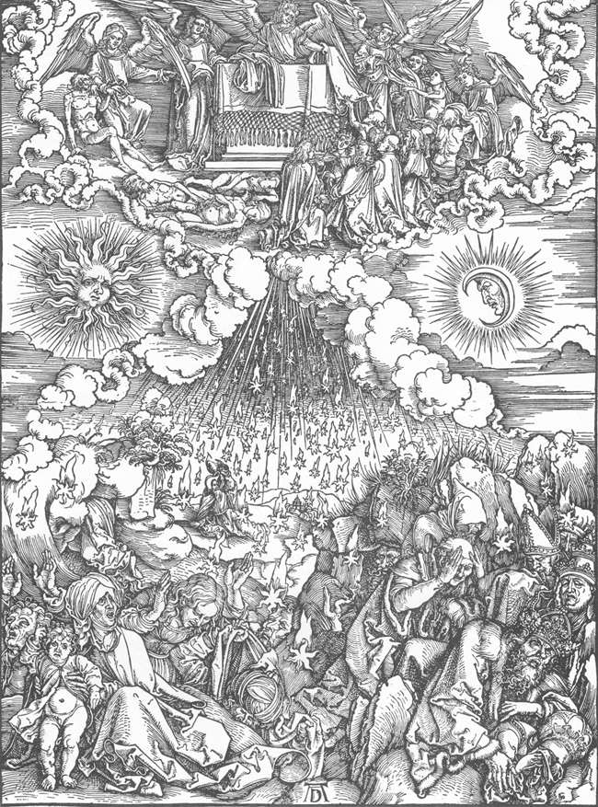
Albrecht Durer,
The Revelation of St John: 5. Opening the Fifth and Sixth Seals
1497-98
Woodcut, 39 x 28 cm
Staatliche Kunsthalle, Karlsruhe
(Stars rain from heaven upon pope, emperor and common folk on the earth below.)

Slide 19
El Greco, The Opening of the Fifth Seal (The Vision of St John),
1608-14
Oil on canvas, 222,3 x 193 cm, Metropolitan Museum of Art, New York
'And when he had opened the fifth seal, I saw under the altar the souls of them that were slain for the word of God . . . And they cried with a loud voice . . . And white robes were given to every one of them . . .‘
Revelation 6: 9-11
The painting has been cut at the top, where there was possibly a representation of the Throne.
This project was El Greco's last large-scale undertaking, and he did not live to complete it.

Slide 20
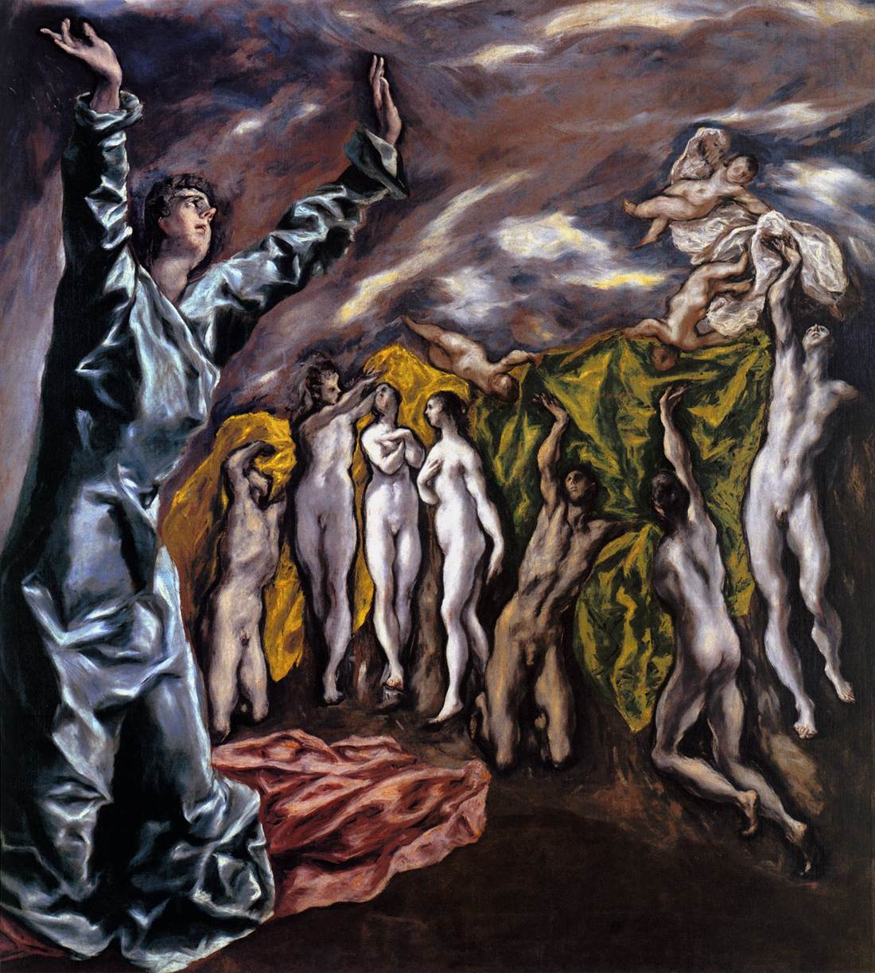

Slide 21
Visions Five and Six
Vision 5 - 10:1-10:11 - The writer is told not to write this one down. An interlude or postscript 11:1-11:14 - in the interlude, the 2nd and 3rd woes and two witnesses are killed and after three days rise.
Vision 6 - 11:15-11:19 - The twenty four elders worship with a song amid thunder peals
Notes:
Vision 5 - 10:1-10:11 - The writer is told not to write this one down. An interlude or postscript 11:1-11:14 - in the interlude, the 2nd and 3rd woes and two witnesses are killed and after three days rise.
Vision 6 - 11:15-11:19 - The twenty four elders worship with a song amid thunder peals.

Slide 22
Vision Seven the Series
S1- 12:1-12:17 - A red dragon tries to devour the newborn infant of a woman clothed with the sun. The child is snatched away to God. There is war in heaven and the dragon is thrown out - and then purses the woman’s other children who keep the commandments and testimony of Christ.
S2- 12:18-13:10 - The red dragon gives up power to an injured, seven headed leopard that does great signs and fools the earth and marks its followers on hand or head.
S3- 13:11-13:18 - The mark of the beast 666 and those without it cannot buy or sell.
Notes:
Vision 7 - This is a sequence of seven scenes followed by a final vision of resolution.
S1- 12:1-12:17 - A red dragon tries to devour the newborn infant of a woman clothed with the sun. The child is snatched away to God. There is war in heaven and the dragon is thrown out - and then purses the woman’s other children who keep the commandments and testimony of Christ.
S2- 12:18-13:10 - The red dragon gives up power to an injured, seven headed leopard that does great signs and fools the earth and marks its followers on hand or head.
S3- 13:11-13:18 - The mark of the beast 666 and those without it cannot buy or sell.

Slide 23
The Series Continues
S4- 14:1-14:12 - Three angels tell of the torment of Babylon before 144 thousand singing virgins as a call for endurance of the saints.
Interlude 14:13 - the blessed dead in the Lord.
Notes:
S4- 14:1-14:12 - Three angels tell of the torment of Babylon before 144 thousand singing virgins as a call for endurance of the saints.
Interlude 14:13 - the blessed dead in the Lord.

Slide 24
V7, Scene Five Three Parts
S5- Is a three part vision: 14:14-17:18 and S6- 18:1 - 18:24 and at 19:1-19:10 -
First The son of man comes on a white cloud, as angels emerge from a temple reaping with sickles, sending seven plagues - bowls of wrath the 6th angel dries the river Euphrates and seven foul spirit demons gather kings at Harmagedon to prepare for battle, then the 7th angel splits Babylon into 1/3's - shown as the whore of Babylon the mother of Earth’s abominations.
Second - 18:1 - 18:24 - Those on earth mourn the loss and tell about the effect on the economy of the greed of the great city for sailors and suppliers of goods.
Third - 19:1-19:10 - Those in Heaven rejoice at the loss.
Notes:
S5- Is a three part vision: 14:14-17:18 and S6- 18:1 - 18:24 and at 19:1-19:10 -
First The son of man comes on a white cloud, as angels emerge from a temple reaping with sickles, sending seven plagues - bowls of wrath the 6th angel dries the river Euphrates and seven foul spirit demons gather kings at Harmagedon to prepare for battle, then the 7th angel splits Babylon into 1/3's - shown as the whore of Babylon the mother of Earths abominations.
Second - 18:1 - 18:24 - Those on earth mourn the loss and tell about the effect on the economy of the greed of the great city for sailors and suppliers of goods.
Third - 19:1-19:10 - Those in Heaven rejoice at the loss.

Slide 25
Pieter Bruegel the Elder, Dulle Griet (Mad Meg), c. 1562
Oil on wood, 117,4 x 162 cm
Museum Mayer van den Bergh, Antwerp
This main figure in this painting was described in 1604 as 'a Mad Meg pillaging at the mouth of Hell / seemingly perplexed / and cruelly and strangely attired', an evil and fearsome woman or witch.
Does she represent Heresy, Madness, or Folly?
The painting has also been interpreted as the Breaking of the Seventh Seal, as recounted in the Book of Revelation. Mad Meg is, indeed, reminiscent of the book of the Apocalypse.

Slide 26
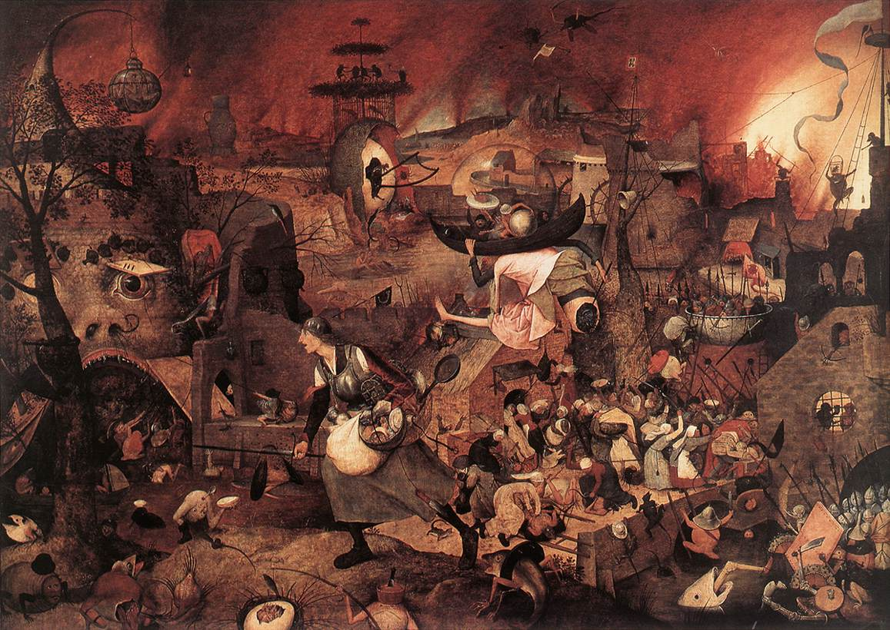

Slide 27
V7, Scene Six
S6- 19:11-20:15 - The Word slays the army of evil and the Beast and False Prophet are thrown into a lake of fire.
The dragon is chained for 1000 years while those headed for belief Rule.
Upon release the dragon gathers evil forces that surround the camp of the Saints, but the besiegers are consumed by fire from heaven forever, including the Beast and False Prophet.
Then all are judged according to what they have done those not in the Book of Life suffer the 2nd death and are thrown into a lake of fire.
Notes:
S6- 19:11-20:15 - The Word slays the army of evil and the Beast and False Prophet are thrown into a lake of fire. The dragon is chained for 1000 years while those headed for belief Rule. Upon release the dragon gathers evil forces that surround the camp of the Saints, but the besiegers are consumed by fire from heaven forever, including the Beast and False Prophet. Then all are judged according to what they have done those not in the Book of Life suffer the 2nd death and are thrown into a lake of fire.

Slide 28
V7, Scene Seven Post Log
Post log S7- 21:1-22:5 - Now the old heaven and earth are replaced with a new heaven and earth, where God will be with his people and the same angels that loosed the bowls of wrath show the New Jerusalem [1500X1500X1500 miles] with nothing unclean and where the water of life from the throne of God with the Lamb flows in the city and where the tree of life is now with 12 kinds of fruit.
The book ends with the writer’s assurance that the book is true and that the Lord is coming soon.
Notes:
Post log S7- 21:1-22:5 - Now the old heaven and earth are replaced with a new heaven and earth, where God will be with his people and the same angels that loosed the bowls of wrath show the New Jerusalem [1500X1500X1500 miles] with nothing unclean and where the water of life from the throne of God with the Lamb flows in the city and where the tree of life is now with 12 kinds of fruit.
The book ends with the writer’s assurance that the book is true and that the Lord is coming soon.

Slide 29
Two
Vision One
  Vision 1 - 4:1-5:11 - Twenty Four Elders before the Throne with a scroll only Christ can open. The four living creatures also appear
Vision Seven, Scene One
  S 1- 12:1-12:17 - A red dragon tries to devour the newborn infant of a woman clothed with the sun. The child is snatched away to God. There is war in heaven and the dragon is thrown out - and then pursues the woman’s other children who keep the commandments and testimony of Christ.
Notes:
Vision One
The Heavenly Worship
4 After this I looked, and there in heaven a door stood open! And the first voice, which I had heard speaking to me like a trumpet, said, “Come up here, and I will show you what must take place after this.” 2 At once I was in the spirit, † and there in heaven stood a throne, with one seated on the throne! 3 And the one seated there looks like jasper and carnelian, and around the throne is a rainbow that looks like an emerald. 4 Around the throne are twenty-four thrones, and seated on the thrones are twenty-four elders, dressed in white robes, with golden crowns on their heads. 5 Coming from the throne are flashes of lightning, and rumblings and peals of thunder, and in front of the throne burn seven flaming torches, which are the seven spirits of God; 6 and in front of the throne there is something like a sea of glass, like crystal.
Around the throne, and on each side of the throne, are four living creatures, full of eyes in front and behind: 7 the first living creature like a lion, the second living creature like an ox, the third living creature with a face like a human face, and the fourth living creature like a flying eagle. 8 And the four living creatures, each of them with six wings, are full of eyes all around and inside. Day and night without ceasing they sing,
“Holy, holy, holy,
the Lord God the Almighty,
who was and is and is to come.”
9 And whenever the living creatures give glory and honor and thanks to the one who is seated on the throne, who lives forever and ever, 10 the twenty-four elders fall before the one who is seated on the throne and worship the one who lives forever and ever; they cast their crowns before the throne, singing,
11 “You are worthy, our Lord and God,
to receive glory and honor and power,
for you created all things,
and by your will they existed and were created.”
The Scroll and the Lamb
5 Then I saw in the right hand of the one seated on the throne a scroll written on the inside and on the back, sealed † with seven seals; 2 and I saw a mighty angel proclaiming with a loud voice, “Who is worthy to open the scroll and break its seals?” 3 And no one in heaven or on earth or under the earth was able to open the scroll or to look into it. 4 And I began to weep bitterly because no one was found worthy to open the scroll or to look into it. 5 Then one of the elders said to me, “Do not weep. See, the Lion of the tribe of Judah, the Root of David, has conquered, so that he can open the scroll and its seven seals.”
6 Then I saw between the throne and the four living creatures and among the elders a Lamb standing as if it had been slaughtered, having seven horns and seven eyes, which are the seven spirits of God sent out into all the earth. 7 He went and took the scroll from the right hand of the one who was seated on the throne. 8 When he had taken the scroll, the four living creatures and the twenty-four elders fell before the Lamb, each holding a harp and golden bowls full of incense, which are the prayers of the saints. 9 They sing a new song:
“You are worthy to take the scroll
and to open its seals,
for you were slaughtered and by your blood you ransomed for God
saints from † every tribe and language and people and nation;
10 you have made them to be a kingdom and priests serving † our God,
and they will reign on earth.”
11 Then I looked, and I heard the voice of many angels surrounding the throne and the living creatures and the elders; they numbered myriads of myriads and thousands of thousands, 12 singing with full voice,
“Worthy is the Lamb that was slaughtered
to receive power and wealth and wisdom and might
and honor and glory and blessing!”
[4.1–5.14: Vision of the glory of God and of the Lamb.
4.1: The first voice, mentioned in Revelation 1.10. Come up, John was exalted in spirit, as was Ezekiel, to behold visions of God (Ezekiel 3.12; Ezekiel 8.3; Ezekiel 11.1). 2: A throne, Ezekiel 1.26–28. 3: The glory of the divine presence is described in terms of precious gems. 4: Twenty-four elders, probably angelic beings of the heavenly court, symbolizing the twelve patriarchs of the Old Testament and the twelve apostles of the New Testament. 5: Flashes of lightning, expressive of the majesty of the Most High (Exodus 19.16; Revelation 11.19). Seven spirits, Revelation 1.4. 6: A sea of glass suggests the distance between God and his creatures, even in heaven. Four living creatures, angelic beings representing humankind and all beasts (Ezekiel 1.5; Ezekiel 1.10). Full of eyes, symbolizing unceasing watchfulness. 8: Six wings . . . Holy, holy, holy, Isaiah 6.2–3. 10: Cast their crowns, acknowledging that all power comes from God. 11: They existed in God’s mind from all eternity.
5.1: A scroll, containing the fixed purposes of God for the future (Ezekiel 2.9–10). Sealed, therefore both unalterable and unknown to others. 3–5: No created being is worthy to carry out God’s plan, only the Messianic king can do so; for his titles (Lion . . . Root), compare Genesis 49.9–10; Isaiah 11.1; Isaiah 11.10.
5.6–9: The Lamb . . . slaughtered, refers to Christ’s sacrificial death, by which God’s purposes contained in the scroll are accomplished (Isaiah 53.7; John 1.29; John 1.36; 1 Peter 1.19). Seven horns . . . seven eyes, plentitude of power and insight. Seven spirits, Revelation 1.4. 8: The prayers of the saints on earth are joined with the worship rendered to the Lamb by heavenly creatures. 9–10: A new song, because Christ has inaugurated a new era (Revelation 14.3). The Lamb is adored in terms similar to the adoration rendered to God (Revelation 4.11). A kingdom and priests, the vocation promised to Israel (Exodus 19.6; Isaiah 61.6) is extended to the church (1 Peter 2.9). 11–12: The sevenfold praise of myriads in heaven honoring the sacrificial Lamb.]
Vision Seven Scene One
Scene one
12:1-17
The Woman and the Dragon
12 A great portent appeared in heaven: a woman clothed with the sun, with the moon under her feet, and on her head a crown of twelve stars. 2 She was pregnant and was crying out in birth pangs, in the agony of giving birth. 3 Then another portent appeared in heaven: a great red dragon, with seven heads and ten horns, and seven diadems on his heads. 4 His tail swept down a third of the stars of heaven and threw them to the earth. Then the dragon stood before the woman who was about to bear a child, so that he might devour her child as soon as it was born. 5 And she gave birth to a son, a male child, who is to rule † all the nations with a rod of iron. But her child was snatched away and taken to God and to his throne; 6 and the woman fled into the wilderness, where she has a place prepared by God, so that there she can be nourished for one thousand two hundred sixty days.
Michael Defeats the Dragon
7 And war broke out in heaven; Michael and his angels fought against the dragon. The dragon and his angels fought back, 8 but they were defeated, and there was no longer any place for them in heaven. 9 The great dragon was thrown down, that ancient serpent, who is called the Devil and Satan, the deceiver of the whole world—he was thrown down to the earth, and his angels were thrown down with him.
10 Then I heard a loud voice in heaven, proclaiming,
“Now have come the salvation and the power
and the kingdom of our God
and the authority of his Messiah, †
for the accuser of our comrades † has been thrown down,
who accuses them day and night before our God.
11 But they have conquered him by the blood of the Lamb
and by the word of their testimony,
for they did not cling to life even in the face of death.
12 Rejoice then, you heavens
and those who dwell in them!
But woe to the earth and the sea,
for the devil has come down to you
with great wrath,
because he knows that his time is short!”
The Dragon Fights Again on Earth
13 So when the dragon saw that he had been thrown down to the earth, he pursued † the woman who had given birth to the male child. 14 But the woman was given the two wings of the great eagle, so that she could fly from the serpent into the wilderness, to her place where she is nourished for a time, and times, and half a time. 15 Then from his mouth the serpent poured water like a river after the woman, to sweep her away with the flood. 16 But the earth came to the help of the woman; it opened its mouth and swallowed the river that the dragon had poured from his mouth. 17 Then the dragon was angry with the woman, and went off to make war on the rest of her children, those who keep the commandments of God and hold the testimony of Jesus.
[12.1–17: The vision of the woman, the child, and the dragon portrays the conflict between Christ and Satan. 1: The woman appears to be the heavenly representative of God’s people, first as Israel (from whom Jesus the Messiah was born, Revelation 12.5), then as the Christian Church (which is persecuted by the dragon, Revelation 12.13). 3: Dragon, identified in Revelation 12.9 as the Devil or Satan. His enormous size and power are suggested in Revelation 12.4. 5: Psalm 2.9 identifies the child to be the Davidic Messiah. 6: The church is sustained by God.
12.7: Michael, an archangel and the champion of Israel (Daniel 10.13; Daniel 10.21; Daniel 12.1; Jude 9). The dragon and his angels, see Ephesians 6.12 n. 9: Luke 10.18. 10: The accuser, Job 1.9–11. 11: They have conquered, through both divine and human effort. 12: Rejoice, Psalm 96.11; Isaiah 49.13. 16: Aid comes from an unexpected quarter. ]

Slide 30
Comments
Another Factor in the text is that within these visions, no matter how one views or divides them there are a number of repeating themes or characters – Next Week.
Home Work - using the above outline, pick one of the Visions and read the text indicated for that vision, using the outline to give a reference point to the whole.
Notes:
Another unity in the text is that within these visions, no matter how one views or divides them there are a number of repeating themes or characters. Some of these will be discussed in the next lesson. For now, using the above outline, pick one of the Visions and read the text indicated for that vision, using the outline to give a reference point to the whole.
As an exercise, you may want to try the following procedure, to test your understanding. Visualize some unfortunate incident of note in your experience from the past. Using a section of the text of the Book of Revelation, or any other part of the New Testament, just as it presents itself to you, do you see any parallel? Is there anything in the text that perhaps affirms or explains what happened in your incident? Is there anything in the text that helps put the incident into perspective, now that some time has gone past. Depending on the incident you choose and the text to which you related it, you may or may not find answers to the questions posed. If not pick a different vision and see if the incident brings any answers to these questions. Scriptures are intended to be encountered in a community rather than as an individual. One way to guard against this is to discuss your reading and conclusions with others. Individual interpretations can lead at times to misunderstandings. Other people will provide a sounding board and a community for support.
By J B Cross

Slide 31
Reference Materials
The Text for the Visions is in the note section for use by the class leader for review.
Notes:
TEXT OF THE SEVEN VISIONS AND POSTLOGUE
Vision One
The Heavenly Worship
4 After this I looked, and there in heaven a door stood open! And the first voice, which I had heard speaking to me like a trumpet, said, “Come up here, and I will show you what must take place after this.” 2 At once I was in the spirit, † and there in heaven stood a throne, with one seated on the throne! 3 And the one seated there looks like jasper and carnelian, and around the throne is a rainbow that looks like an emerald. 4 Around the throne are twenty-four thrones, and seated on the thrones are twenty-four elders, dressed in white robes, with golden crowns on their heads. 5 Coming from the throne are flashes of lightning, and rumblings and peals of thunder, and in front of the throne burn seven flaming torches, which are the seven spirits of God; 6 and in front of the throne there is something like a sea of glass, like crystal.
Around the throne, and on each side of the throne, are four living creatures, full of eyes in front and behind: 7 the first living creature like a lion, the second living creature like an ox, the third living creature with a face like a human face, and the fourth living creature like a flying eagle. 8 And the four living creatures, each of them with six wings, are full of eyes all around and inside. Day and night without ceasing they sing,
“Holy, holy, holy,
the Lord God the Almighty,
who was and is and is to come.”
9 And whenever the living creatures give glory and honor and thanks to the one who is seated on the throne, who lives forever and ever, 10 the twenty-four elders fall before the one who is seated on the throne and worship the one who lives forever and ever; they cast their crowns before the throne, singing,
11 “You are worthy, our Lord and God,
to receive glory and honor and power,
for you created all things,
and by your will they existed and were created.”
The Scroll and the Lamb
5 Then I saw in the right hand of the one seated on the throne a scroll written on the inside and on the back, sealed † with seven seals; 2 and I saw a mighty angel proclaiming with a loud voice, “Who is worthy to open the scroll and break its seals?” 3 And no one in heaven or on earth or under the earth was able to open the scroll or to look into it. 4 And I began to weep bitterly because no one was found worthy to open the scroll or to look into it. 5 Then one of the elders said to me, “Do not weep. See, the Lion of the tribe of Judah, the Root of David, has conquered, so that he can open the scroll and its seven seals.”
6 Then I saw between the throne and the four living creatures and among the elders a Lamb standing as if it had been slaughtered, having seven horns and seven eyes, which are the seven spirits of God sent out into all the earth. 7 He went and took the scroll from the right hand of the one who was seated on the throne. 8 When he had taken the scroll, the four living creatures and the twenty-four elders fell before the Lamb, each holding a harp and golden bowls full of incense, which are the prayers of the saints. 9 They sing a new song:
“You are worthy to take the scroll
and to open its seals,
for you were slaughtered and by your blood you ransomed for God
saints from † every tribe and language and people and nation;
10 you have made them to be a kingdom and priests serving † our God,
and they will reign on earth.”
11 Then I looked, and I heard the voice of many angels surrounding the throne and the living creatures and the elders; they numbered myriads of myriads and thousands of thousands, 12 singing with full voice,
“Worthy is the Lamb that was slaughtered
to receive power and wealth and wisdom and might
and honor and glory and blessing!”
[4.1–5.14: Vision of the glory of God and of the Lamb.
4.1: The first voice, mentioned in Revelation 1.10. Come up, John was exalted in spirit, as was Ezekiel, to behold visions of God (Ezekiel 3.12; Ezekiel 8.3; Ezekiel 11.1). 2: A throne, Ezekiel 1.26–28. 3: The glory of the divine presence is described in terms of precious gems. 4: Twenty-four elders, probably angelic beings of the heavenly court, symbolizing the twelve patriarchs of the Old Testament and the twelve apostles of the New Testament. 5: Flashes of lightning, expressive of the majesty of the Most High (Exodus 19.16; Revelation 11.19). Seven spirits, Revelation 1.4. 6: A sea of glass suggests the distance between God and his creatures, even in heaven. Four living creatures, angelic beings representing humankind and all beasts (Ezekiel 1.5; Ezekiel 1.10). Full of eyes, symbolizing unceasing watchfulness. 8: Six wings . . . Holy, holy, holy, Isaiah 6.2–3. 10: Cast their crowns, acknowledging that all power comes from God. 11: They existed in God’s mind from all eternity.
5.1: A scroll, containing the fixed purposes of God for the future (Ezekiel 2.9–10). Sealed, therefore both unalterable and unknown to others. 3–5: No created being is worthy to carry out God’s plan, only the Messianic king can do so; for his titles (Lion . . . Root), compare Genesis 49.9–10; Isaiah 11.1; Isaiah 11.10.
5.6–9: The Lamb . . . slaughtered, refers to Christ’s sacrificial death, by which God’s purposes contained in the scroll are accomplished (Isaiah 53.7; John 1.29; John 1.36; 1 Peter 1.19). Seven horns . . . seven eyes, plentitude of power and insight. Seven spirits, Revelation 1.4. 8: The prayers of the saints on earth are joined with the worship rendered to the Lamb by heavenly creatures. 9–10: A new song, because Christ has inaugurated a new era (Revelation 14.3). The Lamb is adored in terms similar to the adoration rendered to God (Revelation 4.11). A kingdom and priests, the vocation promised to Israel (Exodus 19.6; Isaiah 61.6) is extended to the church (1 Peter 2.9). 11–12: The sevenfold praise of myriads in heaven honoring the sacrificial Lamb.]
Vision Two==
R61-17
The Seven Seals
6 Then I saw the Lamb open one of the seven seals, and I heard one of the four living creatures call out, as with a voice of thunder, “Come!” † 2 I looked, and there was a white horse! Its rider had a bow; a crown was given to him, and he came out conquering and to conquer.
3 When he opened the second seal, I heard the second living creature call out, “Come!” † 4 And out came † another horse, bright red; its rider was permitted to take peace from the earth, so that people would slaughter one another; and he was given a great sword.
5 When he opened the third seal, I heard the third living creature call out, “Come!” † I looked, and there was a black horse! Its rider held a pair of scales in his hand, 6 and I heard what seemed to be a voice in the midst of the four living creatures saying, “A quart of wheat for a day’s pay, † and three quarts of barley for a day’s pay, † but do not damage the olive oil and the wine!”
7 When he opened the fourth seal, I heard the voice of the fourth living creature call out, “Come!” † 8 I looked and there was a pale green horse! Its rider’s name was Death, and Hades followed with him; they were given authority over a fourth of the earth, to kill with sword, famine, and pestilence, and by the wild animals of the earth.
9 When he opened the fifth seal, I saw under the altar the souls of those who had been slaughtered for the word of God and for the testimony they had given; 10 they cried out with a loud voice, “Sovereign Lord, holy and true, how long will it be before you judge and avenge our blood on the inhabitants of the earth?” 11 They were each given a white robe and told to rest a little longer, until the number would be complete both of their fellow servants † and of their brothers and sisters, † who were soon to be killed as they themselves had been killed.
12 When he opened the sixth seal, I looked, and there came a great earthquake; the sun became black as sackcloth, the full moon became like blood, 13 and the stars of the sky fell to the earth as the fig tree drops its winter fruit when shaken by a gale. 14 The sky vanished like a scroll rolling itself up, and every mountain and island was removed from its place. 15 Then the kings of the earth and the magnates and the generals and the rich and the powerful, and everyone, slave and free, hid in the caves and among the rocks of the mountains, 16 calling to the mountains and rocks, “Fall on us and hide us from the face of the one seated on the throne and from the wrath of the Lamb; 17 for the great day of their wrath has come, and who is able to stand?”
[6.1–17: The opening of the first six seals of the scroll, and the pictorial enactment of what is written therein. 1–8: Come! addressed successively to each of the four riders (Zechariah 6.1–3) who accomplish God’s purposes. 2: The white horse symbolizes a conquering power that none can resist (in Revelation 19.11–13 the reference is to Christ). 4: The red horse symbolizes war and bloodshed. 5: The black horse symbolizes famine, which follows upon war. 8: The pale green horse symbolizes pestilence and death. A fourth part indicates wide but not total devastation. Pestilence, Exodus 9.3; 2 Samuel 24.13; Ezekiel 5.12. Wild animals, Ezekiel 5.17; Ezekiel 29.5; Ezekiel 33.27.
6.9–17: The fifth and sixth seals describe the prayers of the martyrs in heaven (Revelation 6.9–11) and their effects on earth (Revelation 6.12–17). 9: The souls of the martyrs are said to be under the altar because they had been martyred for the sake of Christ (Matthew 24.9; Philippians 2.17; 2 Timothy 4.6). 10: How long? is a cry for divine vindication. Avenge our blood, vengeance belongs to God (Romans 12.19). 11: White robe, see Revelation 2.17 n. and Revelation 7.9 n. 12–14: The great earthquake and cosmic catastrophes are not to be understood literally, but represent social upheavals and divine judgment on the Day of the Lord (Isaiah 34.4; Joel 2.30–31; Amos 8.9). 15–17: All classes of society seek to escape from God (Isaiah 2.10). ]
Vision Three
R7:1-17
The 144,000 of Israel Sealed
7 After this I saw four angels standing at the four corners of the earth, holding back the four winds of the earth so that no wind could blow on earth or sea or against any tree. 2 I saw another angel ascending from the rising of the sun, having the seal of the living God, and he called with a loud voice to the four angels who had been given power to damage earth and sea, 3 saying, “Do not damage the earth or the sea or the trees, until we have marked the servants † of our God with a seal on their foreheads.”
4 And I heard the number of those who were sealed, one hundred forty-four thousand, sealed out of every tribe of the people of Israel:
5 From the tribe of Judah twelve thousand sealed,
from the tribe of Reuben twelve thousand,
from the tribe of Gad twelve thousand,
6 from the tribe of Asher twelve thousand,
from the tribe of Naphtali twelve thousand,
from the tribe of Manasseh twelve thousand,
7 from the tribe of Simeon twelve thousand,
from the tribe of Levi twelve thousand,
from the tribe of Issachar twelve thousand,
8 from the tribe of Zebulun twelve thousand,
from the tribe of Joseph twelve thousand,
from the tribe of Benjamin twelve thousand sealed.
The Multitude from Every Nation
9 After this I looked, and there was a great multitude that no one could count, from every nation, from all tribes and peoples and languages, standing before the throne and before the Lamb, robed in white, with palm branches in their hands. 10 They cried out in a loud voice, saying,
“Salvation belongs to our God who is seated on the throne, and to the Lamb!”
11 And all the angels stood around the throne and around the elders and the four living creatures, and they fell on their faces before the throne and worshiped God, 12 singing,
“Amen! Blessing and glory and wisdom
and thanksgiving and honor
and power and might
be to our God forever and ever! Amen.”
13 Then one of the elders addressed me, saying, “Who are these, robed in white, and where have they come from?” 14 I said to him, “Sir, you are the one that knows.” Then he said to me, “These are they who have come out of the great ordeal; they have washed their robes and made them white in the blood of the Lamb.
15 For this reason they are before the throne of God,
and worship him day and night within his temple,
and the one who is seated on the throne will shelter them.
16 They will hunger no more, and thirst no more;
the sun will not strike them,
nor any scorching heat;
17 for the Lamb at the center of the throne will be their shepherd,
and he will guide them to springs of the water of life,
and God will wipe away every tear from their eyes.”
[ 7.1–17: An interlude between the sixth and seventh seals: two visions (Revelation 7.1–8 and Revelation 7.9–17) which provide assurance that God’s people are secure from the plagues and judgments. 3: The seal (Ezekiel 9.4–6) marks those under God’s protection; they are preserved through, not from, tribulations (1 Corinthians 10.13). 4: The explicit number (144,000) symbolizes completeness; not one of the redeemed is missing.
7.9: A great multitude of the redeemed, so many they cannot be counted. White robes and palm branches symbolize righteousness and victory. 12: A sevenfold ascription of praise to God. 14: The blood of the Lamb cleanses from sin (John 1.29; 1 John 1.7). 15: Before the throne of God, in a favored position because of their faithfulness. To worship God implies activity in heaven. Shelter them, literally “spread his tabernacle over them.” 16: Isaiah 49.10; Psalm 121.6. 17: A paradox, the Lamb is a shepherd (Psalm 23.1–2; Ezekiel 34.23–24; John 10.11). Springs of . . . life, Revelation 21.6; Revelation 22.1; Revelation 22.17; John 4.10; John 7.37. Wipe away every tear, John 21.4; Isaiah 25.8. ]
Vision Four
R8:1-9:21
The Seventh Seal and the Golden Censer
8 When the Lamb opened the seventh seal, there was silence in heaven for about half an hour. 2 And I saw the seven angels who stand before God, and seven trumpets were given to them.
3 Another angel with a golden censer came and stood at the altar; he was given a great quantity of incense to offer with the prayers of all the saints on the golden altar that is before the throne. 4 And the smoke of the incense, with the prayers of the saints, rose before God from the hand of the angel. 5 Then the angel took the censer and filled it with fire from the altar and threw it on the earth; and there were peals of thunder, rumblings, flashes of lightning, and an earthquake.
The Seven Trumpets
6 Now the seven angels who had the seven trumpets made ready to blow them.
7 The first angel blew his trumpet, and there came hail and fire, mixed with blood, and they were hurled to the earth; and a third of the earth was burned up, and a third of the trees were burned up, and all green grass was burned up.
8 The second angel blew his trumpet, and something like a great mountain, burning with fire, was thrown into the sea. 9 A third of the sea became blood, a third of the living creatures in the sea died, and a third of the ships were destroyed.
10 The third angel blew his trumpet, and a great star fell from heaven, blazing like a torch, and it fell on a third of the rivers and on the springs of water. 11 The name of the star is Wormwood. A third of the waters became wormwood, and many died from the water, because it was made bitter.
12 The fourth angel blew his trumpet, and a third of the sun was struck, and a third of the moon, and a third of the stars, so that a third of their light was darkened; a third of the day was kept from shining, and likewise the night.
13 Then I looked, and I heard an eagle crying with a loud voice as it flew in midheaven, “Woe, woe, woe to the inhabitants of the earth, at the blasts of the other trumpets that the three angels are about to blow!”
9 And the fifth angel blew his trumpet, and I saw a star that had fallen from heaven to earth, and he was given the key to the shaft of the bottomless pit; 2 he opened the shaft of the bottomless pit, and from the shaft rose smoke like the smoke of a great furnace, and the sun and the air were darkened with the smoke from the shaft. 3 Then from the smoke came locusts on the earth, and they were given authority like the authority of scorpions of the earth. 4 They were told not to damage the grass of the earth or any green growth or any tree, but only those people who do not have the seal of God on their foreheads. 5 They were allowed to torture them for five months, but not to kill them, and their torture was like the torture of a scorpion when it stings someone. 6 And in those days people will seek death but will not find it; they will long to die, but death will flee from them.
7 In appearance the locusts were like horses equipped for battle. On their heads were what looked like crowns of gold; their faces were like human faces, 8 their hair like women’s hair, and their teeth like lions’ teeth; 9 they had scales like iron breastplates, and the noise of their wings was like the noise of many chariots with horses rushing into battle. 10 They have tails like scorpions, with stingers, and in their tails is their power to harm people for five months. 11 They have as king over them the angel of the bottomless pit; his name in Hebrew is Abaddon, † and in Greek he is called Apollyon. †
12 The first woe has passed. There are still two woes to come.
13 Then the sixth angel blew his trumpet, and I heard a voice from the four † horns of the golden altar before God, 14 saying to the sixth angel who had the trumpet, “Release the four angels who are bound at the great river Euphrates.” 15 So the four angels were released, who had been held ready for the hour, the day, the month, and the year, to kill a third of humankind. 16 The number of the troops of cavalry was two hundred million; I heard their number. 17 And this was how I saw the horses in my vision: the riders wore breastplates the color of fire and of sapphire † and of sulfur; the heads of the horses were like lions’ heads, and fire and smoke and sulfur came out of their mouths. 18 By these three plagues a third of humankind was killed, by the fire and smoke and sulfur coming out of their mouths. 19 For the power of the horses is in their mouths and in their tails; their tails are like serpents, having heads; and with them they inflict harm.
20 The rest of humankind, who were not killed by these plagues, did not repent of the works of their hands or give up worshiping demons and idols of gold and silver and bronze and stone and wood, which cannot see or hear or walk. 21 And they did not repent of their murders or their sorceries or their fornication or their thefts.
[8.1–5: The seventh seal is opened. The sight of the unsealed scroll leads to reverential silence. 3: Incense . . . prayers, Psalm 141.2. 5: Ezekiel 10.2.
8.6–9.21: The first six trumpets introduce new convulsions of nature, in judgment upon the wicked (compare the plagues of Egypt, Exodus 9.23; Exodus 9.25; Exodus 7.17–21; Exodus 10.21–23). These calamities are not consecutive nor are they to be taken literally.
8.11: Wormwood, a bitter drug symbolizing divine chastisements (Jeremiah 9.15; Jeremiah 23.15). 13: An eagle announces impending judgment. Woe . . . , thrice repeated because the last three plagues are especially grievous.
8.6–9.21: The first six trumpets introduce new convulsions of nature, in judgment upon the wicked (compare the plagues of Egypt, Exodus 9.23; Exodus 9.25; Exodus 7.17–21; Exodus 10.21–23). These calamities are not consecutive nor are they to be taken literally.
8.11: Wormwood, a bitter drug symbolizing divine chastisements (Jeremiah 9.15; Jeremiah 23.15). 13: An eagle announces impending judgment. Woe . . . , thrice repeated because the last three plagues are especially grievous.
9.1–12: The plague of demonic locusts, which combine the terrors of evil spirits and of invading horsemen (probably Parthians). 1: A star . . . fallen from heaven, one of the fallen angels, perhaps Satan himself (Revelation 9.11; Luke 10.18). 3: Locusts, Exodus 10.12–15. 4: God’s servants are not to be harmed (Revelation 7.3). 5: Five months, the period from May to September, the life-cycle of a plague of locusts. 6: Will seek death, in utter despair because of the torments.
9.7–10: John apparently would have the reader understand the locusts to be of considerable size. 11: The name Abaddon, which means “Destruction,” denotes the depths of Sheol (Job 26.6; see Proverbs 15.11 n.).
9.13–21: The plague of demonic cavalry. 14: The Euphrates was at the eastern border of the Roman Empire, where invasion by the Parthians was feared. 16–19: As with the locusts, the details regarding the two hundred million cavalry are not to be understood literally. 20–21: Compare the hardness of Pharaoh’s heart despite the plagues (Exodus 8.15; Exodus 8.19). ]
Vision Five
R10:1-11 Interlude 11:1-14
The Angel with the Little Scroll
10 And I saw another mighty angel coming down from heaven, wrapped in a cloud, with a rainbow over his head; his face was like the sun, and his legs like pillars of fire. 2 He held a little scroll open in his hand. Setting his right foot on the sea and his left foot on the land, 3 he gave a great shout, like a lion roaring. And when he shouted, the seven thunders sounded. 4 And when the seven thunders had sounded, I was about to write, but I heard a voice from heaven saying, “Seal up what the seven thunders have said, and do not write it down.” 5 Then the angel whom I saw standing on the sea and the land raised his right hand to heaven
6 and swore by him who lives forever and ever,
who created heaven and what is in it, the earth and what is in it, and the sea and what is in it: “There will be no more delay, 7 but in the days when the seventh angel is to blow his trumpet, the mystery of God will be fulfilled, as he announced to his servants † the prophets.”
8 Then the voice that I had heard from heaven spoke to me again, saying, “Go, take the scroll that is open in the hand of the angel who is standing on the sea and on the land.” 9 So I went to the angel and told him to give me the little scroll; and he said to me, “Take it, and eat; it will be bitter to your stomach, but sweet as honey in your mouth.” 10 So I took the little scroll from the hand of the angel and ate it; it was sweet as honey in my mouth, but when I had eaten it, my stomach was made bitter.
11 Then they said to me, “You must prophesy again about many peoples and nations and languages and kings.”
[10.1–11.13: An interlude between the sixth and seventh trumpets; two visions (Revelation 10.1–11 and Revelation 11.1–13) provide consolation and assurance for the seer and for his fellow-believers.
10.1–2: The smallness of the little scroll is emphasized in contrast to the mighty angel holding it. 6: No more delay in the accomplishment of God’s will. 7: The mystery of God, Romans 16.25–26; Ephesians 1.9; Ephesians 3.3–9; Colossians 1.26; Colossians 1.27. 8: The scroll, which is not the sealed scroll of Revelation 5.1, is a special message from God to John. 9: Ezekiel 2.8; Ezekiel 3.1–3. 10: Sweet, because it contains God’s words; bitter, because it involves his terrible judgments. 11: You must, in accord with the divine will, prophesy again; the second part of the book (Revelation 12–22) contains these prophecies. ]
Interlude
11:1-14
The Two Witnesses
11 Then I was given a measuring rod like a staff, and I was told, “Come and measure the temple of God and the altar and those who worship there, 2 but do not measure the court outside the temple; leave that out, for it is given over to the nations, and they will trample over the holy city for forty-two months. 3 And I will grant my two witnesses authority to prophesy for one thousand two hundred sixty days, wearing sackcloth.”
4 These are the two olive trees and the two lampstands that stand before the Lord of the earth. 5 And if anyone wants to harm them, fire pours from their mouth and consumes their foes; anyone who wants to harm them must be killed in this manner. 6 They have authority to shut the sky, so that no rain may fall during the days of their prophesying, and they have authority over the waters to turn them into blood, and to strike the earth with every kind of plague, as often as they desire.
7 When they have finished their testimony, the beast that comes up from the bottomless pit will make war on them and conquer them and kill them, 8 and their dead bodies will lie in the street of the great city that is prophetically † called Sodom and Egypt, where also their Lord was crucified. 9 For three and a half days members of the peoples and tribes and languages and nations will gaze at their dead bodies and refuse to let them be placed in a tomb; 10 and the inhabitants of the earth will gloat over them and celebrate and exchange presents, because these two prophets had been a torment to the inhabitants of the earth.
11 But after the three and a half days, the breath † of life from God entered them, and they stood on their feet, and those who saw them were terrified. 12 Then they † heard a loud voice from heaven saying to them, “Come up here!” And they went up to heaven in a cloud while their enemies watched them. 13 At that moment there was a great earthquake, and a tenth of the city fell; seven thousand people were killed in the earthquake, and the rest were terrified and gave glory to the God of heaven.
14 The second woe has passed. The third woe is coming very soon.
[11.1–13: The measuring of the temple and the two witnesses. 1: The sanctuary and those who worship there are measured with a view to their preservation (as in Zechariah 2.1–5; compare Ezekiel 40.3–42.20). 2: The court outside, the court of the Gentiles. The holy city, Jerusalem (Matthew 4.5; Matthew 27.53). Forty-two months = 1260 days = 3½ years (Daniel 7.25; Daniel 12.7). 3: My two witnesses, unnamed but resembling Zerubbabel and Joshua (Zechariah 3.1–4.14) as well as Elijah (Revelation 11.5–6; 2 Kings 1.10) and Moses (Revelation 11.6; Exodus 7.17; Exodus 7.19). Clothed in sackcloth, a sign that their prophecy was of repentance. 4: Two olive trees, supplying the lamps in the temple (Zechariah 4.3–14). 6: Shut the sky, cause a draught, as did Elijah (1 Kings 17.1). Authority over the waters, as did Moses and Aaron (Exodus 7.17–21).
11.7: The beast (or “the monster”) is the Antichrist (Revelation 17.8; Daniel 7.3; Daniel 7.7; Daniel 7.21). 8: The name Sodom is applied to Jerusalem in Isaiah 1.10; Jeremiah 23.14; Ezekiel 16.46–56. Prophets had been a torment, to those who have guilty consciences. 11–12: The witnesses are resuscitated (compare Ezekiel 37.5; Ezekiel 37.10) and taken to heaven (2 Kings 2.11).
11.14–19: The seventh trumpet announces (Revelation 11.15) the consummation of God’s kingdom (Revelation 10.7). 17–18: A song of triumph. ]
Vision Six
11:15-19
The Seventh Trumpet
15 Then the seventh angel blew his trumpet, and there were loud voices in heaven, saying,
“The kingdom of the world has become the kingdom of our Lord
and of his Messiah, †
and he will reign forever and ever.”
16 Then the twenty-four elders who sit on their thrones before God fell on their faces and worshiped God, 17 singing,
“We give you thanks, Lord God Almighty,
who are and who were,
for you have taken your great power
and begun to reign.
18 The nations raged,
but your wrath has come,
and the time for judging the dead,
for rewarding your servants, † the prophets
and saints and all who fear your name,
both small and great,
and for destroying those who destroy the earth.”
19 Then God’s temple in heaven was opened, and the ark of his covenant was seen within his temple; and there were flashes of lightning, rumblings, peals of thunder, an earthquake, and heavy hail.
[ 11–12: The witnesses are resuscitated (compare Ezekiel 37.5; Ezekiel 37.10) and taken to heaven (2 Kings 2.11).
11.14–19: The seventh trumpet announces (Revelation 11.15) the consummation of God’s kingdom (Revelation 10.7). 17–18: A song of triumph. ]
Vision Seven Scene One
Scene one
12:1-17
The Woman and the Dragon
12 A great portent appeared in heaven: a woman clothed with the sun, with the moon under her feet, and on her head a crown of twelve stars. 2 She was pregnant and was crying out in birth pangs, in the agony of giving birth. 3 Then another portent appeared in heaven: a great red dragon, with seven heads and ten horns, and seven diadems on his heads. 4 His tail swept down a third of the stars of heaven and threw them to the earth. Then the dragon stood before the woman who was about to bear a child, so that he might devour her child as soon as it was born. 5 And she gave birth to a son, a male child, who is to rule † all the nations with a rod of iron. But her child was snatched away and taken to God and to his throne; 6 and the woman fled into the wilderness, where she has a place prepared by God, so that there she can be nourished for one thousand two hundred sixty days.
Michael Defeats the Dragon
7 And war broke out in heaven; Michael and his angels fought against the dragon. The dragon and his angels fought back, 8 but they were defeated, and there was no longer any place for them in heaven. 9 The great dragon was thrown down, that ancient serpent, who is called the Devil and Satan, the deceiver of the whole world—he was thrown down to the earth, and his angels were thrown down with him.
10 Then I heard a loud voice in heaven, proclaiming,
“Now have come the salvation and the power
and the kingdom of our God
and the authority of his Messiah, †
for the accuser of our comrades † has been thrown down,
who accuses them day and night before our God.
11 But they have conquered him by the blood of the Lamb
and by the word of their testimony,
for they did not cling to life even in the face of death.
12 Rejoice then, you heavens
and those who dwell in them!
But woe to the earth and the sea,
for the devil has come down to you
with great wrath,
because he knows that his time is short!”
The Dragon Fights Again on Earth
13 So when the dragon saw that he had been thrown down to the earth, he pursued † the woman who had given birth to the male child. 14 But the woman was given the two wings of the great eagle, so that she could fly from the serpent into the wilderness, to her place where she is nourished for a time, and times, and half a time. 15 Then from his mouth the serpent poured water like a river after the woman, to sweep her away with the flood. 16 But the earth came to the help of the woman; it opened its mouth and swallowed the river that the dragon had poured from his mouth. 17 Then the dragon was angry with the woman, and went off to make war on the rest of her children, those who keep the commandments of God and hold the testimony of Jesus.
[12.1–17: The vision of the woman, the child, and the dragon portrays the conflict between Christ and Satan. 1: The woman appears to be the heavenly representative of God’s people, first as Israel (from whom Jesus the Messiah was born, Revelation 12.5), then as the Christian Church (which is persecuted by the dragon, Revelation 12.13). 3: Dragon, identified in Revelation 12.9 as the Devil or Satan. His enormous size and power are suggested in Revelation 12.4. 5: Psalm 2.9 identifies the child to be the Davidic Messiah. 6: The church is sustained by God.
12.7: Michael, an archangel and the champion of Israel (Daniel 10.13; Daniel 10.21; Daniel 12.1; Jude 9). The dragon and his angels, see Ephesians 6.12 n. 9: Luke 10.18. 10: The accuser, Job 1.9–11. 11: They have conquered, through both divine and human effort. 12: Rejoice, Psalm 96.11; Isaiah 49.13. 16: Aid comes from an unexpected quarter. ]
Vision Seven Scene Two
V7 S 2 12:18-13:10
The Woman and the Dragon
12 A great portent appeared in heaven: a woman clothed with the sun, with the moon under her feet, and on her head a crown of twelve stars. 2 She was pregnant and was crying out in birth pangs, in the agony of giving birth. 3 Then another portent appeared in heaven: a great red dragon, with seven heads and ten horns, and seven diadems on his heads. 4 His tail swept down a third of the stars of heaven and threw them to the earth. Then the dragon stood before the woman who was about to bear a child, so that he might devour her child as soon as it was born. 5 And she gave birth to a son, a male child, who is to rule † all the nations with a rod of iron. But her child was snatched away and taken to God and to his throne; 6 and the woman fled into the wilderness, where she has a place prepared by God, so that there she can be nourished for one thousand two hundred sixty days.
Michael Defeats the Dragon
7 And war broke out in heaven; Michael and his angels fought against the dragon. The dragon and his angels fought back, 8 but they were defeated, and there was no longer any place for them in heaven. 9 The great dragon was thrown down, that ancient serpent, who is called the Devil and Satan, the deceiver of the whole world—he was thrown down to the earth, and his angels were thrown down with him.
10 Then I heard a loud voice in heaven, proclaiming,
“Now have come the salvation and the power
and the kingdom of our God
and the authority of his Messiah, †
for the accuser of our comrades † has been thrown down,
who accuses them day and night before our God.
11 But they have conquered him by the blood of the Lamb
and by the word of their testimony,
for they did not cling to life even in the face of death.
12 Rejoice then, you heavens
and those who dwell in them!
But woe to the earth and the sea,
for the devil has come down to you
with great wrath,
because he knows that his time is short!”
The Dragon Fights Again on Earth
13 So when the dragon saw that he had been thrown down to the earth, he pursued † the woman who had given birth to the male child. 14 But the woman was given the two wings of the great eagle, so that she could fly from the serpent into the wilderness, to her place where she is nourished for a time, and times, and half a time. 15 Then from his mouth the serpent poured water like a river after the woman, to sweep her away with the flood. 16 But the earth came to the help of the woman; it opened its mouth and swallowed the river that the dragon had poured from his mouth. 17 Then the dragon was angry with the woman, and went off to make war on the rest of her children, those who keep the commandments of God and hold the testimony of Jesus.
13 1 And I saw a beast rising out of the sea, having ten horns and seven heads; and on its horns were ten diadems, and on its heads were blasphemous names. 2 And the beast that I saw was like a leopard, its feet were like a bear’s, and its mouth was like a lion’s mouth. And the dragon gave it his power and his throne and great authority. 3 One of its heads seemed to have received a death-blow, but its mortal wound † had been healed. In amazement the whole earth followed the beast. 4 They worshiped the dragon, for he had given his authority to the beast, and they worshiped the beast, saying, “Who is like the beast, and who can fight against it?”
5 The beast was given a mouth uttering haughty and blasphemous words, and it was allowed to exercise authority for forty-two months. 6 It opened its mouth to utter blasphemies against God, blaspheming his name and his dwelling, that is, those who dwell in heaven. 7 Also it was allowed to make war on the saints and to conquer them. † It was given authority over every tribe and people and language and nation, 8 and all the inhabitants of the earth will worship it, everyone whose name has not been written from the foundation of the world in the book of life of the Lamb that was slaughtered.
9 Let anyone who has an ear listen:
10 If you are to be taken captive,
into captivity you go;
if you kill with the sword,
with the sword you must be killed.
Here is a call for the endurance and faith of the saints.
[ 5: Psalm 2.9 identifies the child to be the Davidic Messiah. 6: The church is sustained by God.
12.7: Michael, an archangel and the champion of Israel (Daniel 10.13; Daniel 10.21; Daniel 12.1; Jude 9). The dragon and his angels, see Ephesians 6.12 n. 9: Luke 10.18. 10: The accuser, Job 1.9–11. 11: They have conquered, through both divine and human effort. 12: Rejoice, Psalm 96.11; Isaiah 49.13. 16: Aid comes from an unexpected quarter.
13.1–18: The two beasts. 1–10: The beast from the sea combines the powers of the four beasts of Daniel 7 and represents the Roman empire, incited by the dragon (Revelation 13.2) to persecute the saints (Revelation 13.7). 5: The sovereignty of God, even amid persecution, is implied by the use of passive verbs here and in Revelation 13.7; Revelation 13.10; Revelation 13.14; Revelation 13.15 (compare Revelation 6.4; see Revelation 17.17 n.). Forty-two months, see Revelation 11.2 n. 8: Book of life, see Revelation 3.5 n. 10: Jeremiah 15.2; Matthew 26.52. ]
Vision Seven Scene Three
V7 S3
The Second Beast
11 Then I saw another beast that rose out of the earth; it had two horns like a lamb and it spoke like a dragon. 12 It exercises all the authority of the first beast on its behalf, and it makes the earth and its inhabitants worship the first beast, whose mortal wound † had been healed. 13 It performs great signs, even making fire come down from heaven to earth in the sight of all; 14 and by the signs that it is allowed to perform on behalf of the beast, it deceives the inhabitants of earth, telling them to make an image for the beast that had been wounded by the sword † and yet lived; 15 and it was allowed to give breath † to the image of the beast so that the image of the beast could even speak and cause those who would not worship the image of the beast to be killed. 16 Also it causes all, both small and great, both rich and poor, both free and slave, to be marked on the right hand or the forehead, 17 so that no one can buy or sell who does not have the mark, that is, the name of the beast or the number of its name. 18 This calls for wisdom: let anyone with understanding calculate the number of the beast, for it is the number of a person. Its number is six hundred sixty-six. †
[13.11–18: The beast from the earth, called the false prophet (Revelation 19.20), enforces Emperor worship (Revelation 13.12), and produces great signs (Revelation 13.13) to deceive the people (Revelation 13.14; compare Deuteronomy 13.1–5; Matthew 24.24; 2 Thessalonians 2.9). 16–17: Marked in imitation of the sealing of God’s servants (Revelation 7.2–4), resulting in economic boycott against the Christians. 18: Since Hebrew and Greek letters have numerical equivalents, the number of the beast (666) is the sum of the separate letters of his name. Of countless explanations, the most probable is Nero Caesar (in Hebrew letters), which, if spelled without the final n, also accounts for the variant reading 616 (see translators' note to this verse). ]
Vision Seven Scene Four
V7S4
The Lamb and the 144,000
14 Then I looked, and there was the Lamb, standing on Mount Zion! And with him were one hundred forty-four thousand who had his name and his Father’s name written on their foreheads. 2 And I heard a voice from heaven like the sound of many waters and like the sound of loud thunder; the voice I heard was like the sound of harpists playing on their harps, 3 and they sing a new song before the throne and before the four living creatures and before the elders. No one could learn that song except the one hundred forty-four thousand who have been redeemed from the earth. 4 It is these who have not defiled themselves with women, for they are virgins; these follow the Lamb wherever he goes. They have been redeemed from humankind as first fruits for God and the Lamb, 5 and in their mouth no lie was found; they are blameless.
The Messages of the Three Angels
6 Then I saw another angel flying in midheaven, with an eternal gospel to proclaim to those who live † on the earth—to every nation and tribe and language and people. 7 He said in a loud voice, “Fear God and give him glory, for the hour of his judgment has come; and worship him who made heaven and earth, the sea and the springs of water.”
8 Then another angel, a second, followed, saying, “Fallen, fallen is Babylon the great! She has made all nations drink of the wine of the wrath of her fornication.”
9 Then another angel, a third, followed them, crying with a loud voice, “Those who worship the beast and its image, and receive a mark on their foreheads or on their hands, 10 they will also drink the wine of God’s wrath, poured unmixed into the cup of his anger, and they will be tormented with fire and sulfur in the presence of the holy angels and in the presence of the Lamb. 11 And the smoke of their torment goes up forever and ever. There is no rest day or night for those who worship the beast and its image and for anyone who receives the mark of its name.”
12 Here is a call for the endurance of the saints, those who keep the commandments of God and hold fast to the faith of † Jesus.
13 And I heard a voice from heaven saying, “Write this: Blessed are the dead who from now on die in the Lord.” “Yes,” says the Spirit, “they will rest from their labors, for their deeds follow them.”
[
14.1–20: An interlude of three visions intended to reassure the church amid trials and persecutions. 1–5: The Lamb and those redeemed from the earth; as in Revelation 7.4, the one hundred forty-four thousand is a symbolic expression for the whole number of the faithful. 1: Mount Zion, that is, the heavenly Zion (Hebrews 12.22). Written on their foreheads, Revelation 7.3; Revelation 22.4. 3: They, the one hundred forty-four thousand. New song, compare Revelation 5.8–10. 4: They are virgins, that is, chaste, in contrast to the devotees of the pagan cults (Revelation 2.20–22). First fruits, Exodus 23.19; James 1.18. 6–13: Three angels announce the coming judgment. 6: God’s eternal purpose is soon to be fulfilled (Revelation 10.7). 7: Fear God, Revelation 15.4; Jeremiah 10.7; Acts 5.11. The hour of his judgment, Acts 10.42; Acts 17.31; Acts 24.25. 8: An anticipation of Revelation 18. 10: Wine of God’s wrath, Jeremiah 25.15–16; Jeremiah 51.7. Unmixed, not diluted. Wine was often mixed with water before being drunk. Tormented with fire, in Gehenna (see Revelation 19.20 n.; Revelation 20.10). 11: Smoke, Revelation 18.9; Revelation 18.18–19.3.
14.13: Blessed, see Revelation 1.3 n. Their deeds, the fruits of Christian character (Galatians 5.22–23). ]
Vision Seven Scene Five Part One
V7S5 three part Vision
Reaping the Earth’s Harvest
14 Then I looked, and there was a white cloud, and seated on the cloud was one like the Son of Man, with a golden crown on his head, and a sharp sickle in his hand! 15 Another angel came out of the temple, calling with a loud voice to the one who sat on the cloud, “Use your sickle and reap, for the hour to reap has come, because the harvest of the earth is fully ripe.” 16 So the one who sat on the cloud swung his sickle over the earth, and the earth was reaped.
17 Then another angel came out of the temple in heaven, and he too had a sharp sickle. 18 Then another angel came out from the altar, the angel who has authority over fire, and he called with a loud voice to him who had the sharp sickle, “Use your sharp sickle and gather the clusters of the vine of the earth, for its grapes are ripe.” 19 So the angel swung his sickle over the earth and gathered the vintage of the earth, and he threw it into the great wine press of the wrath of God. 20 And the wine press was trodden outside the city, and blood flowed from the wine press, as high as a horse’s bridle, for a distance of about two hundred miles. †
The Angels with the Seven Last Plagues
15 Then I saw another portent in heaven, great and amazing: seven angels with seven plagues, which are the last, for with them the wrath of God is ended.
2 And I saw what appeared to be a sea of glass mixed with fire, and those who had conquered the beast and its image and the number of its name, standing beside the sea of glass with harps of God in their hands. 3 And they sing the song of Moses, the servant † of God, and the song of the Lamb:
“Great and amazing are your deeds,
Lord God the Almighty!
Just and true are your ways,
King of the nations! †
4 Lord, who will not fear
and glorify your name?
For you alone are holy.
All nations will come
and worship before you,
for your judgments have been revealed.”
5 After this I looked, and the temple of the tent † of witness in heaven was opened, 6 and out of the temple came the seven angels with the seven plagues, robed in pure bright linen, † with golden sashes across their chests. 7 Then one of the four living creatures gave the seven angels seven golden bowls full of the wrath of God, who lives forever and ever; 8 and the temple was filled with smoke from the glory of God and from his power, and no one could enter the temple until the seven plagues of the seven angels were ended.
The Bowls of God’s Wrath
16 Then I heard a loud voice from the temple telling the seven angels, “Go and pour out on the earth the seven bowls of the wrath of God.”
2 So the first angel went and poured his bowl on the earth, and a foul and painful sore came on those who had the mark of the beast and who worshiped its image.
3 The second angel poured his bowl into the sea, and it became like the blood of a corpse, and every living thing in the sea died.
4 The third angel poured his bowl into the rivers and the springs of water, and they became blood. 5 And I heard the angel of the waters say,
“You are just, O Holy One, who are and were,
for you have judged these things;
6 because they shed the blood of saints and prophets,
you have given them blood to drink.
It is what they deserve!”
7 And I heard the altar respond,
“Yes, O Lord God, the Almighty,
your judgments are true and just!”
8 The fourth angel poured his bowl on the sun, and it was allowed to scorch them with fire; 9 they were scorched by the fierce heat, but they cursed the name of God, who had authority over these plagues, and they did not repent and give him glory.
10 The fifth angel poured his bowl on the throne of the beast, and its kingdom was plunged into darkness; people gnawed their tongues in agony, 11 and cursed the God of heaven because of their pains and sores, and they did not repent of their deeds.
12 The sixth angel poured his bowl on the great river Euphrates, and its water was dried up in order to prepare the way for the kings from the east. 13 And I saw three foul spirits like frogs coming from the mouth of the dragon, from the mouth of the beast, and from the mouth of the false prophet. 14 These are demonic spirits, performing signs, who go abroad to the kings of the whole world, to assemble them for battle on the great day of God the Almighty. 15 (“See, I am coming like a thief! Blessed is the one who stays awake and is clothed, † not going about naked and exposed to shame.”) 16 And they assembled them at the place that in Hebrew is called Harmagedon.
17 The seventh angel poured his bowl into the air, and a loud voice came out of the temple, from the throne, saying, “It is done!” 18 And there came flashes of lightning, rumblings, peals of thunder, and a violent earthquake, such as had not occurred since people were upon the earth, so violent was that earthquake. 19 The great city was split into three parts, and the cities of the nations fell. God remembered great Babylon and gave her the wine-cup of the fury of his wrath. 20 And every island fled away, and no mountains were to be found; 21 and huge hailstones, each weighing about a hundred pounds, † dropped from heaven on people, until they cursed God for the plague of the hail, so fearful was that plague.
The Great Whore and the Beast
17 Then one of the seven angels who had the seven bowls came and said to me, “Come, I will show you the judgment of the great whore who is seated on many waters, 2 with whom the kings of the earth have committed fornication, and with the wine of whose fornication the inhabitants of the earth have become drunk.” 3 So he carried me away in the spirit † into a wilderness, and I saw a woman sitting on a scarlet beast that was full of blasphemous names, and it had seven heads and ten horns. 4 The woman was clothed in purple and scarlet, and adorned with gold and jewels and pearls, holding in her hand a golden cup full of abominations and the impurities of her fornication; 5 and on her forehead was written a name, a mystery: “Babylon the great, mother of whores and of earth’s abominations.” 6 And I saw that the woman was drunk with the blood of the saints and the blood of the witnesses to Jesus.
When I saw her, I was greatly amazed. 7 But the angel said to me, “Why are you so amazed? I will tell you the mystery of the woman, and of the beast with seven heads and ten horns that carries her. 8 The beast that you saw was, and is not, and is about to ascend from the bottomless pit and go to destruction. And the inhabitants of the earth, whose names have not been written in the book of life from the foundation of the world, will be amazed when they see the beast, because it was and is not and is to come.
9 “This calls for a mind that has wisdom: the seven heads are seven mountains on which the woman is seated; also, they are seven kings, 10 of whom five have fallen, one is living, and the other has not yet come; and when he comes, he must remain only a little while. 11 As for the beast that was and is not, it is an eighth but it belongs to the seven, and it goes to destruction. 12 And the ten horns that you saw are ten kings who have not yet received a kingdom, but they are to receive authority as kings for one hour, together with the beast. 13 These are united in yielding their power and authority to the beast; 14 they will make war on the Lamb, and the Lamb will conquer them, for he is Lord of lords and King of kings, and those with him are called and chosen and faithful.”
15 And he said to me, “The waters that you saw, where the whore is seated, are peoples and multitudes and nations and languages. 16 And the ten horns that you saw, they and the beast will hate the whore; they will make her desolate and naked; they will devour her flesh and burn her up with fire. 17 For God has put it into their hearts to carry out his purpose by agreeing to give their kingdom to the beast, until the words of God will be fulfilled. 18 The woman you saw is the great city that rules over the kings of the earth.”
The Fall of Babylon
18 After this I saw another angel coming down from heaven, having great authority; and the earth was made bright with his splendor. 2 He called out with a mighty voice,
“Fallen, fallen is Babylon the great!
It has become a dwelling place of demons,
a haunt of every foul spirit,
a haunt of every foul bird,
a haunt of every foul and hateful beast. †
3 For all the nations have drunk †
of the wine of the wrath of her fornication,
and the kings of the earth have committed fornication with her,
and the merchants of the earth have grown rich from the power † of her luxury.”
4 Then I heard another voice from heaven saying,
“Come out of her, my people,
so that you do not take part in her sins,
and so that you do not share
in her plagues;
5 for her sins are heaped high as heaven,
and God has remembered her iniquities.
6 Render to her as she herself has rendered,
and repay her double for her deeds;
mix a double draught for her in the cup she mixed.
7 As she glorified herself and lived luxuriously,
so give her a like measure of torment and grief.
Since in her heart she says,
‘I rule as a queen;
I am no widow,
and I will never see grief,’
8 therefore her plagues will come in a single day—
pestilence and mourning and famine—
and she will be burned with fire;
for mighty is the Lord God who judges her.”
9 And the kings of the earth, who committed fornication and lived in luxury with her, will weep and wail over her when they see the smoke of her burning; 10 they will stand far off, in fear of her torment, and say,
“Alas, alas, the great city,
Babylon, the mighty city!
For in one hour your judgment has come.”
11 And the merchants of the earth weep and mourn for her, since no one buys their cargo anymore, 12 cargo of gold, silver, jewels and pearls, fine linen, purple, silk and scarlet, all kinds of scented wood, all articles of ivory, all articles of costly wood, bronze, iron, and marble, 13 cinnamon, spice, incense, myrrh, frankincense, wine, olive oil, choice flour and wheat, cattle and sheep, horses and chariots, slaves—and human lives. †
14 “The fruit for which your soul longed
has gone from you,
and all your dainties and your splendor
are lost to you,
never to be found again!”
15 The merchants of these wares, who gained wealth from her, will stand far off, in fear of her torment, weeping and mourning aloud,
16 “Alas, alas, the great city,
clothed in fine linen,
in purple and scarlet,
adorned with gold,
with jewels, and with pearls!
17 For in one hour all this wealth has been laid waste!”
And all shipmasters and seafarers, sailors and all whose trade is on the sea, stood far off 18 and cried out as they saw the smoke of her burning,
“What city was like the great city?”
19 And they threw dust on their heads, as they wept and mourned, crying out,
“Alas, alas, the great city,
where all who had ships at sea
grew rich by her wealth!
For in one hour she has been laid waste.
20 Rejoice over her, O heaven,
you saints and apostles and prophets!
For God has given judgment for you against her.”
21 Then a mighty angel took up a stone like a great millstone and threw it into the sea, saying,
“With such violence Babylon the great city
will be thrown down,
and will be found no more;
22 and the sound of harpists and minstrels and of flutists and trumpeters
will be heard in you no more;
and an artisan of any trade
will be found in you no more;
and the sound of the millstone
will be heard in you no more;
23 and the light of a lamp
will shine in you no more;
and the voice of bridegroom and bride
will be heard in you no more;
for your merchants were the magnates of the earth,
and all nations were deceived by your sorcery.
24 And in you † was found the blood of prophets and of saints,
and of all who have been slaughtered on earth.”
Rejoicing in Heaven
19 After this I heard what seemed to be the loud voice of a great multitude in heaven, saying,
“Hallelujah!
Salvation and glory and power to our God,
2 for his judgments are true and just;
he has judged the great whore
who corrupted the earth with her fornication,
and he has avenged on her the blood of his servants.” †
3 Once more they said,
“Hallelujah!
The smoke goes up from her forever and ever.”
4 And the twenty-four elders and the four living creatures fell down and worshiped God who is seated on the throne, saying,
“Amen. Hallelujah!”
5 And from the throne came a voice saying,
“Praise our God,
all you his servants, †
and all who fear him,
small and great.”
6 Then I heard what seemed to be the voice of a great multitude, like the sound of many waters and like the sound of mighty thunder peals, crying out,
“Hallelujah!
For the Lord our God
the Almighty reigns.
7 Let us rejoice and exult
and give him the glory,
for the marriage of the Lamb has come,
and his bride has made herself ready;
8 to her it has been granted to be clothed
with fine linen, bright and pure”—
for the fine linen is the righteous deeds of the saints.
9 And the angel said † to me, “Write this: Blessed are those who are invited to the marriage supper of the Lamb.” And he said to me, “These are true words of God.” 10 Then I fell down at his feet to worship him, but he said to me, “You must not do that! I am a fellow servant † with you and your comrades † who hold the testimony of Jesus. † Worship God! For the testimony of Jesus † is the spirit of prophecy.”
[14.13: Blessed, see Revelation 1.3 n. Their deeds, the fruits of Christian character (Galatians 5.22–23). 14–20: The final judgment of God (Joel 3.13), involving the ingathering of the saints by one like the Son of Man (Revelation 14.14–16) and the assembling of the wicked for destruction (Revelation 14.17–20; Isaiah 63.1–6). 14: White cloud, Daniel 7.13; Matthew 24.30; Mark 14.62. 15–16: A harvest scene and 18–20: A vintage scene; these two scenes correspond to the parable in Matthew 13.24–30; Matthew 13.37–43. 20: God’s judgment is severe and prolonged.
15.1–16.21: The seven bowls of the wrath of God.
15.2–4: Preparatory vision of the victorious martyrs in heaven (Revelation 8.3–5). 2: Sea, see Revelation 4.6 n. 3: Song of Moses, i.e. Deuteronomy 32 with Exodus 15.1–18. 7: Golden bowls, resembling the bronze basins used by the priests in the sacrificial ritual (Exodus 27.3). 8: Smoke, Isaiah 6.1–4. 15.1–16.21: The seven bowls of the wrath of God.
15.2–4: Preparatory vision of the victorious martyrs in heaven (Revelation 8.3–5). 2: Sea, see Revelation 4.6 n. 3: Song of Moses, i.e. Deuteronomy 32 with Exodus 15.1–18. 7: Golden bowls, resembling the bronze basins used by the priests in the sacrificial ritual (Exodus 27.3). 8: Smoke, Isaiah 6.1–4.
16.1–21: The pouring of the bowls (compare the plagues inflicted on Egypt, Exodus 7–12). The descriptive details are not to be understood literally, but as contributing to the general effect of intense calamity and terror. 2: Exodus 9.10–11; Deuteronomy 28.35. 3–4: Exodus 7.17–21. 5: The angel that has control of the waters. 6: Divine retribution.
16.10: Exodus 10.21. 13: Foul spirits, 1 Timothy 4.1; 1 John 4.3. 15: Like a thief, see Revelation 3.3 n. Blessed, see Revelation 1.3 n. 16: They, the frog-like spirits. Harmagedon, spelled variously in the manuscripts with “gg” and/or “dd”; also “Armageddon.” There is perhaps an allusion to Megiddo, the site of several decisive battles in Israel’s history (compare Judges 5.19; 2 Kings 9.27; 2 Chronicles 35.22). 19: The great city, Rome. 21: Hail, Exodus 9.23.
17.1–18.24: The fall of Babylon, which is Rome, the city on seven hills (Revelation 17.9; Revelation 17.18) and the archpersecutor of the saints (Revelation 17.6).
17.2: Jeremiah 51.7. 3: Scarlet beast, the Roman empire (see Revelation 13.1 n.). Blasphemous names, divine titles given to Roman emperors. 5: On her forehead, as was customary with Roman prostitutes. 8: The beast now represents the Emperor Nero, commonly expected to return to life and power (Revelation 17.11).
17.12: These are probably local governors and satraps. 14: The victory of Christ over the empire of the Antichrist. 17: By divine overruling, the forces of iniquity fulfill the purposes of God (compare the passive verbs in Revelation 6.4; see Revelation 13.5 n.).
17.1–18.24: The fall of Babylon, which is Rome, the city on seven hills (Revelation 17.9; Revelation 17.18) and the archpersecutor of the saints (Revelation 17.6).
17.2: Jeremiah 51.7. 3: Scarlet beast, the Roman empire (see Revelation 13.1 n.). Blasphemous names, divine titles given to Roman emperors. 5: On her forehead, as was customary with Roman prostitutes. 8: The beast now represents the Emperor Nero, commonly expected to return to life and power (Revelation 17.11).
17.12: These are probably local governors and satraps. 14: The victory of Christ over the empire of the Antichrist. 17: By divine overruling, the forces of iniquity fulfill the purposes of God (compare the passive verbs in Revelation 6.4; see Revelation 13.5 n.).
18.1–24: Dirge over the fallen city (Rome), with echoes from the taunt songs in Isaiah 23–24; Isaiah 47; Jeremiah 50–51; Ezekiel 26–27. 1–3: Angelic announcement of doom (Isaiah 21.9; Jeremiah 50.39). 4–8: Summons to God’s people to leave the doomed city; compare Jeremiah 51.45; Matthew 24.16. 5: High as heaven, Jeremiah 51.9. 6: Psalm 137.8.
18.9–20: Lamentation of those who have been enriched by the wicked city: kings (Revelation 18.9–10), merchants (Revelation 18.11–16), and mariners (Revelation 18.17–20). 20: Rejoice over her, Jeremiah 51.48.
18.21–24: Symbolic action representing the total destruction of the city (Jeremiah 51.63–64). 22: Sound of harpists, Jeremiah 25.10; Ezekiel 26.13. 24: Blood of prophets, Matthew 23.34; Matthew 23.35; Luke 11.49–51; Luke 13.33; Luke 13.34.
19.1–10: Praises in heaven for the destruction of Rome (Revelation 19.1–5) and for the marriage of the Lamb (Revelation 19.6–9). 5: Psalm 115.13. 7: His bride, the church (Ephesians 5.23–32). 8: The church is holy as her members are holy (Revelation 7.14; compare Matthew 22.11). 9: Blessed, see Revelation 1.3 n. 10: An aside (compare Revelation 22.8–9). ]
Vision Seven Scene Six
V7S6
The Rider on the White Horse
11 Then I saw heaven opened, and there was a white horse! Its rider is called Faithful and True, and in righteousness he judges and makes war. 12 His eyes are like a flame of fire, and on his head are many diadems; and he has a name inscribed that no one knows but himself. 13 He is clothed in a robe dipped in † blood, and his name is called The Word of God. 14 And the armies of heaven, wearing fine linen, white and pure, were following him on white horses. 15 From his mouth comes a sharp sword with which to strike down the nations, and he will rule † them with a rod of iron; he will tread the wine press of the fury of the wrath of God the Almighty. 16 On his robe and on his thigh he has a name inscribed, “King of kings and Lord of lords.”
The Beast and Its Armies Defeated
17 Then I saw an angel standing in the sun, and with a loud voice he called to all the birds that fly in midheaven, “Come, gather for the great supper of God, 18 to eat the flesh of kings, the flesh of captains, the flesh of the mighty, the flesh of horses and their riders—flesh of all, both free and slave, both small and great.” 19 Then I saw the beast and the kings of the earth with their armies gathered to make war against the rider on the horse and against his army. 20 And the beast was captured, and with it the false prophet who had performed in its presence the signs by which he deceived those who had received the mark of the beast and those who worshiped its image. These two were thrown alive into the lake of fire that burns with sulfur. 21 And the rest were killed by the sword of the rider on the horse, the sword that came from his mouth; and all the birds were gorged with their flesh.
The Thousand Years
20 Then I saw an angel coming down from heaven, holding in his hand the key to the bottomless pit and a great chain. 2 He seized the dragon, that ancient serpent, who is the Devil and Satan, and bound him for a thousand years, 3 and threw him into the pit, and locked and sealed it over him, so that he would deceive the nations no more, until the thousand years were ended. After that he must be let out for a little while.
4 Then I saw thrones, and those seated on them were given authority to judge. I also saw the souls of those who had been beheaded for their testimony to Jesus † and for the word of God. They had not worshiped the beast or its image and had not received its mark on their foreheads or their hands. They came to life and reigned with Christ a thousand years. 5 (The rest of the dead did not come to life until the thousand years were ended.) This is the first resurrection. 6 Blessed and holy are those who share in the first resurrection. Over these the second death has no power, but they will be priests of God and of Christ, and they will reign with him a thousand years.
Satan’s Doom
7 When the thousand years are ended, Satan will be released from his prison 8 and will come out to deceive the nations at the four corners of the earth, Gog and Magog, in order to gather them for battle; they are as numerous as the sands of the sea. 9 They marched up over the breadth of the earth and surrounded the camp of the saints and the beloved city. And fire came down from heaven † and consumed them. 10 And the devil who had deceived them was thrown into the lake of fire and sulfur, where the beast and the false prophet were, and they will be tormented day and night forever and ever.
The Dead Are Judged
11 Then I saw a great white throne and the one who sat on it; the earth and the heaven fled from his presence, and no place was found for them. 12 And I saw the dead, great and small, standing before the throne, and books were opened. Also another book was opened, the book of life. And the dead were judged according to their works, as recorded in the books. 13 And the sea gave up the dead that were in it, Death and Hades gave up the dead that were in them, and all were judged according to what they had done. 14 Then Death and Hades were thrown into the lake of fire. This is the second death, the lake of fire; 15 and anyone whose name was not found written in the book of life was thrown into the lake of fire.
[19.11–21: The victory of Christ and his heavenly armies over the beast and his cohorts. 12: A name . . . that no one knows, the greatness of Christ surpasses human knowledge (Matthew 11.27). 13: As revealer of God he is called The Word of God (John 1.1; John 1.14). 14: Armies, the angelic host (see translators' note to Luke 2.13). 15: Revelation 1.16; Psalm 2.9. 16: Revelation 17.14; Deuteronomy 10.17. 17–18: An angel summons the birds of prey (Ezekiel 39.4; Ezekiel 39.17–20). 19–21: The final battle between Christ and Antichrist (anticipated in Revelation 16.13–16). 20: The false prophet, the second beast of Revelation 13.11–15. The lake of fire is Gehenna (see Revelation 14.10 n.; see translators' note to Matthew 18.9).
20.1–6: The binding of Satan and the reign of the martyrs. 1: Chain, 2 Peter 2.4; Jude 6. 2: As other numerals in this book are to be understood symbolically and not literally, so this period of a thousand years represents the perfection and completion of the martyrs’ reign with Christ, untroubled by Satan’s wiles. The first limiting of the power of the evil one occurred during the ministry of the Seventy (Luke 10.18). One must beware of reading more into this passage than is warranted; e.g. nothing is said here about a reign on earth. 4: Thrones of judgment (Daniel 7.9; Daniel 7.22; Daniel 7.27; Matthew 19.28; Luke 22.30). Those . . . beheaded for their testimony, martyrs (in Revelation 6.9–10 the souls of the martyrs, under the altar, cry for vengeance). Its mark, Revelation 13.16–17; Revelation 14.9. 6: Blessed, see Revelation 1.3 n. Priests, Revelation 1.6; Revelation 5.10. Second death, see Revelation 2.11 n.
20.7–10: The loosing of Satan and the final conflict. Gog and Magog, Ezekiel 38–39. 9: The beloved city, Jerusalem, symbol of the Church universal. Fire, 2 Kings 1.10–12. 10: Was thrown into the lake of fire, the final overthrow of Satan.
20.11–15: The final judgment. 12: Books, containing the record of what everyone has done (Daniel 7.10). Book of life, see Revelation 3.5 n. Judged according to their works, Matthew 16.27; Romans 2.6; 2 Corinthians 5.10. 13–14: Death and Hades (the temporary abode of the dead) are personified. 14: The second death, see Revelation 2.11 n.; Matthew 25.41. ]
Vision Seven Scene Seven
V7S7
The New Heaven and the New Earth
21 Then I saw a new heaven and a new earth; for the first heaven and the first earth had passed away, and the sea was no more. 2 And I saw the holy city, the new Jerusalem, coming down out of heaven from God, prepared as a bride adorned for her husband. 3 And I heard a loud voice from the throne saying,
“See, the home † of God is among mortals.
He will dwell † with them as their God; †
they will be his peoples, †
and God himself will be with them; †
4 he will wipe every tear from their eyes.
Death will be no more;
mourning and crying and pain will be no more,
for the first things have passed away.”
5 And the one who was seated on the throne said, “See, I am making all things new.” Also he said, “Write this, for these words are trustworthy and true.” 6 Then he said to me, “It is done! I am the Alpha and the Omega, the beginning and the end. To the thirsty I will give water as a gift from the spring of the water of life. 7 Those who conquer will inherit these things, and I will be their God and they will be my children. 8 But as for the cowardly, the faithless, † the polluted, the murderers, the fornicators, the sorcerers, the idolaters, and all liars, their place will be in the lake that burns with fire and sulfur, which is the second death.”
Vision of the New Jerusalem
9 Then one of the seven angels who had the seven bowls full of the seven last plagues came and said to me, “Come, I will show you the bride, the wife of the Lamb.” 10 And in the spirit † he carried me away to a great, high mountain and showed me the holy city Jerusalem coming down out of heaven from God. 11 It has the glory of God and a radiance like a very rare jewel, like jasper, clear as crystal. 12 It has a great, high wall with twelve gates, and at the gates twelve angels, and on the gates are inscribed the names of the twelve tribes of the Israelites; 13 on the east three gates, on the north three gates, on the south three gates, and on the west three gates. 14 And the wall of the city has twelve foundations, and on them are the twelve names of the twelve apostles of the Lamb.
15 The angel † who talked to me had a measuring rod of gold to measure the city and its gates and walls. 16 The city lies foursquare, its length the same as its width; and he measured the city with his rod, fifteen hundred miles; † its length and width and height are equal. 17 He also measured its wall, one hundred forty-four cubits † by human measurement, which the angel was using. 18 The wall is built of jasper, while the city is pure gold, clear as glass. 19 The foundations of the wall of the city are adorned with every jewel; the first was jasper, the second sapphire, the third agate, the fourth emerald, 20 the fifth onyx, the sixth carnelian, the seventh chrysolite, the eighth beryl, the ninth topaz, the tenth chrysoprase, the eleventh jacinth, the twelfth amethyst. 21 And the twelve gates are twelve pearls, each of the gates is a single pearl, and the street of the city is pure gold, transparent as glass.
22 I saw no temple in the city, for its temple is the Lord God the Almighty and the Lamb. 23 And the city has no need of sun or moon to shine on it, for the glory of God is its light, and its lamp is the Lamb. 24 The nations will walk by its light, and the kings of the earth will bring their glory into it. 25 Its gates will never be shut by day—and there will be no night there. 26 People will bring into it the glory and the honor of the nations. 27 But nothing unclean will enter it, nor anyone who practices abomination or falsehood, but only those who are written in the Lamb’s book of life.
The River of Life
22 Then the angel † showed me the river of the water of life, bright as crystal, flowing from the throne of God and of the Lamb 2 through the middle of the street of the city. On either side of the river is the tree of life † with its twelve kinds of fruit, producing its fruit each month; and the leaves of the tree are for the healing of the nations. 3 Nothing accursed will be found there anymore. But the throne of God and of the Lamb will be in it, and his servants † will worship him; 4 they will see his face, and his name will be on their foreheads. 5 And there will be no more night; they need no light of lamp or sun, for the Lord God will be their light, and they will reign forever and ever.
[21.1–22.5: Vision of the new Jerusalem.
21.1–8: The renewal of creation. 1: The new heaven and . . . new earth, predicted by Isaiah (Isaiah 65.17; Isaiah 66.22); all creation will be renewed, freed from imperfections, and transformed by the glory of God (Romans 8.19–21). The sea, a symbol of turbulence and unrest. 2: New Jerusalem, the church (Galatians 4.26). Prepared as a bride, suggesting all that is beautiful and lovely (Revelation 19.7–9). 3: Ezekiel 37.27. 4: Revelation 7.16; Isaiah 25.8; Isaiah 35.10. 5: The speaker is the Lord God (Revelation 1.8). 6: Alpha and Omega, see Revelation 1.8 n. Water of life, Isaiah 55.1; John 4.13; John 7.37. 7: Those who conquer, compare the concluding words of each of the seven letters in Revelation 2 and Revelation 3. 8: The cowardly and the faithless do not have faith enough to endure trials, and so fall away in time of persecution. Sorcerers, literally “poisoners,” those dealing in philters and poisons (Acts 19.19). The lake, see Revelation 19.20 n. The second death, contrasted to the water of life in Revelation 21.6 (see Revelation 2.11 n.).
21.9–27: The measuring of the city. Since the city is symbolical, so are its measurements (all of which are multiples of 12). 9: The seven bowls, see Revelation 16. 10: In the spirit, see Revelation 1.10 n. High mountain, Ezekiel 40.2. 11: Jasper, Revelation 4.3. 12: Ezekiel 48.30–34. 14: Apostles, Ephesians 2.20.
21.15–18: The city is represented as being a cube, symbol of perfection; its beauty and magnificence are suggested by the precious stones (Exodus 28.17–21). 19: Isaiah 54.11–12. 21: The street, the paving of the streets.
21.22–23: No temple . . . no sun are needed because the Presence and Glory of God pervades the entire community (Isaiah 24.23; Isaiah 60.1; Isaiah 60.19). Its lamp is the Lamb, John 8.12. 25: Gates are for protection from enemies; perpetually open gates symbolize perfect safety; see Isaiah 60.11. 27: Book of life, see Revelation 3.5 n.
21.1–22.5: Vision of the new Jerusalem.
22.1–5: The river and the tree of life. 1: The river of blessings from God (compare Genesis 2.10; Psalm 46.4; Ezekiel 47.1; Zechariah 14.8; John 4.10; John 4.14). 2: The tree, used here generically of many trees on either side of the river (Ezekiel 47.12). 3: The throne of God and of the Lamb is one throne (John 10.30). 4: To see his face will be the crowning joy of heaven (Matthew 5.8; 1 John 3.2; compare 1 Corinthians 13.12). On their foreheads, see Revelation 7.3 n.; contrast Revelation 13.16. 5: Those who worship God (Revelation 22.3) will reign with him in eternal triumph. ]
Post Logue
Epilogue and Benediction
8 I, John, am the one who heard and saw these things. And when I heard and saw them, I fell down to worship at the feet of the angel who showed them to me; 9 but he said to me, “You must not do that! I am a fellow servant † with you and your comrades † the prophets, and with those who keep the words of this book. Worship God!”
10 And he said to me, “Do not seal up the words of the prophecy of this book, for the time is near. 11 Let the evildoer still do evil, and the filthy still be filthy, and the righteous still do right, and the holy still be holy.”
12 “See, I am coming soon; my reward is with me, to repay according to everyone’s work. 13 I am the Alpha and the Omega, the first and the last, the beginning and the end.”
14 Blessed are those who wash their robes, † so that they will have the right to the tree of life and may enter the city by the gates. 15 Outside are the dogs and sorcerers and fornicators and murderers and idolaters, and everyone who loves and practices falsehood.
16 “It is I, Jesus, who sent my angel to you with this testimony for the churches. I am the root and the descendant of David, the bright morning star.”
17 The Spirit and the bride say, “Come.”
And let everyone who hears say, “Come.”
And let everyone who is thirsty come.
Let anyone who wishes take the water of life as a gift.
18 I warn everyone who hears the words of the prophecy of this book: if anyone adds to them, God will add to that person the plagues described in this book; 19 if anyone takes away from the words of the book of this prophecy, God will take away that person’s share in the tree of life and in the holy city, which are described in this book.
20 The one who testifies to these things says, “Surely I am coming soon.”
Amen. Come, Lord Jesus!
21 The grace of the Lord Jesus be with all the saints. Amen. †
[22.6–21: Epilogue, consisting of warnings and exhortations. 6: He said, an angel (Revelation 22.8), perhaps the one referred to in Revelation 1.1. These words, i.e. the contents of this book. The God of the spirits of the prophets, the one who inspired the spirits of the prophets. 7: A parenthesis, reporting the words of Christ (compare Revelation 16.15). Blessed, see Revelation 1.3 n. 8–9: Revelation 19.10. 10: Do not seal, this book is intended for all to read. 11: The end of the age is too near to allow time for change.
22.12: My reward is with me, Isaiah 40.10; Jeremiah 17.10. 13: Christ applies God’s title to himself (see Revelation 1.8 n.). 14: Blessed, see Revelation 1.3 n. Wash, Revelation 7.14. The city, heavenly Jerusalem. 15: Dogs, impure, lascivious persons (Philippians 3.2). Sorcerers, see Revelation 21.8 n. 16: Root . . . of David, Isaiah 11.1; Isaiah 11.10; Matthew 1.1. Morning star, see Revelation 2.28 n. 17: The bride, the church. “Come,” singular number in Greek, is addressed to Jesus, as Revelation 22.20. 18–19: A solemn warning against perversion of the teachings of this book (compare Deuteronomy 4.2; Deuteronomy 12.32). 20: The one who testifies, Jesus Christ; see Revelation 1.2. 21: A fitting conclusion to this book and to the Bible. ]

