Slide 1
THE BOOK OF REVELATION
FOR THE MODERN READER
Lesson four
Notes:
THE BOOK OF REVELATION
FOR THE MODERN READER
In Five Lessons
First
This is intended as a five lesson course on the book of the New Testament commonly known as The Book of Revelation. The first lesson deals with the introduction to the concepts, origins and history of the text itself. The following three lessons, two, three and four, deal with the text itself. The intention is that this study be undertaken along with your reading of the text, starting after you have finished this first lesson. In this way, you will be able to encounter these scriptures directly. These as with all parts of the Bible, can be read for textual study and as an aid in life. The textual study will bring understanding and one hopes enlightenment. When read with a life challenge in mind, one will discover in scriptural texts, new meaning, that will help in dealing with the challenge at hand. This final section of the New Testament, above all others was written to those facing great and often fatal challenges in life.

Slide 2
The Revelation to John
The Official Name from the Oxford Annotated Introduction

Slide 3
Lesson FOUR
  4. Memorable images
Notes:
1. concepts, origins and history of the text itself.
2. Out Line Organization Seven Letters
3. Outline of the Visions
4. Memorable images
5. Relevance to Modern Life

Slide 4
Review
Lets Review – in the first lesson we learned that Revelation is an example of Apocalyptic Literature.
The meaning an author were known to its audience and murky only to Roman authorities.
The book is divided in to seven letters and then seven visions, some with several scenes.
The vision are unified by the use of recurrent symbols and themes.
Notes:
well known to its readers in the early Church and to the Apostles.
Modern people see a prophesy or a forecast of the literal future.
In the first lesson we discussed the general nature of this type of writing known as Apocalyptic Literature.
Keep these few points in mind:
First, while the book seems to be coded, its intended audience knew the code well for a 1st/ 2nd Century audience,
Second it is remarkable it still has a message for us today
Third the book’s symbols may be found used extensively in the Old Testament.
Fourth the intended audience knew that the book was an intentional and direct communication written by a person known by that audience - murky only to the Romans

Slide 5
Themes
The visions have some recurrent themes and characters.
The last half of the book has a unified message that creation, the universe, will be reconciled with God, through the sacrifice of the Lamb.
This in spite of the fact that in the here and now there is both good and bad, that bad things will happen, even to good people, but in the end somehow, everything will be balanced out.
Notes:
THE BOOK OF REVELATION
FOR THE MODERN READER
In Four Lessons
Third
This is the third of a four lesson course on the book of the New Testament commonly known as The Book of Revelation. The first lesson dealt with the introduction to the concepts, origins and history of the text itself. This and the second lesson deal with the text itself. The intention is that this study be undertaken along with your reading of the text, starting after you have finished the first lesson. In this way, you will be able to encounter these scriptures directly. These as with all parts of the Bible, can be read for textual study and as an aid in life. The textual study will bring understanding and one hopes enlightenment. When read with a life challenge in mind, one will discover in scriptural texts, new meaning, that will help in dealing with the challenge at hand. This final section of the New Testament, above all other was written to those facing great and often fatal challenges in life.

Slide 6
Themes
In some ways one might even perceive some elements of revenge, but in such sections pay attention to how the actions are resolved and by whom.
Often the final resolution is that mercy is extended even to the unjust, just as forgiveness comes to us all, not because of any personal merit, but by the grace of God alone.
In the final battle the victory is won not by weapons that deal death but by the Word of Jesus by the sword from his mouth, his words. See Rev 19:21.
Notes:
A reading of The Revelation to John reveals in the various visions some recurrent themes and characters. The book, particularly the last half, while it may be considered in sections does present a unified message that creation, the universe, will be reconciled with God, through the sacrifice of the Lamb. The text recognizes that in the here and now there is both good and bad, that bad things will happen, even to good people, but in the end somehow, everything will be balanced out. In some ways one might even see some elements of revenge, but in such sections pay attention to how the actions are resolved and by whom. Because often the final resolution is that mercy is extended even to the unjust, just as forgiveness comes to us all, not because of any personal merit, but by the grace of God alone. In the final battle the victory is won not by weapons that deal death but by the Word of Jesus by the sword from his mouth, his words. See Rev 19:21. In the final tally in which creation and God are reconciled, one must infer that even the revenge, will be reconciled with the offense.

Slide 7
More Themes
In the final tally in which creation and God are reconciled, one must infer that even the revenge, will be reconciled with the offense.
These recurrent themes appear not only throughout the Book of Revelation but in much classical art and literature. A discussion of those themes will not only add to the experience of reading The Revelation to John, but will help with those other secular works.
Notes:
These recurrent themes appear not only throughout the Book of Revelation but in much classical art and literature. A discussion of those themes will not only add to the experience of reading The Revelation to John, but will help with those other secular works.

Slide 8
Twenty Four Elders
The term ‘elder’ is also used elsewhere in the New Testament, with various meanings. In Revelation this term is used only in the context the Twenty Four Elders who appear throughout the visions.
In their first appearance each is shown on a heavenly throne from which all throw down their crowns and worship the one who lives forever. The Oxford Annotated Bible foot notes these as a representation of the twelve tribes of Israel plus the twelve apostles.
Notes:
Twenty Four Elders
The term ‘elder’ is also used elsewhere in the New Testament, with various meanings. In Revelation this term is used only in the context the Twenty Four Elders who appear throughout the visions. In their first appearance each is shown on a heavenly throne from which all throw down their crowns and worship the one who lives forever. The Oxford Annotated Bible foot notes these as a representation of the twelve tribes of Israel plus the twelve apostles.
Johnson, Luke Timothy and Todd C. Penner , New Testament Writings, An Interpretation, Second Revised Edition, Pages 582, Augsburg Fortress Press, 1999. Located at Rev 4:4, 10;5:5,6,8,11,14; 7:11,13; 11:16;14:3;19:4.
Oxford Annotated Bible, New Testament, at Page 369 notes that probably these beings are meant to symbolize 12 tribes and 12 Apostles.

Slide 9
Twenty Four Elders
As with many observations about the Bible there is an apparent inconsistency in that if the Book was written by the Apostle John, then the seer would be addressing himself.
These Elders are depicted in six basic appearances. In three of the appearances they are shown in an act of worshipping. In another they appear only as a part of the scene with no action associated with them.
Notes:
As with many observations about the Bible there is an apparent inconsistency in that if the Book was written by the Apostle John, then the seer would be addressing himself. These Elders are depicted in six basic appearances. In three of the appearances they are shown in an act of worshipping. In another they appear only as a part of the scene with no action associated with them.

Slide 10
Twenty Four Elders
In only two of the appearances [Rev 5:5; 7:13] they speak to the seer of Revelation.
In Rev 5:5, one elder assures the seers that the root of David, another name for Jesus, will be able to open the seventh seal.
In Rev 7:13 an elder asks a question of the seer about the identity of those robed in white. The seer’s response turns the question back to the elder who has spoken.
Notes:
.In only two of the appearances [Rev 5:5; 7:13] they speak to the seer of Revelation. In Rev 5:5, one elder assures the seers that the root of David, another name for Jesus, will be able to open the seventh seal. In Rev 7:13 an elder asks a question of the seer about the identity of those robed in white. The seer’s response turns the question back to the elder who has spoken.
Number Symbolism; Twelve, VAN DMLEN, D.H., Oxford Companion to the Bible, Oxford University Press, 1996 by Oxford University Press, Inc. New Oxford Annotated Bible, Version 2.0 for Windows.

Slide 11
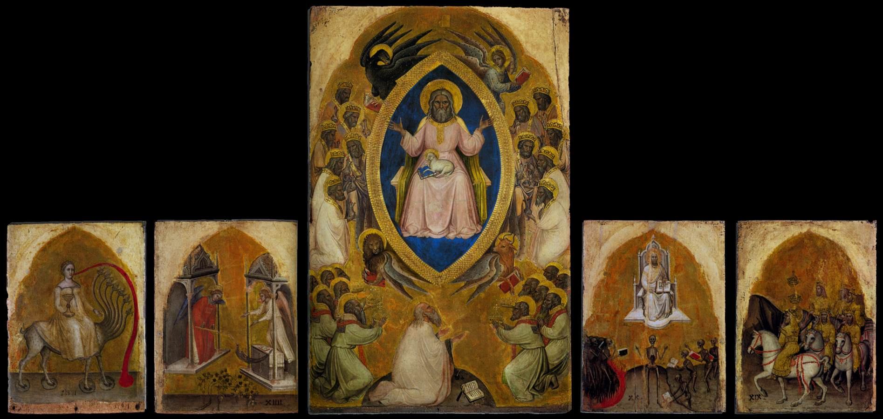
Jacobello Alberegno, Polyptych of the Apocalypse, 1360-90
Tempera on panel, 95 x 61 cm (centre), 45 x 33 cm (sides)
Gallerie dell'Accademia, Venice

Slide 12
Twenty Four Elders
“Twelve, like seven, is a number of completeness and perfection. This number in particular must not always be taken literally, the number twelve meant all Israel."
It was regarded as important that there were twelve apostles and that their number should be complete, but the lists do not quite tally as well.
The twenty‑four elders (Revelation 4.4) clearly represent all Israel and the whole church.
Notes:
The Oxford Companion to the Bible a reference work observes; “Twelve, like seven, is a number of completeness and perfection. This number in particular must not always be taken literally. Israel was comprised of more tribes than the twelve that were actually counted, and the counting of the twelve was not always uniform (Genesis 49; Joshua 13‑19; Revelation 7.7‑8), but the number twelve meant all Israel." It was regarded as important that there were twelve apostles and that their number should be complete, but the lists do not quite tally . . . . The twenty‑four elders (Revelation 4.4) clearly represent all Israel and the whole church.
Number Symbolism; Twelve, VAN DMLEN, D.H., Oxford Companion to the Bible, Oxford University Press, 1996 by Oxford University Press, Inc. New Oxford Annotated Bible, Version 2.0 for Windows.

Slide 13
Four Horsemen of the Apocalypse –
The image of the four horsemen of the Apocalypse is often used in a literary sense to indicate the possibility that very bad things may soon be expected. The four horsemen in Revelation are adapted from Zechariah 6 where patrols are sent by God to the four corners of the Earth.
In the Book of Revelation individually these horsemen represent the kinds of things Christians must endure while waiting final redemption and victory.
Notes:
Four Horsemen of the Apocalypse –
The image of the four horsemen of the Apocalypse is often used in a literary sense to indicate the possibility that very bad things may soon be expected. The four horsemen in Revelation are adapted from Zechariah 6 where patrols are sent by God to the four corners of the Earth.

Slide 14
Four Horsemen of the Apocalypse –
The passage in Zechariah 6- 6 states:
And again I looked up and saw four chariots coming out from between two mountains of bronze. 2 The first chariot had red horses, the second chariot black horses, 3 the third chariot white horses, and the fourth chariot dappled gray horses. 4 Then I said to the angel who talked with me, what are these, my lord? 5 The angel answered me, these are the four winds of heaven going out, after presenting themselves before the Lord of all the earth. 6 The chariot with the black horses goes toward the north country, the white ones go toward the west country, and the dappled ones go toward the south country. 7 When the steeds came out, they were impatient to get off and patrol the earth. And he said, Go, patrol the earth. So they patrolled the earth. 8 Then he cried out to me, Lo, those who go toward the north country have set my spirit at rest in the north country.
Notes:
Four Horsemen of the Apocalypse –
The passage in Zechariah 6- 6 states:
And again I looked up and saw four chariots coming out from between two mountains of bronze. 2 The first chariot had red horses, the second chariot black horses, 3 the third chariot white horses, and the fourth chariot dappled gray horses. 4 Then I said to the angel who talked with me, what are these, my lord? 5 The angel answered me, these are the four winds of heaven going out, after presenting themselves before the Lord of all the earth. 6 The chariot with the black horses goes toward the north country, the white ones go toward the west country, and the dappled ones go toward the south country. 7 When the steeds came out, they were impatient to get off and patrol the earth. And he said, Go, patrol the earth. So they patrolled the earth. 8 Then he cried out to me, Lo, those who go toward the north country have set my spirit at rest in the north country.

Slide 15
The White Horse
The White Horse and rider with a bow- is associated with a conquering general.
The bow is associated with an eastern empire Parthia [now Iraq]
The persecution ongoing at the time of the Book of Revelation was ordered by the Roman emperor, Domitian, he was similar to Nero the first emperor to persecute Christians. There was a rumor in those days that Nero was not in fact dead but would lead a horde back to conquer. The white horse symbol then is Nero - [read Domitian] coming to attack Christians.
Notes:
The White Horse and rider with a bow- is associated with a conquering general. The bow is associated with an eastern empire Parthia [now Iraq] the current persecution ongoing at the time of the Book of Revelation was ordered by the Roman emperor, Domitian, he was similar to Nero the first emperor to persecute Christians. There was a rumor in those days that Nero was not in fact dead but would lead a horde back to conquer. The white horse symbol then is Nero - [read Domitian] coming to attack Christians.
The Message of the Book of Revelation, Charles T. Chapman, Jr., The Liturgical Press, Collegeville, Minnesota, By the Order of St. Benedict, Inc., 1995. Page 49

Slide 16
The Red Horse
The Red Horse and the Huge Sword-
Represent a fairly straight forward symbol that represents the blood shed of war.
Notes:
The Red Horse / Huge Sword- is a fairly straight forward symbol that represents the blood shed of war. The Message of the Book of Revelation, Charles T. Chapman, Jr., The Liturgical Press, Collegeville, Minnesota, By the Order of St. Benedict, Inc., 1995. Page 50.

Slide 17
The Black Horse
The Black Horse and Scale thoughtfully not damaging oil or wine.
Represents famine and the scale represents sacristy of food. Scales concern the measuring of grains. There was in fact a famine at that time due to scarce grain. Domitian had ordered vineyards cut and grain planted but there was such uproar [apparently the thought of facing a famine in a sober state was worse than the plague itself] that the emperor reversed this order and made it unlawful to damage a vineyard.
Notes:
The Black Horse / Scale [not damaging oil or wine] - represents famine and the scale represents sacristy of food. Scales concern the measuring of grains. There was in fact a famine at that time due to scarce grain. Domitian had ordered vineyards cut and grain planted but there was such uproar [apparently the thought of facing a famine in a sober state was worse than the plague itself] that the emperor reversed this order and made it unlawful to damage a vineyard. The Message of the Book of Revelation, Charles T. Chapman, Jr., The Liturgical Press, Collegeville, Minnesota, By the Order of St. Benedict, Inc., 1995. Page 50.

Slide 18
Pale Green Horse
The color is actually “Chlorous” a pale yellow green that gave its name to Chlorox of Hades.
The horse is then a symbol of death.
Notes:
Finally, A Pale Green Horse - The color is Chlorous a pale yellow green that gave its name to Chlorox of Hades - death.
The Message of the Book of Revelation, Charles T. Chapman, Jr., The Liturgical Press, Collegeville, Minnesota, By the Order of St. Benedict, Inc., 1995. Page 50.
The Message of the Book of Revelation, Charles T. Chapman, Jr., The Liturgical Press, Collegeville, Minnesota, By the Order of St. Benedict, Inc., 1995. Page 50

Slide 19
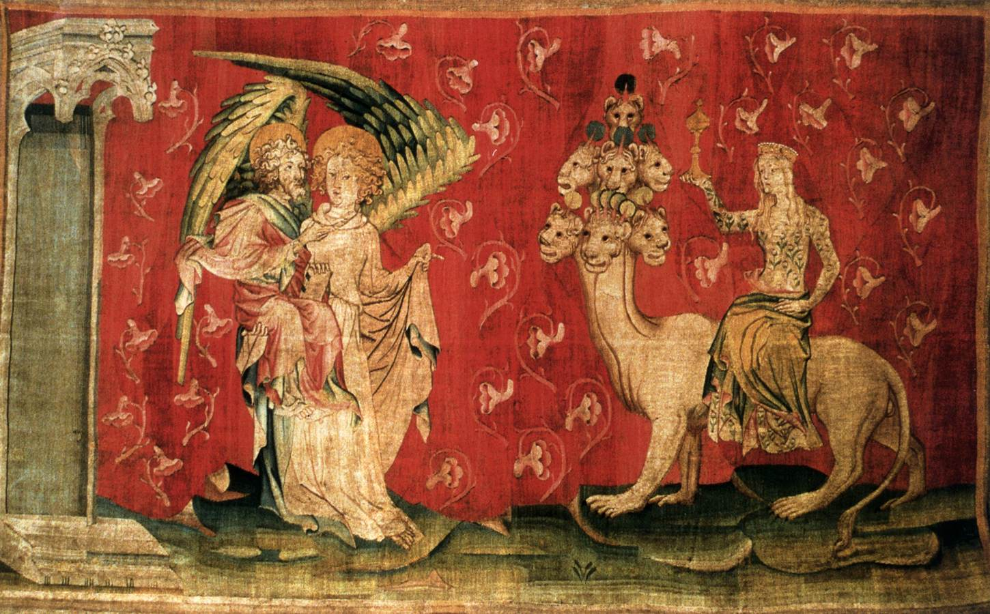
Nicolas Bataille, The Harlot Seated on the Beast, 1375-79
Tapestry, 400 x 1800 cm
Musée des Tapisseries, Angers

Slide 20
Mark of the Beast/666
This theme includes both the beast and the mark itself and which appears in several places in The Book of Revelation.
The number 666 is itself revealed in Revelation 13, followed in Chapters 14 and 16 with general descriptions of the beast and mark.
Revelation Chapter 19 depicts in gory detail the defeat of the beast by the one with a sword from his mouth a reference to an earlier description of Christ.
Revelation Chapter 20 refers again to those marked by the beast.
Notes:
Mark of the Beast -
This is a theme, which includes both the beast and the mark itself and which appears in several places in The Book of Revelation. The number 666 is itself revealed in Revelation 13, followed in Chapters 14 and 16 with general descriptions of the beast and mark. Revelation Chapter 19 depicts in gory detail the defeat of the beast by the one with a sword from his mouth a reference to an earlier description of Christ. Revelation Chapter 20 refers again to those marked by the beast. In the “Oxford Dictionary of The Christian Church,” Second Edition Revised, Oxford University Press, 1983, the significance of the number or mark is laid out with regard to the early Church: “Its hostility to Rome is such that it must have been after one of the persecutions such as Nero in AD 64 and the number of the beast is interpreted to mean Nero Caesar, however, the Neronian persecution is not believed to have affected Asia Minor, and that means a later Emperor such as Domitian, - the number then may refer to him as the second Nero, who was widely regarded as still alive [after his suicide] and that he was planning a return at the head of barbaric hordes.” In the numbering system then in use which used letters instead of number the sum of the letters in Nero’s name was 666.” Also, remember that seven is the perfect number from a Scriptural stand point. The number Six is not seven, it is less than seven. Thus in context it does not appear that this mark really is a dark reference to credit cards or social security numbers, as some have proposed. It seems more likely to be a prediction of the defeat of the Roman Empire and the fate of those seduced to the side of that government and against Christians. The most powerful thing about this is that however farfetched that prediction was when made in the first century, it had largely come true by the third century.
Revelation 13:11 Then I saw another beast that rose out of the earth; it had two horns like a lamb and it spoke like a dragon. 12 It exercises all the authority of the first beast on its behalf, and it makes the earth and its inhabitants worship the first beast, whose mortal wound  had been healed. 13 It performs great signs, even making fire come down from heaven to earth in the sight of all; 14 and by the signs that it is allowed to perform on behalf of the beast, it deceives the inhabitants of earth, telling them to make an image for the beast that had been wounded by the sword and yet lived; 15 and it was allowed to give breath to the image of the beast so that the image of the beast could even speak and cause those who would not worship the image of the beast to be killed. 16 Also it causes all, both small and great, both rich and poor, both free and slave, to be marked on the right hand or the forehead, 17 so that no one can buy or sell who does not have the mark, that is, the name of the beast or the number of its name. 18 This calls for wisdom: let anyone with understanding calculate the number of the beast, for it is the number of a person. Its number is six hundred sixty-six.
Revelation 14: 8 Then another angel, a second, followed, saying, Fallen, fallen is Babylon the great! She has made all nations drink of the wine of the wrath of her fornication. 9 Then another angel, a third, followed them, crying with a loud voice, Those who worship the beast and its image, and receive a mark on their foreheads or on their hands, 10 they will also drink the wine of Gods wrath, poured unmixed into the cup of his anger, and they will be tormented with fire and sulfur in the presence of the holy angels and in the presence of the Lamb. 11 And the smoke of their torment goes up forever and ever. There is no rest day or night for those who worship the beast and its image and for anyone who receives the mark of its name. 12 Here is a call for the endurance of the saints, those who keep the commandments of God and hold fast to the faith of Jesus.
Revelation 16: 2 So the first angel went and poured his bowl on the earth, and a foul and painful sore came on those who had the mark of the beast and who worshiped its image.
Revelation 19. The Beast and Its Armies Defeated 17 Then I saw an angel standing in the sun, and with a loud voice he called to all the birds that fly in midheaven, Come, gather for the great supper of God, 18 to eat the flesh of kings, the flesh of captains, the flesh of the mighty, the flesh of horses and their riders flesh of all, both free and slave, both small and great. 19 Then I saw the beast and the kings of the earth with their armies gathered to make war against the rider on the horse and against his army. 20 And the beast was captured, and with it the false prophet who had performed in its presence the signs by which he deceived those who had received the mark of the beast and those who worshiped its image. These two were thrown alive into the lake of fire that burns with sulfur. 21 And the rest were killed by the sword of the rider on the horse, the sword that came from his mouth; and all the birds were gorged with their flesh.
Revelation 20: 4 Then I saw thrones, and those seated on them were given authority to judge. I also saw the souls of those who had been beheaded for their testimony to Jesus and for the word of God. They had not worshiped the beast or its image and had not received its mark on their foreheads or their hands.
This was certainly even more incredible then than the predictions of either credit cards or social security numbers.

Slide 21
666 Oxford Dictionary of The Christian Church
Referring to the early Church: “Its hostility to Rome is such that it must have been after one of the persecutions such as Nero in AD 64 and the number of the beast is interpreted to mean Nero Caesar.
However, the Neronian persecution is not believed to have affected Asia Minor, and that means a later Emperor such as Domitian, - the number then may refer to him as the second Nero, who was widely regarded as still alive [after his suicide].
Notes:
Mark of the Beast -
This is a theme, which includes both the beast and the mark itself and which appears in several places in The Book of Revelation. The number 666 is itself revealed in Revelation 13, followed in Chapters 14 and 16 with general descriptions of the beast and mark. Revelation Chapter 19 depicts in gory detail the defeat of the beast by the one with a sword from his mouth a reference to an earlier description of Christ. Revelation Chapter 20 refers again to those marked by the beast. In the “Oxford Dictionary of The Christian Church,” Second Edition Revised, Oxford University Press, 1983, the significance of the number or mark is laid out with regard to the early Church: “Its hostility to Rome is such that it must have been after one of the persecutions such as Nero in AD 64 and the number of the beast is interpreted to mean Nero Caesar, however, the Neronian persecution is not believed to have affected Asia Minor, and that means a later Emperor such as Domitian, - the number then may refer to him as the second Nero, who was widely regarded as still alive [after his suicide] and that he was planning a return at the head of barbaric hordes.” In the numbering system then in use which used letters instead of number the sum of the letters in Nero’s name was 666.” Also, remember that seven is the perfect number from a Scriptural stand point. The number Six is not seven, it is less than seven. Thus in context it does not appear that this mark really is a dark reference to credit cards or social security numbers, as some have proposed. It seems more likely to be a prediction of the defeat of the Roman Empire and the fate of those seduced to the side of that government and against Christians. The most powerful thing about this is that however farfetched that prediction was when made in the first century, it had largely come true by the third century.
Revelation 13:11 Then I saw another beast that rose out of the earth; it had two horns like a lamb and it spoke like a dragon. 12 It exercises all the authority of the first beast on its behalf, and it makes the earth and its inhabitants worship the first beast, whose mortal wound  had been healed. 13 It performs great signs, even making fire come down from heaven to earth in the sight of all; 14 and by the signs that it is allowed to perform on behalf of the beast, it deceives the inhabitants of earth, telling them to make an image for the beast that had been wounded by the sword and yet lived; 15 and it was allowed to give breath to the image of the beast so that the image of the beast could even speak and cause those who would not worship the image of the beast to be killed. 16 Also it causes all, both small and great, both rich and poor, both free and slave, to be marked on the right hand or the forehead, 17 so that no one can buy or sell who does not have the mark, that is, the name of the beast or the number of its name. 18 This calls for wisdom: let anyone with understanding calculate the number of the beast, for it is the number of a person. Its number is six hundred sixty-six.
Revelation 14: 8 Then another angel, a second, followed, saying, Fallen, fallen is Babylon the great! She has made all nations drink of the wine of the wrath of her fornication. 9 Then another angel, a third, followed them, crying with a loud voice, Those who worship the beast and its image, and receive a mark on their foreheads or on their hands, 10 they will also drink the wine of Gods wrath, poured unmixed into the cup of his anger, and they will be tormented with fire and sulfur in the presence of the holy angels and in the presence of the Lamb. 11 And the smoke of their torment goes up forever and ever. There is no rest day or night for those who worship the beast and its image and for anyone who receives the mark of its name. 12 Here is a call for the endurance of the saints, those who keep the commandments of God and hold fast to the faith of Jesus.
Revelation 16: 2 So the first angel went and poured his bowl on the earth, and a foul and painful sore came on those who had the mark of the beast and who worshiped its image.
Revelation 19. The Beast and Its Armies Defeated 17 Then I saw an angel standing in the sun, and with a loud voice he called to all the birds that fly in midheaven, Come, gather for the great supper of God, 18 to eat the flesh of kings, the flesh of captains, the flesh of the mighty, the flesh of horses and their riders flesh of all, both free and slave, both small and great. 19 Then I saw the beast and the kings of the earth with their armies gathered to make war against the rider on the horse and against his army. 20 And the beast was captured, and with it the false prophet who had performed in its presence the signs by which he deceived those who had received the mark of the beast and those who worshiped its image. These two were thrown alive into the lake of fire that burns with sulfur. 21 And the rest were killed by the sword of the rider on the horse, the sword that came from his mouth; and all the birds were gorged with their flesh.
Revelation 20: 4 Then I saw thrones, and those seated on them were given authority to judge. I also saw the souls of those who had been beheaded for their testimony to Jesus and for the word of God. They had not worshiped the beast or its image and had not received its mark on their foreheads or their hands.
This was certainly even more incredible then than the predictions of either credit cards or social security numbers.

Slide 22
666 Oxford Dictionary of The Christian Church
It was further thought that Nero was planning a return at the head of barbaric hordes.” In the numbering system then in use which used letters instead of number the sum of the letters in Nero’s name was 666.”
Also, remember that seven is the perfect number from a Scriptural stand point. The number Six is not seven, it is less than seven. Thus in context it does not appear that this mark really is a dark reference to credit cards or social security numbers, as some have proposed.
Notes:
Mark of the Beast -
This is a theme, which includes both the beast and the mark itself and which appears in several places in The Book of Revelation. The number 666 is itself revealed in Revelation 13, followed in Chapters 14 and 16 with general descriptions of the beast and mark. Revelation Chapter 19 depicts in gory detail the defeat of the beast by the one with a sword from his mouth a reference to an earlier description of Christ. Revelation Chapter 20 refers again to those marked by the beast. In the “Oxford Dictionary of The Christian Church,” Second Edition Revised, Oxford University Press, 1983, the significance of the number or mark is laid out with regard to the early Church: “Its hostility to Rome is such that it must have been after one of the persecutions such as Nero in AD 64 and the number of the beast is interpreted to mean Nero Caesar, however, the Neronian persecution is not believed to have affected Asia Minor, and that means a later Emperor such as Domitian, - the number then may refer to him as the second Nero, who was widely regarded as still alive [after his suicide] and that he was planning a return at the head of barbaric hordes.” In the numbering system then in use which used letters instead of number the sum of the letters in Nero’s name was 666.” Also, remember that seven is the perfect number from a Scriptural stand point. The number Six is not seven, it is less than seven. Thus in context it does not appear that this mark really is a dark reference to credit cards or social security numbers, as some have proposed. It seems more likely to be a prediction of the defeat of the Roman Empire and the fate of those seduced to the side of that government and against Christians. The most powerful thing about this is that however farfetched that prediction was when made in the first century, it had largely come true by the third century.
Revelation 13:11 Then I saw another beast that rose out of the earth; it had two horns like a lamb and it spoke like a dragon. 12 It exercises all the authority of the first beast on its behalf, and it makes the earth and its inhabitants worship the first beast, whose mortal wound  had been healed. 13 It performs great signs, even making fire come down from heaven to earth in the sight of all; 14 and by the signs that it is allowed to perform on behalf of the beast, it deceives the inhabitants of earth, telling them to make an image for the beast that had been wounded by the sword and yet lived; 15 and it was allowed to give breath to the image of the beast so that the image of the beast could even speak and cause those who would not worship the image of the beast to be killed. 16 Also it causes all, both small and great, both rich and poor, both free and slave, to be marked on the right hand or the forehead, 17 so that no one can buy or sell who does not have the mark, that is, the name of the beast or the number of its name. 18 This calls for wisdom: let anyone with understanding calculate the number of the beast, for it is the number of a person. Its number is six hundred sixty-six.
Revelation 14: 8 Then another angel, a second, followed, saying, Fallen, fallen is Babylon the great! She has made all nations drink of the wine of the wrath of her fornication. 9 Then another angel, a third, followed them, crying with a loud voice, Those who worship the beast and its image, and receive a mark on their foreheads or on their hands, 10 they will also drink the wine of Gods wrath, poured unmixed into the cup of his anger, and they will be tormented with fire and sulfur in the presence of the holy angels and in the presence of the Lamb. 11 And the smoke of their torment goes up forever and ever. There is no rest day or night for those who worship the beast and its image and for anyone who receives the mark of its name. 12 Here is a call for the endurance of the saints, those who keep the commandments of God and hold fast to the faith of Jesus.
Revelation 16: 2 So the first angel went and poured his bowl on the earth, and a foul and painful sore came on those who had the mark of the beast and who worshiped its image.
Revelation 19. The Beast and Its Armies Defeated 17 Then I saw an angel standing in the sun, and with a loud voice he called to all the birds that fly in midheaven, Come, gather for the great supper of God, 18 to eat the flesh of kings, the flesh of captains, the flesh of the mighty, the flesh of horses and their riders flesh of all, both free and slave, both small and great. 19 Then I saw the beast and the kings of the earth with their armies gathered to make war against the rider on the horse and against his army. 20 And the beast was captured, and with it the false prophet who had performed in its presence the signs by which he deceived those who had received the mark of the beast and those who worshiped its image. These two were thrown alive into the lake of fire that burns with sulfur. 21 And the rest were killed by the sword of the rider on the horse, the sword that came from his mouth; and all the birds were gorged with their flesh.
Revelation 20: 4 Then I saw thrones, and those seated on them were given authority to judge. I also saw the souls of those who had been beheaded for their testimony to Jesus and for the word of God. They had not worshiped the beast or its image and had not received its mark on their foreheads or their hands.
This was certainly even more incredible then than the predictions of either credit cards or social security numbers.

Slide 23
666 Oxford Dictionary of The Christian Church
It seems more likely to be a prediction of the defeat of the Roman Empire and the fate of those seduced to the side of that government and against Christians.
The most powerful thing about this is that however farfetched that prediction was when made in the first century, it had largely come true by the third century.
Notes:
Mark of the Beast -
This is a theme, which includes both the beast and the mark itself and which appears in several places in The Book of Revelation. The number 666 is itself revealed in Revelation 13, followed in Chapters 14 and 16 with general descriptions of the beast and mark. Revelation Chapter 19 depicts in gory detail the defeat of the beast by the one with a sword from his mouth a reference to an earlier description of Christ. Revelation Chapter 20 refers again to those marked by the beast. In the “Oxford Dictionary of The Christian Church,” Second Edition Revised, Oxford University Press, 1983, the significance of the number or mark is laid out with regard to the early Church: “Its hostility to Rome is such that it must have been after one of the persecutions such as Nero in AD 64 and the number of the beast is interpreted to mean Nero Caesar, however, the Neronian persecution is not believed to have affected Asia Minor, and that means a later Emperor such as Domitian, - the number then may refer to him as the second Nero, who was widely regarded as still alive [after his suicide] and that he was planning a return at the head of barbaric hordes.” In the numbering system then in use which used letters instead of number the sum of the letters in Nero’s name was 666.” Also, remember that seven is the perfect number from a Scriptural stand point. The number Six is not seven, it is less than seven. Thus in context it does not appear that this mark really is a dark reference to credit cards or social security numbers, as some have proposed. It seems more likely to be a prediction of the defeat of the Roman Empire and the fate of those seduced to the side of that government and against Christians. The most powerful thing about this is that however farfetched that prediction was when made in the first century, it had largely come true by the third century.
Revelation 13:11 Then I saw another beast that rose out of the earth; it had two horns like a lamb and it spoke like a dragon. 12 It exercises all the authority of the first beast on its behalf, and it makes the earth and its inhabitants worship the first beast, whose mortal wound  had been healed. 13 It performs great signs, even making fire come down from heaven to earth in the sight of all; 14 and by the signs that it is allowed to perform on behalf of the beast, it deceives the inhabitants of earth, telling them to make an image for the beast that had been wounded by the sword and yet lived; 15 and it was allowed to give breath to the image of the beast so that the image of the beast could even speak and cause those who would not worship the image of the beast to be killed. 16 Also it causes all, both small and great, both rich and poor, both free and slave, to be marked on the right hand or the forehead, 17 so that no one can buy or sell who does not have the mark, that is, the name of the beast or the number of its name. 18 This calls for wisdom: let anyone with understanding calculate the number of the beast, for it is the number of a person. Its number is six hundred sixty-six.
Revelation 14: 8 Then another angel, a second, followed, saying, Fallen, fallen is Babylon the great! She has made all nations drink of the wine of the wrath of her fornication. 9 Then another angel, a third, followed them, crying with a loud voice, Those who worship the beast and its image, and receive a mark on their foreheads or on their hands, 10 they will also drink the wine of Gods wrath, poured unmixed into the cup of his anger, and they will be tormented with fire and sulfur in the presence of the holy angels and in the presence of the Lamb. 11 And the smoke of their torment goes up forever and ever. There is no rest day or night for those who worship the beast and its image and for anyone who receives the mark of its name. 12 Here is a call for the endurance of the saints, those who keep the commandments of God and hold fast to the faith of Jesus.
Revelation 16: 2 So the first angel went and poured his bowl on the earth, and a foul and painful sore came on those who had the mark of the beast and who worshiped its image.
Revelation 19. The Beast and Its Armies Defeated 17 Then I saw an angel standing in the sun, and with a loud voice he called to all the birds that fly in midheaven, Come, gather for the great supper of God, 18 to eat the flesh of kings, the flesh of captains, the flesh of the mighty, the flesh of horses and their riders flesh of all, both free and slave, both small and great. 19 Then I saw the beast and the kings of the earth with their armies gathered to make war against the rider on the horse and against his army. 20 And the beast was captured, and with it the false prophet who had performed in its presence the signs by which he deceived those who had received the mark of the beast and those who worshiped its image. These two were thrown alive into the lake of fire that burns with sulfur. 21 And the rest were killed by the sword of the rider on the horse, the sword that came from his mouth; and all the birds were gorged with their flesh.
Revelation 20: 4 Then I saw thrones, and those seated on them were given authority to judge. I also saw the souls of those who had been beheaded for their testimony to Jesus and for the word of God. They had not worshiped the beast or its image and had not received its mark on their foreheads or their hands.
This was certainly even more incredible then than the predictions of either credit cards or social security numbers.

Slide 24
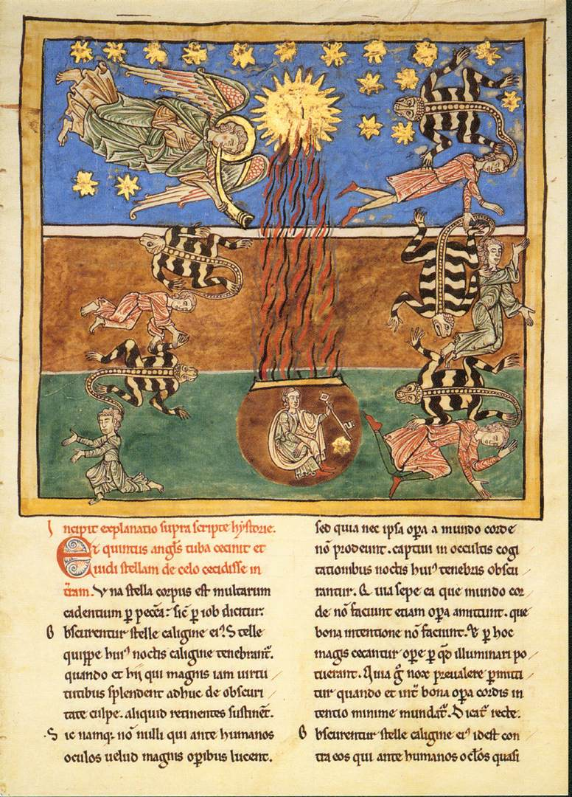
Spanish Miniaturist,
Locusts Come upon the Earth c. 1180
Tempera, gold, and ink on parchment, 445 x 300 mm
Metropolitan Museum of Art, New York

Slide 25
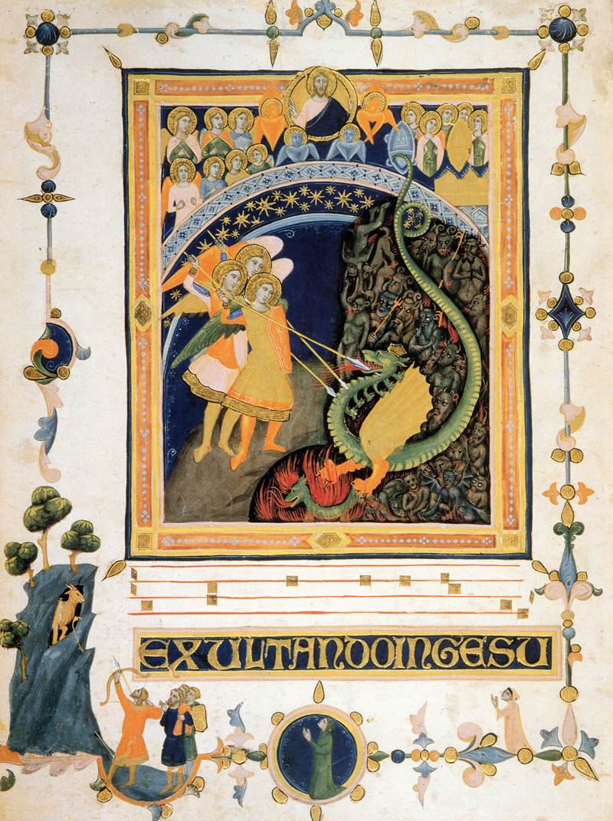
Pacino di Bonaguida, Laudario of the Compagnia di Sant'Agnese, 1320s
Tempera and gold on parchment, 438 x 322 mm
British Library, London
The hymn of praise to St Michael, "Exultando in Gesu" (Rejoicing in Christ), is spelled out in gilt capitals across the bottom of the leaf.

Slide 26
666 Happy?
As with all things Biblical, once you have something worked out, you will find an exception.
The Number 666 has at least one happy or at any rate pleasant mention in the Old Testament.
In the historical book called 1 Kings, the reigns of King David and his son King Solomon are described in great detail. This period was the heroic age of ancient Israel when blessed Kings ruled a nation that included the entire Promised Land in a time of great prosperity. In the section relating the glories of Solomon the text notes “1 Kings 10: 14: The weight of gold that came to Solomon in one year was six hundred sixty-six talents of gold.”
Notes:
Finally as with all things Biblical, once you have something worked out, you will find an exception. The Number 666 has a rather bad reputation. The number however has at least one happy or at any rate pleasant mention in the Old Testament. In the historical book called 1 Kings, the reigns of King David and his son King Solomon are described in great detail. This period was the heroic age of ancient Israel when blessed Kings ruled a nation that included the entire Promised Land in a time of great prosperity. In the section relating the glories of Solomon the text notes “1 Kings 10: 14: The weight of gold that came to Solomon in one year was six hundred sixty-six talents of gold.”

Slide 27
The Number Seven
Seven occurs throughout Revelation and in a very great number of contexts.
  Seven churches, lamp stands and innumerable other references are made to this number.
The number seven also appears throughout the Old and New Testaments and our culture as well.
  Seven deadly sins and seven gifts of the Spirit
Notes:
The Number Seven.
The use of the number seven occurs throughout Revelation and in a very great number of contexts. Seven churches, lamp stands and innumerable other references are made to this number. The number seven also appears throughout the Old and New Testaments and our culture as well. There are the famous seven deadly sins or seven gifts of the Spirit. One reference from early in the visions concerns the Seventh Seal, which only Christ could open. “The Seventh Seal, the last seal is broken and there is two hours of silence in heaven - perhaps so that the prayers of those yet on earth can be heard. This is the final act before the trumpets are sounded which were a herald of the coming judgment of God. The Message of the Book of Revelation, Charles T. Chapman, Jr., The Liturgical Press, Collegeville, Minnesota, By the Order of St. Benedict, Inc., 1995. Page 59 and 60. – Which also notes that a roman will was sealed with seven seals and not broken until death and the legacies were read.

Slide 28
Seventh Seal
  Only Christ could open.
  The “The Seventh Seal, the last seal is broken and there is two hours of silence in heaven - perhaps so that the prayers of those yet on earth can be heard.
  This is the final act before the trumpets are sounded which were a herald of the coming judgment of God.

Slide 29
Still more Sevens
Seven seals, trumpets, and bowls all represent the completion of God's plan.
The seven spirits of God represent either the seven archangels, or all spirits.
Seven churches represent the universal church
Forgive - not just seven times, but seventy times seven times.
The monster Leviathan had seven heads.
The slain Lamb has seven horns and seven eyes
The Antichrist has seven heads
Notes:
Revelation the seventh seal, trumpet, bowl, etc., represent the completion of God's plan. The seven spirits of God (Revelation 1.4) represent either the seven archangels, or all spirits," or the Holy Spirit. Seven churches represent the universal church (Revelation 1.20). It is necessary to forgive, not just seven times, but seventy times seven times (Matthew 18.21-22; cf. Genesis 4.24), that is to say, always. Outside Israel seven was also known as a significant number and the monster Leviathan had seven heads. Later interpreters noted that the Hebrew Bible refers to God by seven different names: Later Christian tradition noted that the Gospels report seven last words or keys of Jesus in all.”
Also See Symbolism and Interpretation, John Sweet, Oxford Companion to the Bible, Oxford University Press, 1996 by Oxford University Press, Inc. New Oxford Annotated Bible, Version 2.0 for Windows There are seven planets, days of the week, colors of the rainbow. These are numbers of wholeness. The slain Lamb has seven horns and seven eyes (Revelation 5.6); the slain beast, the Antichrist that parodies his death and resurrection, has seven heads (Revelation 13.1; Revelation 13.3; Revelation 13.14)
VAN DMLEN , David H., Number Symbolism, Seven, The Oxford Companion to the Bible, Oxford University Press, 1996

Slide 30
Seven Means Completeness and Perfection
Oxford Companion to the Bible:
“Seven, the sum of three plus four, of heaven and earth, signifies completeness and perfection. There were seven chief heavenly bodies (sun, moon, and the five planets known to the ancients), seven days of the week, seven archangels. The great festivals lasted seven days, and there were seven weeks between the Passover and the feast of weeks (Pentecost). Every seventh year was a Sabbath year, when the land would rest and lay fallow, and Hebrew slaves were allowed to go free.. . .”
Notes:
Numbers were important ancient symbols and seven is certainly a central one. A number of the references to the number seven are noted in the Oxford Companion to the Bible: “Seven, the sum of three plus four, of heaven and earth, signifies completeness and perfection. There were seven chief heavenly bodies (sun, moon, and the five planets known to the ancients), seven days of the week, seven archangels. The great festivals lasted seven days, and there were seven weeks between the Passover and the feast of weeks (Pentecost). Every seventh year was a Sabbath year, when the land would rest and lay fallow, and Hebrew slaves were allowed to go free; and every fiftieth year was a jubilee, when alienated property had to be returned in Jubilee" from the rams horn that heralded its beginning).

Slide 31
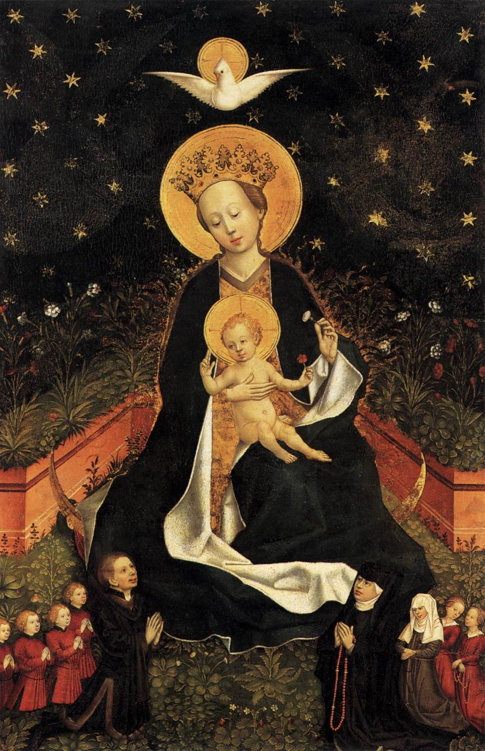
Unknown German Master, Madonna on a Crescent Moon in Hortus Conclusus
1450s
Oak, 95 x 62 cm
Staatliche Museen, Berlin
This image represents an unusual combination of the Woman of the Apocalypse and a Madonna of Humility. The Madonna is shown seated in an enclosed garden, with male and female donors in suitably humble small scale.

Slide 32
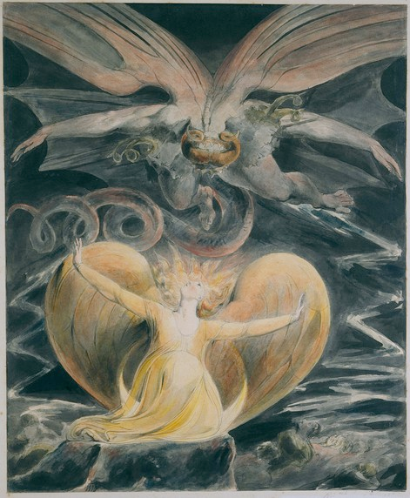
William Blake,
The Great Red Dragon and the Woman Clothed with the Sun: "The Devil is Come Down"
(Based on Revelation 12:12-17)
No sooner she had spoke but Rahab Babylon appeared
Eastward upon the Paved work across Europe & Asia
Glorious as the midday Sun in Satans bosom glowing:
A Female hidden in a Male, Religion hidden in War
Namd Moral Virtue: cruel two-fold Monster shining bright
A Dragon red & hidden Harlot which John in Patmos saw
(Milton a Poem, c. 1811)

Slide 33
Woman Clothed with the Sun and on the Moon.
Chapter 12 describes a woman clothed with the sun, with the moon under her feet, and on her head a crown of twelve stars. She was pregnant and was crying out in birth pangs, in the agony of giving birth.
The next action step is a dragon, poised to devour the child.
Oxford Annotated Bible have this to say: The vision of the woman, the child, and the dragon portrays the conflict between Christ and Satan.
The woman appears to be the heavenly representative of God's people, first as Israel then as the Christian Church.
The woman portrayed in one place as a virgin, in another as a wife and in still another as a mother and all stand for God’s people.
Notes:
Woman Clothed with the Sun and on the Moon.
In this regard Revelation at Chapter 12 describes a woman, a great portent appeared in heaven: a woman clothed with the sun, with the moon under her feet, and on her head a crown of twelve stars. 2 She was pregnant and was crying out in birth pangs, in the agony of giving birth. The next action step is a dragon, poised to devour the child. But, who or what is the woman. The foot notes to the Oxford Annotated Bible have this to say: The vision of the woman, the child, and the dragon portrays the conflict between Christ and Satan. 1: The woman appears to be the heavenly representative of God's people, first as Israel (from whom Jesus the Messiah was born, Revelation 12.5), then as the Christian Church. The symbolism in Revelation, which should be obvious at this point, offers a changing face. A woman portrayed in one place as a virgin, in another as a wife and in still another as a mother, can all stand for God’s people. It is possible that the woman stands for Israel, and the turmoil produced by the early Christian movement. If this is so, this would certainly be a sympathetic symbol, especially given the strident reaction of the Jewish authorities as related in Acts. Perhaps by the time Revelation was written the Roman authorities were a greater threat.
The New Oxford Annotated Bible, 1996 by Oxford University Press, Inc. New Oxford Annotated Bible, Version 2.0 for Windows, Revelation Footnote 12.1-17 The vision of the woman, the child, and the dragon portrays the conflict between Christ and Satan. 1: The woman appears to be the heavenly representative of God's people, first as Israel (from whom Jesus the Messiah was born, Revelation 12.5), then as the Christian Church (which is persecuted by the dragon, Revelation 12.13). 3: Dragon, identified in Revelation 12.9 as the Devil or Satan. His enormous size and power are suggested in Revelation 12.4. 5: Psalm 2.9 identifies the child to be the Davidic Messiah. 6: The church is sustained by God.
Symbolism and Interpretation, John Sweet, Oxford Companion to the Bible, Oxford University Press, 1996 by Oxford University Press, Inc. New Oxford Annotated Bible, Version 2.0 for Windows Symbolism and Interpretation. The symbolism of Revelation is kaleidoscopic and multivalent. One picture melts into another. Gods people can appear as a woman (who can be virgin, wife, or mother) or a city, and the great city where the two witnesses are killed is spiritually called Sodom and Egypt, where also their Lord was crucified (Revelation 11.8)

Slide 34
Dragons
Dragon is a reptilian monster appearing in the mythology and iconography of the ancient near east.
In the OT the dragon appears as the prime evil enemy of God rejected in creation Psalm 74:13-14 and Isaiah 51:9 that will appear at the end to be finally dispatched.
In Revelation this theme is continued only now it is identified with the Satan.
Names:
  Tannin, and Leviathan – also used for monsters of the deep sea. Gen 1:21 and Psalm 104:26.
  Rahab - also sometimes called Egypt in the context of enemy of God’s people Isaiah 30:7; Ezek 29:3
Current Location: Under watch prostrate beneath God Job 9:13
Notes:
Harper Collins Bible Dictionary ed 1996 Page 246 ‘dragon’
Ezek 29:3
Proclamation against Egypt
29 In the tenth year, in the tenth month, on the twelfth day of the month, the word of the Lord came to me: 2 Mortal, set your face against Pharaoh king of Egypt, and prophesy against him and against all Egypt; 3 speak, and say, Thus says the Lord God:
I am against you,
Pharaoh king of Egypt,
the great dragon sprawling
in the midst of its channels,
saying, “My Nile is my own;
I made it for myself.”
4 I will put hooks in your jaws,
and make the fish of your channels stick to your scales.
I will draw you up from your channels,
with all the fish of your channels
sticking to your scales.
5 I will fling you into the wilderness,
you and all the fish of your channels;
you shall fall in the open field,
and not be gathered and buried.
To the animals of the earth and to the birds of the air
I have given you as food.
6 Then all the inhabitants of Egypt shall know
that I am the Lord
because you † were a staff of reed
to the house of Israel;
7 when they grasped you with the hand, you broke,
and tore all their shoulders;
and when they leaned on you, you broke,
and made all their legs unsteady. †
8 Therefore, thus says the Lord God: I will bring a sword upon you, and will cut off from you human being and animal; 9 and the land of Egypt shall be a desolation and a waste. Then they shall know that I am the Lord.
Because you † said, “The Nile is mine, and I made it,” 10 therefore, I am against you, and against your channels, and I will make the land of Egypt an utter waste and desolation, from Migdol to Syene, as far as the border of Ethiopia. † 11 No human foot shall pass through it, and no animal foot shall pass through it; it shall be uninhabited forty years. 12 I will make the land of Egypt a desolation among desolated countries; and her cities shall be a desolation forty years among cities that are laid waste. I will scatter the Egyptians among the nations, and disperse them among the countries.
13 Further, thus says the Lord God: At the end of forty years I will gather the Egyptians from the peoples among whom they were scattered; 14 and I will restore the fortunes of Egypt, and bring them back to the land of Pathros, the land of their origin; and there they shall be a lowly kingdom. 15 It shall be the most lowly of the kingdoms, and never again exalt itself above the nations; and I will make them so small that they will never again rule over the nations. 16 The Egyptians † shall never again be the reliance of the house of Israel; they will recall their iniquity, when they turned to them for aid. Then they shall know that I am the Lord God.
Job 9: 13
Job Replies: There Is No Mediator
9 Then Job answered:
2 “Indeed I know that this is so;
but how can a mortal be just before God?
3 If one wished to contend with him,
one could not answer him once in a thousand.
4 He is wise in heart, and mighty in strength
—who has resisted him, and succeeded?—
5 he who removes mountains, and they do not know it,
when he overturns them in his anger;
6 who shakes the earth out of its place,
and its pillars tremble;
7 who commands the sun, and it does not rise;
who seals up the stars;
8 who alone stretched out the heavens
and trampled the waves of the Sea; †
9 who made the Bear and Orion,
the Pleiades and the chambers of the south;
10 who does great things beyond understanding,
and marvelous things without number.
11 Look, he passes by me, and I do not see him;
he moves on, but I do not perceive him.
12 He snatches away; who can stop him?
Who will say to him, ‘What are you doing?’
13 “God will not turn back his anger;
the helpers of Rahab bowed beneath him.
Job 26
Job Replies: God’s Majesty Is Unsearchable
26 Then Job answered:
2 “How you have helped one who has no power!
How you have assisted the arm that has no strength!
3 How you have counseled one who has no wisdom,
and given much good advice!
4 With whose help have you uttered words,
and whose spirit has come forth from you?
5 The shades below tremble,
the waters and their inhabitants.
6 Sheol is naked before God,
and Abaddon has no covering.
7 He stretches out Zaphon † over the void,
and hangs the earth upon nothing.
8 He binds up the waters in his thick clouds,
and the cloud is not torn open by them.
9 He covers the face of the full moon,
and spreads over it his cloud.
10 He has described a circle on the face of the waters,
at the boundary between light and darkness.
11 The pillars of heaven tremble,
and are astounded at his rebuke.
12 By his power he stilled the Sea;
by his understanding he struck down Rahab.
13 By his wind the heavens were made fair;
his hand pierced the fleeing serpent.

Slide 35
Frans Floris, The Fall of the Rebellious Angels, 1554
Oil on panel, 308 x 220 cm
Koninklijk Museum voor Schone Kunsten, Antwerp
The Fall of the Rebellious Angels was the middle panel of a triptych that decorated the altar at the Fencers' guild in the Onze-Lieve-Vrouwekerk in Antwerp (the Church of Our Lady). In the iconoclastic fury of 1566 the triptych was severely damaged and lost both of its side panels.
The scene represented in the painting stems from Revelation 12. Michael, the patron saint of the Fencers' guild, is fighting the dragon with seven heads, and the devils. The archangel and his helpers are attacking using the fencers' weapons, while the devils are defending themselves with knives, axes, pikes, bows and arrows and torches.

Slide 36
