Slide 1
THE BOOK OF REVELATION
FOR THE MODERN READER
Lesson five
Notes:
THE BOOK OF REVELATION
FOR THE MODERN READER
In Five Lessons
First
This is intended as a five lesson course on the book of the New Testament commonly known as The Book of Revelation. The first lesson deals with the introduction to the concepts, origins and history of the text itself. The following three lessons, two, three and four, deal with the text itself. The intention is that this study be undertaken along with your reading of the text, starting after you have finished this first lesson. In this way, you will be able to encounter these scriptures directly. These as with all parts of the Bible, can be read for textual study and as an aid in life. The textual study will bring understanding and one hopes enlightenment. When read with a life challenge in mind, one will discover in scriptural texts, new meaning, that will help in dealing with the challenge at hand. This final section of the New Testament, above all others was written to those facing great and often fatal challenges in life.

Slide 2
The Revelation to John
The Official Name from the Oxford Annotated Introduction

Slide 3
Lesson FIVE
  5. Relevance to Modern Life
Notes:
1. concepts, origins and history of the text itself.
2. Out Line Organization Seven Letters
3. Outline of the Visions
4. Memorable images
5. Relevance to Modern Life

Slide 4
Relevance to the 21st Century
What does this book have to say to us today in 21st Century America?
The situations which the author of Revelation specifically addressed have long since ended.
At the time the Council of Nicea in 325, those situations had already largely been resolved.
Remember the most improbable victory in history had already occurred.
Christianity a tiny sect in a forgotten corner of the Roman Empire had made Rome a Christian empire.
So what does it have to say to us?
Notes:
The question is what does this book have to say to us today in 21st Century America? The situations which the author of Revelation specifically addressed have long since ended. At the time the book was finally placed in the Cannon Scripture in the Council of Nicea in 325, those situations had already largely been resolved. Remember, what must be the most improbable victory in history had already occurred. Christianity a tiny sect in a forgotten corner of the Roman Empire, had grown at a phenomenal rate despite harsh persecutions. Rome, the consistent villain of Revelation, had itself converted and become a Christian empire. This is simply the date the entire Cannon was finalized in 325 AD. While there was not apparently an official list until the time of the Reformation, after 325 AD there was a general acknowledgment of the list.
John wrote to illuminate his own situation. Later, when his specific circumstances were forgotten, some took Revelation as a literal prediction of the future; others, in reaction against crude literalism, especially with regard to the millennium, interpreted it allegorically and saw the millennium as the present age of the church. In the twelfth century, Joachim of Fiore drew from Revelation (along with the rest of scripture) an understanding of the whole movement of history; his vision came to be widely influential. At various times, people have seen Revelation as a veiled picture of the subsequent history of the world or of the church, placing themselves at the penultimate moment and identifying beast and harlot with current bogeys, whether emperor or pope, church or sect. But it is now clear that John wrote for a past situation and that to look for literal fulfillments in the events of our day is misguided.
In spite of Alexandrian doubts, Revelation has had a firm place within the New Testament canon; it has had an immense influence on later Christianity. It can be seen as the most un-Christian book the Judas Iscariot of the New Testament, according to D. H. Lawrence (Apocalypse [1931])but, with its echoes of the beginning, the tree of life restored and no more curse (Revelation 22.2; Revelation 22.3), it is a fitting climax to the whole Bible story. Oxford Companion to the Bible, Oxford University Press, 1996 by Oxford University Press, Inc. New Oxford Annotated Bible, Version 2.0 for Windows

Slide 5
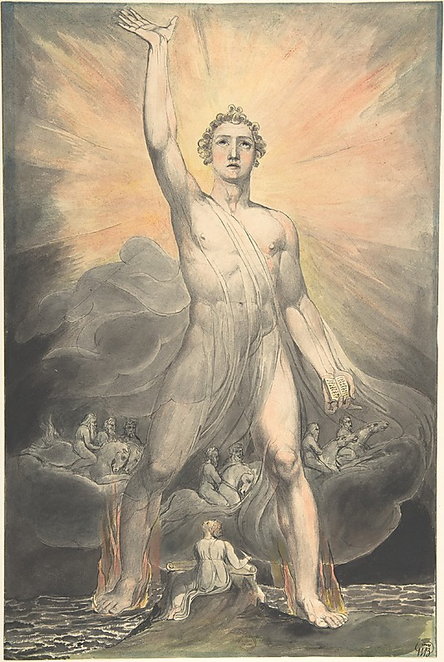
William Blake ,
Angel of the Revelation
(Book of Revelation, chapter 10) c. 1803–5
15-7/16 x 10-1/4 in.
Metropolitan Museum, NY

Slide 6
Things aren’t so Bad
An Old Testament theme is one in which the people have turned from the faithful worship of God and after some calamity, God has decided to yet again forgive and take Israel back into his protection.
Revelation is the final act of that story of continuing redemption.
The final affirmation that in the end God will forgive and redeem his people on this earth and the universe. The final battle of Armageddon being the assurance that good will prevail over evil and God will inhabit the Earth with his own.
The battles dragons, plagues, and terrible fates [especially the one about scorpion stings].
Our problems don’t seem as bad as those and we know Good will Prevail
Notes:
A recurrent theme of the Old Testament is one in which the people have turned from the faithful worship of God and after some calamity, God has decided to yet again forgive and take Israel back into his protection. Perhaps Revelation is the final act of that story of continuing redemption. The final affirmation that in the end God will forgive and redeem his people on this earth and the universe. The final battle of Armageddon being the assurance that good will prevail over evil and God will inhabit the Earth with his own. The battles described in the latter portion of the Book of Revelation are complete with dragons, plagues, and terrible fates [especially the one about scorpion stings]. Surely, no matter how overwhelming our problems seem, they are not as bad as those. We have the assurance through John’s vision, that in the end that Satan will be ejected from Heaven, defeated and cast into a lake of fire forever. The Message of the Book of Revelation, Charles T. Chapman, Jr., The Liturgical Press, Collegeville, Minnesota, By the Order of St. Benedict, Inc., 1995. Page 9 We can summarize the message of Revelation in this way: John describes history as a cycle of nationalism, war, famine, and death. God warns the Roman emperor, who has declared himself to be a god and is persecuting the Church like a new Nero, that the empire will be destroyed if he does not repent. Various natural disasters underscore the warning. Next John describes the story of salvation as a cosmic battle between good and evil, with the person of Jesus Christ at its center. John then describes the destruction of Rome, the return of Christ as a victorious warrior, the era of peace which Christ establishes, the destruction of the old universe, and the creation of a new universe in which God lives in a new Jerusalem on a new planet Earth inhabited by all the blessed of God (the wicked along with death and hell, having been tossed into a lake of fire). He closes the message by urging his readers to pray that Christ will soon return.

Slide 7
Moderation
The seven letters to the Churches of Asia may provide guidance to the modern Church.
The Seven Churches are alternately praised for love, endurance, patience, intolerance of evil and faithfulness and then criticized for coldness, lack of love and indifference.
The letters show a need for wisdom in the search for that delicate balance between tolerance or love on the one hand and intolerance for evil on the other.
Love is the equivalent of inclusion and acceptance but how are we to tell when to love one another despite faults and when to reject the Jezebel in our midst?
The question is balance - one trait to the exclusion of others will turn a good thing into a bad one.
Notes:
In a corporate sense, that is concerning the Church universal and its individual congregations, the seven letters to the Churches of Asia may provide some insight. The Churches are alternately praised for love, endurance, patience, intolerance of evil and faithfulness and then criticized for coldness, lack of love and indifference. The individual letters are far too short to help with specific situations such as in Paul’s many letters, or in Acts. But one can get a sense of the need for wisdom in the search for that delicate balance between tolerance or love on the one hand and intolerance for evil on the other. If love is the equivalent of inclusion and acceptance, how are we to tell when to love one another despite faults and when to reject the Jezebel in our midst? If we accept that the meaning of scripture should be something that is applicable for then, now and in the future, then maybe the message isn’t what is the correct balance of these things, but rather that the balance whatever it may be in a particular circumstance, is a delicate matter that should be under constant consideration. That when we emphasize one trait to the exclusion of others we turn a good thing into a bad one.

Slide 8
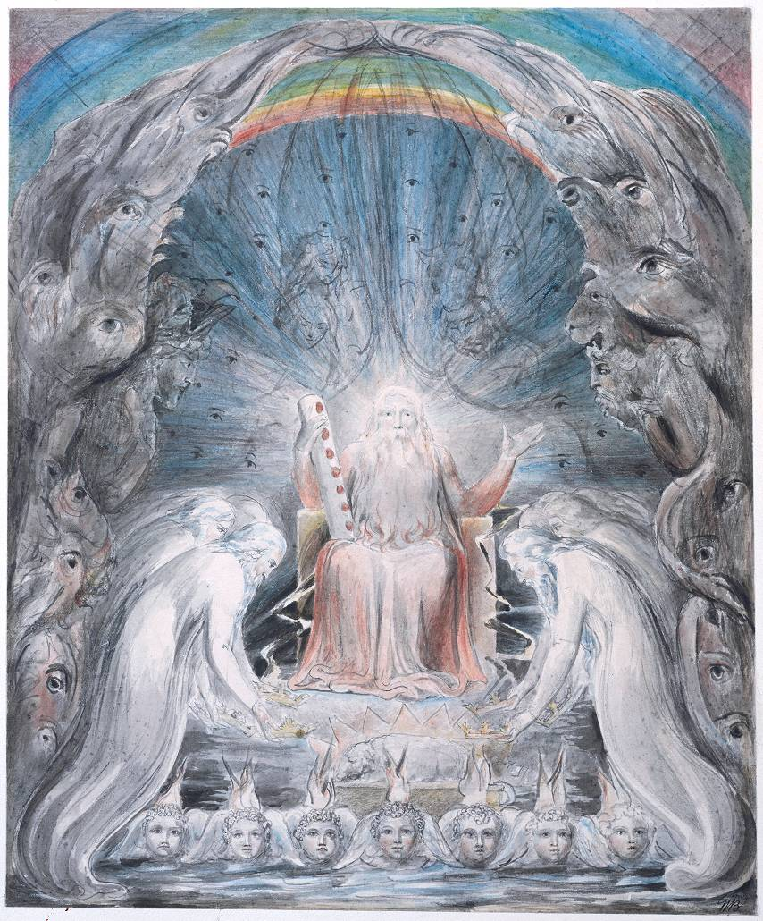
William Blake,
The Four and Twenty Elders Casting their Crowns before the Divine Throne, c.1803-5
Tate Gallery, London before the throne there was a sea of glass like unto crystal... round about... were four beasts full of eyes... The four and twenty elders fall down before him... and worship him that liveth for ever and ever.

Slide 9
Idols
Revelation can be seen as a more personal message of encouragement and hope.
The among the main themes in the Book of Revelation are tirades against the worship of idols, the supremacy of Christ over the forces of evil, and endurance in the faith.
How do these become a source of encouragement to the modern American believer.
There are no temples to Jupiter in Little Rock and the government does not require sacrifices.
But we live in a society that in many ways makes it difficult or unattractive to worship.
So what things confront us that take us away from our faith?
Notes:
What are our modern Idols? What road blocks does our society put in the way of our beliefs. Are the pursuit of money, career or the acquisition of possessions the idols we worship? Thus John on ancient Patmos, delivers his message to you, today. Don’t be distracted by these things money, career or the acquisition of possessions. Or conversely, when times are hard, and financial or health problems seem overwhelming, maintain your perspective and focus. If nothing else, attend Church, make sure your kids, grand kids and friends attend. Work actively on your faith. For some that means study, but for others that could mean helping with Sunday School or some other volunteer effort at Church. Join or start a Bible study. None of these things will be easy. To this John on Patmos again speaks and encourages you to endure in your quest. With the pressures of modern life, it is easy to be distracted and to put Church in a box to be taken out on Sunday, with your Sunday Clothes. It is easy when the pressures of work make it seem that you have to make a choice between attendance and working on Sunday morning or a neat weekend trip. Perhaps this interpretation is less exciting than floods, or predictions about the ends of the Earth. Perhaps this conclusion is not nearly as much fun as trying to figure which of the horrible plagues will be visited on people with whom we are currently upset. But, in this light the Book of Revelation has something to say to our Church and to us personally. And it cannot hurt in the swirl of everyday life to think about a place and a time when God himself will live with us and “.... ( 4) he will wipe every tear from [our] eyes. Death will be no more; mourning and crying and pain will be no more,. . . .”
An idol is often something that on its surface seems pleasant. Identifying an idol is no easy task. In Milton an idol is described as :
“Oft to the Image of a Brute, adorn'd
With gay Religions full of Pomp and Gold,
And Devils to adore for Deities:
Then were they known to men by various Names,
And various Idols through the Heathen World. [ 375 ]” Milton’s Paradise Lost, Book One. The point being that the harmful nature of the idol is disguised from us by the pomp and gold.
Revelation 21, V3-4

Slide 10
Joseph Mallord William Turner,
The Angel Standing in the Sun, exhibited 1846
Tate Gallery, London
This late painting shows the Archangel Michael appearing on the Day of Judgement with his flaming sword. In the foreground are Old Testament scenes of murder and betrayal: Adam and Eve weeps over the body of Abel (left), and Judith stands over the headless body of Holofernes (right).

Slide 11
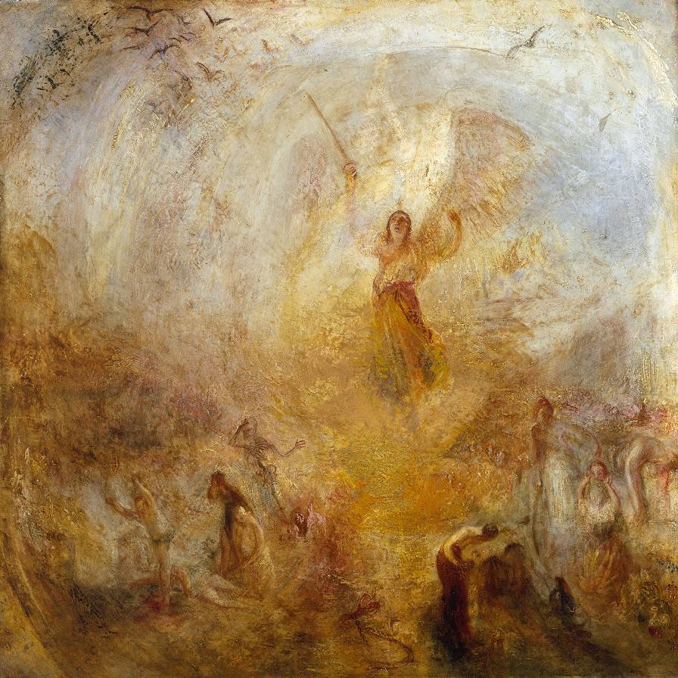

Slide 12
Modern Idols
What are our modern Idols?
What blocks us from doing God’s work?
The pursuit of money, career or the acquisition of possessions.
Are these the idols we worship?
If so here is a message from John on ancient Patmos - Don’t be distracted by these things.
Or conversely, when times are hard, and financial or health problems seem overwhelming, maintain your perspective and focus.
If nothing else do a good deed.
Perhaps this interpretation is less exciting than floods, or predictions about the ends of the Earth or not nearly as much fun as trying to figure which of the horrible plagues will be visited on people with whom we are currently upset.
Notes:
What are our modern Idols?4 What road blocks does our society put in the way of our beliefs. Are the pursuit of money, career or the acquisition of possessions the idols we worship? Thus John on ancient Patmos, delivers his message to you, today. Don’t be distracted by these things money, career or the acquisition of possessions. Or conversely, when times are hard, and financial or health problems seem overwhelming, maintain your perspective and focus. If nothing else, attend Church, make sure your kids, grand kids and friends attend. Work actively on your faith. For some that means study, but for others that could mean helping with Sunday School or some other volunteer effort at Church. Join or start a Bible study. None of these things will be easy. To this John on Patmos again speaks and encourages you to endure in your quest. With the pressures of modern life, it is easy to be distracted and to put Church in a box to be taken out on Sunday, with your Sunday Clothes. It is easy when the pressures of work make it seem that you have to make a choice between attendance and working on Sunday morning or a neat weekend trip. Perhaps this interpretation is less exciting than floods, or predictions about the ends of the Earth. Perhaps this conclusion is not nearly as much fun as trying to figure which of the horrible plagues will be visited on people with whom we are currently upset. But, in this light the Book of Revelation has something to say to our Church and to us personally. And it cannot hurt in the swirl of everyday life to think about a place and a time when God himself will live with us and “.... ( 4) he will wipe every tear from [our] eyes. Death will be no more; mourning and crying and pain will be no more,. . . .”5

Slide 13
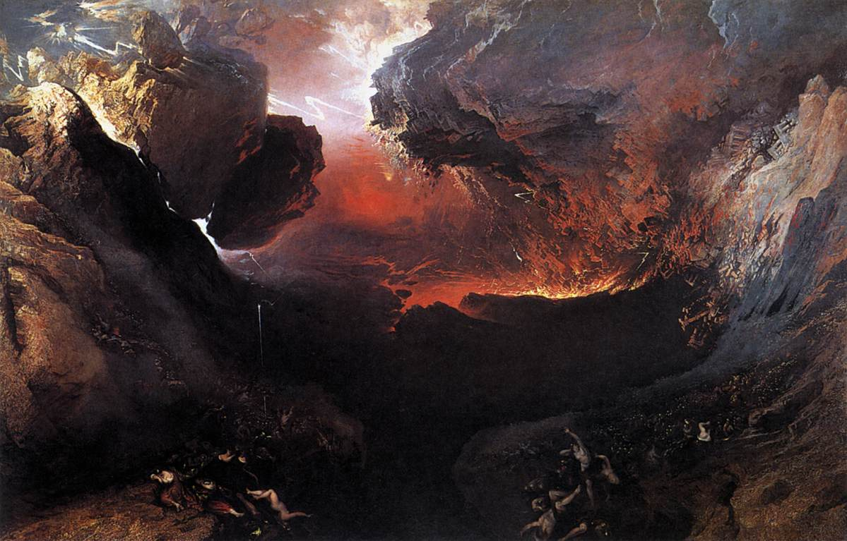
John Martin, Great Day of His Wrath, 1851-53
Oil on canvas, 197 x 303 cm, Tate Gallery, London

Slide 14
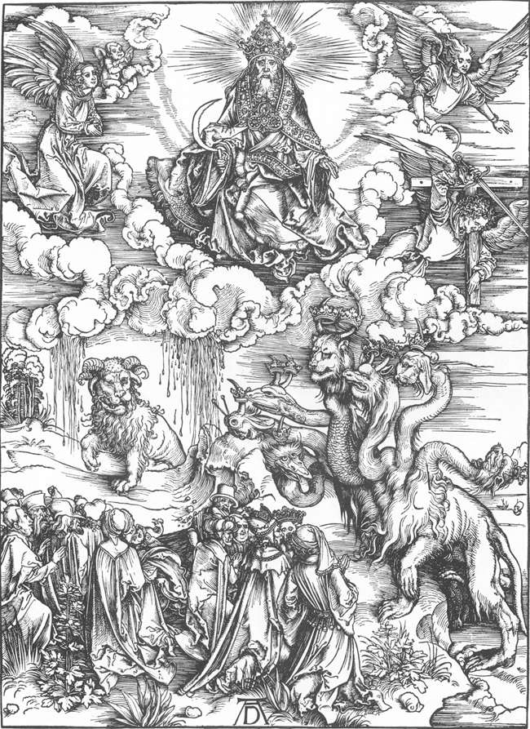
Albrecht Durer,
The Revelation of St John:
12. The Sea Monster and the Beast with the Lamb's Horn
1497-98
Woodcut, 39 x 28 cm
Staatliche Kunsthalle, Karlsruhe

Slide 15
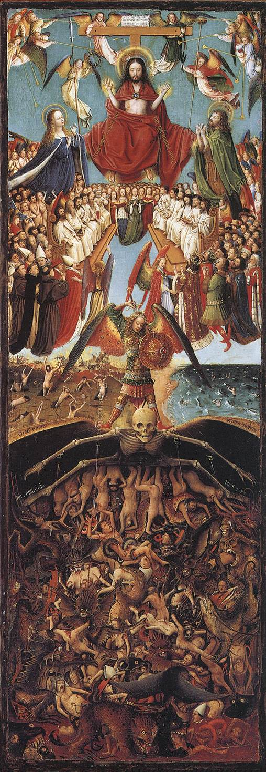
Jan van Eyck (?),
Last Judgment, 1420-25
Oil on wood transferred to canvas,
56,5 x 19,5 cm
Metropolitan Museum of Art, New York

Slide 16
Jan van Eyck (?),
Last Judgment, 1420-25
Oil on wood transferred to canvas,
56,5 x 19,5 cm
Metropolitan Museum of Art, New York

Slide 17
Jan van Eyck (?),
Last Judgment, 1420-25
Oil on wood transferred to canvas,
56,5 x 19,5 cm
Metropolitan Museum of Art, New York

Slide 18
Jan van Eyck (?),
Last Judgment, 1420-25
Oil on wood transferred to canvas,
56,5 x 19,5 cm
Metropolitan Museum of Art, New York

Slide 19
Revelation and Genesis
John’s Revelation tells that in the end there will be no death in the world just as it was in the beginning as revealed by Genesis at a time before sin.
In this light The Revelation of John then has its fitting place in the scriptures.
Notes:
And finally, for those who still wonder whether and how Revelation fits into the New Testament or the entire cannon of scripture. In the New Testament, Revelation serves as a fitting book end to the collection. The Gospels tell the story and ministry of Jesus the Christ in his time on earth and that He will return. The Book of Acts tells us about the immediate reaction of those who knew him and what they were moved to do. The epistles then in broad terms tell us about everyday life and the concerns of the early community. Revelation in this light tells what to expect in the future and at the final end of the world. In a larger context, there is also much to connect Revelation to the Hebrew Bible, the Old Testament. In Genesis 1:28 the world as first created from chaos is one where there is no death and both man and all of the animals eat only plants and not each other! The result of man’s encounter with the Tree of the Knowledge of Good and Evil is that this relationship of harmony is lost. Sin is a fact of this existence; in order to counter this fact, we require a savoir in the struggle for reconciliation. But, as a message of hope see Isaiah 11 where a world is described in which this relationship will be regained, where the lion and the ox will eat straw and so will man live in harmony with all animals. Then as a final prologue, John’s Revelation tells that there will be no death in the world just as it was in the beginning as revealed by Genesis at a time before sin. In this light The Revelation of John then has its fitting place in the scriptures.
Genesis 1: 28 God blessed them, and God said to them, Be fruitful and multiply, and fill the earth and subdue it; and have dominion over the fish of the sea and over the birds of the air and over every living thing that moves upon the earth. 29 God said, See, I have given you every plant yielding seed that is upon the face of all the earth, and every tree with seed in its fruit; you shall have them for food. 30 And to every beast of the earth, and to every bird of the air, and to everything that creeps on the earth, everything that has the breath of life, I have given every green plant for food. And it was so. 31 God saw everything that he had made, and indeed, it was very good. And there was evening and there was morning, the sixth day.
Isaiah 11 The Peaceful Kingdom
11 A shoot shall come out from the stump of Jesse,
and a branch shall grow out of his roots.
2 The spirit of the Lord shall rest on him,
the spirit of wisdom and understanding,
the spirit of counsel and might,
the spirit of knowledge and the fear of the Lord.
3 His delight shall be in the fear of the Lord.
He shall not judge by what his eyes see,
or decide by what his ears hear;
4 but with righteousness he shall judge the poor,
and decide with equity for the meek of the earth;
he shall strike the earth with the rod of his mouth,
and with the breath of his lips he shall kill the wicked.
5 Righteousness shall be the belt around his waist,
and faithfulness the belt around his loins.
6 The wolf shall live with the lamb,
the leopard shall lie down with the kid,
the calf and the lion and the fatling together,
and a little child shall lead them.
7 The cow and the bear shall graze,
their young shall lie down together;
and the lion shall eat straw like the ox.
8 The nursing child shall play over the hole of the asp,
and the weaned child shall put its hand on the adder’ s den.
9 They will not hurt or destroy
on all my holy mountain;
for the earth will be full of the knowledge of the Lord
as the waters cover the sea.

Slide 20
Andrea del Sarto, Madonna of the Harpies, 1517
Oil on wood, 208 x 178 cm
Galleria degli Uffizi, Florence
This is a highly unusual presentation of the Virgin, a figure on a pedestal with the images of the "harpies." This has led to a lot of thought and attempted explanations on the part of critics. The most recent interpretation is that it is a depiction, based on the text of the Book of Revelation, of the Virgin triumphant over evil, symbolized by the monstrous figures, the "harpies," which are in fact the "locusts" mentioned in Revelation; and besides that, bears witness to the cult of the Virgin by the clients, an order of Franciscan nuns. The saints shown are Francis and John the Evangelist.

Slide 21
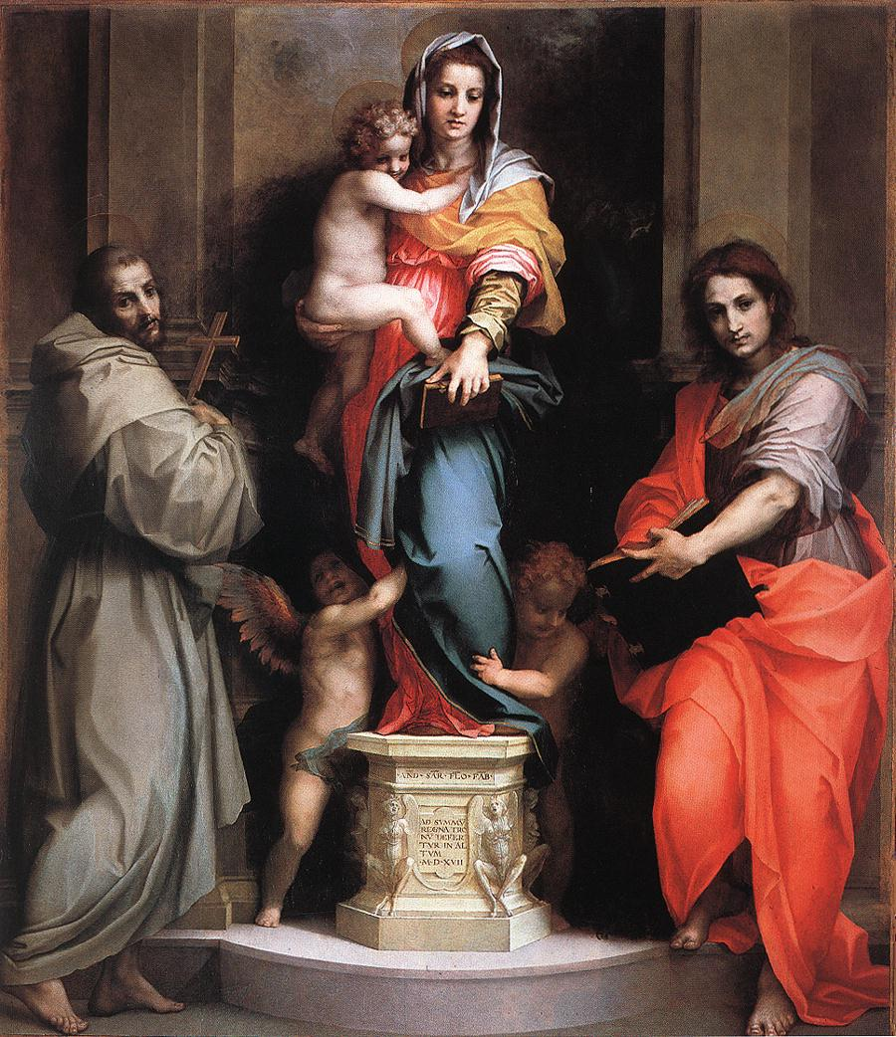

Slide 22
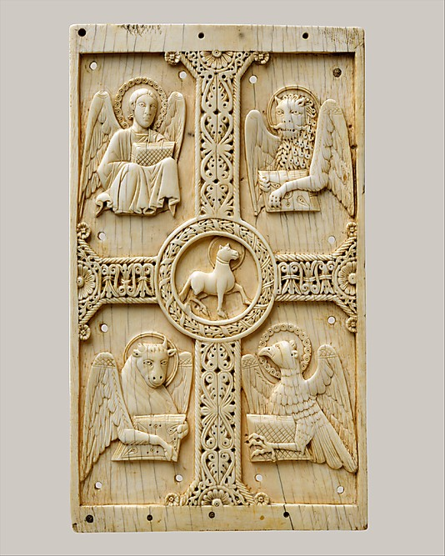
Southern Italian, Plaque (Gospel Cover) with Agnus Dei on a Cross between Emblems of the Four Evangelists, c. 1000–1050
Ivory, 9 1/4 x 5 3/8 x 3/8 in, Metropolitan Museum

Slide 23
Jan Van Eyck, Adoration of the Mystical Lamb
Detail from Center Panel of the Ghent Altarpiece, 1432
To view whole altarpiece with zoom: http://closertovaneyck.kikirpa.be/

Slide 24
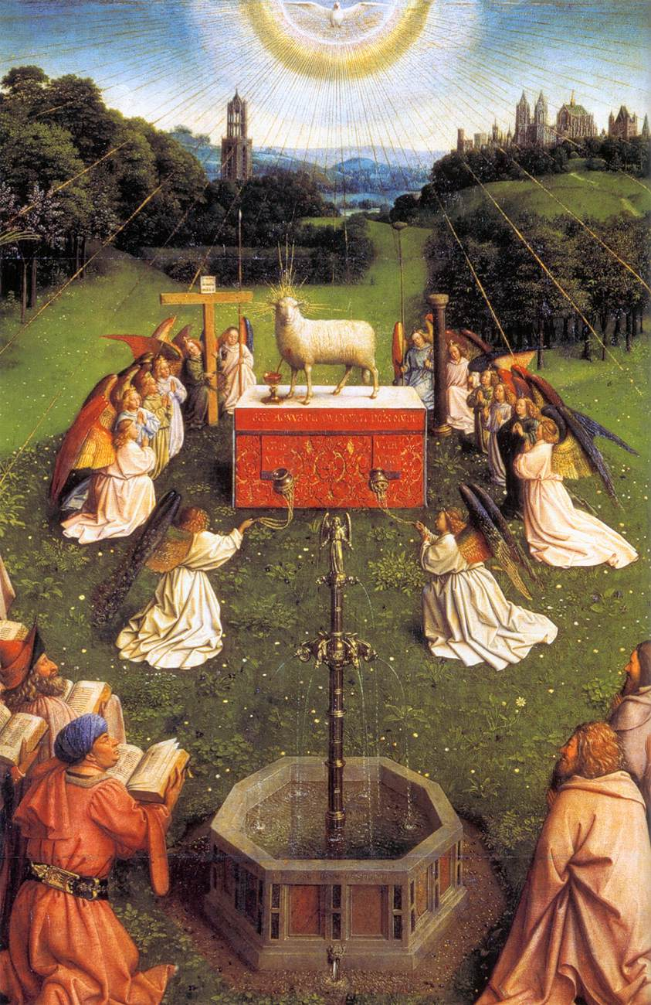

Slide 25
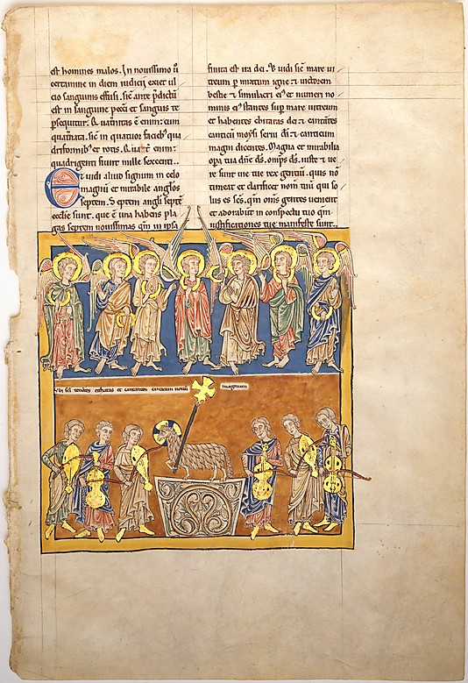
Spanish Artist,
Leaf from a Beatus Manuscript: Seven Angels Hold the Cups of the Seven Last Plagues; The Hymn of the Lamb c. 1180
17 1/2 x 11 13/16 in.
Metropolitan Museum, NY

Slide 26
A New World
God himself will be with them;
4 he will wipe every tear from their eyes.
Death will be no more; mourning and crying and pain will be no more, for the first things have passed away.”
5 And the one who was seated on the throne said “See, I am making all things new.”

