Slide 1
GENESIS
An Adult Education Study of the Text known to Christians as Genesis
Notes:
This PowerPoint is intended as an aid for the leader of an adult Christian Education group. All sources are footnoted and from easily available materials. Please respect the sacred nature of the scriptures covered. Use these materials as a way to start and sustain a lively discussion and consideration of a marvelous gift to us for a richer experience of life.
J B Cross
www.episcopalchristioneducation.com

Slide 2
Introduction to these materials
This is intended as a course on the Book of Genesis, the first book of the Bible as it is known to Christians. The scripture materials are taken from the text, footnotes and articles presented in The New Oxford Annotated Bible, New York, Oxford University Press, 1996. Introduction Notes Page XXXV OT. For the most part the history, background and interpretation is taken from or suggested by Year One EFM “Hebrew Scriptures”, Ross Mackenzie, Editor, Fourth Edition, Sewanee, Tennessee, USA.
This is intended as a class outline for an adult Sunday school class. They may also be used as a self-directed personal study.

Slide 3
Introduction to Genesis
Genesis, meaning "origin," covers the time from creation to the Israelite sojourn in Egypt.
The book falls naturally into two main sections.
The primeval history, which is universal in scope, tells how the blessing of God enabled humanity to multiply, diversify, and disperse on the face of the earth.
The ancestral history, on the other hand, deals with the limited family history of Israel's ancestors.
The primary purpose of the book, however, is not to present straight forward history but to tell the dramatic story of God's dealings with the world.
Notes:
The New Oxford Annotated Bible (c) Oxford University Press, 1996. All rights reserved.
Introduction to Genesis
Genesis, meaning "origin," covers the time from creation to the Israelite sojourn in Egypt. The book falls naturally into two main sections. The primeval history (Genesis 1-11), which is universal in scope, tells how the blessing of God enabled humanity to multiply, diversify, and disperse on the face of the earth. The ancestral history (Genesis 12-50), on the other hand, deals with the limited family history of Israel's ancestors: Abraham and Sarah (Genesis 12-25), Isaac and Rebekah and their twin sons Esau and Jacob (Genesis 26-46), and Jacob's family, the chief member of which was Joseph (Genesis 37-50).
The primeval history reflects a "prehistorical" or mythical view of the movement from creation to the return of chaos in a catastrophic flood and the new beginning afterwards, while the ancestral history can be read, at least to some degree, in the context of the history of the Near East in the latter part of the second millennium (1500 - 1200 B.C.). The primary purpose of the book, however, is not to present straightforward history but to tell the dramatic story of God's dealings with the world and, in particular, to interpret Israel's special role in God's purpose.
Thus the migration of Abram and Abraham's family in response to God's promise (Genesis 12.1-3) is the turning point in the unfolding story. God's creation had been marred by human violence that, under the judgment of God, threatened the earth with a return to pre-creation chaos. Out of this fallible human material, however, God gradually separated one family line, promising that the descendants of Abraham and Sarah would increase in number, receive a land, and have a relationship with God that would benefit other peoples (Genesis 12.1-3). The promise in its threefold aspect is threatened by various experiences, such as Sarah's barrenness or Jacob's having to flee from the land of Canaan. Despite trials and tribulations, however, the people move toward the horizon of God's future, and when the book ends, in the time of Joseph's wise and benevolent administration of Egypt, the promise is pressing toward realization.
The New Oxford Annotated Bible (c) Oxford University Press, 1996. All rights reserved.

Slide 4
Reading
The reading materials are of course the Book of Genesis itself. All are encouraged to read the text using any translation that you prefer.
The intention is for a lively discussion and one way to encourage that is to first read the pertinent passage aloud together.
Then review what scholars and artists over the years have said about the text. But keeping in mind that what is important is what you take from your encounter with the text.
Then with those things in mind consider what the text says to you for your life today.

Slide 5
Creation

Slide 6
Genesis 1:1-5
In the beginning when God created the heavens and the earth, the earth was a formless void and darkness covered the face of the deep, while a wind from God swept over the face of the waters. Then God said, "Let there be light"; and there was light. And God saw that the light was good; and God separated the light from the darkness. God called the light Day, and the darkness he called Night. And there was evening and there was morning, the first day.

Slide 7
Genesis 1:6-8
And God said, "Let there be a dome in the midst of the waters, and let it separate the waters from the waters." So God made the dome and separated the waters that were under the dome from the waters that were above the dome. And it was so. God called the dome Sky. And there was evening and there was morning, the second day.

Slide 8
Genesis 1:9-13
And God said, "Let the waters under the sky be gathered together into one place, and let the dry land appear." And it was so. God called the dry land Earth, and the waters that were gathered together he called Seas. And God saw that it was good. Then God said, "Let the earth put forth vegetation: plants yielding seed, and fruit trees bearing fruit of every kind on earth that bear fruit with the seed in it." And it was so. The earth brought forth vegetation: plants yielding seed of every kind, and trees of every kind bearing fruit with the seed in it. And God saw that it was good. And there was evening and there was morning, the third day.

Slide 9
Genesis 1:14-19
And God said, "Let there be lights in the dome of the sky to separate the day from the night; and let them be for signs and for seasons and for days and years, and let them be lights in the dome of the sky to give light upon the earth." And it was so. God made the two great lights-- the greater light to rule the day and the lesser light to rule the night-- and the stars. God set them in the dome of the sky to give light upon the earth, to rule over the day and over the night, and to separate the light from the darkness. And God saw that it was good. And there was evening and there was morning, the fourth day.

Slide 10
Genesis 1:20-23
And God said, "Let the waters bring forth swarms of living creatures, and let birds fly above the earth across the dome of the sky." So God created the great sea monsters and every living creature that moves, of every kind, with which the waters swarm, and every winged bird of every kind. And God saw that it was good. God blessed them, saying, "Be fruitful and multiply and fill the waters in the seas, and let birds multiply on the earth." And there was evening and there was morning, the fifth day.

Slide 11
Genesis 1:24-26
And God said, "Let the earth bring forth living creatures of every kind: cattle and creeping things and wild animals of the earth of every kind." And it was so. God made the wild animals of the earth of every kind, and the cattle of every kind, and everything that creeps upon the ground of every kind. And God saw that it was good.
Then God said, "Let us make humankind in our image, according to our likeness; and let them have dominion over the fish of the sea, and over the birds of the air, and over the cattle, and over all the wild animals of the earth, and over every creeping thing that creeps upon the earth."

Slide 12
Genesis 1:27-28
So God created humankind in his image,
in the image of God he created them;
male and female he created them.
God blessed them, and God said to them, "Be fruitful and multiply, and fill the earth and subdue it; and have dominion over the fish of the sea and over the birds of the air and over every living thing that moves upon the earth.”

Slide 13
Genesis 1:29-31
God said, "See, I have given you every plant yielding seed that is upon the face of all the earth, and every tree with seed in its fruit; you shall have them for food. And to every beast of the earth, and to every bird of the air, and to everything that creeps on the earth, everything that has the breath of life, I have given every green plant for food." And it was so. God saw everything that he had made, and indeed, it was very good. And there was evening and there was morning, the sixth day.

Slide 14
Genesis 2:1-4a
Thus the heavens and the earth were finished, and all their multitude. And on the seventh day God finished the work that he had done, and he rested on the seventh day from all the work that he had done. So God blessed the seventh day and hallowed it, because on it God rested from all the work that he had done in creation. These are the generations of the heavens and the earth when they were created.

Slide 15
A Time before
The alternate wording for: “1 In the beginning when God created † the heavens and the earth. . .”
Is : “When God Began to Create. . . .”
The alternate conveys that there was a time when only God existed and that at some point for some reason God created the universe we now inhabit.
Notes:
The New Oxford Annotated Bible (c) Oxford University Press, 1996. All rights reserved.
1.1–2.3: The story of creation. Out of original chaos God created an orderly world, assigning a preeminent place to human beings. 1: The traditional translation as an independent sentence, following the Greek Bible (Septuagint) of the 3rd cent. B.C., is defensible, in which case Genesis 1.1 is a thematic sentence, corresponding to the climactic summary of Genesis 2.1. Many, however, favor When God began to create (see translators' note to this verse) . . . , taking the verse to be introductory to Genesis 1.2 (as above) or possibly to the first act of creation in Genesis 1.3 (compare Genesis 2.4b–7). The ancients believed the world originated from and was founded upon a watery abyss (the deep; compare Psalm 24.2; Psalm 104.6), portrayed as a sea-monster in various myths (Isaiah 51.9). 3–5: Creation by the word of God (Psalm 33.6) expresses God’s absolute sovereignty and anticipates the doctrine of creation out of nothing (2 Maccabees 7.28). Light burst forth first (2 Corinthians 4.6), even before the creation of the sun (Genesis 1.14–18), and was separated from night, a remnant of uncreated darkness (Genesis 1.2). Since the Jewish day began with sundown, the order is evening and morning.
1.6–8: A dome, the sky was understood to be a solid expanse capable of separating the upper from the lower waters (Exodus 20.4; Psalm 148.4). See Genesis 7.11 n.
1.9–10: The Seas, remnants of the watery chaos, were assigned boundaries at the edge of the earth (Psalm 139.9; Proverbs 8.29), where they continue to menace God’s creation (Psalm 104.7–9). 11–12: Vegetation was created only indirectly by God, whose creative command empowered mother earth to become fertile. 14–19: The sun, moon, and stars are not divine powers that control human destiny, as was believed in antiquity, but are only lights. Implicitly, worship of the heavenly host is forbidden (Deuteronomy 4.19; Zephaniah 1.5).
1.20–23: The creation of birds and fishes marks the first appearance of life on the earth. Sea monsters, Psalm 74.13; Psalm 104.25–26. 24–25: God’s command for the earth to bring forth (a maternal verb, compare Genesis 1.20) suggests that the animals are immediately bound to the ground and only indirectly related to God, in contrast to human beings. 26–27: The solemn divine declaration emphasizes humanity’s supreme place at the climax of God’s creative work.
1.26: The plural us, our (Genesis 3.22; Genesis 11.7; Isaiah 6.8) probably refers to the divine beings who compose God’s heavenly court (1 Kings 22.19; Job 1.6). Image, likeness, refer not to physical appearance but to relationship and activity. Humankind is commissioned to manifest God’s rule on earth, on the analogy of a child who represents a parent (see Genesis 5.3). 27–28: Them, literally “him” or “it” (see second translators' note to Genesis 1.27), referring to humankind; however, humanity is differentiated sexually, and to “them,” male and female, God gives power to reproduce their kind and to exercise dominion over the earth. Together men and women, made in the image of God, share the task of being God’s stewards on earth (Psalm 8.6–8). 29–30: Human dominion is limited, as shown by the vegetarian requirement; in fact, there is to be no killing, a command that was relaxed in Noah’s time (Genesis 9.2–3). Human dominion, corresponding to God’s rule, is to be benevolent and peaceful (compare Isaiah 11.6–8). 31: Very good (Genesis 1.4; Genesis 1.10; Genesis 1.12, etc.), corresponding perfectly to God’s creative intention.
2.1–3: The verb rested (Hebrew “shabat”) is the basis of the noun sabbath (Exodus 31.12–17).
2.4a: Not the conclusion of the priestly creation story, but a separate caption introducing the following material, as elsewhere in Genesis (e.g. Genesis 5.1; Genesis 6.9; Genesis 10.1)

Slide 16
The story of creation
Out of original chaos God created an orderly world, assigning a preeminent place to human beings.
Image, likeness, refers not to physical appearance but to relationship and activity. Humankind is commissioned to manifest God's rule on earth.
Humanity is differentiated sexually, and to "them," male and female, God gives power to reproduce their kind and to exercise dominion over the earth.
Notes:
The New Oxford Annotated Bible (c) Oxford University Press, 1996. All rights reserved.
Genesis 1
1.1-2.3: The story of creation. Out of original chaos God created an orderly world, assigning a preeminent place to human beings. 1: The traditional translation as an independent sentence, following the Greek Bible (Septuagint) of the 3rd cent. B.C., is defensible, in which case Genesis 1.1 is a thematic sentence, corresponding to the climactic summary of Genesis 2.1. Many, however, favor When God began to create (see translators' note to this verse) ... , taking the verse to be introductory to Genesis 1.2 (as above) or possibly to the first act of creation in Genesis 1.3 (compare Genesis 2.4b-7). The ancients believed the world originated from and was founded upon a watery abyss (the deep; compare Psalm 24.2; Psalm 104.6), portrayed as a sea-monster in various myths (Isaiah 51.9). 3-5: Creation by the word of God (Psalm 33.6) expresses God's absolute sovereignty and anticipates the doctrine of creation out of nothing (2 Maccabees 7.28). Light burst forth first (2 Corinthians 4.6), even before the creation of the sun (Genesis 1.14-18), and was separated from night, a remnant of uncreated darkness (Genesis 1.2). Since the Jewish day began with sundown, the order is evening and morning.
1.6-8: A dome, the sky was understood to be a solid expanse capable of separating the upper from the lower waters (Exodus 20.4; Psalm 148.4). See Genesis 7.11 n.
1.9-10: The Seas, remnants of the watery chaos, were assigned boundaries at the edge of the earth (Psalm 139.9; Proverbs 8.29), where they continue to menace God's creation (Psalm 104.7-9). 11-12: Vegetation was created only indirectly by God, whose creative command empowered mother earth to become fertile. 14-19: The sun, moon, and stars are not divine powers that control human destiny, as was believed in antiquity, but are only lights. Implicitly, worship of the heavenly host is forbidden (Deuteronomy 4.19; Zephaniah 1.5).
1.20-23: The creation of birds and fishes marks the first appearance of life on the earth. Sea monsters, Psalm 74.13; Psalm 104.25-26. 24-25: God's command for the earth to bring forth (a maternal verb, compare Genesis 1.20) suggests that the animals are immediately bound to the ground and only indirectly related to God, in contrast to human beings. 26-27: The solemn divine declaration emphasizes humanity's supreme place at the climax of God's creative work.
1.26: The plural us, our (Genesis 3.22; Genesis 11.7; Isaiah 6.8) probably refers to the divine beings who compose God's heavenly court (1 Kings 22.19; Job 1.6). Image, likeness, refer not to physical appearance but to relationship and activity. Humankind is commissioned to manifest God's rule on earth, on the analogy of a child who represents a parent (see Genesis 5.3). 27-28: Them, literally "him" or "it" (see second translators' note to Genesis 1.27), referring to humankind; however, humanity is differentiated sexually, and to "them," male and female, God gives power to reproduce their kind and to exercise dominion over the earth. Together men and women, made in the image of God, share the task of being God's stewards on earth (Psalm 8.6-8). 29-30: Human dominion is limited, as shown by the vegetarian requirement; in fact, there is to be no killing, a command that was relaxed in Noah's time (Genesis 9.2-3). Human dominion, corresponding to God's rule, is to be benevolent and peaceful (compare Isaiah 11.6-8). 31: Very good (Genesis 1.4; Genesis 1.10; Genesis 1.12, etc.), corresponding perfectly to God's creative intention.
2.1-3: The verb rested (Hebrew "shabat") is the basis of the noun sabbath (Exodus 31.12-17).
2.4a: Not the conclusion of the priestly creation story, but a separate caption introducing the following material, as elsewhere in Genesis (e.g. Genesis 5.1; Genesis 6.9; Genesis 10.1).
The New Oxford Annotated Bible (c) Oxford University Press, 1996. All rights reserved.

Slide 17
Human Dominion
There is a limit shown by the vegetarian requirement
There is to be no killing, a command that was relaxed in Noah's time
Human dominion, corresponding to God's rule, is to be benevolent and peaceful .
And all is found to be Very good
So far so GOOD
Notes:
The New Oxford Annotated Bible (c) Oxford University Press, 1996. All rights reserved.
Human dominion
. Together men and women, made in the image of God, share the task of being God's stewards on earth (Psalm 8.6-8). 29-30: Human dominion is limited, as shown by the vegetarian requirement; in fact, there is to be no killing, a command that was relaxed in Noah's time (Genesis 9.2-3). Human dominion, corresponding to God's rule, is to be benevolent and peaceful (compare Isaiah 11.6-8). 31: Very good (Genesis 1.4; Genesis 1.10; Genesis 1.12, etc.), corresponding perfectly to God's creative intention.
2.1-3: The verb rested (Hebrew "shabat") is the basis of the noun sabbath (Exodus 31.12-17).
2.4a: Not the conclusion of the priestly creation story, but a separate caption introducing the following material, as elsewhere in Genesis (e.g. Genesis 5.1; Genesis 6.9; Genesis 10.1).
The New Oxford Annotated Bible (c) Oxford University Press, 1996. All rights reserved.

Slide 18
The creation of Creation
The development of the book of Genesis was a long process extending over centuries.
The creation of the world and the creation of humankind are independent traditions.
The creation of humankind is the earlier in time of the two Genesis 2-3 emphasizes the creation of the human race.
The later narrative (Genesis 1.1-2.4) emphasizes the creation of the world.
The distribution of creation over seven days forms a temporal unity that recalls the week and its culmination in the Sabbath
Notes:
The New Oxford Annotated Bible (c) Oxford University Press, 1996. All rights reserved.
Genesis, The Book of; Genesis 1-11: Primeval History
Genesis 1-11: Primeval History. Genesis 1-11 forms an internally coherent unity. The creation (Genesis 1-2) and Flood (Genesis 6-9) belong together; the crime against a brother (Genesis 4) belongs within the story of rebellion against God (Genesis 3; See Fall, The).
The building blocks of Genesis 1-11 are narratives (Genesis 1; Genesis 2-3; Genesis 4; Genesis 6-9) and genealogies (Genesis 5; Genesis 10). The narratives recount the beginnings of the world and its people; they cover the creation of the earth and of human beings (Genesis 1-2), wrongdoing and punishment (Genesis 3; Genesis 4; Genesis 6-9; Genesis 11), the first signs of cultural development, and the scattering of tribes and tongues. It is through the genealogies that the events in Genesis 1-11 become a coherent story. The creator's blessing causes the expansion of humankind through the course of time (Genesis 5: genealogy from Adam to Abraham) and the reach of space (Genesis 10: the table of nations). Between the two genealogies stands the catastrophe of the Flood (Genesis 6-9), which is caused by the corruption of humankind and threatens to destroy its existence. The accounts of wrongdoing and punishment demonstrate the many possibilities for transgression; both the individual (Genesis 3; Genesis 4; Genesis 9) and the group (Genesis 6.1-4; Genesis 5-9; Genesis 11) can overstep the boundaries set for human beings.
The narratives of creation. The creation of the world and the creation of humankind are independent traditions, each found in early religions throughout the world; the creation of humankind is the earlier of the two. Creation stories did not arise out of a curiosity about origins but from a sense of the menace to human existence in an endangered world. The older narrative (Genesis 2-3) emphasizes the creation of the human race, intertwined with the story of its failure; the limits of sin and death are an integral part of human existence. Human beings themselves, formed from earthly elements, become living beings by receiving the breath of God. They are creatures in all aspects of their existence; these include territory (the garden), food (the fruit of the garden), labor (the tilling and keeping of garden), community (the creation of woman), language (the call and naming), and their relationship to God.
The later narrative (Genesis 1.1-2.4) emphasizes the creation of the world. In early religions, creation occurs through action, through generation and birth, and through combat. In Genesis 1, everything that exists or becomes has its origins in God's commanding word. The distribution of creation over seven days forms a temporal unity that recalls the week and its culmination in the Sabbath, and it suggests that the history of creation and humanity also has an aim. The creation of plants and animals according to species show that a created order can include evolution rather than excluding it. The creation of the human "in God's image" means "corresponding to God," that is, as a creature to whom God can speak and who can respond to God. Human dignity is based on this likeness to God. Human rule over the rest of creation is understood in terms of the rule of a king who is responsible for the well-being of his subjects. The growth of humankind involves human effort and the advancement of culture. The refrain, "And God saw that it was good," signifies that creation was good in God's eyes, that it was in accord with God's purpose.
The narratives of wrongdoing and punishment: human limitations. The present human condition is explained as having emerged from the basic and polarized experiences of being at once secure in God and alienated from God. Created by God, the human creature can turn against God and thus incur guilt. This is recounted in the expulsion from the garden (Genesis 3). The serpent, the source of temptation, is a creature of God; there is no explanation for the provenance of evil. But God seeks out even the guilty ("Where are you?" [Genesis 3.9]), and they are able to defend themselves. The punishment is expulsion from the garden, from God's presence and from access to the tree of life (although mortality is already part of the human condition [Genesis 3.19]). In Genesis 4, crime against a brother augments the disobedience to God's command ("Where is your brother Abel?"). Separated from God, human beings become capable of murder and, in Genesis 9.20-28, of dishonoring their parents. To this is added the overstepping of boundaries by human communities, as in Genesis 6.1-4 (the sons of God), Genesis 6-9 (the destruction of humanity), and Genesis 11.1-9 (the tower of Babel).
Development of the text. The development of the book of Genesis was a long process extending over centuries. The first book of Moses, or Genesis, as we know it, is only the final stage of this process. Oral tradition—narratives, genealogies, itineraries—played a large part in the evolution of this book; it was a long way to the present unity that combines all of primeval and ancestral history. The question of the identity of the author (in the modern sense) of Genesis is irrelevant. It was not writers or poets who desired and first formulated these accounts; their origins lie in the human communities to whose life they belonged. Thus they express an understanding of God, of the world, and of humanity, which did not yet make distinctions between knowledge and belief, between science, philosophy, history, and religion. This explains in part the parallels to the themes of the creation story in many other cultures. These parallels
The Oxford Companion to the Bible (c) Oxford University Press, 1996. All rights reserved.
were not necessarily due to literary derivation; rather, questions about origins were asked everywhere in early human history. Therefore, primeval events cannot be understood or described as the beginning of history; it is misguided to inquire about their "historicity." The appropriate question to ask of this material is not, "Did it really happen that way?" but, "Is it our world that is being portrayed? Is this description of human beings accurate?" The essential fact is that, in describing creation, people for the first time grasped the world, and humanity, as a whole.
CLAUS WESTERMANN
Next...
The Oxford Companion to the Bible (c) Oxford University Press, 1996. All rights reserved.

Slide 19
Translation Issue
In the Oxford Annotated Bible an uncertain translation is noted by the presence of an italic cross. V2 is an example: “2 the earth was a formless void and darkness covered the face of the deep, while a wind from God † swept over the face of the waters.”
The alternate translations are:
“While the Spirit of God” or “While a mighty wind”
This is used as the reading for Trinity Sunday in the Revised Common Lectionary, because to Christians it suggests the presence of both Jesus and the Holy Spirit as already present before the moment of creation.

Slide 20

Christian Trinitarian Theology
To a Christian reader of this ancient Jewish text, the first three actions of God in the creation story suggest what has come to be the classical understanding of who the three persons of the Trinity are and what they do.
God= "In the beginning when God created the heavens and the earth ..." God, the creator.
The Holy Spirit="... the earth was a formless void and darkness covered the face of the deep, while a wind from God swept over the face of the waters." A wind from God: the Holy Spirit.
Christ="Then God said, 'Let there be light'; and there was light." The light in the darkness: the Son, Jesus Christ.
Three distinct persons performing different actions, yet co-existing in unity.
Notes:
The Rev. Canon Jason Alexander Trinity Sunday, Year A
June 19, 2011
Christ Church, Little Rock
I love science fiction. Well, "love" might be the wrong word as it implies some sort of reciprocal relationship whereas my relationship with the genre is strictly one-sided. I don't make contributions to it; I just consume it, and often in large, unhealthy doses. So, no, it's not so much love as it is an obsession, really. I'm obsessed with science fiction. And since the invention of Netflix, with which I can schedule my sci-fi DVD rentals to show up in the daily mail, the obsession has gotten worse. My wife can attest to this, as she has repeatedly witnessed me stumbling into bed in the wee hours of the morning mumbling incoherencies about warp speed, stargates, cylons, and the Dharma Initiative, and despite my best efforts at self-control, I just had to watch one more episode.
I do take comfort in the fact, though, that I am not alone. I'll bet some of you share my obsession with the genre. And even if you're not into the late-night TV space-drama marathons, a good sci-fi novel can do you in as well. Clarke, Bradbury, and Sagan can keep you up well into the night. I'll also bet some of you are scratching your head wondering, what's the draw? Fair enough.
Despite the dramatic advances in movie-making technology, the best science fiction has to do less with cool gadgets and blue-screen enhanced cinematography, and more with story, particularly with how a story addresses the "big questions," the existential conundrums: Why are we here? What is the purpose of human existence? Who or what created us, and when? A reader or viewer is invited into a world where the imagination can run wild and explore these questions. With the trustworthy and capable Captain James T. Kirk of the Starship Enterprise as your guide and friend, you can "boldly go where no one has gone before," travel 500-billion light-years across the universe to find out where religion and science meet and still be home in time for dinner.
Present at the heart of every good science fiction story is one thing. And as heretical as the comparison might sound, that same thing is also one of the most compelling parts of the Christian tradition: The quest for understanding in the face of mystery. As Christians, we begin this quest the moment we are baptized and encounter mystery in the sacramental life of the Church and through each other in community. On Sunday mornings during the Eucharist, you and I journey to the altar, we reach out our hands towards God, God reaches back, and a connection is made. We experience a relationship that feeds us and enables us to be more and do more than if we were alone. We have language for that God we can mysteriously connect with: Father, Son, and Holy Spirit, a Trinity of persons, a unity of substance. But our language only brings us so far in our quest. The mystery remains.
Today is Trinity Sunday. Statistically speaking, it's probably the Sunday out of the year on which you are most likely to find a guest preacher in the pulpit. It's kind of a running joke among preachers that we all try to offload the responsibility of preaching on the Trinity to someone else. The Trinity is not one of the clearest doctrines in the Church, and therefore a
challenge to explain. A preacher runs the risk of either stumbling into heresy or venturing down some overly academic tangent and then having to wake up the congregation for the creed.
The inner workings of the mysterious Trinity have been a matter of debate for centuries. A debate we certainly won't settle today. But, the lectionary helps us out a little this morning in having us hear the first chapter of Genesis. In a Christian read of this ancient Jewish text, the first three actions of God in the creation story suggest what has come to be the classical understanding of who the three persons of the Trinity are and what they do. "In the
beginning when God created the heavens and the earth ..." God, the creator. "... the earth was a formless void and darkness covered the face of the deep, while a wind from God swept over the face of the waters." A wind from God: the Holy Spirit. "Then God said, 'Let there be light'; and there was light." The light in the darkness: the Son, Jesus Christ.
Three distinct persons performing different actions, yet co-existing in unity.
Genesis gives us a good start in understanding a triune God, but we tend to hold up the Trinity not only as the theological starting line, but as the finish line as well; the assumption is that if one comes to fully understand this crown jewel of a doctrine the quest for understanding is complete. Mystery solved. But what if understanding something like the Trinity isn't the aim of the quest at all, but it has to do with allowing ourselves to savor the mystery?
Interesting thing about science fiction TV. As I have watched episode after episode of these epic tales, I have begun to dread series finales. Despite what I'm sure are the best efforts of the writers, the conclusions always seem to leave me wanting more. And then I realize that no one watches these shows for their endings anyways. I mean, really, who can remember the final episode of Star Trek? What we remember are the characters, the way they treated one another, the friendships that were formed, the loss and grief they experienced as they explored the mysteries of the universe. What we remember is the quest they shared together.
For me, Trinity Sunday is a lot like a science fiction TV series finale. It comes at the end of the amazing plot of the Easter season, from the empty tomb on Easter morning, to the resurrection appearances, to the dramatic entrance of the Spirit at Pentecost. And like most series finales, Trinity Sunday doesn't tie it all up in a neat package and answer all of our questions. Instead it points us back to the quest and it reminds us that an understanding of Christian mystery is not necessarily found in the finer points of doctrine, but rather along the way with one another.
In today's Gospel, the eleven disciples go to a mountain in Galilee to see and worship the resurrected Christ one final time before he ascends. The author of the Gospel makes sure to note that while the disciples were worshiping, some doubted. This was it, the season finale, and yet after all they had been through, still some couldn't quite buy into it all. But Jesus simply told them to go out among all nations and build community in his name, to find others with whom they may share the journey.
Today (AT THE 10:30 SERVICE) we (WILL) baptize Judah Anderson in the name of the Father and of the Son and of the Holy Spirit, and welcome him into the Christian community. Today he joins all of us on the quest for understanding. You might say that for Judah, today is his pilot episode, the first episode in the series. And the point of a pilot is to get you hooked, to convince you that this is a journey worth embarking on and that these are the people with whom you want to travel. How might we convince him, how might we convince others that this is indeed the journey of a lifetime?

Slide 21
Creation in Art

Slide 22
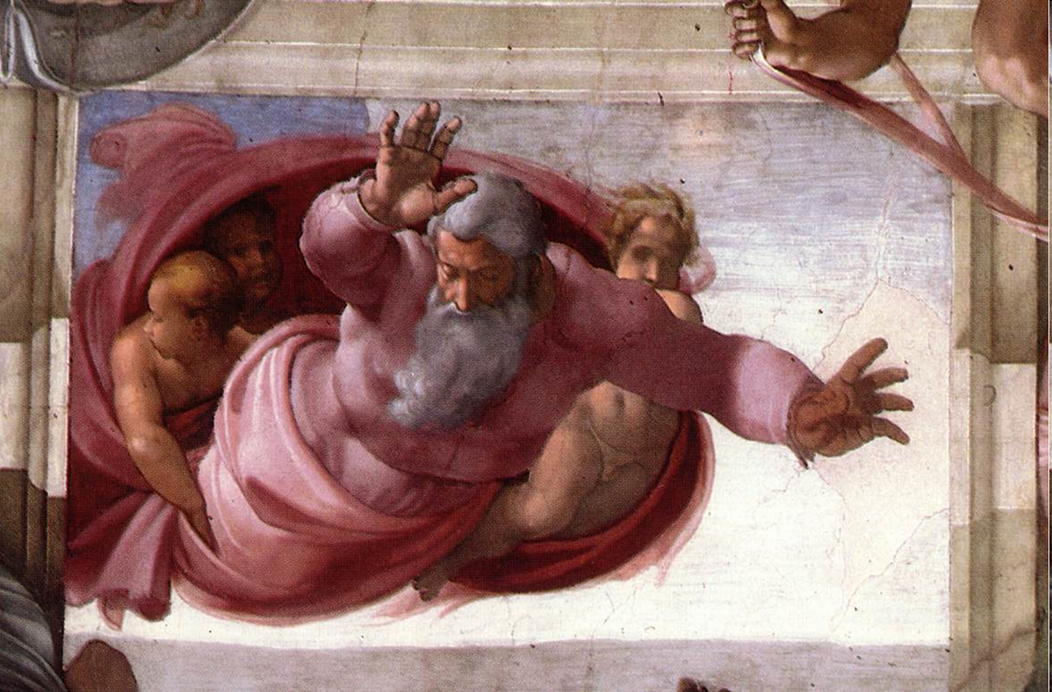
Michelangelo Buonarroti, Separation of the Earth from the Waters, 1511 Fresco, 155 x 270 cm
Cappella Sistina, Vatican

Slide 23
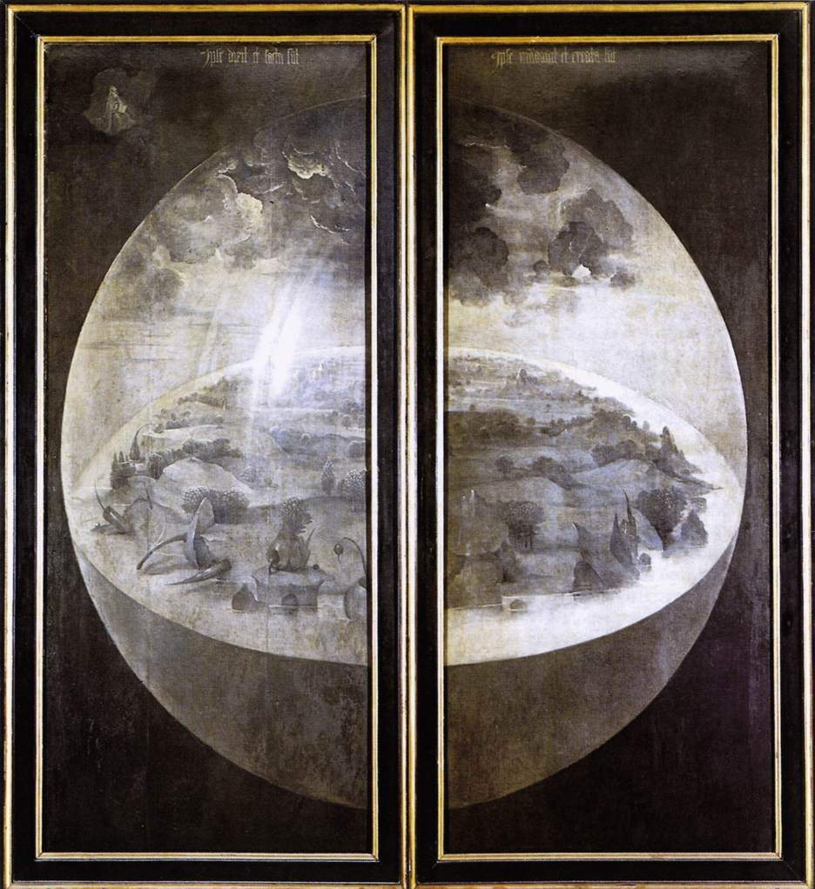
Hieronymus Bosch: Triptych of Garden of Earthly Delights
(outer wings showing world at creation)
, c. 1500
Oil on panel, 220 x 97 cm (each wing), Museo del Prado, Madrid

Slide 24
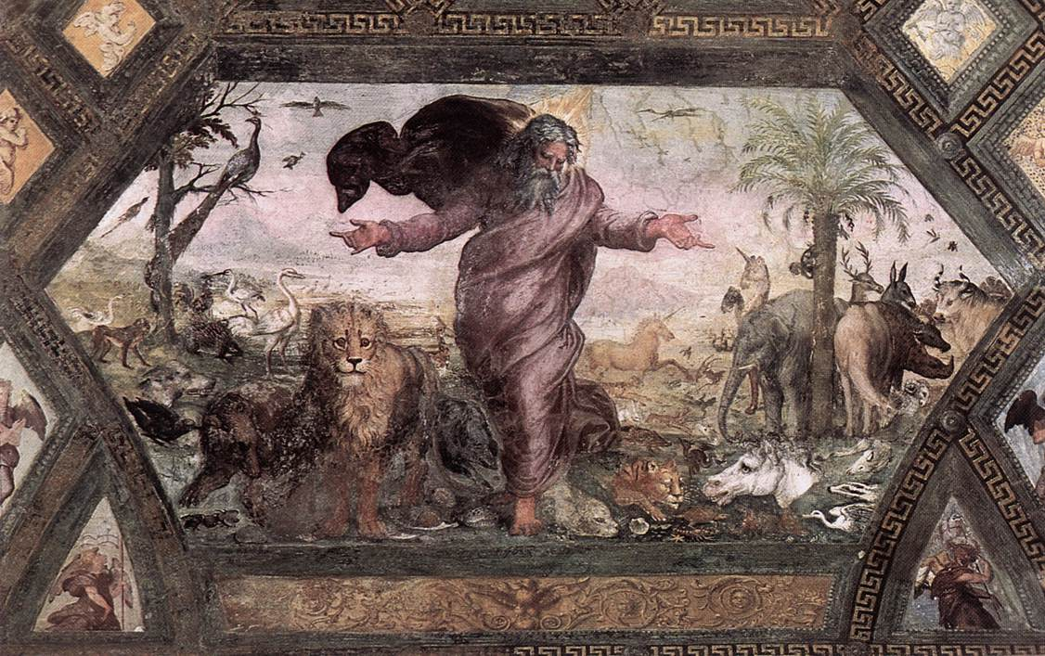
Raphael, The Creation of the Animals, 1518-19 Fresco, Loggia on the second floor, Palazzi Pontifici, Vatican

Slide 25
Discussion Notes
Is it important to you that science has a different description of the first moment of the universe?
Consider science may be interested in exactly how the universe came to be in order to understand its current properties.
The text in Genesis is concerned with why the universe came to be and how God, relates to our place.
Why do you think the author seems to go to some lengths to tell that what was physically created was good?

