Slide 1
Lesson 3
The Expulsion
Notes:
This PowerPoint is intended as an aid for the leader of an adult Christian Education group. All sources are footnoted and from easily available materials. Please respect the sacred nature of the scriptures covered. Use these materials as a way to start and sustain a lively discussion and consideration of a marvelous gift to us for a richer experience of life.
J B Cross
https://episcopalchristianeducation.com/

Slide 2
Genesis 2:15-17; 3:1-7
The LORD God took the man and put him in the garden of Eden to till it and keep it. And the LORD God commanded the man, "You may freely eat of every tree of the garden; but of the tree of the knowledge of good and evil you shall not eat, for in the day that you eat of it you shall die.” Now the serpent was more crafty than any other wild animal that the LORD God had made. He said to the woman, "Did God say,

Slide 3
Genesis 2:15-17; 3:1-7
`You shall not eat from any tree in the garden'?" The woman said to the serpent, "We may eat of the fruit of the trees in the garden; but God said, `You shall not eat of the fruit of the tree that is in the middle of the garden, nor shall you touch it, or you shall die.'" But the serpent said to the woman, "You will not die; for God knows that when you eat of it your eyes will be opened, and you will be like God, knowing good and evil.”

Slide 4
Genesis 2:15-17; 3:1-7
So when the woman saw that the tree was good for food, and that it was a delight to the eyes, and that the tree was to be desired to make one wise, she took of its fruit and ate; and she also gave some to her husband, who was with her, and he ate. Then the eyes of both were opened, and they knew that they were naked; and they sewed fig leaves together and made loincloths for themselves.

Slide 5
Genesis 3:8-15
The man and his wife heard the sound of the LORD God walking in the garden at the time of the evening breeze, and they hid themselves from the presence of the LORD God among the trees of the garden. But the LORD God called to the man, and said to him, "Where are you?" He said, "I heard the sound of you in the garden, and I was afraid, because I was naked; and I hid myself."

Slide 6
Genesis 3:8-15
He said, "Who told you that you were naked? Have you eaten from the tree of which I commanded you not to eat?" The man said, "The woman whom you gave to be with me, she gave me fruit from the tree, and I ate." Then the LORD God said to the woman, "What is this that you have done?" The woman said, "The serpent tricked me, and I ate." The LORD God said to the serpent,

Slide 7
Genesis 3:8-15
"Because you have done this, cursed are you among all animals and among all wild creatures; upon your belly you shall go, and dust you shall eat all the days of your life. I will put enmity between you and the woman, and between your offspring and hers; he will strike your head, and you will strike his heel."

Slide 8

Buck passing
God asks the man what’s going on, and Adam, like a child caught with chocolate-smeared fingers, tries to act innocent.
When confronted the man blames the woman that God gave him.
She blames the snake!
The snake in this picture is oddly less cowardly than Adam or Eve who both blame the next one down the line.
Notes:
The New Oxford Annotated Bible (c) Oxford University Press, 1996. All rights reserved.
3.1–24: The temptation story. 3.1–7: The temptation begins with an insinuation of doubt (Genesis 3.1–3), increases as suspicion is cast upon God’s motive (Genesis 3.4–5), and becomes irresistible when the couple sense the possibilities of freedom (Genesis 3.6). 1: The serpent, one of the wild creatures, distinguished by uncanny wisdom (Matthew 10.16); there is a hint of an evil power, hostile to God, out in the world. 5: Like God, perhaps “like gods” (Septuagint), the divine beings of the heavenly court (Genesis 3.22; Genesis 1.26 n.). Knowing good and evil, the entirety of knowledge; see Genesis 2.9 n. 7: Bodily shame (Genesis 2.25) symbolizes loss of an innocent, trusting relationship with God.
3.8–13: Guilt and anxiety prompt an attempt to hide from God (Psalm 139.7–12), who is here picturesquely portrayed as strolling in the garden to enjoy the cool evening breeze. 14–15: The curse contains an old explanation of why the serpent crawls rather than walks and why people are instinctively hostile to it. 16: This divine judgment contains an old explanation of woman’s pain in childbirth, her sexual desire for her husband (i.e. her motherly impulse, compare Genesis 30.1), and her subordinate position to man in ancient society, in contrast with the ideal equality of creation (see Genesis 1.27–28 n.; Genesis 2.18–21 n.).
3.17–19: An explanation of why people (“’adam”) have to struggle to eke out an existence from the ground (“’adamah”). Work is not intrinsically evil (Genesis 2.15) but it becomes toil when relationship with the Creator is broken. In Genesis 3.17 and elsewhere (Genesis 2.20; Genesis 3.21) later editors took the Hebrew word “’adam” to be a personal name (see translators' note to this verse), as in the genealogy of Genesis 5.1ff. The mortal nature of humanity was implicit in the circumstances of its origin from dust (Genesis 2.7); because of human disobedience, God now makes death an inevitable fate that haunts human beings throughout life until they return to the ground (“’adamah”). 21: Garments of skins, a sign of God’s protective care even in the time of judgment (Genesis 4.15).
3.22: Like one of us, see Genesis 3.5 n. The tree of life (Genesis 2.9) does not figure in the temptation story, which explicitly speaks of only one tree in the center of the garden (Genesis 3.3–6; Genesis 3.11–12; Genesis 3.17). 24: The cherubim, guardians of sacred areas (1 Kings 8.6–7), were represented as winged creatures like the Sphinx of Egypt, half-human and half-lion (Ezekiel 41.18–19). A divine sword (compare Jeremiah 47.6) was placed near the cherubim to warn banished human beings of the impossibility of overstepping their creaturely bounds (compare Ezekiel 28.13–16).

Slide 9
Judgment
God of course punishes each of them to an appropriate degree.
It seems that humans living in complete harmony and without suffering or deprivation, were able to find a way to muddle things up.
Or, is this an explanation for the state of humans in this world – beings with moral awareness, able to make choices and live with the consequences of those choices.

Slide 10

Parable
The story is for all intents a parable and can be understood in that way.
As a parable we can look at the action and the actors as a way to examine the story.

Slide 11
The Characters
The Snake – a wild creature, distinguished by uncanny wisdom and there is a hint of an evil power, hostile to God, in the world.
Adam and Eve – Both are apparently present for the snake’s line, yet only the Woman speaks.
God – Through His commandment and His tree.
Notes:
The New Oxford Annotated Bible (c) Oxford University Press, 1996. All rights reserved.
Genesis 3
3.1-24: The temptation story. 3.1-7: The temptation begins with an insinuation of doubt (Genesis 3.1-3), increases as suspicion is cast upon God's motive (Genesis 3.4-5), and becomes irresistible when the couple sense the possibilities of freedom (Genesis 3.6). 1: The serpent, one of the wild creatures, distinguished by uncanny wisdom (Matthew 10.16); there is a hint of an evil power, hostile to God, out in the world. 5: Like God, perhaps "like gods" (Septuagint), the divine beings of the heavenly court (Genesis 3.22; Genesis 1.26 n.). Knowing good and evil, the entirety of knowledge; see Genesis 2.9 n. 7: Bodily shame (Genesis 2.25) symbolizes loss of an innocent, trusting relationship with God.
3.8-13: Guilt and anxiety prompt an attempt to hide from God (Psalm 139.7-12), who is here picturesquely portrayed as strolling in the garden to enjoy the cool evening breeze. 14-15: The curse contains an old explanation of why the serpent crawls rather than walks and why people are instinctively hostile to it. 16: This divine judgment contains an old explanation of woman's pain in childbirth, her sexual desire for her husband (i.e. her motherly impulse, compare Genesis 30.1), and her subordinate position to man in ancient society, in contrast with the ideal equality of creation (see Genesis 1.27-28 n.; Genesis 2.18-21 n.).
3.17-19: An explanation of why people ("'adam") have to struggle to eke out an existence from the ground ("'adamah"). Work is not intrinsically evil (Genesis 2.15) but it becomes toil when relationship with the Creator is broken. In Genesis 3.17 and elsewhere (Genesis 2.20; Genesis 3.21) later editors took the Hebrew word "'adam" to be a personal name (see translators' note to this verse), as in the genealogy of Genesis 5.1ff. The mortal nature of humanity was implicit in the circumstances of its origin from dust (Genesis 2.7); because of human disobedience, God now makes death an inevitable fate that haunts human beings throughout life until they return to the ground ("'adamah"). 21: Garments of skins, a sign of God's protective care even in the time of judgment (Genesis 4.15).
3.22: Like one of us, see Genesis 3.5 n. The tree of life (Genesis 2.9) does not figure in the temptation story, which explicitly speaks of only one tree in the center of the garden (Genesis 3.3-6; Genesis 3.11-12; Genesis 3.17). 24: The cherubim, guardians of sacred areas (1 Kings 8.6-7), were represented as winged creatures like the Sphinx of Egypt, half-human and half-lion (Ezekiel 41.18-19). A divine sword (compare Jeremiah 47.6) was placed near the cherubim to warn banished human beings of the impossibility of overstepping their creaturely bounds (compare Ezekiel 28.13-16).
The New Oxford Annotated Bible (c) Oxford University Press, 1996. All rights reserved.

Slide 12
The Setup
Adam and Eve are at peace in the Garden.
The snake tells Eve about the tree and casts doubt on God’s motive in the commandment.
The object to be acquired is “the knowledge of Good and Evil.”
The snake uses a ‘lie’ that the tree is not deadly – we know from hindsight that the ultimate punishment / result would be the cause of bad things.

Slide 13
The Action
Eve sees that the fruit is attractive and ‘desired to make one wise.’
Eve picks the fruit and eats it.
Eve hands it to Adam.
They become wise, and know they are naked.
They discover that they could choose to follow God’s commandment, or not.

Slide 14
Misconception
The story has been used to illustrate Eve’s temptation of Adam.
The text itself is ambiguous – Adam may or may not have been with Eve when she encountered the snake.
But, in the text he was present when she picked and ate the fruit. Adam and Eve had equal moral positions.

Slide 15

Eve
In the traditional storytelling, the emphasis is on the gullibility of Eve.
This is only one possible interpretation of the Genesis narrative.
Another might be that since the man and the woman were together when the serpent spoke - the serpent might have addressed the woman as provider of food or as theological thinker, not as the more gullible.
Notes:
The New Oxford Annotated Bible (c) Oxford University Press, 1996. All rights reserved.
Eve
Eve. The name given to the first woman by the first man (Genesis 3.20). The Bible interprets this name to mean "the mother of all living," both because Eve is, through her sons, the female ancestor of the entire human race and because the name sounds similar to the Hebrew word for "living being." The wordplay is probably etymologically incorrect, and later rabbinic tradition proposed a connection with the Aramaic word for "serpent." The actual linguistic derivation of the name remains uncertain.
According to the account in Genesis 2-3, the woman is created to be a companion corresponding to (not originally subordinate to) the man. Because the two of them eat the forbidden fruit (See Fall, The), the man is destined to toil as a farmer in fields of thorns and thistles, and the woman is destined to suffer pain in childbearing. It is in the aftermath of these divine pronouncements that the man names the woman as he had earlier named the animals, thus indicating dominion over her.
Both Jewish tradition and the New Testament offer a very negative view of Eve, presenting her as representative of the alleged weaknesses of women. Paul feared that the Corinthian Christians would be led astray from Christ as Eve was deceived by the serpent (2 Corinthians 11.3). In 1 Timothy 2.13-15, Eve's deception by the serpent and also her creation subsequent to the man are cited as reasons that women must keep silent in church (cf. 1 Corinthians 14.34-35) and hold no authority over men. Early Christian theologians contrasted Eve's sinfulness with the perfection of the "new Eve," Mary, the mother of Jesus.
This traditional emphasis on the gullibility of Eve and her tendency toward sin is one possible interpretation of the Genesis narrative; it is not, however, inherent in the text of the narrative itself. Genesis 3 gives no indication why the serpent addressed the woman and even indicates that the man and the woman were together when the serpent spoke. It has been suggested that the serpent might have addressed the woman as provider of food or as theological thinker, not as the more gullible of the couple, and that the woman's addition to the divine prohibition about the fruit ("we may not touch it") represents not a lie, but a desirable exaggeration meant to make sure that the basic command would not be broken. The man and the woman together discover their nakedness, together make fig leaf garments, and together hide from the deity. Both are destined to a life of pain (neither is cursed) because of their actions, and together they are expelled from the garden. Thus, once the reader sets aside the portrait of Eve based on later traditions, the great skill of the Genesis narrator in presenting a character open to diverse interpretation becomes apparent.
See Also Adam; Eden, The Garden of; Genesis, The Book of; Lilith; Women.
KATHARINE DOOB SAKENFELD
The Oxford Companion to the Bible (c) Oxford University Press, 1996. All rights reserved.

Slide 16
Adam and Eve
The man and the woman together discover their nakedness, together make fig leaf garments, and together hide from the deity.
Both are destined to pain and are expelled from the garden.
Thus, once the reader sets aside the portrait of Eve based on later traditions, her character becomes open to diverse interpretations.
Notes:
The New Oxford Annotated Bible (c) Oxford University Press, 1996. All rights reserved.
Eve
Eve. The name given to the first woman by the first man (Genesis 3.20). The Bible interprets this name to mean "the mother of all living," both because Eve is, through her sons, the female ancestor of the entire human race and because the name sounds similar to the Hebrew word for "living being." The wordplay is probably etymologically incorrect, and later rabbinic tradition proposed a connection with the Aramaic word for "serpent." The actual linguistic derivation of the name remains uncertain.
According to the account in Genesis 2-3, the woman is created to be a companion corresponding to (not originally subordinate to) the man. Because the two of them eat the forbidden fruit (See Fall, The), the man is destined to toil as a farmer in fields of thorns and thistles, and the woman is destined to suffer pain in childbearing. It is in the aftermath of these divine pronouncements that the man names the woman as he had earlier named the animals, thus indicating dominion over her.
Both Jewish tradition and the New Testament offer a very negative view of Eve, presenting her as representative of the alleged weaknesses of women. Paul feared that the Corinthian Christians would be led astray from Christ as Eve was deceived by the serpent (2 Corinthians 11.3). In 1 Timothy 2.13-15, Eve's deception by the serpent and also her creation subsequent to the man are cited as reasons that women must keep silent in church (cf. 1 Corinthians 14.34-35) and hold no authority over men. Early Christian theologians contrasted Eve's sinfulness with the perfection of the "new Eve," Mary, the mother of Jesus.
This traditional emphasis on the gullibility of Eve and her tendency toward sin is one possible interpretation of the Genesis narrative; it is not, however, inherent in the text of the narrative itself. Genesis 3 gives no indication why the serpent addressed the woman and even indicates that the man and the woman were together when the serpent spoke. It has been suggested that the serpent might have addressed the woman as provider of food or as theological thinker, not as the more gullible of the couple, and that the woman's addition to the divine prohibition about the fruit ("we may not touch it") represents not a lie, but a desirable exaggeration meant to make sure that the basic command would not be broken. The man and the woman together discover their nakedness, together make fig leaf garments, and together hide from the deity. Both are destined to a life of pain (neither is cursed) because of their actions, and together they are expelled from the garden. Thus, once the reader sets aside the portrait of Eve based on later traditions, the great skill of the Genesis narrator in presenting a character open to diverse interpretation becomes apparent.
See Also Adam; Eden, The Garden of; Genesis, The Book of; Lilith; Women.
KATHARINE DOOB SAKENFELD
The Oxford Companion to the Bible (c) Oxford University Press, 1996. All rights reserved.

Slide 17
The Fall
The Fall refers to the disobedience and the expulsion of Adam and Eve from the garden of Eden.
Adam and Eve—initially enjoyed a life of ease and intimacy with God, but their desire to become "like gods“ led them to disobey God's prohibition against eating from the tree of knowledge.
Other traditions have similar stories.
The biblical narrative is unique, however, in implying that humanity's degradation was indirectly caused by its own free choice.
Notes:
The New Oxford Annotated Bible (c) Oxford University Press, 1996. All rights reserved.
Fall, The
Fall, The. The Fall refers to the disobedience and the expulsion of Adam and Eve from the garden of Eden. According to the J account of creation (Genesis 2-3), humanity—represented by Adam and Eve—initially enjoyed a life of ease and intimacy with God, but their desire to become "like gods" (Genesis 3.5) led them to disobey God's prohibition against eating from the tree of knowledge. They were punished with expulsion from paradise and condemned to a life of suffering that was passed on to their descendants.
The biblical myth of the Fall is similar to other legends that contrast humanity's present state of suffering with an earlier time of perfection, a lost paradise or golden age. The biblical narrative is unique, however, in implying that humanity's degradation was indirectly caused by its own free choice.
The fall of divine beings played a central role in the writings of the Gnostics (second and third centuries CE), many of whom believed that creation and even human existence were caused by a precosmic error. According to the Gnostics, the physical cosmos was a concrete nightmare from which the divine sparks of humanity sought to escape.
In the New Testament Paul explained that Adam, the man of flesh, brought sin and death to the world while Christ, the second Adam and the man of spirit, brought life (1 Corinthians 15.21-22). Paul's view that Adam's fall introduced sin and death (Romans 5.12) led Augustine (fifth century CE) to develop the doctrine of original sin: that Adam's fall perverted all humanity and that its effects were passed by hereditary transmission from generation to generation. The belief that Adam, as a corporate personality, was responsible for the sins of humanity was never adopted by Judaism and was resisted by Christian thinkers such as Pelagius and Julian of Eclanum (fifth century CE), but Augustine's interpretation of the Fall became the accepted doctrine of Catholic Christianity. Like all myths of a lost paradise or golden age, the story of the Fall, whether of gods or humans, is an index of humanity's yearning for a better world and an attempt to account for the problems of evil and human suffering.
GREGORY SHAW
The Oxford Companion to the Bible (c) Oxford University Press, 1996. All rights reserved.

Slide 18
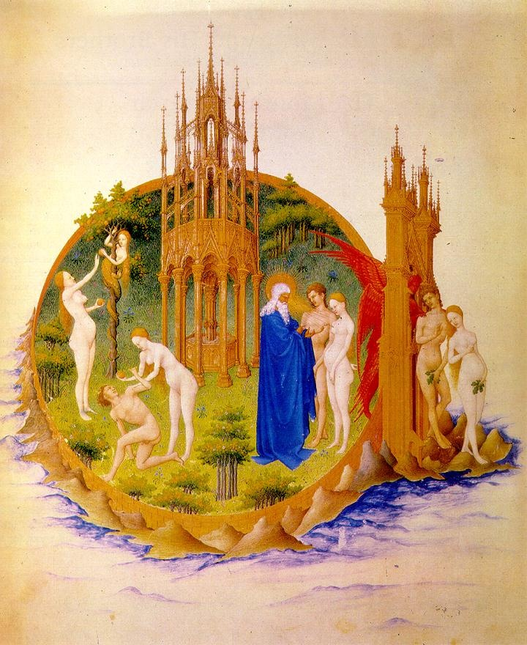
The Limbourg Brothers, The Fall and the Expulsion from Paradise
(from the Book of Hours of the Duc de Berry), 1415-16
Vellum, 29 x 21 cm, Musée Condé, Chantilly
The structure in the middle is the fountain of life.

Slide 19
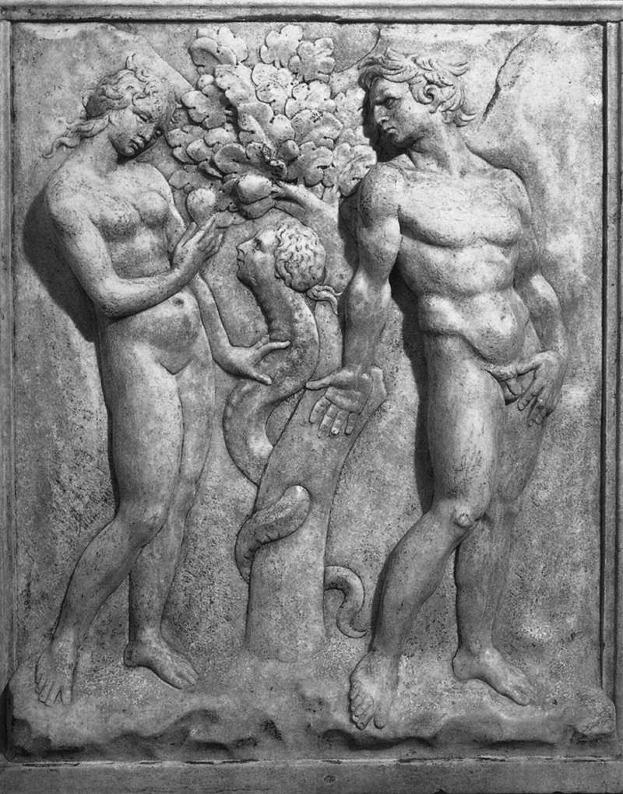
Jacopo della Quercia, Temptation, 1425-28
Marble, 99 x 92 cm
San Petronio, Bologna
The heroic bodies of Adam and Eve influenced Michelangelo who was drawn to them while in Bologna.

Slide 20
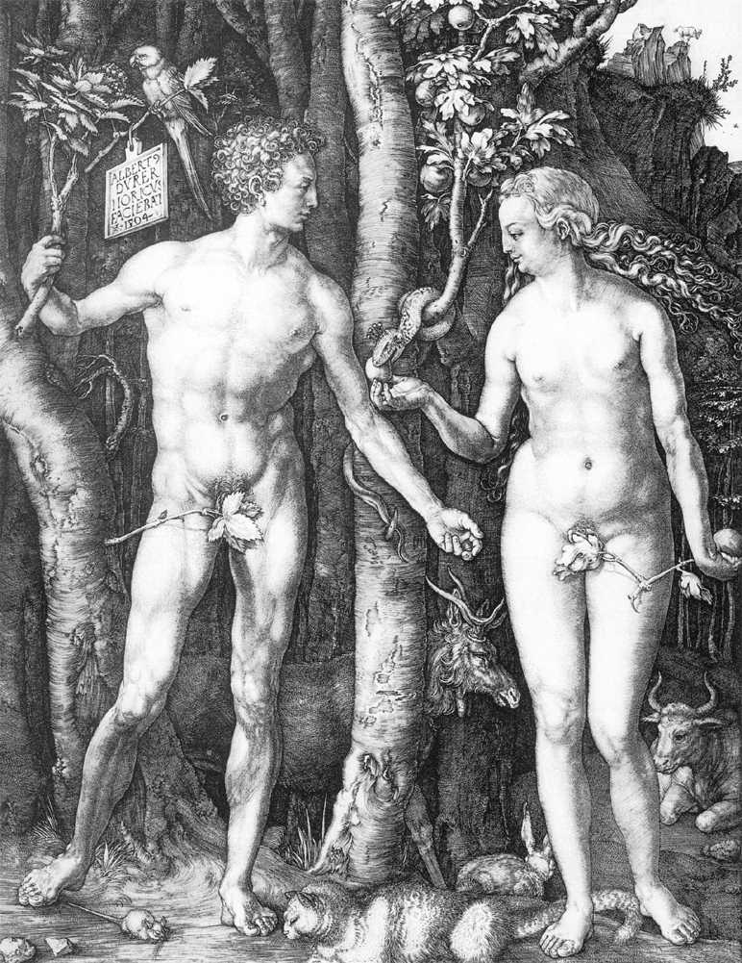
Albrecht Dürer,
Adam and Eve, 1504
Engraving, 252 x 194 mm
The figures are based on classical sculptures: the Apollo Belvedere and the Medici Venus. The elk, hare, cat and ox symbolize the four humours into which the human soul was divided after the Fall.

Slide 21
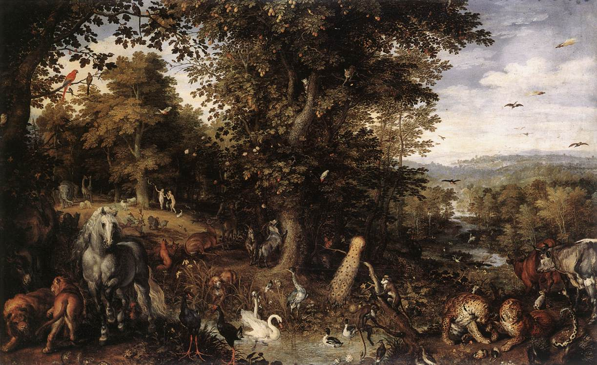

Slide 23
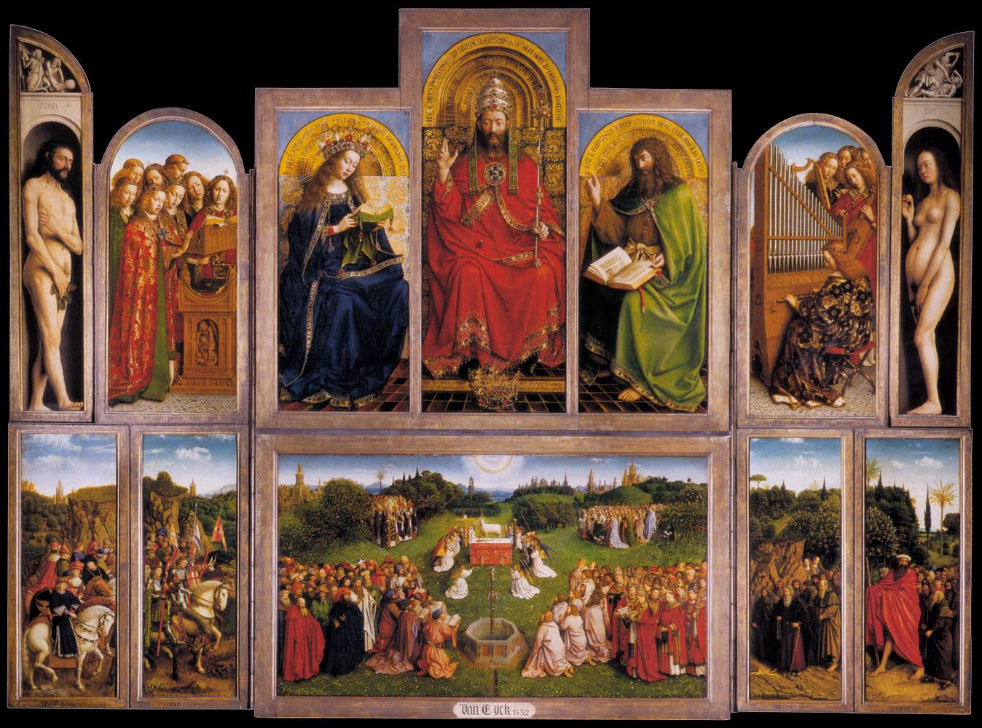

Slide 24
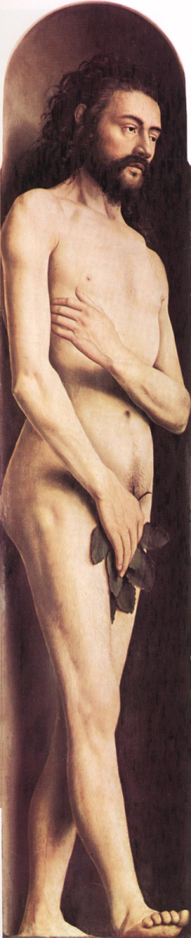
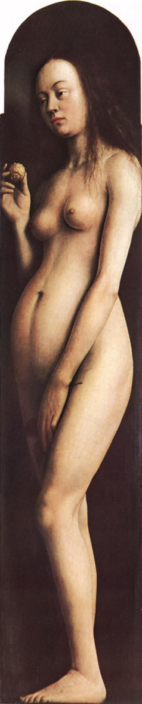
Jan van Eyck,
The Ghent Altarpiece: Adam & Eve
1425-29
Oil on wood, 213,3 x 32,3 cm
Cathedral of St Bavo, Ghent

Slide 25
SO?
Is this a story about how bad snakes are?
Is this a story to explain the transition as mankind reached intelligence and then self awareness?
If one is not self aware e.g. aware of another less than ideal life, was it really paradise in the garden?
Is the garden a description of the perfect life [see Isaiah or Revelation] to come, and to which we seek a return as ourselves but sinless?

