Slide 1
Lesson 5
Family History of the descendants of Abraham
“...the Lord said to Abram, ‘go from your country’”
Notes:
This PowerPoint is intended as an aid for the leader of an adult Christian Education group. All sources are footnoted and from easily available materials. Please respect the sacred nature of the scriptures covered. Use these materials as a way to start and sustain a lively discussion and consideration of a marvelous gift to us for a richer experience of life.
J B Cross
www.episcopalchristianeducation.com

Slide 2
Abraham

Slide 3
Abraham
Abraham is the earliest biblical character who is delineated clearly enough to be correlated, to a limited extent, within world history.
This is the start of the Abraham Saga. The genealogies of Genesis end in the prior chapter with the father and uncles of Abraham.
Abraham should be looked to as a source of unity and harmony rather than dissent among Jews, Christians, and Muslims.
The covenant is with all of the descendants of Abraham.
Notes:
The New Oxford Annotated Bible (c) Oxford University Press, 1996. All rights reserved.
Abraham
Abraham. Abraham is the earliest biblical character who is delineated clearly enough to be correlated, to a limited extent, within world history. His homeland on the Fertile Crescent (possibly at Haran, at least in Genesis 12.1-5) and movements southeast toward Chaldean Ur (Genesis 11.31), then west to Canaan and Egypt, correspond to known Amorite migratory and commercial routes. He may have been a caravan merchant, though the Bible presents him only as a pastoralist. This vague relation of Abraham to history does not exclude debate as to how much of his biography might have been worked up for vividness or as retrojection of a later tribal unity. More insistent claims of historicity presume contemporaneity with Hammurapi (despite the discredited equation of the latter with Amraphel [Genesis 14.1]). An even earlier date was put forward on the basis of some premature interpretations of Sodom at Ebla. The name Abram (= Abiram, as Abner = Abiner), used in Genesis from Genesis 11.27 to Genesis 17.5, is there ritually changed to Abraham, a normal dialectal variant, though explained in relation to ab-hamon, "father of many."
A certain unity in the whole Abraham saga (Genesis 11.27-25.11) involves a rich variety of peoples and individuals conditioning his activity; twenty-two separate episodes are discernible (see L. Hicks, Interpreter's Dictionary of the Bible 1.16). Eleven are attributed to the Yahwist (J): base around Haran, Genesis 11.28-30; call westward, Genesis 12.1-3; Canaan pause, Genesis 12.4-9; separation from Lot, Genesis 13.1-13; promise involving Mamre, Genesis 13.14-18; progeny like stars, covenant-incubation, Genesis 15.1-6; Genesis 15.7-24; Hagar, Genesis 16; the three at Mamre, Genesis 18.1-15; vain plea for Sodom, Genesis 18.16-33; birth of Isaac, Genesis 21.1-7; and old age, Genesis 24.1-25.11. Five other episodes suggest the Elohist (E): parts of the narrative of the covenant in Genesis 15, especially Genesis 15.13-16; Gerar, Genesis 20; Ishmael expelled, Genesis 21.6-21; Abimelech Genesis 21.22-34; and the call to sacrifice Isaac, Genesis 22 (See Aqedah). The Priestly (P) additions include: journey to Canaan, parts of Genesis 11-12; birth of Ishmael, Genesis 16.1-16; covenant of El-Shaddai and circumcision, Genesis 17; birth of Isaac, Genesis 21.1-3; Machpelah, Genesis 23; death, Genesis 25.7-11; and, less clearly, the unique episode concerning Melchizedek (Genesis 14).
The three strands respectively see Abraham as "father of all nations" (J); "model of faith" (E; see Romans 4.9; Hebrews 11.8); and "guarantor of Israel's survival" (P, in the context of exile). The covenant with Abraham is also a blessing for all the peoples of the earth (Genesis 12.3; Genesis 18.18) and especially a bond of religious unity with his other descendants, the Ishmaelites (Arabs: Genesis 21.21; Genesis 25.12). Abraham's progress from (Ur or) Haran through Canaan into Egypt involves numerous theophanies (Genesis 12.6, Shechem; Genesis 12.8, Bethel; Genesis 13.18, Hebron; Genesis 21.33, Beer-sheba; Genesis 22.14, Moriah), justifying his eventual takeover of the whole area (Genesis 13.14-17) or, more sweepingly, the takeover by "his god" (El) of the cult of the local El, not clearly seen as either identical or different.
In Deuteronomy, Abraham is associated with Isaac and Jacob (Deuteronomy 1.8; Deuteronomy 6.10); the three are often generalized as "your fathers" (Deuteronomy 9.18; Deuteronomy 11.9; NRSV: "your ancestors"), especially as those with whom God made a covenant (Deuteronomy 7.12; Deuteronomy 8.18), a covenant still in force (Deuteronomy 5.3). The Deuteronomic history recalls Abraham in Joshua 24.2-3; 1 Kings 18.36; 2 Kings 13.23; but it is surprising how seldom he is mentioned there, as well as in the Psalms (only Psalm 47.9; Psalm 105.6; Psalm 105.9; Psalm 105.42) and the preexilic prophets (only Micah 7.20, probably a late addition). The poorer classes of Judah who never were sent into exile justified their inheritance as the promise to Abraham (Ezekiel 33.24), but the stronger group of returnees attributed their own liberation to God's faithfulness to Abraham "my friend" (Isaiah 41.8, prominent in James 2.23 and in Muslim tradition, notably as the name of Hebron, al-Halil). Abraham is often mentioned in the book of Jubilees and sometimes in other pseudepigrapha.
Abraham is second only to Moses among New Testament mentions of biblical heroes. Sometimes this is in a slightly belittling sense, when he is claimed as father of the impious (Matthew 3.9; John 8.39). More often the truly Abrahamic descent of the Jews is acknowledged as a stimulus for them to live up to their heritage (Luke 19.9; Luke 16.24; Hebrews 6.13). This true but qualified descent from Abraham forms a key factor in Paul's anguished efforts to determine how and in what sense Christianity can claim the promises made to Israel (Romans 4.1; Romans 4.13; Galatians 3.7; Galatians 4.22). Ultimately, as father of all believers (Galatians 3.7), Abraham is to be looked to as a source of unity and harmony rather than dissent among Jews, Christians, and Muslims.
See Also Abraham's Bosom; Ancestors, The; Genesis, The Book of; Pentateuch.
ROBERT NORTH
The Oxford Companion to the Bible (c) Oxford University Press, 1996. All rights reserved.

Slide 4
Genesis as Ancestral History
The second part is the ancestral history, which deals with the limited family history of Israel’s ancestors:
  Abraham and Sarah
  Isaac and Rebekah, and
  Jacob’s family, the chief member of which was Joseph
By the time Genesis ends, in the time of Joseph’s wise and benevolent administration of Egypt, the promise to Abram in today’s reading is pressing toward realization.
Notes:
The New Oxford Annotated Bible (c) Oxford University Press, 1996. All rights reserved.

Slide 5
Abram later Abraham
In Genesis, Abram just appears in Chapter 12.
Later to be known as Abraham, he is the original hero of ancient Israel.
In the OT there are twenty-two separate episodes in Abraham’s life, some discernible from the various OT traditions: J, E, and P.
Eleven are attributed to the Yahwist (J)
Five other episodes suggest the Elohist (E)
And six or more to the Priestly (P)
Notes:
The New Oxford Annotated Bible (c) Oxford University Press, 1996. All rights reserved.
Abraham
Abraham. Abraham is the earliest biblical character who is delineated clearly enough to be correlated, to a limited extent, within world history. His homeland on the Fertile Crescent (possibly at Haran, at least in Genesis 12.1-5) and movements southeast toward Chaldean Ur (Genesis 11.31), then west to Canaan and Egypt, correspond to known Amorite migratory and commercial routes. He may have been a caravan merchant, though the Bible presents him only as a pastoralist. This vague relation of Abraham to history does not exclude debate as to how much of his biography might have been worked up for vividness or as retrojection of a later tribal unity. More insistent claims of historicity presume contemporaneity with Hammurapi (despite the discredited equation of the latter with Amraphel [Genesis 14.1]). An even earlier date was put forward on the basis of some premature interpretations of Sodom at Ebla. The name Abram (= Abiram, as Abner = Abiner), used in Genesis from Genesis 11.27 to Genesis 17.5, is there ritually changed to Abraham, a normal dialectal variant, though explained in relation to ab-hamon, "father of many."
A certain unity in the whole Abraham saga (Genesis 11.27-25.11) involves a rich variety of peoples and individuals conditioning his activity; twenty-two separate episodes are discernible (see L. Hicks, Interpreter's Dictionary of the Bible 1.16). Eleven are attributed to the Yahwist (J): base around Haran, Genesis 11.28-30; call westward, Genesis 12.1-3; Canaan pause, Genesis 12.4-9; separation from Lot, Genesis 13.1-13; promise involving Mamre, Genesis 13.14-18; progeny like stars, covenant-incubation, Genesis 15.1-6; Genesis 15.7-24; Hagar, Genesis 16; the three at Mamre, Genesis 18.1-15; vain plea for Sodom, Genesis 18.16-33; birth of Isaac, Genesis 21.1-7; and old age, Genesis 24.1-25.11. Five other episodes suggest the Elohist (E): parts of the narrative of the covenant in Genesis 15, especially Genesis 15.13-16; Gerar, Genesis 20; Ishmael expelled, Genesis 21.6-21; Abimelech Genesis 21.22-34; and the call to sacrifice Isaac, Genesis 22 (See Aqedah). The Priestly (P) additions include: journey to Canaan, parts of Genesis 11-12; birth of Ishmael, Genesis 16.1-16; covenant of El-Shaddai and circumcision, Genesis 17; birth of Isaac, Genesis 21.1-3; Machpelah, Genesis 23; death, Genesis 25.7-11; and, less clearly, the unique episode concerning Melchizedek (Genesis 14).
The three strands respectively see Abraham as "father of all nations" (J); "model of faith" (E; see Romans 4.9; Hebrews 11.8); and "guarantor of Israel's survival" (P, in the context of exile). The covenant with Abraham is also a blessing for all the peoples of the earth (Genesis 12.3; Genesis 18.18) and especially a bond of religious unity with his other descendants, the Ishmaelites (Arabs: Genesis 21.21; Genesis 25.12). Abraham's progress from (Ur or) Haran through Canaan into Egypt involves numerous theophanies (Genesis 12.6, Shechem; Genesis 12.8, Bethel; Genesis 13.18, Hebron; Genesis 21.33, Beer-sheba; Genesis 22.14, Moriah), justifying his eventual takeover of the whole area (Genesis 13.14-17) or, more sweepingly, the takeover by "his god" (El) of the cult of the local El, not clearly seen as either identical or different.
In Deuteronomy, Abraham is associated with Isaac and Jacob (Deuteronomy 1.8; Deuteronomy 6.10); the three are often generalized as "your fathers" (Deuteronomy 9.18; Deuteronomy 11.9; NRSV: "your ancestors"), especially as those with whom God made a covenant (Deuteronomy 7.12; Deuteronomy 8.18), a covenant still in force (Deuteronomy 5.3). The Deuteronomic history recalls Abraham in Joshua 24.2-3; 1 Kings 18.36; 2 Kings 13.23; but it is surprising how seldom he is mentioned there, as well as in the Psalms (only Psalm 47.9; Psalm 105.6; Psalm 105.9; Psalm 105.42) and the preexilic prophets (only Micah 7.20, probably a late addition). The poorer classes of Judah who never were sent into exile justified their inheritance as the promise to Abraham (Ezekiel 33.24), but the stronger group of returnees attributed their own liberation to God's faithfulness to Abraham "my friend" (Isaiah 41.8, prominent in James 2.23 and in Muslim tradition, notably as the name of Hebron, al-Halil). Abraham is often mentioned in the book of Jubilees and sometimes in other pseudepigrapha.
Abraham is second only to Moses among New Testament mentions of biblical heroes. Sometimes this is in a slightly belittling sense, when he is claimed as father of the impious (Matthew 3.9; John 8.39). More often the truly Abrahamic descent of the Jews is acknowledged as a stimulus for them to live up to their heritage (Luke 19.9; Luke 16.24; Hebrews 6.13). This true but qualified descent from Abraham forms a key factor in Paul's anguished efforts to determine how and in what sense Christianity can claim the promises made to Israel (Romans 4.1; Romans 4.13; Galatians 3.7; Galatians 4.22). Ultimately, as father of all believers (Galatians 3.7), Abraham is to be looked to as a source of unity and harmony rather than dissent among Jews, Christians, and Muslims.
See Also Abraham's Bosom; Ancestors, The; Genesis, The Book of; Pentateuch.
ROBERT NORTH
The Oxford Companion to the Bible (c) Oxford University Press, 1996. All rights reserved.

Slide 6
Covenant
One of the fundamental theological motifs of the Hebrew and Christian scriptures.
In the ancient world, covenants or treaties often governed the relations between peoples. There were parity treaties between two equal sovereign states, and there were overlord treaties between a powerful monarch and a vassal state.
Notes:
The New Oxford Annotated Bible (c) Oxford University Press, 1996. All rights reserved.
Covenant
Covenant. One of the fundamental theological motifs of the Hebrew and Christian scriptures. Eventually the expressions "old covenant" and "new covenant," which once referred to two eras (Jeremiah 31.31-33) or dispensations (2 Corinthians 3.4-11), came to designate the two parts of the Christian Bible, the Old Testament (Covenant) and the New.
The Hebrew term for covenant (berit) seems to have the root meaning of "bond, fetter," indicating a binding relationship; the idea of "binding, putting together" is also suggested in the Greek term synthēkē. Another term used in the New Testament is diathēkē ("will, testament"), pointing more to the obligatory or legal aspect of a covenant. The meaning of covenant, however, is not determined primarily by etymology but by how these and related terms function in various literary contexts. In general, covenant signifies a relationship based on commitment, which includes both promises and obligations, and which has the quality of reliability and durability. The relationship is usually sealed by a rite—for example, an oath, sacred meal, blood sacrifice, invocation of blessings and curses—which makes it binding.
In the Hebrew Bible, various secular covenants are mentioned: covenants between leaders of two peoples (Abraham and Abimelech, Genesis 21.25-32), between two heads of state (Ahab and Benhadad, 1 Kings 20.34), between king and people (David and the elders of Israel, 1 Chronicles 11.3), between a revolutionary priest and the army (Jehoiada, 2 Kings 11.4), between a conquering king and a vassal (Nebuchadrezzar and a Judean prince, Ezekiel 17.13-19; cf. 1 Samuel 11.1). These treaties or pacts were usually thought to be supervised by the deity. This was the case for instance, in the covenant between Jacob and Laban, which was sealed with a sacred meal and which concluded with a prayer that God would see to it that both sides lived up to the terms of the agreement (Genesis 31.44-54). Likewise the covenant between Jonathan and David, based on the loyalty (hesed) of friendship, was "a covenant before Yahweh" (1 Samuel 23.18).
In the ancient world, covenants or treaties often governed the relations between peoples. There were parity treaties between two equal sovereign states, and there were overlord treaties between a powerful monarch and a vassal state. Illustrative of the latter is the suzerainty treaty form of the second and first millennia, which apparently influenced Israel's Mosaic covenant theology found in the book of Deuteronomy. These treaties included such elements as a summary of the benevolent deeds of the overlord, the stipulations binding on the vassal who receives favor and protection, and the sanctions of blessings and curses in case of obedience or disobedience.
Covenant expresses a novel element of the religion of ancient Israel: the people are bound in relationship to the one God, Yahweh, who makes an exclusive ("jealous") claim upon their loyalty in worship and social life. In a larger sense, the relationship between all creatures and their creator is expressed in the universal covenant with Noah (Genesis 9.1-17), which assures God's faithful pledge to humanity, to nonhuman creatures, and to the earth itself. In the Pentateuch, however, primary emphasis is given to God's covenant with the Israelite people, portrayed in the migration of Abraham and Sarah in response to the divine promise (Genesis 11.31-12.7) and the special relationship between God and their descendants (Genesis 15.1-21; Genesis 17.1-22). In the biblical narrative, the covenant with Israel's ancestors is the prelude to the crucial events of the Exodus and the Mosaic covenant at Sinai and is supplemented by the covenant between God and the Davidic monarch, who mediates God's cosmic rule, manifest in the anointed one (the reigning ruler) and in the Temple of Zion (Psalm 78.67-72; 2 Samuel 7).
The covenants between God and the people are all covenants of divine favor or grace (Hebr. hesed). They express God's gracious commitment and faithfulness and thus establish a continuing relationship. They differ from one another theologically at the point of whether the accent falls upon God's loyalty, which endows the relationship with constancy and durability, or upon the people's response, which is subject to human weakness and sin. The Abrahamic and Davidic covenants belong to the type of the "everlasting covenant" (berit olam), for they rest upon divine grace alone and are not conditioned by human behavior. On the other hand, the Mosaic covenant, set forth classically in the book of Deuteronomy, has a strong conditional note, for its endurance depends on the people's obedience to the covenant commandments.
Furthermore, all of God's covenants with Israel include divine promises, as well as human obligations, though they differ as to which is emphasized. The Abrahamic covenant is primarily a promissory covenant. In it God imposes no conditions (circumcision is a sign, not a legal condition of the relationship) but rather gives promises: the land as an everlasting possession, numerous posterity, and a special relationship between God and the descendants of Abraham and Sarah (Genesis 17.7-8). Similarly, the Davidic covenant, perhaps on the analogy of royal grants of the ancient Near East, does not impose legal conditions, but offers a gracious promise of an unbroken succession of kings upon the throne of David (2 Samuel 7). Although unfaithful kings will be chastised if they behave badly in office, God will not abrogate
The Oxford Companion to the Bible (c) Oxford University Press, 1996. All rights reserved.
the covenant promises of grace made to David (Psalm 89; See Also Kingship and Monarchy). The Mosaic covenant, however, like the suzerainty treaties of the ancient world, is a covenant of obligation, subject to the sanctions of blessings and curses (Deuteronomy 30.15-20). If the people are unfaithful and disobey the covenant stipulations, they will be punished for breaking the covenant. Carried to the extreme, this covenant could even be annulled, so that no longer would Yahweh be their God and no longer would Israel be God's people (Hosea 1.9). The renewal of the covenant, in this view, would be based solely on God's forgiving grace (Exodus 34.6-9; Jeremiah 31.31-33; Ezekiel 16.59-63).
The New Testament draws upon all of these covenant traditions. In some circles, however, there was a strong preference for the promissory covenants associated with Abraham and David (cf. "the covenants of promise," Ephesians 2.12). Paul's interpretation of the new relationship between God and people, shown by the display of God's grace in Jesus Christ, sent him back beyond the Mosaic covenant of obligation to the Abrahamic promissory covenant (Galatians 3.6-18). And the promissory Davidic covenant, found especially in the prophecy of the book of Isaiah, provided a theological context for the announcement that Jesus is the Messiah (Christ), the Son of God.
See Also Biblical Theology, article on Old Testament.
BERNHARD W. ANDERSON
The Oxford Companion to the Bible (c) Oxford University Press, 1996. All rights reserved.

Slide 7
Covenant
The Abrahamic covenant is primarily a promissory covenant. In it God imposes no conditions (circumcision is a sign, not a legal condition of the relationship) but rather gives promises: the land as an everlasting possession, numerous posterity, and a special relationship between God and the descendants of Abraham and Sarah.
Carried to the extreme, this covenant could even be annulled, so that no longer would Yahweh be their God and no longer would Israel be God's people (Hosea 1.9). The renewal of the covenant, in this view, would be based solely on God's forgiving grace
Notes:
The New Oxford Annotated Bible (c) Oxford University Press, 1996. All rights reserved.
Covenant
Covenant. One of the fundamental theological motifs of the Hebrew and Christian scriptures. Eventually the expressions "old covenant" and "new covenant," which once referred to two eras (Jeremiah 31.31-33) or dispensations (2 Corinthians 3.4-11), came to designate the two parts of the Christian Bible, the Old Testament (Covenant) and the New.
The Hebrew term for covenant (berit) seems to have the root meaning of "bond, fetter," indicating a binding relationship; the idea of "binding, putting together" is also suggested in the Greek term synthēkē. Another term used in the New Testament is diathēkē ("will, testament"), pointing more to the obligatory or legal aspect of a covenant. The meaning of covenant, however, is not determined primarily by etymology but by how these and related terms function in various literary contexts. In general, covenant signifies a relationship based on commitment, which includes both promises and obligations, and which has the quality of reliability and durability. The relationship is usually sealed by a rite—for example, an oath, sacred meal, blood sacrifice, invocation of blessings and curses—which makes it binding.
In the Hebrew Bible, various secular covenants are mentioned: covenants between leaders of two peoples (Abraham and Abimelech, Genesis 21.25-32), between two heads of state (Ahab and Benhadad, 1 Kings 20.34), between king and people (David and the elders of Israel, 1 Chronicles 11.3), between a revolutionary priest and the army (Jehoiada, 2 Kings 11.4), between a conquering king and a vassal (Nebuchadrezzar and a Judean prince, Ezekiel 17.13-19; cf. 1 Samuel 11.1). These treaties or pacts were usually thought to be supervised by the deity. This was the case for instance, in the covenant between Jacob and Laban, which was sealed with a sacred meal and which concluded with a prayer that God would see to it that both sides lived up to the terms of the agreement (Genesis 31.44-54). Likewise the covenant between Jonathan and David, based on the loyalty (hesed) of friendship, was "a covenant before Yahweh" (1 Samuel 23.18).
In the ancient world, covenants or treaties often governed the relations between peoples. There were parity treaties between two equal sovereign states, and there were overlord treaties between a powerful monarch and a vassal state. Illustrative of the latter is the suzerainty treaty form of the second and first millennia, which apparently influenced Israel's Mosaic covenant theology found in the book of Deuteronomy. These treaties included such elements as a summary of the benevolent deeds of the overlord, the stipulations binding on the vassal who receives favor and protection, and the sanctions of blessings and curses in case of obedience or disobedience.
Covenant expresses a novel element of the religion of ancient Israel: the people are bound in relationship to the one God, Yahweh, who makes an exclusive ("jealous") claim upon their loyalty in worship and social life. In a larger sense, the relationship between all creatures and their creator is expressed in the universal covenant with Noah (Genesis 9.1-17), which assures God's faithful pledge to humanity, to nonhuman creatures, and to the earth itself. In the Pentateuch, however, primary emphasis is given to God's covenant with the Israelite people, portrayed in the migration of Abraham and Sarah in response to the divine promise (Genesis 11.31-12.7) and the special relationship between God and their descendants (Genesis 15.1-21; Genesis 17.1-22). In the biblical narrative, the covenant with Israel's ancestors is the prelude to the crucial events of the Exodus and the Mosaic covenant at Sinai and is supplemented by the covenant between God and the Davidic monarch, who mediates God's cosmic rule, manifest in the anointed one (the reigning ruler) and in the Temple of Zion (Psalm 78.67-72; 2 Samuel 7).
The covenants between God and the people are all covenants of divine favor or grace (Hebr. hesed). They express God's gracious commitment and faithfulness and thus establish a continuing relationship. They differ from one another theologically at the point of whether the accent falls upon God's loyalty, which endows the relationship with constancy and durability, or upon the people's response, which is subject to human weakness and sin. The Abrahamic and Davidic covenants belong to the type of the "everlasting covenant" (berit olam), for they rest upon divine grace alone and are not conditioned by human behavior. On the other hand, the Mosaic covenant, set forth classically in the book of Deuteronomy, has a strong conditional note, for its endurance depends on the people's obedience to the covenant commandments.
Furthermore, all of God's covenants with Israel include divine promises, as well as human obligations, though they differ as to which is emphasized. The Abrahamic covenant is primarily a promissory covenant. In it God imposes no conditions (circumcision is a sign, not a legal condition of the relationship) but rather gives promises: the land as an everlasting possession, numerous posterity, and a special relationship between God and the descendants of Abraham and Sarah (Genesis 17.7-8). Similarly, the Davidic covenant, perhaps on the analogy of royal grants of the ancient Near East, does not impose legal conditions, but offers a gracious promise of an unbroken succession of kings upon the throne of David (2 Samuel 7). Although unfaithful kings will be chastised if they behave badly in office, God will not abrogate
The Oxford Companion to the Bible (c) Oxford University Press, 1996. All rights reserved.
the covenant promises of grace made to David (Psalm 89; See Also Kingship and Monarchy). The Mosaic covenant, however, like the suzerainty treaties of the ancient world, is a covenant of obligation, subject to the sanctions of blessings and curses (Deuteronomy 30.15-20). If the people are unfaithful and disobey the covenant stipulations, they will be punished for breaking the covenant. Carried to the extreme, this covenant could even be annulled, so that no longer would Yahweh be their God and no longer would Israel be God's people (Hosea 1.9). The renewal of the covenant, in this view, would be based solely on God's forgiving grace (Exodus 34.6-9; Jeremiah 31.31-33; Ezekiel 16.59-63).
The New Testament draws upon all of these covenant traditions. In some circles, however, there was a strong preference for the promissory covenants associated with Abraham and David (cf. "the covenants of promise," Ephesians 2.12). Paul's interpretation of the new relationship between God and people, shown by the display of God's grace in Jesus Christ, sent him back beyond the Mosaic covenant of obligation to the Abrahamic promissory covenant (Galatians 3.6-18). And the promissory Davidic covenant, found especially in the prophecy of the book of Isaiah, provided a theological context for the announcement that Jesus is the Messiah (Christ), the Son of God.
See Also Biblical Theology, article on Old Testament.
BERNHARD W. ANDERSON
The Oxford Companion to the Bible (c) Oxford University Press, 1996. All rights reserved.
Covenant
The OT tells many stories of God's covenant with the people of Israel. God made a covenant with Noah and his descendants that there will never again be a flood to destroy the earth. Noah serves as mediator of this covenant between God and all that lives on the earth. God's bow in the clouds was the sign of this covenant (Gn 9:8-17). God also made a covenant with Abraham, in which God promised Abraham that his posterity would be as numerous as the stars and that Abraham's descendants would have the promised land (Gn 15:1-21). God made a covenant with Moses that the people of Israel would be God's people, and God would be their God. God also promised to free them from the burdens of the Egyptians and to bring them to the land that God covenanted to give to Abraham, Isaac, and Jacob (Ex 6:2-8). God's covenant with Moses and the people of Israel was to be lived out by them in terms of the Ten Commandments (see Ex 20:1-17, Ex 34, Dt 5:6-21).
Glossary definitions provided courtesy of Church Publishing Incorporated, New York, NY,(All Rights reserved) from "An Episcopal Dictionary of the Church, A User Friendly Reference for Episcopalians," Don S. Armentrout and Robert Boak Slocum, editors.

Slide 8
Not Exclusive
The Judeo-Christian tradition is not the only one that claims this covenant.
The covenant is repeated to Abram and later to Abraham several times.
Each time it is renewed after Abram is tested in some way.

Slide 9
Other Traditions
Initially this covenant was thought to be with the Jewish nation.
Then it was extended to the Christians
But there is also, Islam, which like Judaism and Christianity honors as its patriarch, Abraham.

Slide 10
Genesis 12:1-9
The Lord said to Abram, "Go from your country and your kindred and your father's house to the land that I will show you. I will make of you a great nation, and I will bless you, and make your name great, so that you will be a blessing. I will bless those who bless you, and the one who curses you I will curse; and in you all the families of the earth shall be blessed.”

Slide 11
Genesis 12:1-9
So Abram went, as the Lord had told him; and Lot went with him. Abram was seventy-five years old when he departed from Haran. Abram took his wife Sarai and his brother's son Lot, and all the possessions that they had gathered, and the persons whom they had acquired in Haran; and they set forth to go to the land of Canaan. When they had come to the land of Canaan, Abram passed through the land to the place at Shechem, to the oak of Moreh.

Slide 12
Genesis 12:1-9
At that time the Canaanites were in the land. Then the Lord appeared to Abram, and said, "To your offspring I will give this land." So he built there an altar to the Lord, who had appeared to him. From there he moved on to the hill country on the east of Bethel, and pitched his tent, with Bethel on the west and Ai on the east; and there he built an altar to the Lord and invoked the name of the Lord. And Abram journeyed on by stages toward the Negeb.

Slide 13
The start of the Abram Saga
After Noah and the tower of Babel.
The genealogy continues and ends with Terah, father of Abram, Nahor and Haran, father of Lot. Lot’s father passed away before Terah.
Terah, Abram, including Sarai, and Lot moved to Haran, where Terah died at 205 years of age.
Notes:
The New Oxford Annotated Bible (c) Oxford University Press, 1996. All rights reserved.
Descendants of Terah
27 Now these are the descendants of Terah. Terah was the father of Abram, Nahor, and Haran; and Haran was the father of Lot. 28 Haran died before his father Terah in the land of his birth, in Ur of the Chaldeans. 29 Abram and Nahor took wives; the name of Abram’s wife was Sarai, and the name of Nahor’s wife was Milcah. She was the daughter of Haran the father of Milcah and Iscah. 30 Now Sarai was barren; she had no child.
31 Terah took his son Abram and his grandson Lot son of Haran, and his daughter-in-law Sarai, his son Abram’s wife, and they went out together from Ur of the Chaldeans to go into the land of Canaan; but when they came to Haran, they settled there. 32 The days of Terah were two hundred five years; and Terah died in Haran.
FN 31: Haran, in northwest Mesopotamia, was Abraham’s ancestral home according to Genesis 24.10 (compare Genesis 29.4). Extra-biblical sources show that several of the names in the genealogy, e.g. Peleg (Genesis 11.16), Serug (Genesis 11.20), Terah and Nahor (Genesis 11.24), were place-names in this region, variously called Paddan-aram or Aram-naharaim. The migration from Mesopotamia into Canaan may be part of population movements in the second millennium b.c.

Slide 14
God's call of Abram
The background of God’s call is a broken and divided humanity.
Israel, represented by Abram and Sarai, is chosen to play a decisive role in God's historical purpose.
The promise includes receiving a land, becoming a numerous people, and having a relationship with God that will benefit other human families.
The language—great nation instead of “people”—reflects the national consciousness of the early monarchy, when the story was retold.
Notes:
The New Oxford Annotated Bible (c) Oxford University Press, 1996. All rights reserved.
Genesis 12
12.1-9: God's call of Abraham is sketched against the background of a broken, divided humanity. 1-3: Israel, represented by Abraham and Sarah, is chosen to play a decisive role in God's historical purpose (Isaiah 19.24; Isaiah 51.2; Isaiah 49.6; Romans 4.13). The promise includes receiving a land, becoming a numerous people, and having a relationship with God that will benefit other human families. 1: Your country, see Genesis 11.31 n. 2: The language—great nation instead of "people"—reflects the national consciousness of the early monarchy, when the story was retold. 3: By breaking ties of land and kindred (Genesis 12.1) and responding to God's summons into a new world, Abraham typifies the person of faith (Hebrews 11.5). 6: Shechem, located at the commercial crossroads of Canaan in the pass between Mount Ebal and Mount Gerizim, was a flourishing Canaanite city in the second millennium B.C. (Judges 9). Nearby was the oak of Moreh ("oracle giver"), a sacred tree (Genesis 35.4; Deuteronomy 11.30; Joshua 24.26; Judges 9.37).
12.10-13.1: Sarah in jeopardy. God's promise of a posterity was temporarily eclipsed in Egypt where Sarah, the ancestress of Israel, was almost taken into Pharaoh's harem. 13: Sarah was Abraham's sister, i.e. half-sister, according to Genesis 20.12. The narrative does not moralize about the white lie but rather portrays the Lord's rescue of Sarah from the jeopardy into which Abraham's self-interest had placed her (compare Genesis 20; Genesis 26.1-11).
The New Oxford Annotated Bible (c) Oxford University Press, 1996. All rights reserved.

Slide 15
Abraham
Abraham is the earliest biblical character who is delineated clearly enough to be correlated, to a limited extent, within world history.
His homeland on the Fertile Crescent and movements southeast toward Chaldean Ur, then west to Canaan and Egypt, correspond to known Amorite migratory and commercial routes.
He may have been a caravan merchant, though the Bible presents him only as a pastoralist.
Some doubtfully claim him as a contemporary with Hammurapi.
Notes:
The New Oxford Annotated Bible (c) Oxford University Press, 1996. All rights reserved.
Abraham
Abraham. Abraham is the earliest biblical character who is delineated clearly enough to be correlated, to a limited extent, within world history. His homeland on the Fertile Crescent (possibly at Haran, at least in Genesis 12.1-5) and movements southeast toward Chaldean Ur (Genesis 11.31), then west to Canaan and Egypt, correspond to known Amorite migratory and commercial routes. He may have been a caravan merchant, though the Bible presents him only as a pastoralist. This vague relation of Abraham to history does not exclude debate as to how much of his biography might have been worked up for vividness or as retrojection of a later tribal unity. More insistent claims of historicity presume contemporaneity with Hammurapi (despite the discredited equation of the latter with Amraphel [Genesis 14.1]). An even earlier date was put forward on the basis of some premature interpretations of Sodom at Ebla. The name Abram (= Abiram, as Abner = Abiner), used in Genesis from Genesis 11.27 to Genesis 17.5, is there ritually changed to Abraham, a normal dialectal variant, though explained in relation to ab-hamon, "father of many."
A certain unity in the whole Abraham saga (Genesis 11.27-25.11) involves a rich variety of peoples and individuals conditioning his activity; twenty-two separate episodes are discernible (see L. Hicks, Interpreter's Dictionary of the Bible 1.16). Eleven are attributed to the Yahwist (J): base around Haran, Genesis 11.28-30; call westward, Genesis 12.1-3; Canaan pause, Genesis 12.4-9; separation from Lot, Genesis 13.1-13; promise involving Mamre, Genesis 13.14-18; progeny like stars, covenant-incubation, Genesis 15.1-6; Genesis 15.7-24; Hagar, Genesis 16; the three at Mamre, Genesis 18.1-15; vain plea for Sodom, Genesis 18.16-33; birth of Isaac, Genesis 21.1-7; and old age, Genesis 24.1-25.11. Five other episodes suggest the Elohist (E): parts of the narrative of the covenant in Genesis 15, especially Genesis 15.13-16; Gerar, Genesis 20; Ishmael expelled, Genesis 21.6-21; Abimelech Genesis 21.22-34; and the call to sacrifice Isaac, Genesis 22 (See Aqedah). The Priestly (P) additions include: journey to Canaan, parts of Genesis 11-12; birth of Ishmael, Genesis 16.1-16; covenant of El-Shaddai and circumcision, Genesis 17; birth of Isaac, Genesis 21.1-3; Machpelah, Genesis 23; death, Genesis 25.7-11; and, less clearly, the unique episode concerning Melchizedek (Genesis 14).
The three strands respectively see Abraham as "father of all nations" (J); "model of faith" (E; see Romans 4.9; Hebrews 11.8); and "guarantor of Israel's survival" (P, in the context of exile). The covenant with Abraham is also a blessing for all the peoples of the earth (Genesis 12.3; Genesis 18.18) and especially a bond of religious unity with his other descendants, the Ishmaelites (Arabs: Genesis 21.21; Genesis 25.12). Abraham's progress from (Ur or) Haran through Canaan into Egypt involves numerous theophanies (Genesis 12.6, Shechem; Genesis 12.8, Bethel; Genesis 13.18, Hebron; Genesis 21.33, Beer-sheba; Genesis 22.14, Moriah), justifying his eventual takeover of the whole area (Genesis 13.14-17) or, more sweepingly, the takeover by "his god" (El) of the cult of the local El, not clearly seen as either identical or different.
In Deuteronomy, Abraham is associated with Isaac and Jacob (Deuteronomy 1.8; Deuteronomy 6.10); the three are often generalized as "your fathers" (Deuteronomy 9.18; Deuteronomy 11.9; NRSV: "your ancestors"), especially as those with whom God made a covenant (Deuteronomy 7.12; Deuteronomy 8.18), a covenant still in force (Deuteronomy 5.3). The Deuteronomic history recalls Abraham in Joshua 24.2-3; 1 Kings 18.36; 2 Kings 13.23; but it is surprising how seldom he is mentioned there, as well as in the Psalms (only Psalm 47.9; Psalm 105.6; Psalm 105.9; Psalm 105.42) and the preexilic prophets (only Micah 7.20, probably a late addition). The poorer classes of Judah who never were sent into exile justified their inheritance as the promise to Abraham (Ezekiel 33.24), but the stronger group of returnees attributed their own liberation to God's faithfulness to Abraham "my friend" (Isaiah 41.8, prominent in James 2.23 and in Muslim tradition, notably as the name of Hebron, al-Halil). Abraham is often mentioned in the book of Jubilees and sometimes in other pseudepigrapha.
Abraham is second only to Moses among New Testament mentions of biblical heroes. Sometimes this is in a slightly belittling sense, when he is claimed as father of the impious (Matthew 3.9; John 8.39). More often the truly Abrahamic descent of the Jews is acknowledged as a stimulus for them to live up to their heritage (Luke 19.9; Luke 16.24; Hebrews 6.13). This true but qualified descent from Abraham forms a key factor in Paul's anguished efforts to determine how and in what sense Christianity can claim the promises made to Israel (Romans 4.1; Romans 4.13; Galatians 3.7; Galatians 4.22). Ultimately, as father of all believers (Galatians 3.7), Abraham is to be looked to as a source of unity and harmony rather than dissent among Jews, Christians, and Muslims.
See Also Abraham's Bosom; Ancestors, The; Genesis, The Book of; Pentateuch.
ROBERT NORTH
The Oxford Companion to the Bible (c) Oxford University Press, 1996. All rights reserved.

Slide 16
The story of Abram
Those familiar with Abram through the usual lectionary selections will find in Genesis a new, fuller view of this foundational character.
Chapters 13 through 14 are not a part of the Revised Common Lectionary readings.
As Abram leads his family out of his home country, he faces a famine and, as wandering peoples did in those times, heads to Egypt.
The adventure there is the first of two parallel encounters involving Sarai, later known as Sarah.

Slide 17
Genesis 12:10-20 and 13:1
Now there was a famine in the land. So Abram went down to Egypt to reside there as an alien, for the famine was severe in the land. When he was about to enter Egypt, he said to his wife Sarai, “I know well that you are a woman beautiful in appearance; and when the Egyptians see you, they will say, ‘This is his wife’; then they will kill me, but they will let you live. Say you are my sister, so that it may go well with me because of you, and that my life may be spared on your account.” When Abram entered Egypt the Egyptians saw that the woman was very beautiful. When the oﬃcials of Pharaoh saw her, they praised her to Pharaoh. And the woman was taken into Pharaoh’s house. And for her sake he dealt well with Abram; and he had sheep, oxen, male donkeys, male and female slaves, female donkeys, and camels. But the Lord aﬄicted Pharaoh and his house with great plagues because of Sarai, Abram’s wife. So Pharaoh called Abram, and said, “What is this you have done to me? Why did you not tell me that she was your wife? Why did you say, ‘She is my sister,’ so that I took her for my wife? Now then, here is your wife, take her, and be gone.” And Pharaoh gave his men orders concerning him; and they set him on the way, with his wife and all that he had. So Abram went up from Egypt, he and his wife, and all that he had, and Lot with him, into the Negeb.
Notes:
The New Oxford Annotated Bible (c) Oxford University Press, 1996. All rights reserved.
¹⁰ Now there was a famine in the land. So Abram went down to Egypt to reside there as an alien, for the famine was severe in the land. ¹¹ When he was about to enter Egypt, he said to his wife Sarai, “I know well that you are a woman beautiful in appearance; ¹² and when the Egyptians see you, they will say, ‘This is his wife’; then they will kill me, but they will let you live. ¹³ Say you are my sister, so that it may go well with me because of you, and that my life may be spared on your account.” ¹⁴ When Abram entered Egypt the Egyptians saw that the woman was very beautiful. ¹⁵ When the oﬃcials of Pharaoh saw her, they praised her to Pharaoh. And the woman was taken into Pharaoh’s house. ¹⁶ And for her sake he dealt well with Abram; and he had sheep, oxen, male donkeys, male and female slaves, female donkeys, and camels. ¹⁷ But the Lord aﬄicted Pharaoh and his house with great plagues because of Sarai, Abram’s wife. ¹⁸ So Pharaoh called Abram, and said, “What is this you have done to me? Why did you not tell me that she was your wife? ¹⁹ Why did you say, ‘She is my sister,’ so that I took her for my wife? Now then, here is your wife, take her, and be gone.” ²⁰ And Pharaoh gave his men orders concerning him; and they set him on the way, with his wife and all that he had. 13 So Abram went up from Egypt, he and his wife, and all that he had, and Lot with him, into the Negeb.

Slide 18
The first migration into Egypt
Generations after this, Jacob and his children will also enter Egypt to escape a famine and remain 400 years. But not now.
Here we see Abram as a practical man willing to lie about his wife and see her taken into Pharaoh's home. As recompense Abram is given flocks and slaves to make him wealthy.
The scheme ends only when the occurrence of plagues alerts Pharaoh that he has been keeping company with Abram’s wife.
Sarai is returned and Abram leaves Egypt a rich man.
Here we see Abram breaking the rules to survive. Abram was a man who was faithful despite personal flaws.
Notes:
The New Oxford Annotated Bible (c) Oxford University Press, 1996. All rights reserved.
Oxford Annotated Foot Notes 12.10–13.1: First story of endangerment of the matriarch (cf. ch 20; 26.6–11). Putting Sarah in jeopardy to protect himself, Abraham appears not to trust the promise of protection just oﬀered him. On Abraham’s later claim to be Sarah’s half-brother, see 20.12n. Overall, this story of descent into Egypt because of famine and rescue through plagues anticipates many aspects of the later narrative about Israel’s descent into Egypt and Exodus from it (Gen 45–Ex 14).

Slide 19
Parallel Passages
There are two interesting parallels here.
The first is the trip into Egypt in a famine and a later departure with great wealth. The broader story of Moses.
The second is the subterfuge concerning his wife Sarai. Abram uses his cunning to survive and obtain advantage by means that seem at best questionable to modern thinking.
An illustration that we do not have to be perfect to be in God’s good grace. This is not an endorsement of the behavior, but an illustration that despite this God did not abandon Abram. It is proof that anyone can be accepted by God.

Slide 20
Abram and Lot
Abram was accompanied out of Haran by his nephew Lot.
As they leave Egypt, now rich from Pharaoh’s gifts, their flocks are so large that the land cannot support them both.
To avoid conflict between their followers, Abram proposes that they split. Lot is given the choice, and he departs, eventually ending up near the cities of the plain, Sodom.
All goes well, and God again promises Abram land and prosperity.
But Lot settles in an area that then becomes involved in a war, and he is taken hostage.

Slide 21
Genesis 14:8-12
Then the king of Sodom, the king of Gomorrah, the king of Admah, the king of Zeboiim, and the king of Bela (that is, Zoar) went out, and they joined battle in the Valley of Siddim with King Chedorlaomer of Elam, King Tidal of Goiim, King Amraphel of Shinar, and King Arioch of Ellasar, four kings against ﬁve. Now the Valley of Siddim was full of bitumen pits; and as the kings of Sodom and Gomorrah ﬂed, some fell into them, and the rest ﬂed to the hill country. So the enemy took all the goods of Sodom and Gomorrah, and all their provisions, and went their way; they also took Lot, the son of Abram’s brother, who lived in Sodom, and his goods, and departed.

Slide 22
Genesis 14:13-16
Then one who had escaped came and told Abram the Hebrew, who was living by the oaks of Mamre the Amorite, brother of Eshcol and of Aner; these were allies of Abram. When Abram heard that his nephew had been taken captive, he led forth his trained men, born in his house, three hundred eighteen of them, and went in pursuit as far as Dan. He divided his forces against them by night, he and his servants, and routed them and pursued them to Hobah, north of Damascus. Then he brought back all the goods, and also brought back his nephew Lot with his goods, and the women and the people.

Slide 23
Genesis 14:17-24
After his return from the defeat of Chedorlaomer and the kings who were with him, the king of Sodom went out to meet him at the Valley of Shaveh (that is, the King’s Valley). And King Melchizedek of Salem brought out bread and wine; he was priest of God Most High. He blessed him and said, “Blessed be Abram by God Most High, maker of heaven and earth; and blessed be God Most High, who has delivered your enemies into your hand!” And Abram gave him one-tenth of everything. Then the king of Sodom said to Abram, “Give me the persons, but take the goods for yourself.” But Abram said to the king of Sodom, “I have sworn to the Lord, God Most High, maker of heaven and earth, that I would not take a thread or a sandal thong or anything that is yours, so that you might not say, ‘I have made Abram rich.’ I will take nothing but what the young men have eaten, and the share of the men who went with me—Aner, Eshcol, and Mamre. Let them take their share.

Slide 24
Abram as a Military Leader
We have seen Abram the trickster and now a new side as warrior. There are no details to the battle. We know Abram won where several ‘kings’ fled before.
Abram takes nothing for himself. He only allows his warriors their individual share.
Appearance of the priest Melchizedek from Salem, meaning Jerusalem, is abrupt and mysterious. The god of that city was Elyon (God Most High). But Abram pays a tithe, perhaps treating the local god of Salem as God. It will be more than a thousand years before King David will capture Jerusalem here called Salem.
We now see Abram as cunning in Egypt and courageous and magnanimous in victory.
Notes:
The New Oxford Annotated Bible (c) Oxford University Press, 1996. All rights reserved.
14.1–24: Abraham’s rescue of Lot from the eastern kings. This and ch 15 are closely related (see 15.1n., 15.12–16n.) and link in multiple ways with late layers of the primeval history (see 9.18–27n.; 10.16–18a n.). 1–12: Here an alliance of four eastern kings conquers ﬁve Canaanite kings associated with the Dead Sea region where Lot is said to have settled. In a fulﬁllment of the curse of Noah predicting the enslavement of Canaan by Shem (9.25–26), these Canaanite kings had been subject for twelve years to an eastern alliance of kings headed by the Shemite king, Chedorlaomer (cf. 10.22). When the Canaanite kings rebel, the eastern kings crush the revolt and seize Lot and his household and take them back toward their home. Neither the battle nor any of the kings can be identiﬁed in nonbiblical sources. 13–16: Abraham’s ability to pursue and overcome the Shemite conquerors testiﬁes to his status as heir of Shem and recipient of Shem’s blessing (9.25–27). Moreover, this demonstrates the fulﬁllment of the divine promise to protect Abraham and his household (12.3). 13: Hebrew, probably meaning an outsider, as often in the Bible (see 39.14; Ex 1.15; 1 Sam 29.3; Jon 1.9). 17–20: This is the only section of Genesis associating a patriarch with Jerusalem; indeed, it is the only place in the entire Torah where Jerusalem is referred to by name. As heir of Shem, Abraham now receives the blessing of the priest in what will become Israel’s royal and religious center. Salem is a name for Jerusalem (Ps 76.2), where the ancient high god of the Canaanite pantheon, El Elyon (God Most High), was worshiped in pre- and early Israelite times. The King’s Valley is near Jerusalem (2 Sam 18.18), and the priest Melchizedek appears as the founder of a royal priesthood in an ancient Jerusalemite psalm (110.4). This mysterious Melchizedek was later interpreted eschatologically at Qumran and typologically by early Christians (Heb 7.1–17). 20: One-tenth, i.e., a tithe; cf. 28.22; Num 18.21–28.

Slide 25
Genesis 15:1-12, 17-18
The word of the LORD came to Abram in a vision, "Do not be afraid, Abram, I am your shield; your reward shall be very great." But Abram said, "O Lord GOD, what will you give me, for I continue childless, and the heir of my house is Eliezer of Damascus?" And Abram said, "You have given me no offspring, and so a slave born in my house is to be my heir.”

Slide 26
Genesis 15:1-12, 17-18
But the word of the LORD came to him, "This man shall not be your heir; no one but your very own issue shall be your heir." He brought him outside and said, "Look toward heaven and count the stars, if you are able to count them." Then he said to him, "So shall your descendants be." And he believed the LORD; and the LORD reckoned it to him as righteousness.

Slide 27
Genesis 15:1-12, 17-18
Then he said to him, "I am the LORD who brought you from Ur of the Chaldeans, to give you this land to possess." But he said, "O Lord GOD, how am I to know that I shall possess it?" He said to him, "Bring me a heifer three years old, a female goat three years old, a ram three years old, a turtledove, and a young pigeon.”

Slide 28
Genesis 15:1-12, 17-18
He brought him all these and cut them in two, laying each half over against the other; but he did not cut the birds in two. And when birds of prey came down on the carcasses, Abram drove them away.
As the sun was going down, a deep sleep fell upon Abram, and a deep and terrifying darkness descended upon him. [omitted section]

Slide 29
Genesis 15:1-12, 17-18
When the sun had gone down and it was dark, a smoking fire pot and a flaming torch passed between these pieces. On that day the LORD made a covenant with Abram, saying, "To your descendants I give this land, from the river of Egypt to the great river, the river Euphrates.“

Slide 30
Genesis 15:13-16
Then the LORD said to Abram, “Know this for certain, that your offspring shall be aliens in a land that is not theirs, and shall be slaves there, and they shall be oppressed for four hundred years; but I will bring judgment on the nation that they serve, and afterward they shall come out with great possessions. As for yourself, you shall go to your ancestors in peace; you shall be buried in a good old age. And they shall come back here in the fourth generation; for the iniquity of the Amorites is not yet complete.”
Scholars believe this was inserted by later Priestly editors.
Notes:
The New Oxford Annotated Bible (c) Oxford University Press, 1996. All rights reserved.
Oxford Annotated Footnote “Though this is promised in four generations at the end of the speech (15.16), a Priestly editor may have modified this in v. 13 to four hundred years in order to better match Priestly material in Exodus (Ex 12.40).”

Slide 31
The Ceremony
The covenant ceremony described in these verses comes from early tradition, as evidenced by the archaic ritual of making a covenant by cutting animals in two and passing between the parts. The meaning is no longer clear; according to one view, the parties invoke dismemberment if they fail to keep the covenant oath.
Abram fell into a deep sleep in which he received the revelation
The iniquity of the Amorites was the sexual corruption that led to their downfall.
Notes:
The New Oxford Annotated Bible (c) Oxford University Press, 1996. All rights reserved. Genesis 15
Footnotes:
15.1–21: The first covenant with Abraham. The Lord promises Abraham protection, reward, and an heir in the wake of his recent military encounter with the eastern kings. 1: The promise to be a shield (Heb “magen”) for Abraham echoes Melchizedek’s praise of the god who “delivered” (“miggen”) Abraham (14.20), and the reward replaces the goods he had refused from the king of Sodom (14.21–24). 2–5: The parallel objections from Abraham (vv. 2 and 3) and parallel divine responses (vv. 4 and 5) may be indicators of growth in this text, whether parallel sources (J and E; see the Introduction) or the supplementation of an earlier story by later material. 6: This verse indicates that Abraham considered his objections answered. Though later tradition has generally understood God to be the one who reckoned righteousness to Abraham (e.g., Rom 4.9; Gal 3.6), the subject and object are not specified in Hebrew. Righteousness is being true to one’s social obligations and commitments. It is possible that it is Abraham here who reckons righteousness to the Lord, certifying that he now believes that the Lord will be true to his commitments in 15.1 (cf. 15.2–3). 7–21: This section parallels the promise-objection-reassurance pattern of 15.1–6, but with the added component of a covenant ceremony sealing God’s promise to give Abraham the land. 9–17: The ceremony (9–11,17) reflects an ancient practice in which the participants in a covenant oath passed through the dismembered parts of an animal and proclaimed a similar fate on themselves if they disobeyed the terms of the agreement (see Jer 34.18). Likely because of this, the Hebrew word for “making” a covenant is literally to “cut” a covenant (found in 15.18). In this case, God passes between the pieces in the form of fire (see Ex 3.2; 13.21). 12-16: A speech has been inserted into this ceremony that echoes Abraham’s earlier triumph over the eastern kings at “Dan” and return from there with “goods” (Heb “rekush”; 14.14–16). Here in v. 14 God promises a future judgment (Heb “dan”) on Egypt and escape of Abraham’s descendants from there with yet more goods (again “rekush” in 15.14; see Ex 3.21–22; 12.33–36). Though this is promised in four generations at the end of the speech (15.16), a Priestly editor may have modified this in v. 13 to four hundred years in order to better match Priestly material in Exodus (Ex 12.40). 16: The iniquity of the Amorites, see Lev 20.23; Deut 9.4. 18–21: The ceremony is concluded with God’s promise to give the land of the Canaanite peoples (cf. 10.16–18) to Abraham. 18: The boundaries given here are the broadest definition of the promised land in the Bible. They correspond to similarly broad, ideal descriptions of the land in the Deuteronomistic History (e.g., 2 Sam 8.3; 1 Kings 4.21; cf. Deut 1.7; 11.24; Josh 1.4). The phrase river of Egypt occurs only here, and may refer to the Nile. But elsewhere in the Bible (e.g., Num 34.5; 2 Kings 24.7; Isa 27.12) and in other sources, the “Wadi of Egypt” is apparently either the Wadi Besor or the Wadi el-Arish, both south of Gaza. 19–21: The form of this list of ten nations to be displaced resembles the list of Canaanite groups in Gen 10.16–18, but its contents more resemble lists of Canaanite peoples in the Tetrateuch (e.g., Ex 3.8,17; 13.5) and Deuteronomistic History (e.g., Deut 7.1; 20.17; Josh 3.10). This list, however, is longer than others. Though it is missing the “Hivites” (see 10.16–18a n.), who occur on most other lists, this list is unique in including the Kenites, Kenizzites, Kadmonites, and Rephaim.

Slide 32
The last Sentence
In the deep sleep or trance the revelation is made.
The presence of God as a covenant party is symbolized by fire passing between the pieces.
The ideal boundaries of the promised land, from the river of Egypt to the Euphrates, were those of David’s empire.

Slide 33
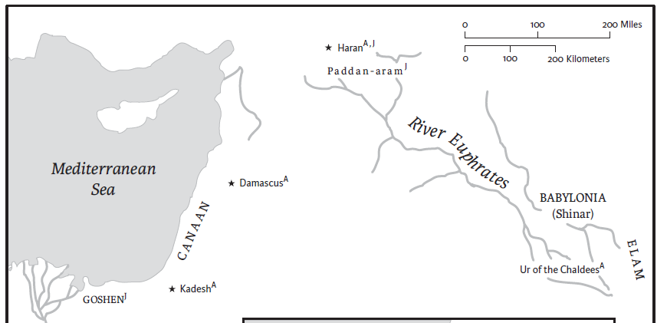
Abraham’s Journey: Ur → Haran → Canaan
1 Ur of the Chaldeans — Abram’s birthplace; the journey begins (Gen 11:31)
2 Haran — family settles; Abram is called onward (Gen 12:1–4)
3 Canaan — the promised land Abram enters (Gen 12:5–7)
2
3
1
Based on Genesis 11:31–12:9: Abram’s migration from Ur of the Chaldeans, through Haran, to the land of Canaan.
Notes:
The New Oxford Annotated Bible (c) Oxford University Press, 1996. All rights reserved.
Oxford Annotated Page 27

Slide 34
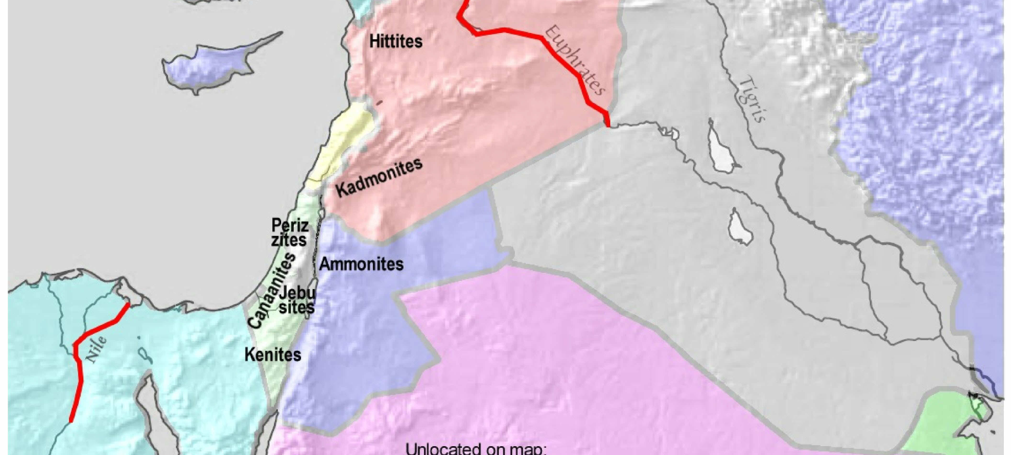
Abram’s Promised Land
3
Peoples of the Promised Land (Gen 15:19–21)
1 Kenites
2 Kadmonites
3 Hittites
4 Perizzites
5 Amorites
6 Canaanites
7 Jebusites
Not located on map: Kenizzites, Rephaim, Girgashites
2
4
5
6
7
1
Notes:
Abram’s Promised Land — Genesis 15:18–21
As God seals the covenant of Genesis 15, the gift of land is defined as the territory of ten peoples, with boundaries reaching “from the river of Egypt to the great river, the river Euphrates” (15:18) — the broadest description of the promised land in the Bible, corresponding to the ideal extent of David’s empire.
The ten nations to be displaced (15:19–21):
• Kenites — nomadic metalworkers associated with the southern desert and the Negev.
• Kenizzites — a clan linked with Edom and the family of Caleb (not located on the map).
• Kadmonites — literally “easterners”; an otherwise unknown people (not located on the map).
• Hittites — settlers of the central hill country who bear the name of the Anatolian empire.
• Perizzites — frequently paired with the Canaanites; understood as rural, unwalled-village dwellers.
• Rephaim — remembered as the land’s ancient giant inhabitants (not located on the map).
• Amorites — highland peoples; the term is also used broadly for the land’s earlier inhabitants.
• Canaanites — lowland and coastal peoples who give the land its name.
• Girgashites — a Canaanite group named in covenant lists (not located on the map).
• Jebusites — the inhabitants of Jerusalem until David’s conquest of the city.
This list is unusually long and is unique among such lists in including the Kenites, Kenizzites, Kadmonites, and Rephaim. The Kenizzites, Rephaim, and Girgashites could not be assigned a fixed location and are noted separately on the map.

Slide 35
Final Notes
The Amorites, as you can see from the map, occupy part of the Promised Land. Their downfall needed to be complete before the land would be given.
This is the first of two principal covenant stories. See Gen 17. In the second, the sign of the promise is circumcision.

Slide 36
The meaning of the text for Christianity
In the reading, Abram is declared righteous due to his faith.
What is significant is that this declaration came more than 400 years before the “law” was given at Sinai, following the departure from Egypt.
Paul will later note that faith rendered Abram righteous WITHOUT circumcision.
This was used as a powerful argument by Paul concerning the Law and salvation.

Slide 37
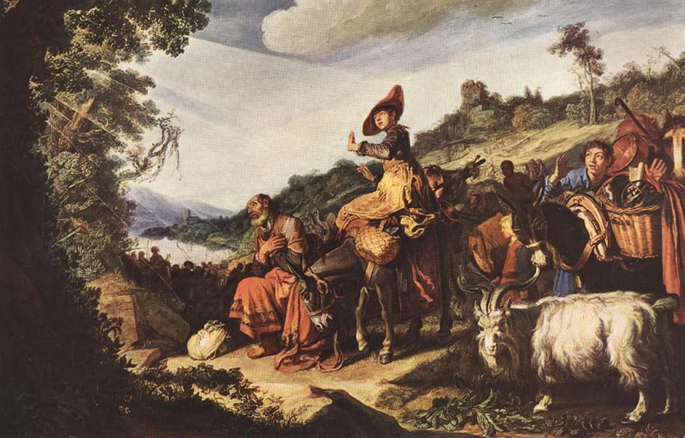
Pieter Lastman, Abraham's Journey to Canaan, 1614
Oil on canvas transferred from wood, 72 x 122 cm, The Hermitage, St. Petersburg

Slide 38
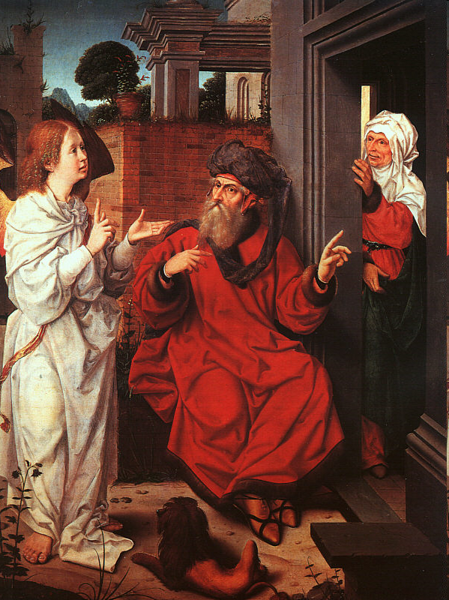
Jan Provost or Anonymous Antwerp artist,
Abraham, Sarah, and the Angel
1520s
Oil on wood, 71 x 58 cm
Musée du Louvre, Paris

Slide 39
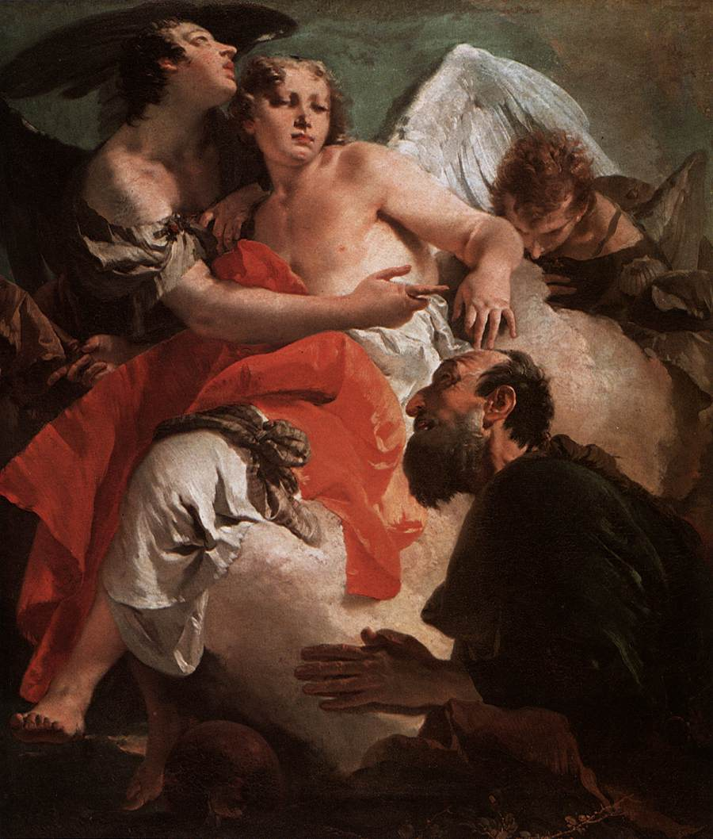
Giovanni Battista Tiepolo,
Abraham Praying before the Three Angels, c. 1730
Oil on canvas, 140 x 120 cm
Scuola Grande di San Rocco, Venice

Slide 40
Antonio Zanchi,
Abraham Teaching Astrology to the Egyptians, c. 1665
Oil on canvas, 276 x 370 cm
Santa Maria del Giglio, Venice
The subject of the painting is fairly rare; it was described by Josephus in his Antiquities of the Jews. The episode relates that Abraham came to know God not through reading the Scriptures but by studying the stars.

Slide 41
