Slide 1
Lesson 6
The Sons
Notes:
This PowerPoint is intended as an aid for the leader of an adult Christian Education group. All sources are footnoted and from easily available materials. Please respect the sacred nature of the scriptures covered. Use these materials as a way to start and sustain a lively discussion and consideration of a marvelous gift to us for a richer experience of life.
J B Cross
www.episcopalchristianeducation.com

Slide 2
GEN 16 Sarai and Hagar
16 Now Sarai, Abram’s wife, bore him no children. She had an Egyptian slave-girl whose name was Hagar, 2 and Sarai said to Abram, “You see that the LORD has prevented me from bearing children; go in to my slave-girl; it may be that I shall obtain children by her.” And Abram listened to the voice of Sarai. 3 So, after Abram had lived ten years in the land of Canaan, Sarai, Abram’s wife, took Hagar the Egyptian, her slave-girl, and gave her to her husband Abram as a wife. ⁴ He went in to Hagar, and she conceived; and when she saw that she had conceived, she looked with contempt on her mistress. ⁵ Then Sarai said to Abram, “May the wrong done to me be on you! I gave my slave-girl to your embrace, and when she saw that she had conceived, she looked on me with contempt. May the LORD judge between you and me!” ⁶ But Abram said to Sarai, “Your slave-girl is in your power; do to her as you please.” Then Sarai dealt harshly with her, and she ran away from her.
Notes:
The New Oxford Annotated Bible (c) Oxford University Press, 1996. All rights reserved.
16 Now Sarai, Abram’s wife, bore him no children. She had an Egyptian slave-girl whose name was Hagar, 2 and Sarai said to Abram, “You see that the LORD has prevented me from bearing children; go in to my slave-girl; it may be that I shall obtain children by her.” And Abram listened to the voice of Sarai. 3 So, after Abram had lived ten years in the land of Canaan, Sarai, Abram’s wife, took Hagar the Egyptian, her slave-girl, and gave her to her husband Abram as a wife. ⁴ He went in to Hagar, and she conceived; and when she saw that she had conceived, she looked with contempt on her mistress. ⁵ Then Sarai said to Abram, “May the wrong done to me be on you! I gave my slave-girl to your embrace, and when she saw that she had conceived, she looked on me with contempt. May the LORD judge between you and me!” ⁶ But Abram said to Sarai, “Your slave-girl is in your power; do to her as you please.” Then Sarai dealt harshly with her, and she ran away from her. ⁷ The angel of the LORD found her by a spring of water in the wilderness, the spring on the way to Shur. ⁸ And he said, “Hagar, slave-girl of Sarai, where have you come from and where are you going?” She said, “I am running away from my mistress Sarai.” ⁹ The angel of the LORD said to her, “Return to your mistress, and submit to her.” 10 The angel of the LORD also said to her, “I will so greatly multiply your offspring that they cannot be counted for multitude.” 11 And the angel of the LORD said to her, “Now you have conceived and shall bear a son; you shall call him Ishmael, for the LORD has given heed to your affliction.
12 He shall be a wild ass of a man, with his hand against everyone, and everyone’s hand against him; and he shall live at odds with all his kin.”
13 So she named the LORD who spoke to her, “You are El-roi” for she said, “Have I really seen God and remained alive after seeing
him?” 1⁴ Therefore the well was called Beerlahai-roi it lies between Kadesh and Bered. 15 Hagar bore Abram a son; and Abram
named his son, whom Hagar bore, Ishmael. 16 Abram was eighty-six years old when Hagar bore him Ishmael.

Slide 3
GEN 16 Sarai and Hagar
⁷ The angel of the LORD found her by a spring of water in the wilderness, the spring on the way to Shur. ⁸ And he said, “Hagar, slave-girl of Sarai, where have you come from and where are you going?” She said, “I am running away from my mistress Sarai.” ⁹ The angel of the LORD said to her, “Return to your mistress, and submit to her.” 10 The angel of the LORD also said to her, “I will so greatly multiply your offspring that they cannot be counted for multitude.” 11 And the angel of the LORD said to her, “Now you have conceived and shall bear a son; you shall call him Ishmael, for the LORD has given heed to your affliction.
12 He shall be a wild ass of a man, with his hand against everyone, and everyone’s hand against him; and he shall live at odds with all his kin.” 13 So she named the LORD who spoke to her, “You are El-roi” for she said, “Have I really seen God and remained alive after seeing him?” 1⁴ Therefore the well was called Beerlahai-roi it lies between Kadesh and Bered. 15 Hagar bore Abram a son; and Abram named his son, whom Hagar bore, Ishmael. 16 Abram was eighty-six years old when Hagar bore him Ishmael.
Notes:
The New Oxford Annotated Bible (c) Oxford University Press, 1996. All rights reserved.
16 Now Sarai, Abram’s wife, bore him no children. She had an Egyptian slave-girl whose name was Hagar, 2 and Sarai said to Abram, “You see that the LORD has prevented me from bearing children; go in to my slave-girl; it may be that I shall obtain children by her.” And Abram listened to the voice of Sarai. 3 So, after Abram had lived ten years in the land of Canaan, Sarai, Abram’s wife, took Hagar the Egyptian, her slave-girl, and gave her to her husband Abram as a wife. ⁴ He went in to Hagar, and she conceived; and when she saw that she had conceived, she looked with contempt on her mistress. ⁵ Then Sarai said to Abram, “May the wrong done to me be on you! I gave my slave-girl to your embrace, and when she saw that she had conceived, she looked on me with contempt. May the LORD judge between you and me!” ⁶ But Abram said to Sarai, “Your slave-girl is in your power; do to her as you please.” Then Sarai dealt harshly with her, and she ran away from her. ⁷ The angel of the LORD found her by a spring of water in the wilderness, the spring on the way to Shur. ⁸ And he said, “Hagar, slave-girl of Sarai, where have you come from and where are you going?” She said, “I am running away from my mistress Sarai.” ⁹ The angel of the LORD said to her, “Return to your mistress, and submit to her.” 10 The angel of the LORD also said to her, “I will so greatly multiply your offspring that they cannot be counted for multitude.” 11 And the angel of the LORD said to her, “Now you have conceived and shall bear a son; you shall call him Ishmael, for the LORD has given heed to your affliction.
12 He shall be a wild ass of a man, with his hand against everyone, and everyone’s hand against him; and he shall live at odds with all his kin.”
13 So she named the LORD who spoke to her, “You are El-roi” for she said, “Have I really seen God and remained alive after seeing
him?” 1⁴ Therefore the well was called Beerlahai-roi it lies between Kadesh and Bered. 15 Hagar bore Abram a son; and Abram
named his son, whom Hagar bore, Ishmael. 16 Abram was eighty-six years old when Hagar bore him Ishmael.

Slide 4
Hagar and Sarai
This is an illustration of human beings being human. Sarai wants to provide a child and cannot. She offers Hagar in an acceptable tradition. But, she is only human and jealousy intervenes.
Notice the parallel desert encounter at a well that will become part of the Exodus tradition and again for Hagar and her son, years later.
In all we see God’s intervention. But, in a way that allows all sides to continue and prosper. A human solution would likely have left one dead or with nothing.
When we call on God to vanquish our enemy, remember that to God our enemy is also the object of His love.
Notes:
The New Oxford Annotated Bible (c) Oxford University Press, 1996. All rights reserved.
Oxford Annotated Footnotes
16.1–16: Hagar’s encounter with God and the birth of Ishmael stand at the heart of the Abraham story (see “Chiasm in the Abraham Story” on p. 38), enveloped by parallel traditions dealing with covenant (chs 15 and 17), Lot and Abraham (chs 13–14 and 18–19), the endangerment of Sarah (12.10–20 and ch 20), and the promise
(12.1–6 and 22.1–19). This story echoes the story of Abraham’s endangerment of Sarah in 12.10–20 in describing the complications resulting from human attempts to fulfill the promise, in this case the promise of offspring. In addition, like that story, this one links with the Exodus, though offering a quite different picture. In the book
of Exodus Israelites are “oppressed” (Heb “‘anah”) by the Egyptians (Ex 1.12), flee east toward Israel through the wilderness, and meet God there (Ex 19.24.1–2,10–11). In this chapter, however, it is an Egyptian, Hagar, who is “oppressed” (Heb “‘anah”; “dealt harshly with” in the NRSV of v. 6) by the Israelite matriarch Sarah; Hagar flees
west from Israel toward Egypt and meets God in the wilderness. Later, in Gen 21.8–21, we will see a doublet of this story, where Hagar again must leave Abraham’s clan, go into the desert, and hear an oracle that will revolve around an interpretation of the name of Hagar’s son, Ishmael (Heb for “God hears”). Both stories have their origins in ancient traditions surrounding the origins of the Ishmaelites, seen in Genesis as ancestors of the Arab peoples (see Gen 25.12–18), but the version here in Gen 16 is distinguished by its echoes of the Exodus story and ultimately sympathetic focus on Hagar. 2: According to ancient surrogate motherhood customs, a wife
could give her maid to her husband and claim the child as her own (30.3,9). 3: This duplicate notice of Sarah’s transfer of Hagar to Abraham as a surrogate mother probably comes from the Priestly source. 4–5: The translation looked with contempt implies that Hagar disdained her mistress, whereas the Hebrew verb (“qll,” “to treat
lightly”) only implies that Hagar did not look up to her mistress the way she once did. Having had a child, Hagar is now derisively seen by her mistress as a slave who is not sufficiently submissive. 7: Here the angel of the LORD is not a heavenly being subordinate to God but the LORD (Yahweh) in earthly manifestation, as is clear from v. 13
(cf. 21.17,19; Ex 14.19). 11: The LORD has given heed, lit., “The LORD has heard,” an explanation of the name Ishmael (see note a and 21.17n.). 13: God of seeing (see note b) was the name of the deity at the Beer-lahai-roi well, now identified with Israel’s God. On Hagar’s question, cf. 32.30; Ex 33.20; Judg 6.22–23; 13.22. 15–16: Priestly material
focusing more on Ishmael than on Hagar.

Slide 5
Genesis 17:1–7, 15–16
When Abram was ninety-nine years old, the LORD appeared to Abram, and said to him, “I am God Almighty; walk before me, and be blameless. And I will make my covenant between me and you, and will make you exceedingly numerous.” Then Abram fell on his face; and God said to him, “As for me, this is my covenant with you:

Slide 6
Genesis 17:1–7, 15–16
You shall be the ancestor of a multitude of nations. No longer shall your name be Abram, but your name shall be Abraham; for I have made you the ancestor of a multitude of nations. I will make you exceedingly fruitful; and I will make nations of you, and kings shall come from you. I will establish my covenant between me and you, and your offspring after you throughout their generations, for an everlasting covenant, to be God to you and to your offspring after you.”

Slide 7
Genesis 17:1–7, 15–16
God said to Abraham, “As for Sarah your wife, you shall not call her Sarai, but Sarah shall be her name. I will bless her, and moreover I will give you a son by her. I will bless her, and she shall give rise to nations; kings of peoples shall come from her.”

Slide 8
Names
A new name signifies a new relationship or status.
Abraham, a dialectical variant of Abram, means “the [divine] ancestor is exalted.” The name is explained by its similarity to the Hebrew for ancestor of a multitude, referring to the nations whose ancestry was traced to Abraham.
Sarah, meaning “princess,” is a variant of Sarai.
Notes:
The New Oxford Annotated Bible (c) Oxford University Press, 1996. All rights reserved.
Genesis 17
17.1–27: The everlasting covenant. This account from the priestly tradition is a parallel version of the Abrahamic covenant given in the early tradition (Genesis 15.7–21). 1: God Almighty (El Shaddai), meaning “God, the One of the Mountains,” was a divine name current in the pre-Mosaic period (Exodus 6.2–3), perhaps brought from Mesopotamia into Palestine. 2: Covenant is a term of relationship between a superior and an inferior party, the former “making” or “establishing” (Genesis 17.7) the bond. God’s covenant guarantees an exceedingly numerous posterity, one of the divine promises (Genesis 12.2; see below Genesis 17.7–8). 5: A new name signifies a new relationship or status (see Genesis 32.28). Abraham, a dialectical variant of Abram, means “the [divine] ancestor is exalted”; here the name is explained by its similarity to the Hebrew for ancestor of a multitude, referring to the nations whose ancestry was traced to Abraham (Genesis 17.16; Genesis 28.3; Genesis 35.11; Genesis 48.4), e.g. Edomites and Ishmaelites. 7: Like the covenant with Noah (Genesis 9.8–17), this is an everlasting covenant (Genesis 17.13; Genesis 17.19), one that lasts in perpetuity because it is grounded in the sovereign will of God, not in human behavior. 7–8: To be God to you, this covenant not only assures a new relationship with God, to be realized fully in the Exodus and the Sinai revelation (Exodus 6.2–8), but unconditionally guarantees the promise of the land of Canaan as a perpetual holding.
17.9–14: To keep the covenant involves the practice of circumcision, an ancient rite that was practiced by some of Israel’s neighbors and whose origin is explained by various traditions (Exodus 4.24–26; Joshua 5.2–9). Binding only on males, circumcision is an external sign (Genesis 17.11) of membership in the covenant community. Unlike the universal Noachic covenant (see Genesis 9.1–19 n.), this everlasting covenant pertains only to the descendants of Abraham and Sarah.
17.15: Sarah, meaning “princess,” is a variant of Sarai. See Genesis 17.5 n. 17: Genesis 18.11–15. 18–20: Genesis 16.10–12.

Slide 9
THE EVERLASTING COVENANT
This account from the priestly tradition is a parallel version of the Abrahamic covenant given in the early tradition (Genesis 15.7–21).
The Name for God used in this passage is El Shaddai - meaning “God, the One of the Mountains,” was a divine name current in the pre-Mosaic period.
Covenant is a term of relationship between a superior and an inferior party, the former “making” the bond. God’s covenant guarantees an exceedingly numerous posterity as one of the divine promises.
Like the covenant with Noah this is an everlasting covenant that lasts in perpetuity.
The covenant involves the practice of circumcision, an ancient rite that was practiced by some of Israel’s neighbors
In contrast to the universal Noachic covenant this everlasting covenant pertains only to the descendants of Abraham and Sarah.
Notes:
The New Oxford Annotated Bible (c) Oxford University Press, 1996. All rights reserved.
Genesis 17
17.1–27: The everlasting covenant. This account from the priestly tradition is a parallel version of the Abrahamic covenant given in the early tradition (Genesis 15.7–21). 1: God Almighty (El Shaddai), meaning “God, the One of the Mountains,” was a divine name current in the pre-Mosaic period (Exodus 6.2–3), perhaps brought from Mesopotamia into Palestine. 2: Covenant is a term of relationship between a superior and an inferior party, the former “making” or “establishing” (Genesis 17.7) the bond. God’s covenant guarantees an exceedingly numerous posterity, one of the divine promises (Genesis 12.2; see below Genesis 17.7–8). 5: A new name signifies a new relationship or status (see Genesis 32.28). Abraham, a dialectical variant of Abram, means “the [divine] ancestor is exalted”; here the name is explained by its similarity to the Hebrew for ancestor of a multitude, referring to the nations whose ancestry was traced to Abraham (Genesis 17.16; Genesis 28.3; Genesis 35.11; Genesis 48.4), e.g. Edomites and Ishmaelites. 7: Like the covenant with Noah (Genesis 9.8–17), this is an everlasting covenant (Genesis 17.13; Genesis 17.19), one that lasts in perpetuity because it is grounded in the sovereign will of God, not in human behavior. 7–8: To be God to you, this covenant not only assures a new relationship with God, to be realized fully in the Exodus and the Sinai revelation (Exodus 6.2–8), but unconditionally guarantees the promise of the land of Canaan as a perpetual holding.
17.9–14: To keep the covenant involves the practice of circumcision, an ancient rite that was practiced by some of Israel’s neighbors and whose origin is explained by various traditions (Exodus 4.24–26; Joshua 5.2–9). Binding only on males, circumcision is an external sign (Genesis 17.11) of membership in the covenant community. Unlike the universal Noachic covenant (see Genesis 9.1–19 n.), this everlasting covenant pertains only to the descendants of Abraham and Sarah.
17.15: Sarah, meaning “princess,” is a variant of Sarai. See Genesis 17.5 n. 17: Genesis 18.11–15. 18–20: Genesis 16.10–12.

Slide 10
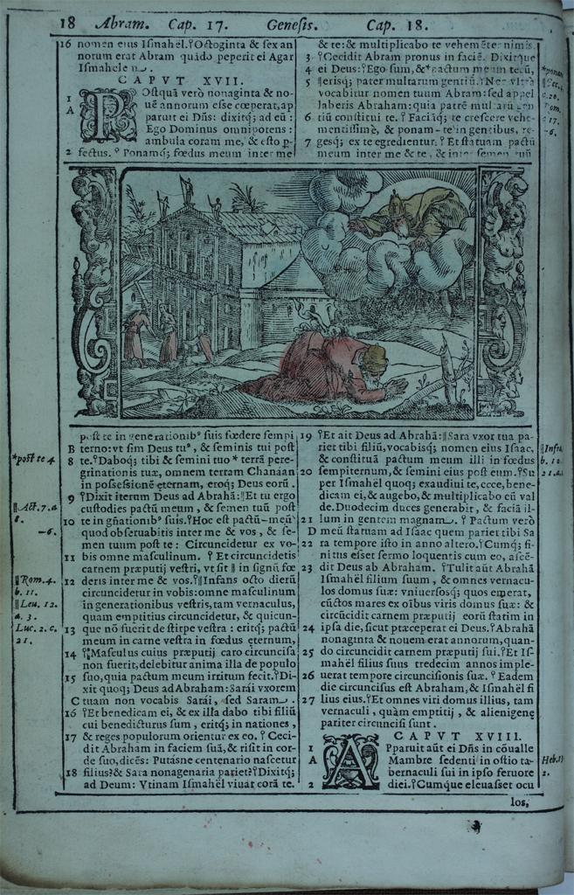
Anonymous illustration from a Bible published in Venice in 1578
Abraham and the Covenant of the LORD
Woodcut

Slide 11


Slide 12
Genesis 18:1–10a
The LORD appeared to Abraham by the oaks of Mamre, as he sat at the entrance of his tent in the heat of the day. He looked up and saw three men standing near him. When he saw them, he ran from the tent entrance to meet them, and bowed down to the ground. He said, “My lord, if I find favor with you, do not pass by your servant. Let a little water be brought, and wash your feet, and rest yourselves under the tree. Let me bring a little bread, that you may refresh yourselves, and after that you may pass on-- since you have come to your servant.”

Slide 13
Genesis 18:1–10a
So they said, “Do as you have said.” And Abraham hastened into the tent to Sarah, and said, “Make ready quickly three measures of choice flour, knead it, and make cakes.” Abraham ran to the herd, and took a calf, tender and good, and gave it to the servant, who hastened to prepare it. Then he took curds and milk and the calf that he had prepared, and set it before them; and he stood by them under the tree while they ate.

Slide 14
Genesis 18:1–10a
They said to him, “Where is your wife Sarah?” And he said, “There, in the tent.” Then one said, “I will surely return to you in due season, and your wife Sarah shall have a son.”
And Sarah was listening at the tent entrance behind him. Now Abraham and Sarah were old, advanced in age; it had ceased to be with Sarah after the manner of women.

Slide 15
Genesis 18:(10b–14)
So Sarah laughed to herself, saying, “After I have grown old, and my husband is old, shall I have pleasure?” The LORD said to Abraham, “Why did Sarah laugh, and say, ‘Shall I indeed bear a child, now that I am old?’ Is anything too wonderful for the LORD? At the set time I will return to you, in due season, and Sarah shall have a son.”

Slide 16
The LORD’s visit to Abraham and Sarah
The oaks of Mamre in Genesis 13, after Lot and then Abram separated, Abram was directed to this location and had built an altar there.
Abraham’s behavior toward the visitors is an illustration of oriental courtesy and hospitality.
When the visitors appeared at the noontime siesta, Abraham did not recognize them as divine beings.
Notes:
The New Oxford Annotated Bible (c) Oxford University Press, 1996. All rights reserved.
Genesis 18
A Son Promised to Abraham and Sarah
18 The LORD appeared to Abraham t by the oaks of Mamre, as he sat at the entrance of his tent in the
heat of the day. 2 He looked up and saw three men standing near him. When he saw them, he ran from the tent entrance to meet them, and bowed down to the ground. 3 He said, “My lord, if I find favor with you, do not pass by your servant. 4 Let a little water be brought, and wash your feet, and rest yourselves under the tree. 5 Let me bring a little bread, that you may refresh yourselves, and after that you may pass on—since you have come to your servant.” So they said, “Do as you have said.” 6 And Abraham hastened into the tent to Sarah, and said, “Make ready quickly three measures t of choice flour, knead it, and make cakes.” 7 Abraham ran to the herd, and took a calf, tender and good, and gave it to the servant, who hastened to prepare it. 8 Then he took curds and milk and the calf that he had prepared, and set it before them; and he stood by them under the tree while they ate.
9 They said to him, “Where is your wife Sarah?” And he said, “There, in the tent.” 10 Then one said, “I will surely return to you in due season, and your wife Sarah shall have a son.” And Sarah was listening at the tent entrance behind him. 11 Now Abraham and Sarah were old, advanced in age; it had ceased to be with Sarah after the manner of women. 12 So Sarah laughed to herself, saying, “After I have grown old, and my husband is old, shall I have pleasure?” 13 The LORD said to Abraham, “Why did Sarah laugh, and say, Shall I indeed bear a child, now that I am old?’ 14 Is anything too wonderful for the LORD? At the set time I will return to you, in due season, and Sarah shall have a son.” 15 But Sarah denied, saying, “I did not laugh”; for she was afraid. He said, “Oh yes, you did laugh.”
Judgment Pronounced on Sodom
16 Then the men set out from there, and they looked toward Sodom; and Abraham went with them to set them on their way. 17 The LORD said, “Shall I hide from Abraham what I am about to do, 18 seeing that Abraham shall become a great and mighty nation, and all the nations of the earth shall be blessed in him? t 19 No, for I have chosen t him, that he may charge his children and his household after him to keep the way of the LORD by doing righteousness and justice; so that the LORD may bring about for Abraham what he has promised him.” 20 Then the LORD said, “How great is the outcry against Sodom and Gomorrah and how very grave their sin! 21 1 must go down and see whether they have done altogether according to the outcry that has come to me; and if not, I will know.”
22 So the men turned from there, and went toward Sodom, while Abraham remained standing before the LORD. t 23 Then Abraham came near and said, “Will you indeed sweep away the righteous with the wicked? 24 Suppose there are fifty righteous within the city; will you then sweep away the place and not forgive it for the fifty righteous who are in it? 25 Far be it from you to do such a thing, to slay the righteous with the wicked, so that the righteous fare as the wicked! Far be that from you! Shall not the Judge of all the earth do what is just?” 26 And the LORD said, “If I find at Sodom fifty righteous in the city, I will forgive the whole place for their sake.” 27 Abraham answered, “Let me take it upon myself to speak to the Lord, who am but dust and ashes. 28 Suppose five of the fifty righteous are lacking? Will you destroy the whole city for lack of five?” And he said, “I will not destroy it if I find forty-five there.” 29 Again he spoke to him, “Suppose forty are found there.” He answered, “For the sake of forty I will not do it.” 30 Then he said, “Oh do not let the Lord be angry if I speak. Suppose thirty are found there.” He answered, “I will not do it, if find thirty there.” 31 He said, “Let me take it upon myself to speak to the Lord. Suppose twenty are found there.” He answered, “For the sake of twenty I will not destroy it.” 32 Then he said, “Oh do not let the Lord be angry if I speak just once more. Suppose ten are found there.” He answered, “For the sake of ten I will not destroy it.” 33 And the LORD went his way, when he had finished speaking to Abraham; and Abraham returned to his place.
Genesis 18
18.1–15: The LORD’s visit to Abraham and Sarah. 1: The oaks of Mamre, see Genesis 13.18 n. 2–8: A fine description of oriental courtesy and hospitality. When the visitors appeared at the noontime siesta, Abraham did not recognize them as divine beings (Hebrews 13.2). The relation of the three visitors to the LORD or Yahweh (Genesis 18.1) is difficult. All three angels (Genesis 19.1) may represent the LORD (see Genesis 16.7 n.); thus the plurality becomes a single person in Genesis 18.10; Genesis 18.13. On the other hand, Genesis 18.22 and Genesis 19.1 suggest that the LORD is one of the three, the other two being attendants.
18.9–15: The narrator stresses the incredibility of God’s promise. 12: Sarah’s laughter arises from the absurd disproportion between the divine promise and the human possibilities. Other traditions also play upon the name of Isaac, meaning “he laughs” (compare Genesis 17.17–19; Genesis 21.6).
18.16–33: Abraham’s intercession for Sodom and Gomorrah. 17–19: Because Abraham is chosen for a special role (Genesis 12.13), he is taken into the LORD’s counsel, for Sodom will become an example to future generations (Isaiah 1.9).
18.23–33: Abraham diplomatically questions the justice of God in allowing innocent people to be punished with the guilty. The first example in the Bible of expostulation with God; see also Jeremiah’s “confessions,” the prophecy of Habakkuk, the book of Job.

Slide 17
The Three Visitors
The relation of the three visitors to the LORD or Yahweh is problematic. All three angels may represent the LORD as a single person.
On the other hand it appears that the LORD is one of the three, the other two being attendants.
At the end of this Chapter the LORD goes his own way and two angels arrive in Sodom.

Slide 18
Sarah’s Laughter
The narrator stresses the incredibility of God’s promise.
Sarah’s laughter arises from the absurd disproportion between the divine promise and the human possibilities.
Other traditions also play upon the name of Isaac, meaning “he laughs”

Slide 19
Angels
In Israel’s early traditions, God was perceived as administering the cosmos with a retinue of divine assistants. The members of this divine council were identified generally as “sons of God” and “morning stars”, “gods” or the “host of heaven”, and they functioned as God’s vicegerents and administrators in a hierarchical bureaucracy over the world.
In early narratives God is frequently depicted dealing directly with humans without intermediaries – “Theophany”
Later, with an increasing emphasis on God’s transcendence writers developed an increasing need for divine mediators.
These beings who brought God’s messages to humans are typically portrayed as anthropomorphic in form, and such a being may often be called a “man” as in today’s reading.
Notes:
The New Oxford Annotated Bible (c) Oxford University Press, 1996. All rights reserved.
Angels
Angels. In Israel’s early traditions, God was perceived as administering the cosmos with a retinue of divine assistants. The members of this divine council were identified generally as “sons of God” and “morning stars” (Job 1.6; Job 38.7), “gods” (Psalm 82) or the “host of heaven” (Nehemiah 9.6; cf. Revelation 1.20), and they functioned as God’s vicegerents and administrators in a hierarchical bureaucracy over the world (Deuteronomy 32.8 [LXX]; cf. Deuteronomy 4.19; Deuteronomy 29.26). Where Israel’s polytheistic neighbors perceived these beings as simply a part of the pantheon, the Bible depicts them as subordinate and in no way comparable to the God of Israel.
The most ancient Israelites would probably have felt uncomfortable in describing all these beings as “angels,” for the English word “angel” comes from the Greek aggelos, which at first simply meant “messenger” (as does the Hebrew term for angel, mal<CLk). God’s divine assistants were often more than mere messengers. Cherubim and seraphim, for example, never function as God’s messengers, for their bizarre appearance would unnecessarily frighten humans. On the contrary, God is frequently depicted in early narratives as dispensing with divine messengers, for he deals directly with humans without intermediaries (See Theophany).
As time passed, however, an increasing emphasis on God’s transcendence correlated with an increasing need for divine mediators. These beings who brought God’s messages to humans are typically portrayed as anthropomorphic in form, and such a being may often be called a “man” (Genesis 18.2; Joshua 5.13; Ezekiel 9.2; Ezekiel 9.11; Daniel 9.21; Daniel 12.6–7; Zechariah 1.8; Luke 24.4). The members of God’s council are the envoys who relay God’s messages and perform tasks appropriate to their status as messengers (1 Kings 22.19–22; Job 1.6–12). In some narratives of encounters with supernatural beings, there is reluctance to identify them by name (Genesis 32.29; Judges 13.17–18). But as these messengers become more and more frequent, they eventually are provided with individual names and assigned increasingly specific tasks that go beyond that of a messenger. The only two angels named in the Hebrew Bible are in the book of Daniel: Gabriel reveals the future (Daniel 8–9; cf. Luke 1) while Michael has a more combative role, opposing the forces of evil (Daniel 10; Daniel 12; Jude 9; Revelation 12.7). The angelic hierarchy becomes more and more explicit and elaborate (Daniel 10.13; Ephesians 6.12; Jude 9; 1 Peter 3.22; See Archangels), and each human being has his or her own protecting angel (Matthew 18.10; Acts 12.15). The term “messenger” (Grk. aggelos; Hebr. mal<CLk) is used so frequently to depict these beings in their encounters with humans that it becomes a generic term to describe all supernatural beings apart from God, whether or not they actually functioned as messengers.
Angels are depicted as having the freedom to make moral choices, for they require judicial supervision (1 Corinthians 6.3; Jude 6) and God himself is reluctant to trust them (Job 4.18). The Bible records a number of angelic rebellions or perversions (Genesis 6.1–4; Psalm 82; Isaiah 14.12–15; Ezekiel 28; 2 Peter 2.4; Revelation 12.4–9), as a result of which some rebel angels are already incarcerated (Jude 6).
“The Angel [or Messenger] of the LORD” is a problematic figure. The ambiguous Hebrew phrase is best translated without the definite article, that is, “an angel [messenger] of Yahweh” (as do the Septuagint and NJV; cf. Matthew 1.20; Matthew 2.13; Matthew 2.19; Matthew 28.2; Acts 8.26). Later Christian theology tended to see the preincarnate Christ in this figure (hence the definite article), but the phrase probably referred vaguely to any mediator sent by God. He may be human (Haggai 1.13; Malachi 2.7). When the figure is clearly referred to as superhuman, he does not always function as a messenger but instead talks and behaves as if he were God, even failing to introduce his words as the message of another who sent him. Since early stories are internally inconsistent, identifying the figure as both God and God’s messenger (Genesis 16.7–13; Genesis 22.11–12; Genesis 31.11–13; Exodus 3.2–4; Judges 6.11–23), it is probable that some of these stories originally described God at work but were modified through time to accommodate God’s increasing transcendence as one who no longer casually confronted humankind.
The increasing role played by angels in the later stages of the Hebrew Bible is found everywhere in the New Testament. The voice of God (the Father) is only exceptionally heard in the New Testament, unlike earlier biblical traditions. Instead, angels bring God’s message to humans (Matthew 1.20; Luke 1.11; Luke 1.26; Luke 2.9; Acts 8.26; Acts 10.3) and assist Jesus (Matthew 4.1; Luke 22.43) and his followers (Acts 5.19; Acts 12.7). Angels have limited knowledge (Matthew 24.36; 1 Peter 1.12), and when they appear to human beings, they may be described as descending from heaven (Matthew 28.2; John 1.51; cf. Genesis 28.12). Although Jesus alludes to the absence of the institution of marriage among angels (Matthew 22.30), angels are sexual beings (Genesis 6.4; Zechariah 5.9). Some Jews, particularly the most conservative, denied their existence (Acts 23.8). But among Jews and Christians in general, angelology continued to develop so that not only was Satan provided with his own retinue of angels as a counterpart to God (Matthew 25.41; 2 Corinthians 12.7), but hundreds of names and functions are also applied to
angels in extra biblical texts such as the books of Enoch.
SAMUEL A. MEIER
The Oxford Companion to the Bible (c) Oxford University Press, 1996. All rights reserved.

Slide 20
Abraham and the Angels
The first image is from a church in Ravenna, Italy, a place famous for its mosaics.
The second is a print by Rembrandt.

Slide 21
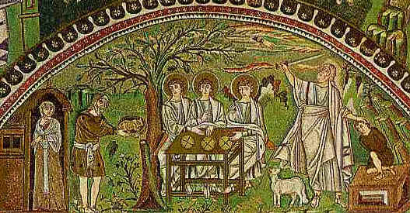
Abraham and the Visitors
(Sacrifice of Isaac on right)
Mosaic, 6th C. CE
S. Apollinaire, Ravenna, Italy

Slide 22
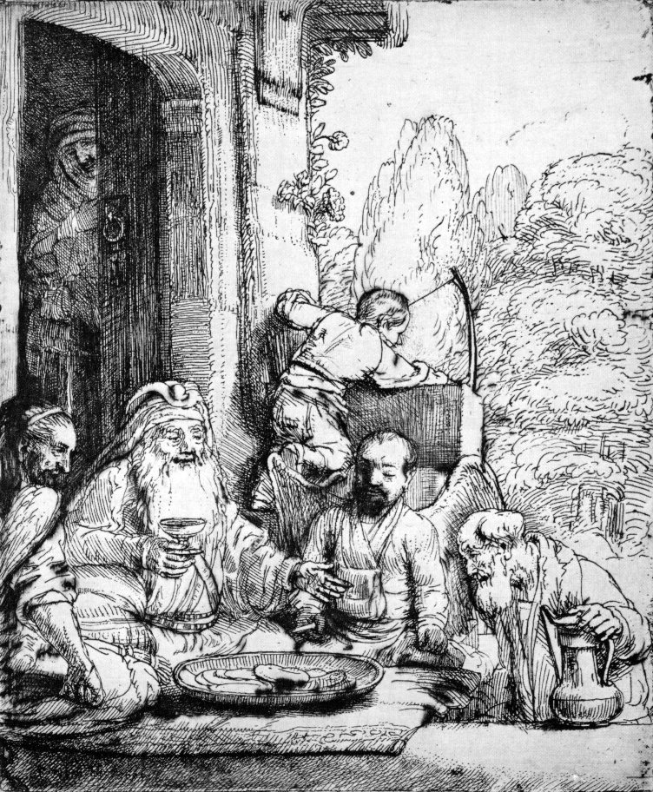
Rembrandt, Abraham Entertaining the Angels, 1656 etching

