Slide 1
Lesson 7
Sodom and Gomorrah
Abimelech
Isaac and Ishmael
Notes:
This PowerPoint is intended as an aid for the leader of an adult Christian Education group. All sources are footnoted and from easily available materials. Please respect the sacred nature of the scriptures covered. Use these materials as a way to start and sustain a lively discussion and consideration of a marvelous gift to us for a richer experience of life.
J B Cross
www.episcopalchristianeducation.com

Slide 2
Genesis 18:20-32
The LORD said to Abraham, "How great is the outcry against Sodom and Gomorrah and how very grave their sin! I must go down and see whether they have done altogether according to the outcry that has come to me; and if not, I will know."
So the men turned from there, and went toward Sodom, while Abraham remained standing before the LORD. Then Abraham came near and said, "Will you indeed sweep away the righteous with the wicked?

Slide 3
Genesis 18:20-32
Suppose there are fifty righteous within the city; will you then sweep away the place and not forgive it for the fifty righteous who are in it? Far be it from you to do such a thing, to slay the righteous with the wicked, so that the righteous fare as the wicked! Far be that from you! Shall not the Judge of all the earth do what is just?" And the LORD said, "If I find at Sodom fifty righteous in the city, I will forgive the whole place for their sake." Abraham answered, "Let me take it upon myself to speak to the Lord, I who am but dust and ashes.

Slide 4
Genesis 18:20-32
Suppose five of the fifty righteous are lacking? Will you destroy the whole city for lack of five?" And he said, "I will not destroy it if I find forty-five there." Again he spoke to him, "Suppose forty are found there." He answered, "For the sake of forty I will not do it." Then he said, "Oh do not let the Lord be angry if I speak. Suppose thirty are found there." He answered, "I will not do it, if I find thirty there." He said, "Let me take it upon myself to speak to the Lord. Suppose twenty are found there.”

Slide 5
Genesis 18:20-32
He answered, "For the sake of twenty I will not destroy it." Then he said, "Oh do not let the Lord be angry if I speak just once more. Suppose ten are found there." He answered, "For the sake of ten I will not destroy it."

Slide 6
Abraham's intercession for Sodom and Gomorrah
Abraham is taken into the Lord's counsel concerning God’s intention to make Sodom an example to future generations.
Abraham diplomatically questions the justice of God in allowing innocent people to be punished with the guilty.
This is the first example in the Bible of an expression of disapproval with God.
Notes:
The New Oxford Annotated Bible (c) Oxford University Press, 1996. All rights reserved.
18.16-33: Abraham's intercession for Sodom and Gomorrah. 17-19: Because Abraham is chosen for a special role (Genesis 12.13), he is taken into the Lord's counsel, for Sodom will become an example to future generations (Isaiah 1.9).
18.23-33: Abraham diplomatically questions the justice of God in allowing innocent people to be punished with the guilty. The first example in the Bible of expostulation with God; see also Jeremiah's "confessions," the prophecy of Habakkuk, the book of Job.
The New Oxford Annotated Bible (c) Oxford University Press, 1996. All rights reserved.

Slide 7
What do we learn?
In the story, God has condemned Sodom.
Did God really intend to punish the innocent with the guilty?
Wouldn’t God have already known if there were good people in Sodom and how many?
Was this a test of humans using Abraham as a representative?
Was God’s purpose to see if Abraham was concerned at all with other humans?

Slide 8
Who
Abraham would be expected to bargain to save Lot, a member of his family.
It would have been easier for him to only ask God to let Lot leave.
Instead Abraham bargains for the benefit of all of the innocent people of the city.
Was Abraham trying to see just how ‘good’ any of us have to be?
What do you think is God’s purpose in letting Abraham bargain and in His agreement?

Slide 9
Genesis 19 Sodom and Lot
The aftermath of Abraham’s bargain to save Sodom is famously complete.
In summary, there were not ten righteous men, only Lot and he does not compare well. Lot did offer courtesy to the now only two angels, but his efforts were bumbling in the best light and in its worst cruel.
All of the men in the town come to assault the visitors. Lot cruelly offers his daughters. Only the intervention of the angels stops this foolish tactic, which had failed in any event as it made the mob even more vengeful.
Lot when told of God’s plan, is peevish and has to be forced to flee, Lot’s wife’s look back seems mild compared with Lot’s ingratitude.
They escape to a small city and leave it later for the hills, so there seems little basis for the daughters to conclude there are no more men, and thus they are impregnated by their father.
Notes:
19 The two angels came to Sodom in the evening, and Lot was sitting in the gateway of Sodom. When Lot saw them, he rose to meet them, and bowed down with his face to the ground. 2 He said, “Please, my lords, turn aside to your servant’s house and spend the night, and wash your feet; then you can rise early and go on your way.” They said, “No; we will spend the night in the square.”
3 But he urged them strongly; so they turned aside to him and entered his house; and he made them a feast, and baked unleavened bread, and they ate. ⁴ But before they lay down, the men of the city, the men of Sodom, both young and old, all the people to the last man, surrounded the house; ⁵ and they called to Lot, “Where are the men who came to you tonight? Bring them out to us, so that we may know them.” ⁶ Lot went out of the door to the men, shut the door after him, ⁷ and said, “I beg you, my brothers, do not act so wickedly. ⁸ Look, I have two daughters who have not known a man; let me bring them out to you, and do to them as you please; only do nothing
to these men, for they have come under the shelter of my roof.” ⁹ But they replied, “Stand back!” And they said, “This fellow came here as an alien, and he would play the judge! Now we will deal worse with you than with them.” Then they pressed hard against the man Lot, and came near the door to break it down. 1⁰ But the men inside reached out their hands and brought Lot into the house with them, and shut the door. 11 And they struck with blindness the men who were at the door of the house, both small and great, so that they were unable to find the door. 12 Then the men said to Lot, “Have you anyone else here? Sons-in-law, sons, daughters, or anyone you have in the city—bring them out of the place. 13 For we are about to destroy this place, because the outcry against its people has become great before the Lord, and the Lord has sent us to destroy it.” 1⁴ So Lot went out and said to his sons-in-law, who were to marry his daughters, “Up, get out of this place; for the Lord is about to destroy the city.” But he seemed to his sons-in-law to be jesting.
1⁵ When morning dawned, the angels urged Lot, saying, “Get up, take your wife and your two daughters who are here, or else you will be consumed in the punishment of the city.” 1⁶ But he lingered; so the men seized him and his wife and his two daughters by the hand, the Lord being merciful to him, and they brought him out and left him outside the city. 1⁷ When they had brought them outside, they said, “Flee for your life; do not look back or stop anywhere in the Plain; flee to the hills, or else you will be consumed.” 1⁸ And Lot said to them, “Oh, no, my lords; 1⁹ your servant has found favor with you, and you have shown me great kindness in saving my life; but I cannot flee to the hills, for fear the disaster will overtake me and I die. 2⁰ Look, that city is near enough to flee to, and it is a little one. Let me escape there—is it not a little one?—and my life will
be saved!” 21 He said to him, “Very well, I grant you this favor too, and will not
Overthrow the city of which you have spoken. 22 Hurry, escape there, for I can do nothing until you arrive there.” Therefore the city was called Zoar. 23 The sun had risen on the earth when Lot came to Zoar. 2⁴ Then the Lord rained on Sodom and Gomorrah sulfur and fi re from the Lord out of heaven; 2⁵ and he overthrew those cities, and all the Plain, and all the inhabitants of the cities, and what grew on the ground. 2⁶ But Lot’s wife, behind him, looked back, and she became a pillar of salt.
2⁷ Abraham went early in the morning to the place where he had stood before the Lord; 2⁸ and he looked down toward Sodom and Gomorrah and toward all the land of the Plain and saw the smoke of the land going up like the smoke of a furnace. 2⁹ So it was that, when God destroyed the cities of the Plain, God remembered Abraham, and sent Lot out of the midst of the overthrow, when he overthrew the cities in which Lot had settled.
3⁰ Now Lot went up out of Zoar and settled in the hills with his two daughters, for he was afraid to stay in Zoar; so he lived in a cave with his two daughters. 31 And the firstborn said to the younger, “Our father is old, and there is not a man on earth to come in to us after the manner of all the world. 32 Come, let us make our father drink wine, and we will lie with him, so that we may preserve off spring through our father.” 33 So they made their father drink wine that night; and the firstborn went in, and lay with her father; he did not know when she lay down or when she rose. 3⁴ On the next day, the firstborn said to the younger, “Look, I lay last night with my father; let us make him drink wine tonight also; then you go in and lie with him, so that we may preserve off spring through our father.” 3⁵ So they made their father drink wine that night also; and the younger rose, and lay with him; and he did not know when she lay down or when she rose. 3⁶ Thus both the daughters of Lot became pregnant by their father. 3⁷ The firstborn bore
a son, and named him Moab; he is the ancestor of the Moabites to this day. 3⁸ The younger also bore a son and named him Ben-ammi; he is the ancestor of the Ammonites to this day.

Slide 10
The lessons of Sodom
Lot seems innocent only by comparison to his neighbors. Unlike Abraham who accepts God’s commandments without question, Lot has to be forced. Lot in this and all his situations is only saved by the intervention of Abraham.
One thought is that this shows that Lot did not deserve to be Abraham’s successor. He is willing without thought to turn his back on all of the females in his family.
Perhaps this story is laid out in such unpleasant detail to be an example of the thoroughness of God’s anger. An example of what we can expect without the intervention of Grace.
Notes:
The New Oxford Annotated Bible (c) Oxford University Press, 1996. All rights reserved.
19.1–38: The rescue of Lot and his family from the destruction of Sodom and Gomorrah. The destruction of Sodom and Gomorrah was a prominent example in Israelite tradition of God’s total judgment (Deut 29.23; Isa 1.9; Jer 49.18; Am 4.11). 1: Two angels, see 18.2–8n. 1–11: As in the case of 18.1–8, the main issue here is hospitality to secretly divine visitors. Here, however, the sanctity of hospitality is threatened by the men of the city who wish to rape (know) the guests (cf. Judg 19.22–30). The primary point of this text is how this threat by the townspeople violates the value of hospitality (contrast 18.1–16). Hospitality is valued so strongly in this context that Lot offers his virgin daughters in place of his guests (vv. 7–8). Nevertheless, this foolish and cruel act has the opposite of its intended effect, leading the townspeople to threaten worse things to Lot than the rape they were going to inflict on his guests (v. 9), and requiring the guests to protect their host (vv. 10–11). Where Abraham was the model of hospitality (Gen 18.1–16), Lot’s actions show him to be a bungling, almost heartless imitator who does not deserve to be the heir of the promise to Abraham. 12–14: In place of Sarah’s laughter (Heb“tsh q”) in the preceding hospitality scene (18.11–14), we have here the Sodomite sons-in-law assuming that Lot is jesting (Heb “tsh
˙
q”). 15–23: Once again, Lot is unfavorably contrasted with Abraham. Where Abraham hurried
to serve his angelic guests (18.2,6,7), Lot hesitates at their urging to leave Sodom, requiring them to take him away by force (vv. 15–16). Then, doubting their rescue plan, he asks them to let him stop in a nearby city (Zoar, which means “little”; see note b and v. 20) lest he be caught up in the coming destruction (vv. 17–22). In the end, though Lot claims that he has found a Noah-like favor with his angelic rescuers (19.19; cf. Gen 6.8), this is not affirmed by the angels or the narrator. 24–25: The rain of destruction continues the echoes of the Noah story.
26: This text turns salt formations in the Dead Sea area into a testimony to the truth of the story, asserting that one of those formations was Lot’s wife, who disobediently looked back at the cities God was destroying. 29: This is a Priestly summary of the story, echoing 8.1 and attributing Lot’s rescue to his relation with Abraham. imitator who does not deserve to be the heir of the promise to Abraham. 12–14: In place of Sarah’s laughter (Heb“tsh q”) in the preceding hospitality scene (18.11–14), we have here the Sodomite sons-in-law assuming that Lot is jesting (Heb “tsh
˙
37–38: This story suggests that two of Israel’s closest neighbors, the Moabites and Ammonites in Transjordan, originated in incest. Mistakenly assuming that the destruction of Sodom and Gomorrah was so total that there is no one else on earth by whom to have children (19.31), Lot’s daughters get their father drunk so that he will conceive with them. The themes of drunkenness and (implicit) nakedness are reminiscent of the story of Noah and his sons (9.20–27).

Slide 11
Sodom parting thoughts
Sodom will become a synonym for evil and an example used in all scripture.
We can see in Sodom the need in all creation for God’s undeserved forgiveness. As humans, Sodom did not have even ten good people. Only Lot and he was not the pride of humanity.
Keep in mind, that Sodom had been saved in a prior war by Abraham in Lot’s rescue. But Sodom learned no humility from its rescue and showed no respect to Lot for whom Sodom had been saved.
The details of the vice of Sodom are not the issue, the fact that they looked only to themselves for salvation following no law or rule of civility is the critical element.

Slide 12
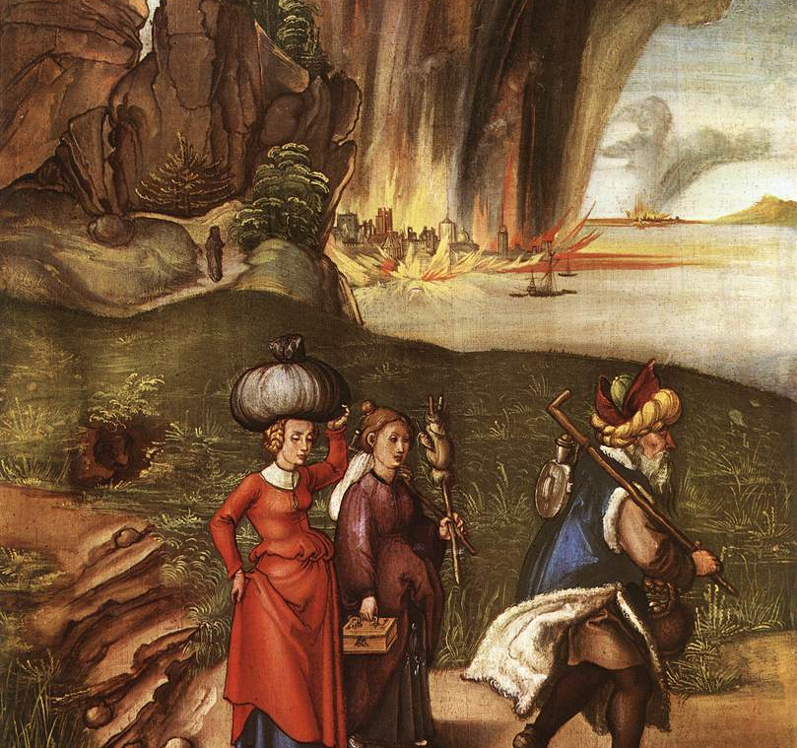
Albrecht Durer, Lot Fleeing with his Daughters from Sodom, c. 1498
Oil and tempera on panel, 52 x 41 cm
National Gallery of Art, Washington

Slide 13
Gen 20 Sarah and Abimelech …. And Abraham
20 From there Abraham journeyed toward the region of the Negeb, and settled between Kadesh and Shur. While residing in Gerar as an alien, ² Abraham said of his wife Sarah, “She is my sister.” And King Abimelech of Gerar sent and took Sarah. ³ But God came to Abimelech in a dream by night, and said to him, “You are about to die because of the woman whom you have taken; for she is a married woman.” ⁴ Now Abimelech had not approached her; so he said, “Lord, will you destroy an innocent people? ⁵ Did he not himself say to me, ‘She is my sister’? And she herself said, ‘He is my brother.’ I did this in the integrity of my heart and the innocence of my hands.” ⁶ Then God said to him in the dream, “Yes, I know that you did this in the integrity of your heart; furthermore it was I who kept you from sinning against me. Therefore I did not let you touch her. ⁷ Now then, return the man’s wife; for he is a prophet, and he will pray for you and you shall live. But if you do not restore her, know that you shall surely die, you and all that are yours.”

Slide 14
Gen 20 Sarah and Abimelech …. And Abraham
⁸ So Abimelech rose early in the morning, and called all his servants and told them all these things; and the men were very much afraid. ⁹ Then Abimelech called Abraham, and said to him, “What have you done to us? How have I sinned against you, that you have brought such great guilt on me and my kingdom? You have done things to me that ought not to be done.” ¹⁰ And Abimelech said to Abraham, “What were you thinking of, that you did this thing?” ¹¹ Abraham said, “I did it because I thought, There is no fear of God at all in this place, and they will kill me because of my wife. ¹² Besides, she is indeed my sister, the daughter of my father but not the daughter of my mother; and she became my wife. ¹³ And when God caused me to wander from my father’s house, I said to her, ‘This is the kindness you must do me: at every place to which we come, say of me, He is my brother.’” ¹⁴ Then Abimelech took sheep and oxen, and male and female slaves, and gave them to Abraham, and restored his wife Sarah to him.

Slide 15
Gen 20 Sarah and Abimelech …. And Abraham
¹⁵ Abimelech said, “My land is before you; settle where it pleases you.” ¹⁶ To Sarah he said, “Look, I have given your brother a thousand pieces of silver; it is your exoneration before all who are with you; you are completely vindicated.” ¹⁷ Then Abraham prayed to God; and God healed Abimelech, and also healed his wife and female slaves so that they bore children. ¹⁸ For the Lord had closed fast all the wombs of the house of Abimelech because of Sarah, Abraham’s wife.

Slide 16
Gen 20 – the text
This is a parallel story of Sarah’s sacrifice to save her husband. The first instance is in Egypt.
Scholars argue that this is an example where two stories, one from the Yahwistic and another from the Elohistic tradition, were wound together.
The story may be about the endangerment of Sarai, now Sarah, as in the prior story, along with the Hagar narrative.
It may be an ancient literary convention, a chiasmus, in which a similar event is used to tell a story, then retell it in reverse order or ring structure.
We still see in all these circumstances imperfect people that God regards and protects.
Notes:
The New Oxford Annotated Bible (c) Oxford University Press, 1996. All rights reserved.
Footnotes 20.1–18: The second story of endangerment of the matriarch (cf. 12.10–20; 26.6–11). Many scholars have argued that chs 20–22 contain the first major block of an Elohistic (E) source parallel to the Yahwistic (J) source found in chs 12–19 and extending through the rest of the Pentateuch (see further 15.2–5n. and the Introduction). Note parallels between stories of endangerment of Sarah in 20.1–18 (E) and 12.10–20 (J); the Hagar stories 21.8–19 (E) and 16.1–14 (J), and even stories about Abimelech in 21.22–34 (E) and 26.17–33 (J). These similarities indicate that the author of the non-Priestly Abraham narrative probably drew upon cycles of Yahwistic and Elohistic traditions that were parallel at some points. Nevertheless, there are some important indicators that the Elohistic traditions seen in Gen 20–22 were written down as part of a larger whole that included the preceding narratives in Gen 12–19 and thus do not reflect (in their present form) a separate written source. Not only are the Elohistic accounts organized as part of a broader chiasm that includes the narratives of Genesis 12–19, but details of Genesis 20–22 are understandable only when these chapters are read following Genesis 12–19. chiasm in the Abraham story There are a series of correspondences between different parts of the Abraham story, where themes introduced at the outset of a narrative are resumed in reverse order in its second half. This chiastic pattern binds many parts of the Abraham story together and puts a heightened emphasis on the sections that occur at the center (in boldface). A. Prologue (11.28–30) B. First challenge: call for Abraham to leave family of origin (12:1–3) C. Wife-sister story 12:10–13:1 D. Separation from Lot (13:2–18) E. Covenant of pieces with Abraham (14–15) F. Hagar-Ishmael story (Gen 16:1–14) E.' Covenant of circumcision with Abraham (17) D.' Hospitality/progeny episodes; Abraham contrasted with Lot (18–19) C.' Wife-sister story (20) B.' Final challenge: calls for Abraham to let go of family of future (21.8–21 and 22.1–19) A.' Epilogue 22.20–24 For example, Abraham’s brief claim in 20.2 that Sarah is his sister would not make sense without the explanation of his request to her to make the same claim in 12.11–13. 3–7: The depiction of Abimelech is far more detailed and sympathetic than that of the foreign king in either of the parallel accounts (cf. 12.15–19; 26.9–10). 7: To Abraham is attributed the intercessory role of prophet; this is the Bible’s first use of the term, and the only designation of Abraham as a prophet in the Torah (but see Ps 105.15). 12: The narrator never asserts that Sarah is Terah’s daughter (cf. 11.27–30). Nevertheless, faced with Abimelech’s passionate questioning, Abraham claims to be her half-brother by way of his father. Though many have taken his assertion at face value, it may be an attempt to provide as many excuses for his behavior as possible (cf. 20.11).
A chiasm (also called a chiasmus) is a literary device in which a sequence of ideas is presented and then repeated in reverse order. The result is a “mirror” effect as the ideas are “reflected” back in a passage. Each idea is connected to its “reflection” by a repeated word, often in a related form. The term chiasm comes from the Greek letter chi, which looks like our letter X. Chiastic pattern is also called “ring structure.”

Slide 17
Genesis 21:1-7
The LORD dealt with Sarah as he had said, and the LORD did for Sarah as he had promised. Sarah conceived and bore Abraham a son in his old age, at the time of which God had spoken to him. Abraham gave the name Isaac to his son whom Sarah bore him. And Abraham circumcised his son Isaac when he was eight days old, as God had commanded him. Abraham was a hundred years old when his son Isaac was born to him. Now Sarah said, "God has brought laughter for me; everyone who hears will laugh with me." And she said, "Who would ever have said to Abraham that Sarah would nurse children? Yet I have borne him a son in his old age."

Slide 18
Genesis 21:8-21
The child grew, and was weaned; and Abraham made a great feast on the day that Isaac was weaned. But Sarah saw the son of Hagar the Egyptian, whom she had borne to Abraham, playing with her son Isaac. So she said to Abraham, "Cast out this slave woman with her son; for the son of this slave woman shall not inherit along with my son Isaac." The matter was very distressing to Abraham on account of his son. But God said to Abraham, "Do not be distressed because of the boy and because of your slave woman; whatever Sarah says to you, do as she tells you, for it is through Isaac that offspring shall be named for you.

Slide 19
Genesis 21:8-21
As for the son of the slave woman, I will make a nation of him also, because he is your offspring." So Abraham rose early in the morning, and took bread and a skin of water, and gave it to Hagar, putting it on her shoulder, along with the child, and sent her away. And she departed, and wandered about in the wilderness of Beer-sheba.
When the water in the skin was gone, she cast the child under one of the bushes. Then she went and sat down opposite him a good way off, about the distance of a bowshot; for she said, "Do not let me look on the death of the child.”

Slide 20
Genesis 21:8-21
And as she sat opposite him, she lifted up her voice and wept. And God heard the voice of the boy; and the angel of God called to Hagar from heaven, and said to her, "What troubles you, Hagar? Do not be afraid; for God has heard the voice of the boy where he is. Come, lift up the boy and hold him fast with your hand, for I will make a great nation of him." Then God opened her eyes and she saw a well of water. She went, and filled the skin with water, and gave the boy a drink.
God was with the boy, and he grew up; he lived in the wilderness, and became an expert with the bow. He lived in the wilderness of Paran; and his mother got a wife for him from the land of Egypt.

Slide 21
Incredibility Of God's Promise
The story as told stresses the incredibility of God's promise.
Abraham is 99 years old, Sarah has aged as well, the promise was no longer possible in human terms.
Even Sarah laughs at the absurd disproportion between the divine promise and the human possibilities.
Yet, Abraham had been faithful and God fulfilled the promise.
The presence of another son complicates the domestic situation.
Notes:
The New Oxford Annotated Bible (c) Oxford University Press, 1996. All rights reserved.
Genesis 18
18.1-15: The LORD's visit to Abraham and Sarah. 1: The oaks of Mamre, see Genesis 13.18 n. 2-8: A fine description of oriental courtesy and hospitality. When the visitors appeared at the noontime siesta, Abraham did not recognize them as divine beings (Hebrews 13.2). The relation of the three visitors to the LORD or Yahweh (Genesis 18.1) is difficult. All three angels (Genesis 19.1) may represent the LORD (see Genesis 16.7 n.); thus the plurality becomes a single person in Genesis 18.10; Genesis 18.13. On the other hand, Genesis 18.22 and Genesis 19.1 suggest that the LORD is one of the three, the other two being attendants.
18.9-15: The narrator stresses the incredibility of God's promise. 12: Sarah's laughter arises from the absurd disproportion between the divine promise and the human possibilities. Other traditions also play upon the name of Isaac, meaning "he laughs" (compare Genesis 17.17-19; Genesis 21.6).
18.16-33: Abraham's intercession for Sodom and Gomorrah. 17-19: Because Abraham is chosen for a special role (Genesis 12.13), he is taken into the LORD's counsel, for Sodom will become an example to future generations (Isaiah 1.9).
18.23-33: Abraham diplomatically questions the justice of God in allowing innocent people to be punished with the guilty. The first example in the Bible of expostulation with God; see also Jeremiah's "confessions," the prophecy of Habakkuk, the book of Job.
The New Oxford Annotated Bible (c) Oxford University Press, 1996. All rights reserved.

Slide 22
Isaac and Ishmael
Sarah as would be natural wished to advance her own child and could not stand seeing the two boys as equal even at play.
“God has heard” is a play on the name Ishmael which means "God hears.”
Although Ishmael was not the heir of the promise in our tradition, God was with Ishmael, destining him to be the ancestor of Bedouin tribes of the southern wilderness
Those who follow Islam trace their ancestry to Abraham through Ishmael.
Notes:
The New Oxford Annotated Bible (c) Oxford University Press, 1996. All rights reserved.
Genesis 21
21.1-21: Isaac and Ishmael. Although Isaac was designated to continue Abraham's line, Ishmael too was promised a great future. 4: On circumcision, see Genesis 17.9-14 n. 6: See Genesis 18.9-15 n.
21.9-10: The jealous mother could not stand seeing the two boys on the same level, even at play. 11-14: Compare Abraham's different attitude in the parallel story (Genesis 16). 14: Beer-sheba is the locale of the Isaac stories, just as Abraham is associated primarily with Mamre or Hebron (see Genesis 13.18 n.).
21.17: The angel of God, see Genesis 16.7 n. God has heard, a play on the name Ishmael, meaning "God hears" (Genesis 16.11). 20: Although Ishmael was not the heir of the promise, God was with the boy, destining him to be the ancestor of bedouin tribes of the southern wilderness (Genesis 16.12). Muslims trace their ancestry to Abraham through Ishmael.
21.22-34: Abraham's dispute with Abimelech. This story contains two traditional explanations of the name Beer-sheba. According to one, Abimelech guaranteed Abraham's loyalty by an oath. Hence Beer-sheba means "Well of the oath" (Genesis 21.31). According to the other (Genesis 21.25-26; Genesis 21.25-30), a dispute over a well resulted in a covenant, seven ewe-lambs being taken in witness. Thus the alternate meaning, "Well of seven." 33: The Everlasting God ("El Olam") is an ancient divine name, once associated with the pre-Israelite sanctuary of Beer-sheba, which Israel adopted as a title for the LORD (Isaiah 40.28). 34: The land of the Philistines is an anachronism, for the Philistines came into Canaan after 1200 B.C. (see Genesis 10.2-5 n.).
The New Oxford Annotated Bible (c) Oxford University Press, 1996. All rights reserved.

Slide 23
Ishmael
The son of Abraham and Hagar is not an infant, as the text might imply; he was at least 13 years old.
Genesis presents a generally positive account of Ishmael and his descendants.
He is the recipient of a special divine blessing.
Like Jacob, Ishmael is the father of twelve sons, the ancestors of twelve tribes.
There are hints of ethnic tension in the narratives as well. Ishmael is depicted as an outcast and prone to violence.
Notes:
The New Oxford Annotated Bible (c) Oxford University Press, 1996. All rights reserved.
Ishmael
Ishmael. Son of Abraham and Hagar. A generally positive attitude toward Ishmael and thus toward his descendants is found in the Genesis traditions. He is the recipient of a special divine blessing (Genesis 17.20) and is present at the burial of Abraham (Genesis 25.9). Like Jacob, Ishmael is the father of twelve sons, the ancestors of twelve tribes (Genesis 25.16). Another indication of the generally favorable view of this patriarch is the fact that several other later Israelites have the same name. There are, however, hints of ethnic tension in the narratives as well. Like Cain, Ishmael is depicted as an outcast and prone to violence (Genesis 16.12), and as a wanderer (note the opening words of Melville's Moby-Dick). The Ishmaelite are elsewhere described as leading a typically nomadic life (Genesis 37.25; Psalm 83.6; 1 Chronicles 27.30). The story of Ishmael and Hagar's separation from Abraham's household contains the kind of scurrilous sexual innuendo found elsewhere in J's etiological narratives concerning Israel's neighbors.
In Muslim tradition, the Arabs trace their ancestry back to Abraham through Ishmael. Because Ishmael was circumcised (Genesis 17.25), so are most Muslims. And, analogous to Paul's reversal of the figures of Isaac and Ishmael (Galatians 4.24-26), Muslim tradition makes Ishmael rather than Isaac the son Abraham was commanded to sacrifice (See Aqedah).
MICHAEL D. COOGAN
The Oxford Companion to the Bible (c) Oxford University Press, 1996. All rights reserved.

Slide 24
Human Vs. Divine
The wife / handmaiden switch was a human solution to a real problem as rearing children is a vital part of life.
The jealousy of the wife once her son was born is also a human solution.
Both are the children of Abraham. Abraham did not send them out until told by God and promised against all odds that things would work out.
Hagar’s resignation to certain death is also a human reaction.
Where, then, is the Divine solution?

Slide 25
The Divine Solution
In a theme that recurs in the Old and New Testaments, we see God who often chooses the outcast, younger or in this case abandoned son, the weak, or disheartened such as Elijah as he flees Jezebel and lies down in the desert to die.
God saves Ishmael, who from this terrible event will live and prosper and in time be the father of many nations.
This does not end the story of Abraham, Ishmael and Isaac.
This is a story of Grace, even in the worst of times, we can look to see that there is a way to the future – even if not the one we want or expect.

Slide 26
Genesis 22:1-14
God tested Abraham. He said to him, "Abraham!" And he said, "Here I am." He said, "Take your son, your only son Isaac, whom you love, and go to the land of Moriah, and offer him there as a burnt offering on one of the mountains that I shall show you." So Abraham rose early in the morning, saddled his donkey, and took two of his young men with him, and his son Isaac; he cut the wood for the burnt offering, and set out and went to the place in the distance that God had shown him. On the third day Abraham looked up and saw the place far away. Then Abraham said to his young men, "Stay here with the donkey; the boy and I will go over there; we will worship, and then we will come back to you.”

Slide 27
Genesis 22:1-14
Abraham took the wood of the burnt offering and laid it on his son Isaac, and he himself carried the fire and the knife. So the two of them walked on together. Isaac said to his father Abraham, "Father!" And he said, "Here I am, my son." He said, "The fire and the wood are here, but where is the lamb for a burnt offering?" Abraham said, "God himself will provide the lamb for a burnt offering, my son." So the two of them walked on together.
When they came to the place that God had shown him, Abraham built an altar there and laid the wood in order. He bound his son Isaac, and laid him on the altar, on top of the wood.

Slide 28
Genesis 22:1-14
Then Abraham reached out his hand and took the knife to kill his son. But the angel of the LORD called to him from heaven, and said, "Abraham, Abraham!" And he said, "Here I am." He said, "Do not lay your hand on the boy or do anything to him; for now I know that you fear God, since you have not withheld your son, your only son, from me." And Abraham looked up and saw a ram, caught in a thicket by its horns. Abraham went and took the ram and offered it up as a burnt offering instead of his son. So Abraham called that place "The LORD will provide"; as it is said to this day, "On the mount of the LORD it shall be provided."

Slide 29
The consecration of the firstborn.
Exodus 13:1-6 According to ancient belief, the devotion of the firstborn of humans and of beasts to God, the giver of fertility, was necessary for continuing increase and well-being.
In this context – The sacrifice of the firstborn was an ancient fertility rite.
In early times the concept developed allowing substitution of a lamb for the firstborn human child.
Notes:
The New Oxford Annotated Bible (c) Oxford University Press, 1996. All rights reserved.
The consecration of the firstborn. 2: According to ancient belief, the devotion of the firstborn of humans and of beasts to God, the giver of fertility, was necessary for continuing increase and well-being (Exodus 22.29b–30; Leviticus 27.26–27; Numbers 3.13; Numbers 8.17–18; Numbers 18.15). 3–10: Old tradition about the festival of unleavened bread (compare the parallel priestly version; Exodus 12.14–20). 4: Abib, the older name for the month of the Exodus (Exodus 23.15; see Exodus 12.2 n.). 5: See Exodus 3.8. 8: In later times people could tell what the Lord did for me when I came out of Egypt, for in worship the redemptive event was made present (Exodus 12.26–27; see Deuteronomy 5.2–3 n.). 9: See Deuteronomy 6.8.
13.11–16: An old tradition about the consecration of the firstborn. 13: Unclean animals, of which the donkey is typical (Leviticus 11; Deuteronomy 14), may be redeemed by substituting a lamb. In early times the custom arose of substituting an animal for the human firstborn (Exodus 34.19–20; compare Genesis 22.13), although pagan human sacrifice persisted (1 Kings 16.34; 2 Kings 16.3; Ezekiel 20.26; Micah 6.7). 14–15: The practice, rooted in ancient fertility beliefs, is here reinterpreted in the light of the Exodus.
13.17–14.31: Israel’s deliverance.

Slide 30
Text
The testing of Abraham. In its oldest form this story was told to show that the Deity surrendered a claim upon the life of the firstborn and provided an animal for a substitute .
In its present context the story portrays another threat to the divine promise: God asks Abraham to sacrifice his only heir, the child of the promise, in whom the people's future would be realized, a trial to see whether he would obey in faith.
Notes:
The New Oxford Annotated Bible (c) Oxford University Press, 1996. All rights reserved.
Genesis 22
22.1-19: The testing of Abraham. In its oldest form this story was told to show that the Deity surrendered a claim upon the life of the firstborn and provided an animal for a substitute (Exodus 13.2; Exodus 13.11-16; Exodus 22.29; Exodus 34.19-20). In its present context the story portrays another threat
to the divine promise: God asks Abraham to sacrifice his only heir, the child of the promise, in whom the people's future would be realized. 1: Tested, i.e. put under trial to see whether he would obey in faith (Genesis 12.4; compare Hebrews 11.17-19). 2: The mountain in the land of Moriah is unknown. In 2 Chronicles 3.1 it is identified with Jerusalem. Samaritan tradition locates the scene on Mount Gerizim (Shechem; compare Genesis 12.6), three days' journey (Genesis 22.4) from Beer-sheba (Genesis 22.19; Genesis 21.33).
22.14: Provide, see Genesis 22.8. 15-18: Since Abraham survives the test, God renews the promise to him and his descendants (see Genesis 12.1-3).
22.20-24: The descendants of Abraham's brother Nahor. See Genesis 24.
The New Oxford Annotated Bible (c) Oxford University Press, 1996. All rights reserved.

Slide 31
Unity
The event is a prime event for Jews, Christians and Muslims.
The same event is featured in the Qur’an (also spelled Koran), but with slightly different details.

Slide 32
The Qur’an
We gave him news of a gentle son. And when he reached the age when he could work with him his father said to him: `My son, I dreamt that I was sacrificing you. Tell me what you think.‘ He replied: `Father, do as you are bidden. Allah willing, you shall find me faithful.'
And when they had both surrendered themselves to Allah's will, and Abraham had laid down his son prostrate upon his face, We called out to him, saying: `Abraham, you have fulfilled your vision.' Thus did We reward the righteous. That was indeed a bitter test. We ransomed his son…
Qur’an 37:100–113 (Surah al-Saffat, ‘The Rangers’). Translated by N. J. Dawood, Penguin Classics, 1974, p. 172.
Notes:
The Qur’an, Surah 37 (al-Saffat, ‘The Rangers’), verses 100–113. Penguin Classics, N.J. Dawood Translator, 1974. Page 172

Slide 33
Who?
The text has been the subject of disagreement since the ‘son’ is not named. [Isaac is not mentioned until later…]
Early Muslim scholars disagreed as to whether the son, unnamed in the passage, is Isaac or Ishmael.
Some of the earliest traditions declare him to be Isaac, but by the ninth or tenth century the consensus was Ishmael.
It is interesting that in this version both Abraham and his son are willing to submit to God’s will.
Notes:
his son also appear in the Qur’an (37.101-113). Early Muslim exegetes disagreed as to whether the son, unnamed in the Qur’anic passage, is Isaac or Ishmael. Some of the earliest traditions declare him to be Isaac, but by the ninth or tenth century the consensus was that Ishmael, increasingly associated with Mecca and identified as the ancestor of the northern Arabs, was the voluntary sacrificial offering.
From
Aqedah
Aqedah. The Hebrew word for "binding," and the common designation for Genesis 22.1-19, in which God tests Abraham by commanding that he sacrifice his son Isaac. Abraham binds Isaac (Genesis 22.9). When he is about to slaughter him, an angel calls to him to desist, whereupon Abraham offers a ram instead. Although the Aqedah is the climax of the Genesis narratives about Abraham, a final testimony to his faith in, obedience to, and fear of God, it is not mentioned elsewhere in the Hebrew Bible. Isaac's role in Genesis 22 is passive, but postbiblical Jewish interpretations of the first to the eighth centuries CE transform him into an adult, voluntary sacrificial offering. Some texts give reasons for the episode, including Satan's questioning of Abraham's devotion to God (b. Sanh. 89b; cf. Job 1-2) and Isaac's and Ishmael's arguments concerning who was the more righteous (Gen. Rab. 55.4). During this period, the Aqedah became associated with the Rosh ha-Shanah liturgy, with the shofar recalling the substituted ram. Mount Moriah, where the Aqedah took place, was identified with the site of the Temple. Isaac emerges both as the paradigm of the martyr and as the perfect sacrifice whose act brings merit to and has redemptive value for his own descendants. Some rabbinic traditions maintain that Isaac, as a sacrificial victim, shed blood, and others conclude that he also died and was resurrected; thus wrote the twelfth-century rabbi Ephraim of Bonn, in the context of the martyrdom of many Rhineland Jews and the destruction of their communities.
The New Testament refers to the Aqedah not as an example of a redemptive sacrificial death but rather as an example of faith (James 2.21; Hebrews 11.17-19; possibly Romans 4.16-18). Echoes of the former may however be found in Paul's understanding of the significance of the death and resurrection of Jesus, and the Septuagint of Genesis 22 may be alluded to in Romans 8.32, Mark 1.11, and Matthew 3.17. Early church fathers such as Clement and Tertullian understood Isaac's sacrifice as a prototype of the sacrifice of Jesus (See Typology). The divine testing of Abraham and the subsequent near sacrifice of his son also appear in the Qur’an (37.101-113). Early Muslim exegetes disagreed as to whether the son, unnamed in the Qur’anic passage, is Isaac or Ishmael. Some of the earliest traditions declare him to be Isaac, but by the ninth or tenth century the consensus was that Ishmael, increasingly associated with Mecca and identified as the ancestor of the northern Arabs, was the voluntary sacrificial offering.
From antiquity to the present, the Aqedah has been portrayed in the arts. For example, it appears on a wall painting of the third-century CE synagogue at Dura-Europos and on a floor mosaic of the sixth-century synagogue at Beth Alpha. During the Renaissance, such sculptors and painters as Ghiberti, Donatello, Titian, Caravaggio, and Rembrandt included the Aqedah among their depictions of biblical subjects. Among notable modern literary treatments of the Aqedah is Soren Kierkegaard's Fear and Trembling (1843).
See Also Suffering.
BARBARA GELLER NATHANSON
The Oxford Companion to the Bible (c) Oxford University Press, 1996. All rights reserved.

Slide 34
Abraham and Ishmael in Art

Slide 35
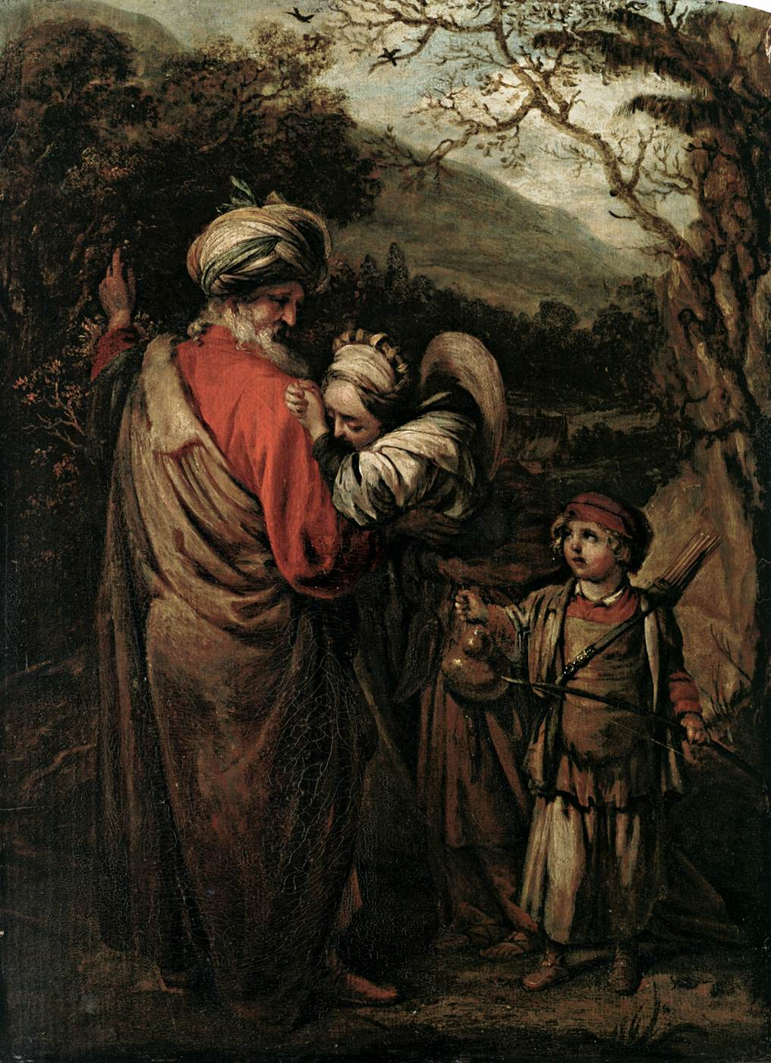
Barent Fabritius,
Abraham Dismissing Hagar and Ishmael
1658
Oil on wood, 50 x 36 cm
Metropolitan Museum of Art, New York

Slide 36
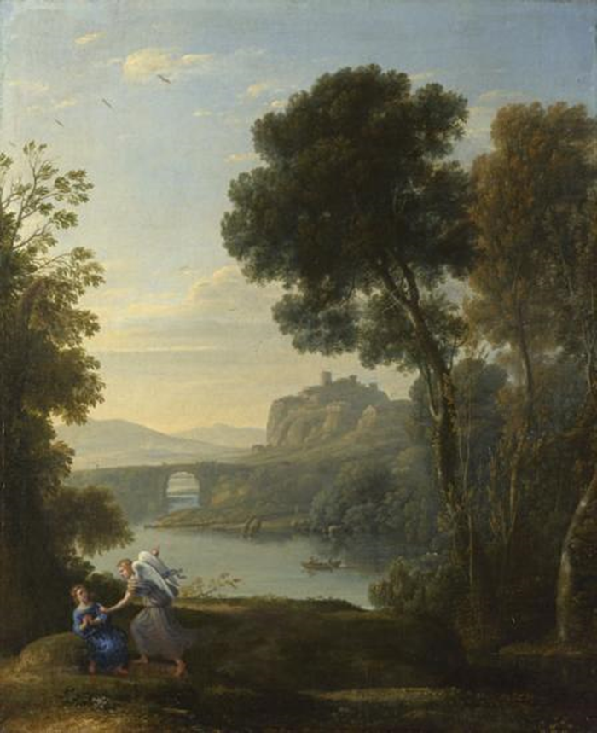
Claude Lorrain, Landscape with Hagar and the Angel, 1646
Oil on canvas, 52.2 x 42.3 cm, National Gallery, London
Owned by Sir George Beaumont and much admired by Turner and Constable.

Slide 37
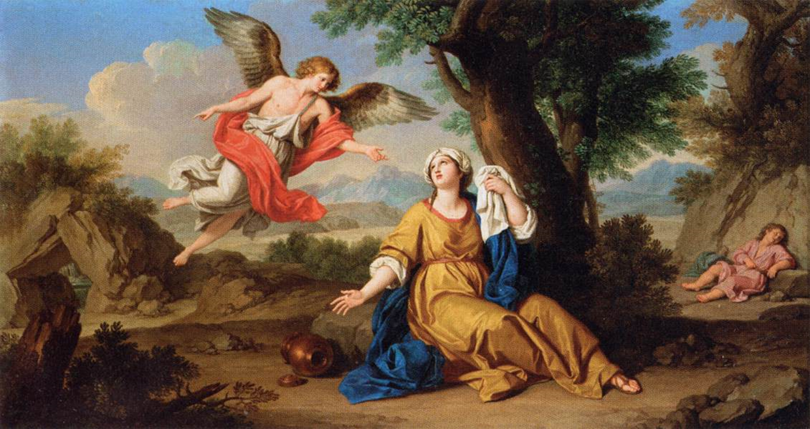
Giuseppe Bottani, Hagar and the Angel, c. 1776
Oil on canvas, 40 x 73 cm, Musée du Louvre, Paris

Slide 38
Abraham and Isaac in Art

Slide 39
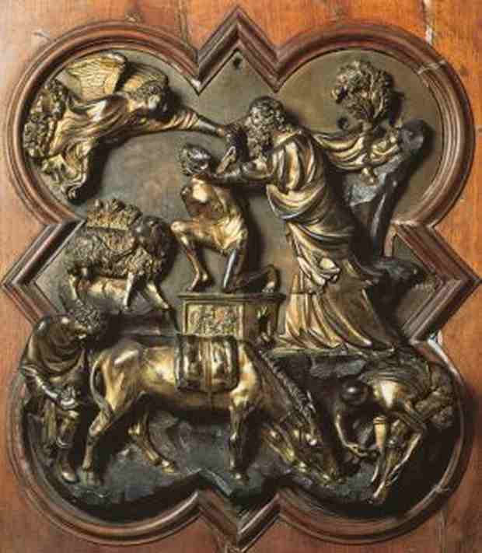
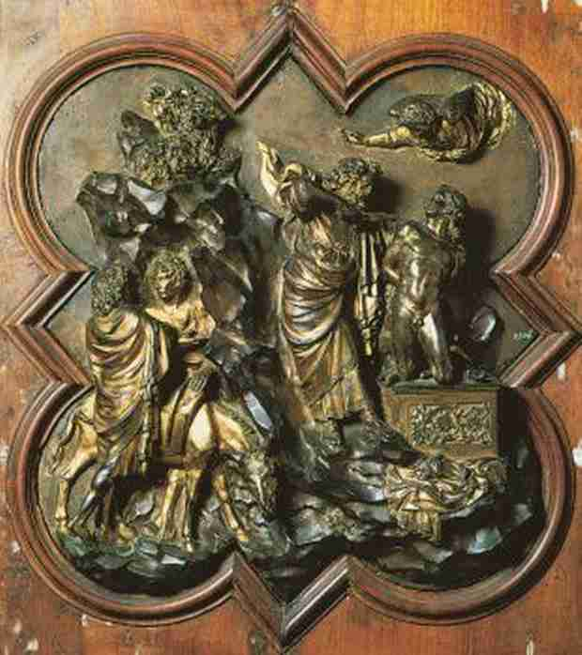

Slide 40
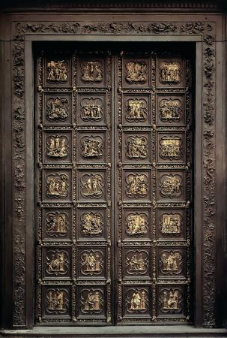
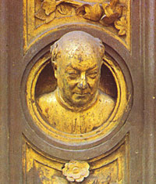
Ghiberti, First Set of Doors, 1402-25

Slide 41
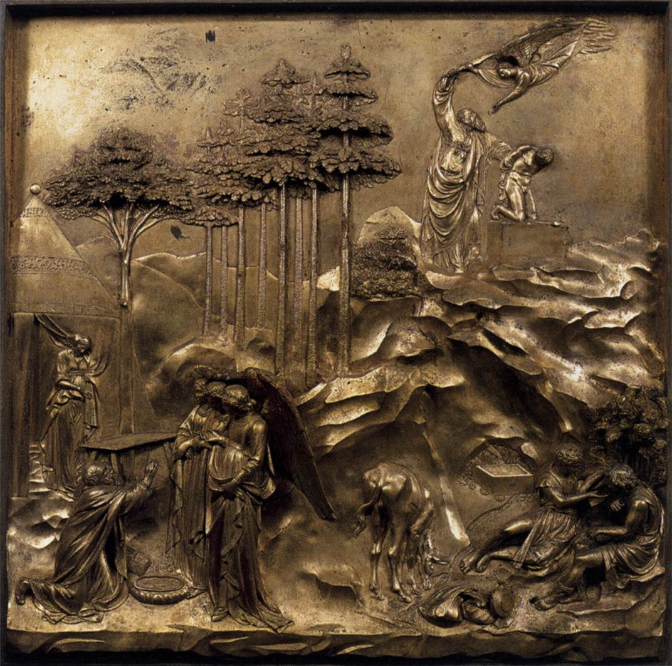
Lorenzo Ghiberti, The Story of Abraham, 1425-52
Gilded bronze, 79 x 79 cm, Baptistry, Florence

Slide 42
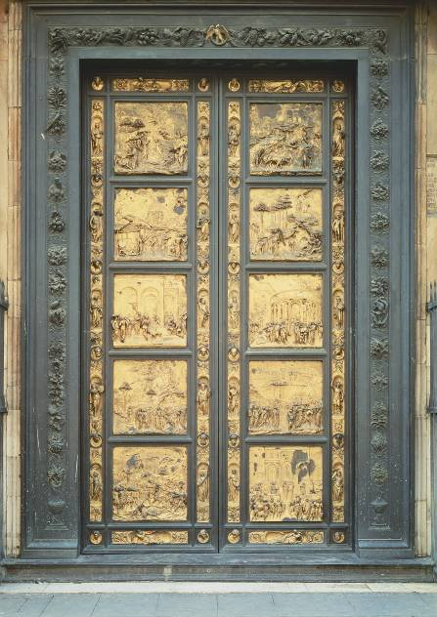
Ghiberti, Second Set of Doors, 1425-52

Slide 43
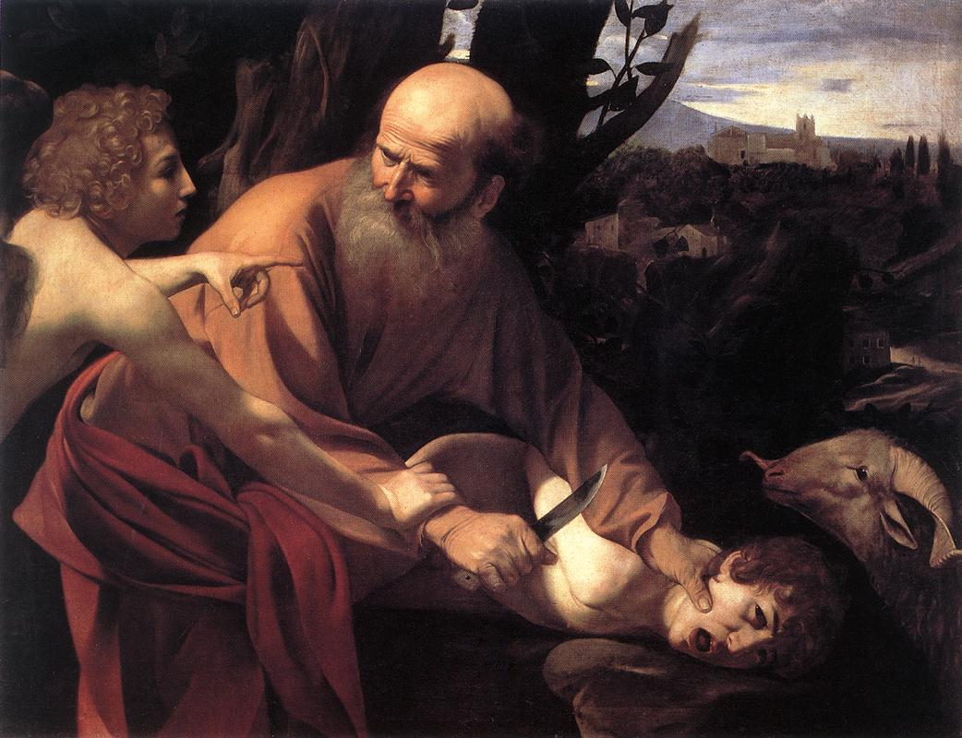
Caravaggio, The Sacrifice of Isaac, 1601-02
Oil on canvas, 104 x 135 cm, Galleria degli Uffizi, Florence

Slide 44
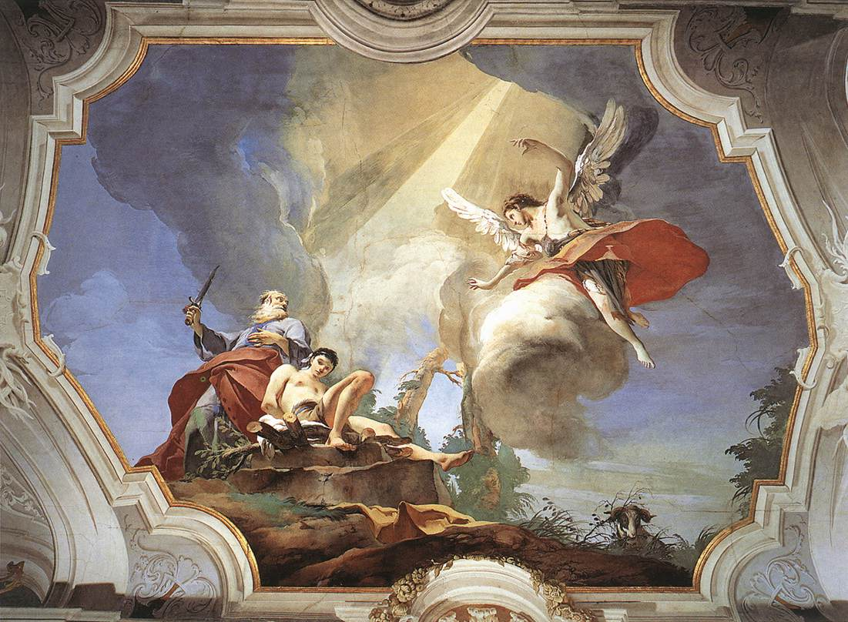
Giovanni Battista Tiepolo, The Sacrifice of Isaac, 1726-29
Fresco, 4000 x 5000 cm, Palazzo Patriarcale, Udine

