Slide 1
Lesson 8
Abraham
Sarah
Isaac
Jacob the Trickster
Notes:
This PowerPoint is intended as an aid for the leader of an adult Christian Education group. All sources are footnoted and from easily available materials. Please respect the sacred nature of the scriptures covered. Use these materials as a way to start and sustain a lively discussion and consideration of a marvelous gift to us for a richer experience of life.
J B Cross
www.episcopalchristioneducation.com

Slide 2
Abraham and the Christian Church
The Christian Church has always recognized in Abraham its spiritual ancestor on account of his faith, a concept worked out by St. Paul.
The Early Church Fathers also looked to his obedience in leaving his homeland at God’s call.
St. Augustine compared it to the following of the Word practiced by the Apostles.
Notes:
The New Oxford Annotated Bible (c) Oxford University Press, 1996. All rights reserved.
The Christian Church has always recognized in Abraham her spiritual ancestor on account of his faith, a conception worked out by St. Paul (Rom. 4. 11, Gal. 3. 7), St. James (2. 21-23), and the author of Hebrews (11. 8-10). The Fathers, e.g. St. *Clement of Rome and St. *Ambrose, exalted his generous obedience in leaving his homeland; and St.*Augustine loved to compare it to the following of the Word practiced by the Apostles. Later spiritual writers see in it a type of the religious vocation of the individual soul. His sacrifice particularly furnished the Fathers with a model of perfect submission to the will of God even in the severest trials. It came to prefigure the death of Christ, and many writers, e.g. *Tertullian, *Qrigen, St. *Cyril of Alexandria, and *Theodoret, draw out all the similarities, e.g. the ram that is killed signifies the humanity, and Isaac who remains alive the Divinity of the Lord. In the *Canon of the Mass, and in the prose for the Feast of *Corpus Christi, *Lauda Sion', the immolation of Isaac prefigures the Sacrifice of the Mass.

Slide 3
Abraham and the Christian Church
His sacrifice in this text particularly furnished the early Church with a model of perfect submission to the will of God in the severest trials.
It came to prefigure the death of Christ.
Many have drawn out further similarities:
1. the ram that is killed signifies the humanity of Jesus, and
2. Isaac who remains alive signifies the Divinity of Jesus.

Slide 4
Genesis 23 The Death of Sarah
The entire chapter tells the story of the death and burial of Sarah after a life of one hundred twenty-seven years.
Abraham, who was honored by the Hittites, seeks and finally obtains for a price land with a cave for her burial.
Abraham buried Sarah his wife in the cave of the field of Machpelah facing Mamre (that is, Hebron) in the land of Canaan.
Later he will himself be buried in this place at the age of one hundred seventy-five, but not before taking another wife and having more children.
Notes:
The New Oxford Annotated Bible (c) Oxford University Press, 1996. All rights reserved.
23 Sarah lived one hundred twenty-seven years; this was the length of Sarah’s life. 2 And Sarah died at Kiriath-arba (that is, Hebron) in the land of Canaan; and Abraham went in to mourn for Sarah and to weep for her. 3 Abraham rose up from beside his dead, and said to the Hittites, ⁴ “I am a stranger and an alien residing among you; give me property among you for a burying place, so that I may bury my dead out of my sight.” ⁵ The Hittites answered Abraham, ⁶ “Hear us, my lord; you are a mighty prince among us. Bury your dead in the choicest of our burial places; none of us will withhold from you any burial ground for burying your dead.” ⁷ Abraham rose and bowed to the Hittites, the people of the land. ⁸ He said to them, “If you are willing that I should bury my dead out of my sight, hear me, and entreat for me Ephron son of Zohar, ⁹ so that he may give me the cave of Machpelah, which he owns; it is at the end of his field. For the full price let him give it to me in your presence as a possession for a burying place.” 1⁰ Now Ephron was sitting among the Hittites; and Ephron the Hittite answered Abraham in the hearing of the Hittites, of all who went in at the gate of his city, 11 “No, my lord, hear me; I give you the field, and I give you the cave that is in it; in the presence of my people I give it to you; bury your dead.” 12 Then Abraham bowed down before the people of the land. 13 He said to Ephron in the hearing of the people of the land, “If you only will listen to me! I will give the price of the field; accept it from me, so that I may bury my dead there.” 1⁴ Ephron answered Abraham, 1⁵ “My lord, listen to me; a piece of land worth four hundred shekels of silver—what is that between you and me? Bury your dead.” 1⁶ Abraham agreed with Ephron; and Abraham weighed out for Ephron the silver that he had named in the hearing of the Hittites, four hundred shekels of silver, according to the weights current among the merchants. 1⁷ So the field of Ephron in Machpelah, which was to the east of Mamre, the field with the cave that was in it and all the trees that were in the field, throughout its whole area, passed 1⁸ to Abraham as a possession in the presence of the Hittites, in the presence of all who went in at the gate of his city. 1⁹ After this, Abraham buried Sarah his wife in the cave of the field of Machpelah facing Mamre (that is, Hebron) in the land of Canaan. 2⁰ The field and the cave that is in it passed from the Hittites into Abraham’s possession as a burying place.
23.1–20: Abraham’s purchase of a family burial place. A late Priestly tradition. 2: Kiriath-arba, the older name of Hebron (Josh 14.15; 15.13; Judg 1.10). 3: The Hitites are considered at this point to be among the Canaanite peoples (see v. 7 and 10.15; 15.9). 4–16: The narrative stresses the legitimacy of the Israelites’ claim to this burial plot. 10: Legal transactions often took place at the city gate; see 34.20; Deut 20.19; 25.7; Ruth 4.1–11; 2 Sam 15.2). 15: Four hundred shekels, about 10 lb (4.5 kg). 17–20: As in many ancient cultures, the Israelites believed that burial of ancestors in a plot of land gave their heirs a sacred claim to it. The Priestly notices of the Genesis story indicate that descendants of Abraham who did not inherit the promise ended up outside Canaan (e.g., Ishmael in 25.12–18 and Esau in 36.1–43; cf. 25.1–6), while Israel’s early patriarchs and matriarchs were buried in the land (25.9–10; 35.27–29; 49.29–32; 50.12–13; etc.; cf. non-Priestly traditions in 35.19–20; 50.5,25).

Slide 5
A wife for Isaac
Notes:
The New Oxford Annotated Bible (c) Oxford University Press, 1996. All rights reserved.
23.1–20: Abraham’s purchase of a family burial place. A late Priestly tradition. 2: Kiriath-arba, the older name of Hebron (Josh 14.15; 15.13; Judg 1.10). 3: The Hittites are considered at this point to be among the Canaanite peoples (see v. 7 and 10.15; 15.9). 4–16: The narrative stresses the legitimacy of the Israelites’ claim to this burial plot. 10: Legal transactions often took place at the city gate; see 34.20; Deut 20.19; 25.7; Ruth 4.1–11; 2 Sam 15.2). 15: Four hundred shekels, about 10 lb (4.5 kg). 17–20: As in many ancient cultures, the Israelites believed that burial of ancestors in a plot of land gave their heirs a sacred claim to it. The Priestly notices of the Genesis story indicate that descendants of Abraham who did not inherit the promise ended up outside Canaan (e.g., Ishmael in 25.12–18 and Esau in 36.1–43; cf. 25.1–6), while Israel’s early patriarchs and matriarchs were buried in the land (25.9–10; 35.27–29; 49.29–32; 50.12–13; etc.; cf. non-Priestly traditions in 35.19–20; 50.5,25).

Slide 6
Genesis 24:34-38, 42-49, 58-67
The servant said to Laban, "I am Abraham's servant. The LORD has greatly blessed my master, and he has become wealthy; he has given him flocks and herds, silver and gold, male and female slaves, camels and donkeys. And Sarah my master's wife bore a son to my master when she was old; and he has given him all that he has. My master made me swear, saying, `You shall not take a wife for my son from the daughters of the Canaanites, in whose land I live; but you shall go to my father's house, to my kindred, and get a wife for my son.’ "I came today to the spring, and said, `O LORD, the God of my master Abraham, if now you will only make successful the way I am going! I am standing here by the spring of water; let the young woman who comes out to draw, to whom I shall say, "Please give me a little water from your jar to drink," and who will say to me, "Drink, and I will draw for your camels also" -- let her be the woman whom the LORD has appointed for my master's son.’

Slide 7
Genesis 24:34-38, 42-49, 58-67
"Before I had finished speaking in my heart, there was Rebekah coming out with her water jar on her shoulder; and she went down to the spring, and drew. I said to her, `Please let me drink.' She quickly let down her jar from her shoulder, and said, `Drink, and I will also water your camels.' So I drank, and she also watered the camels. Then I asked her, `Whose daughter are you?' She said, `The daughter of Bethuel, Nahor's son, whom Milcah bore to him.' So I put the ring on her nose, and the bracelets on her arms. Then I bowed my head and worshiped the LORD, and blessed the LORD, the God of my master Abraham, who had led me by the right way to obtain the daughter of my master's kinsman for his son. Now then, if you will deal loyally and truly with my master, tell me; and if not, tell me, so that I may turn either to the right hand or to the left.”

Slide 8
Genesis 24:34-38, 42-49, 58-67
And they called Rebekah, and said to her, "Will you go with this man?" She said, "I will." So they sent away their sister Rebekah and her nurse along with Abraham's servant and his men. And they blessed Rebekah and said to her, "May you, our sister, become thousands of myriads; may your offspring gain possession of the gates of their foes." Then Rebekah and her maids rose up, mounted the camels, and followed the man; thus the servant took Rebekah, and went his way. Now Isaac had come from Beer-lahai-roi, and was settled in the Negeb. Isaac went out in the evening to walk in the field; and looking

Slide 9
Genesis 24:34-38, 42-49, 58-67
up, he saw camels coming. And Rebekah looked up, and when she saw Isaac, she slipped quickly from the camel, and said to the servant, "Who is the man over there, walking in the field to meet us?" The servant said, "It is my master." So she took her veil and covered herself. And the servant told Isaac all the things that he had done. Then Isaac brought her into his mother Sarah's tent. He took Rebekah, and she became his wife; and he loved her. So Isaac was comforted after his mother's death.

Slide 10
Text - a wife for Isaac from Haran
The servant was perhaps Abraham's major-domo, Eliezer – who might have inherited but for Isaac.
Aloofness from the Canaanites was based upon fear of the corrupting influence of Canaanite culture.
The city of Nahor was near Haran.
Unlike the plot of your standard romantic comedy, the story line here is driven by the assumption that the young woman had been appointed by the LORD to be Isaac's wife.
Notes:
The New Oxford Annotated Bible (c) Oxford University Press, 1996. All rights reserved.
Genesis 24
24.1-67: Finding a wife for Isaac among kinfolk in Haran. 2: The servant was perhaps Abraham's major-domo, Eliezer (Genesis 15.2). Putting the hand under the thigh, an old form of oath taking (Genesis 47.29), reflected the view that the fountain of reproductivity was sacred to the Deity (see Genesis 16.2 n.). 3: Aloofness from the Canaanites was based upon fear of the corrupting influence of Canaanite culture (Exodus 34.15-16; Deuteronomy 7.3-4). 7: His angel, see Genesis 16.7 n.
24.10: The city of Nahor, near Haran (see Genesis 11.31 n.). 12: Steadfast love: NRSV's translation of a Hebrew term (`used") that signifies the loyalty arising from a relationship (e.g. friendship; see 1 Samuel 20.8), which motivates the stronger party to show favor or give help to the weaker. Applied to God's covenant with human beings, it means benevolent action, loyalty manifest in deeds, gracious favor. 14: The story assumes that the young woman had been appointed by the LORD to be Isaac's wife; therefore events unfold according to divine providence (see Genesis 24.21; Genesis 24.26-27; Genesis 24.50; Genesis 24.56). 15: Genesis 22.20-23.
24.62: Beer-lahai-roi, Genesis 16.14.
The New Oxford Annotated Bible (c) Oxford University Press, 1996. All rights reserved.

Slide 11
Isaac
Isaac’s story, as told in Genesis 21-28, for the most part features other people: his father, his servants, and his sons.
There is a parallel event in which his wife also spends time with a local king.
Beyond these, Isaac is seen as a child, then here and later as an old man, without much in between.
An unremarkable life as a wealthy man is perhaps not such a great burden.
Notes:
The New Oxford Annotated Bible (c) Oxford University Press, 1996. All rights reserved.
Isaac
Isaac. Son of Abraham and father of Esau and Jacob. The principal stories about Isaac are found in Genesis 21-28. Isaac is a more shadowy figure than the other patriarchs, and little if anything can be said of him as a historical figure. He is said to have been born when his parents were both advanced in years as a fulfillment of God's promise to Abraham to grant him posterity against all human expectation (see Romans 4.16-22). In Genesis 22 God himself seems to challenge his own promise by demanding that Isaac be offered as a human sacrifice, but rewards Abraham's unquestioning obedience by providing a ram as a substitute at the last possible moment. This story (the Aqedah) has been important in Judaism as a reminder of the precariousness of Israel's election and yet the sure promises of God, as well as in Christianity as a "type" of the sacrifice of Christ.
Of Isaac's maturity we learn little. Genesis 24 tells how he acquired a wife (Rebekah), but the principal characters in this tale are Isaac's servant and Rebekah's family. In Genesis 26 Isaac and Rebekah are involved in an incident with "Abimelech king of the Philistines" (an anachronistic reference), who takes Rebekah into his harem—essentially the same incident twice reported of Abraham and Sarah (Genesis 12 and Genesis 20). Isaac next appears as an old man, deceived by Jacob into giving him the blessing of the firstborn that should by right have been Esau's (Genesis 27). The stories about Isaac locate him at Beersheba in the far south of Judah (Genesis 26.23-33) and associate him with the worship of the God El-roi (Genesis 22.14; Gen 24.62), while Jacob later swears by "the Fear of his father Isaac" (Genesis 31.53), perhaps an old divine name (See Names of God in the Hebrew Bible).
See Also Ancestors, The; Genesis, The Book of.
JOHN BARTON
The Oxford Companion to the Bible (c) Oxford University Press, 1996. All rights reserved.

Slide 12
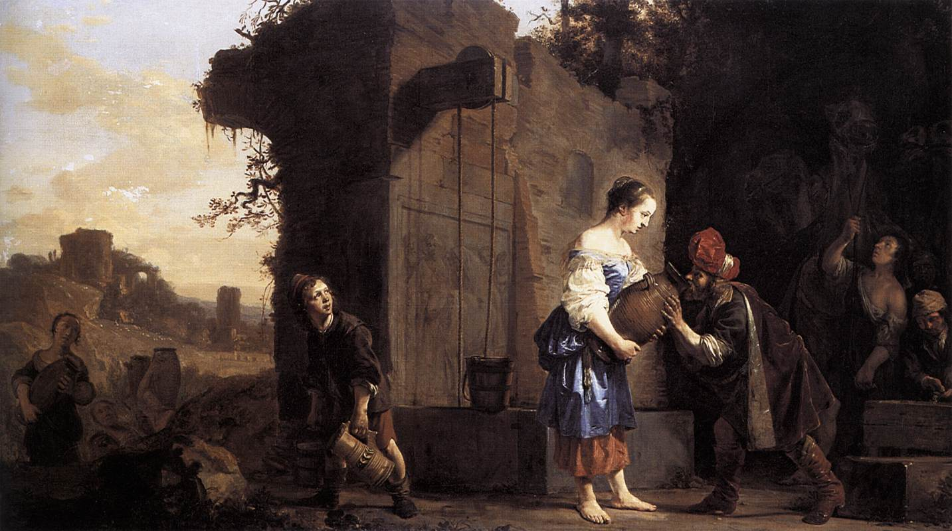
Salomon de Bray, Eliezer and Rebecca, 1660
Oil on canvas, 90 x 156 cm
Musée de la Chartreuse, Douai

Slide 13
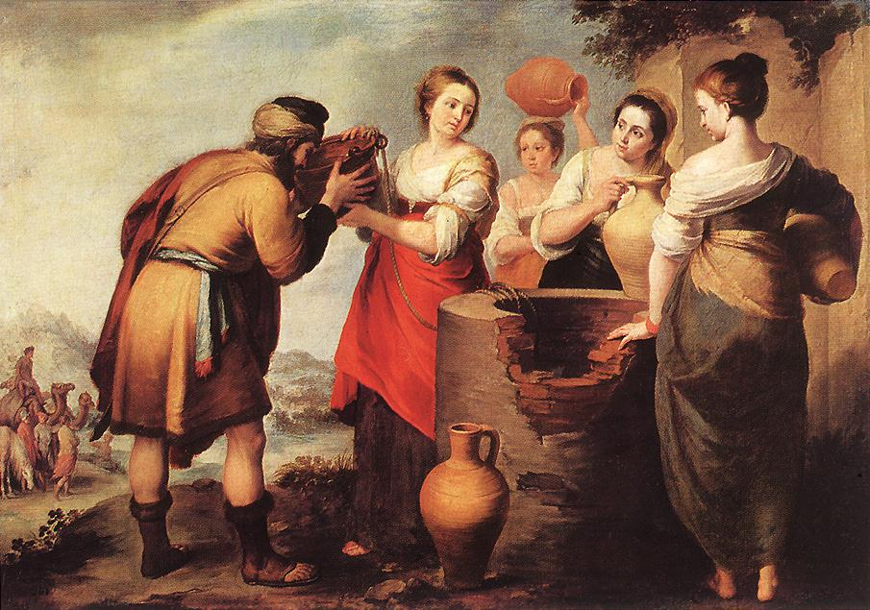
Bartolomé Esteban Murillo, Rebecca and Eliezer, c. 1650
Oil on canvas, 107 x 171 cm, Museo del Prado, Madrid

Slide 14
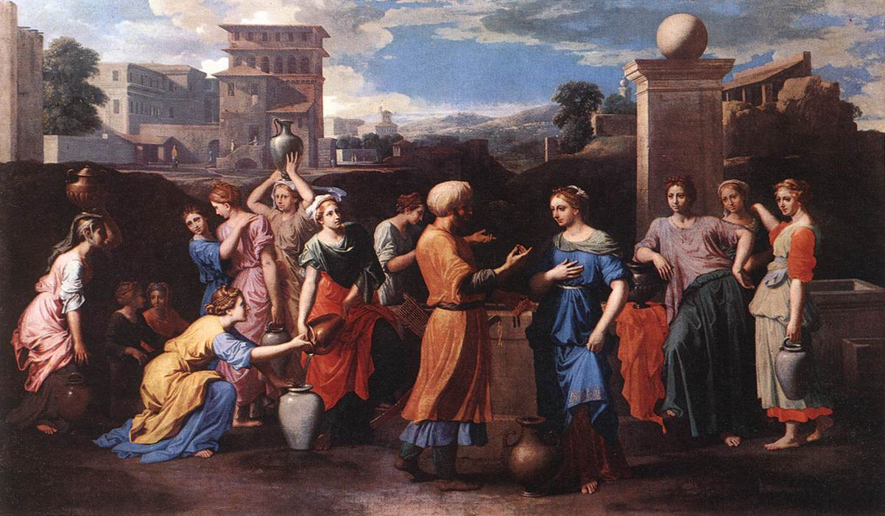
Nicolas Poussin, Rebecca at the Well, c. 1648
Oil on canvas, 118 x 199 cm, Musée du Louvre, Paris

Slide 16
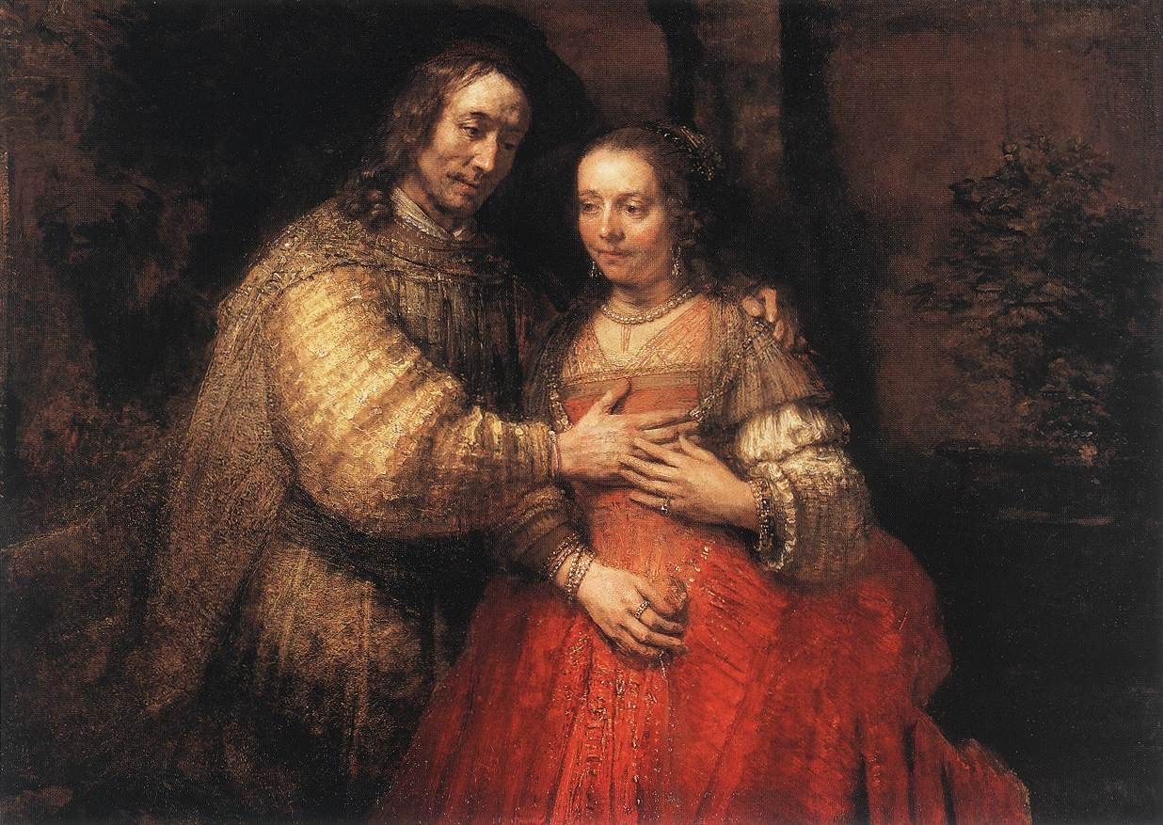
Rembrandt, The Jewish Bride, c. 1665
Oil on canvas, 121,5 x 166,5 cm, Rijksmuseum, Amsterdam

Slide 17

The Burial of Abraham

Slide 18
Gen 25: 1 - 19
25 Abraham took another wife, whose name was Keturah. ² She bore him Zimran, Jokshan, Medan, Midian, Ishbak, and Shuah. 3 Jokshan was the father of Sheba and Dedan. The sons of Dedan were Asshurim, Letushim, and Leummim. ⁴ The sons of Midian were Ephah, Epher, Hanoch, Abida, and Eldaah. All these were the children of Keturah. ⁵ Abraham gave all he had to Isaac. ⁶ But to the sons of his concubines Abraham gave gifts, while he was still living, and he sent them away from his son Isaac, eastward to the east country. ⁷
Notes:
The New Oxford Annotated Bible (c) Oxford University Press, 1996. All rights reserved.
25 Abraham took another wife, whose name was Keturah. ² She bore him Zimran, Jokshan, Medan, Midian, Ishbak, and Shuah. 3 Jokshan was the father of Sheba and Dedan. The sons of Dedan were Asshurim,
Letushim, and Leummim. ⁴ The sons of Midian were Ephah, Epher, Hanoch, Abida, and Eldaah. All these were the children of Keturah. ⁵ Abraham gave all he had to Isaac. ⁶ But to the sons of his concubines Abraham gave gifts, while he was still living, and he sent them away from his son Isaac, eastward to the east country. ⁷ This is the length of Abraham’s life, one hundred seventy-five years. ⁸ Abraham breathed his last and died in a good old age, an old man and full of years, and was gathered to his people. ⁹ His sons Isaac and Ishmael buried him in the cave of Machpelah, in the field of Ephron son of Zohar the Hittite, east of Mamre, 1⁰ the field that Abraham purchased from the Hittites. There Abraham was buried, with his wife Sarah. 11 After the death of Abraham God blessed his son Isaac. And Isaac settled at Beer-lahai-roi.
12 These are the descendants of Ishmael, Abraham’s son, whom Hagar the Egyptian, Sarah’s slave-girl, bore to Abraham. 13 These are the names of the sons of Ishmael, named in the order of their birth: Nebaioth, the fi rstborn of Ishmael; and Kedar, Adbeel, Mibsam, 1⁴ Mishma, Dumah, Massa, 1⁵ Hadad, Tema, Jetur, Naphish, and Kedemah. 1⁶ These are the sons of Ishmael and these are their names, by their villages and by their encampments, twelve princes according to their tribes. 1⁷ (This is the length of the life of Ishmael, one hundred thirty-seven years; he breathed his last and died, and was gathered to his people.) 1⁸ They settled from Havilah to Shur, which is opposite Egypt in the direction of Assyria; he settled down alongside of all his people.

Slide 19
Gen 25: 1 - 19
⁷ This is the length of Abraham’s life, one hundred seventy-five years. ⁸ Abraham breathed his last and died in a good old age, an old man and full of years, and was gathered to his people. ⁹ His sons Isaac and Ishmael buried him in the cave of Machpelah, in the field of Ephron son of Zohar the Hittite, east of Mamre, 10 the field that Abraham purchased from the Hittites. There Abraham was buried, with his wife Sarah. 11 After the death of Abraham God blessed his son Isaac. And Isaac settled at Beer-lahai-roi.
Notes:
The New Oxford Annotated Bible (c) Oxford University Press, 1996. All rights reserved.
25 Abraham took another wife, whose name was Keturah. ² She bore him Zimran, Jokshan, Medan, Midian, Ishbak, and Shuah. 3 Jokshan was the father of Sheba and Dedan. The sons of Dedan were Asshurim,
Letushim, and Leummim. ⁴ The sons of Midian were Ephah, Epher, Hanoch, Abida, and Eldaah. All these were the children of Keturah. ⁵ Abraham gave all he had to Isaac. ⁶ But to the sons of his concubines Abraham gave gifts, while he was still living, and he sent them away from his son Isaac, eastward to the east country. ⁷ This is the length of Abraham’s life, one hundred seventy-five years. ⁸ Abraham breathed his last and died in a good old age, an old man and full of years, and was gathered to his people. ⁹ His sons Isaac and Ishmael buried him in the cave of Machpelah, in the field of Ephron son of Zohar the Hittite, east of Mamre, 1⁰ the field that Abraham purchased from the Hittites. There Abraham was buried, with his wife Sarah. 11 After the death of Abraham God blessed his son Isaac. And Isaac settled at Beer-lahai-roi.
12 These are the descendants of Ishmael, Abraham’s son, whom Hagar the Egyptian, Sarah’s slave-girl, bore to Abraham. 13 These are the names of the sons of Ishmael, named in the order of their birth: Nebaioth, the fi rstborn of Ishmael; and Kedar, Adbeel, Mibsam, 1⁴ Mishma, Dumah, Massa, 1⁵ Hadad, Tema, Jetur, Naphish, and Kedemah. 1⁶ These are the sons of Ishmael and these are their names, by their villages and by their encampments, twelve princes according to their tribes. 1⁷ (This is the length of the life of Ishmael, one hundred thirty-seven years; he breathed his last and died, and was gathered to his people.) 1⁸ They settled from Havilah to Shur, which is opposite Egypt in the direction of Assyria; he settled down alongside of all his people.

Slide 20

The sons of Abraham
The omitted parts deal with the lineage of Issac and Ishmael on the surface as an explanation of how certain tribes came to be located.
But what about Issac and Ismael? As the story was told and embellished by time they should have been enemies – one cast out for the jealousy of the other’s mother.
Notes:
The New Oxford Annotated Bible (c) Oxford University Press, 1996. All rights reserved.
25.1–11: The death of Abraham. 1–6: The ancestry of Arabian tribes, including Midian (Ex 2.15b–22; 18.1–27),
is traced to Abraham through another wife, Keturah. 7–11: A conclusion to the Abraham story taken from the
Priestly source. On the cave of Machpelah, see ch 23. 11: Beer-lahai-roi, see 16.14; 24.62.
25.12–18: Overview of the descendants of Ishmael (cf. 36.1–43). Before the narrative discusses the descendants
of Isaac (25.19–35.29), it gives an overview of the descendants of Ishmael, the firstborn son of Abraham.
For the genealogy of Abraham, see chart on p. 52. 16: Like Israel, the Ishmaelites are said to have twelve tribes.
18: The Ishmaelites are placed in the desert on either side of the Red Sea. See map on p. 23.

Slide 21
Brothers
Return and look at the story as told. The two brothers the older Ismael and the younger Isaac seemed to play together. In fact it is this sight that enrages Sarah to demand the expulsion.
A careful reading will reveal that the boys were older than you may think from a cursory reading.
God, saved Ishmael and his mother with a powerful miracle twice.
Even though the relationship between the parents was broken, there was in the relationship of the boys a note of grace.
We do not know what transpired, how Ishmael was summoned.
We do know that they came together to honor their father.

Slide 22

The Story of Jacob

Slide 23
Genesis 25:19-34
These are the descendants of Isaac, Abraham's son: Abraham was the father of Isaac, and Isaac was forty years old when he married Rebekah, daughter of Bethuel the Aramean of Paddan-aram, sister of Laban the Aramean. Isaac prayed to the LORD for his wife, because she was barren; and the LORD granted his prayer, and his wife Rebekah conceived. The children struggled together within her; and she said, "If it is to be this way, why do I live?" So she went to inquire of the LORD. And the LORD said to her,

Slide 24
Genesis 25:19-34
"Two nations are in your womb, and two peoples born of you shall be divided; the one shall be stronger than the other, the elder shall serve the younger." When her time to give birth was at hand, there were twins in her womb. The first came out red, all his body like a hairy mantle; so they named him Esau. Afterward his brother came out, with his hand gripping Esau's heel; so he was named Jacob. Isaac was sixty years old when she bore them.

Slide 25
Genesis 25:19-34
When the boys grew up, Esau was a skillful hunter, a man of the field, while Jacob was a quiet man, living in tents. Isaac loved Esau, because he was fond of game; but Rebekah loved Jacob.
Once when Jacob was cooking a stew, Esau came in from the field, and he was famished. Esau said to Jacob, "Let me eat some of that red stuff, for I am famished!" (Therefore he was called Edom.) Jacob said, "First sell me your birthright." Esau said, "I am about to die; of what use is a birthright to me?"

Slide 26
Genesis 25:19-34
Jacob said, "Swear to me first." So he swore to him, and sold his birthright to Jacob. Then Jacob gave Esau bread and lentil stew, and he ate and drank, and rose and went his way. Thus Esau despised his birthright.

Slide 27

Text Notes
The Hebrew word red (“’admoni”) is a play on the word Edom.
The Hebrew word (“se'ar”) is a play on Seir, the region of the Edomites.
Jacob is interpreted by a play on the Hebrew word for “heel,” i.e. “he takes by the heel” or “he supplants.”
The two boys typify the hunter and the shepherd, two rival ways of life.
The birthright refers to the rights of the eldest son: leadership of the family and a double share of the inheritance.
The caricature of Esau as a dull person, easily outwitted on an empty stomach, is intended to explain why Israel gained ascendancy over Edom even though the latter became a nation before Israel.
Notes:
The New Oxford Annotated Bible (c) Oxford University Press, 1996. All rights reserved.
Footnotes from Oxford
25.19–34: The rivalry of Jacob (Israel) and Esau (Edom). 20: Paddan-aram, see Genesis 11.31 n. 21: See Genesis 16.2 n. 22–23: Rebekah went to a sanctuary to inquire of the Lord and received the oracular answer in Genesis 25.23. 25: The Hebrew word red (“’admoni”) is a play on the word Edom (“’edom”; Genesis 25.30); hairy (“se'ar”) is a play on Seir, the region of the Edomites (Genesis 32.3). 26: Jacob is interpreted by a play on the Hebrew word for “heel,” i.e. “he takes by the heel” or “he supplants” (Hosea 12.3; Jeremiah 9.4).
25.27–28: The two boys typify the hunter and the shepherd, two rival ways of life (Genesis 4.2). 31–34: The birthright refers to the rights of the eldest son: leadership of the family and a double share of the inheritance (Deuteronomy 21.15–17). The caricature of Esau as a dull person, easily outwitted on an empty stomach, is intended to explain why Israel gained ascendancy over Edom (2 Samuel 8.12–14; 2 Chronicles 25.11–24) even though the latter became a nation first (Genesis 36.31–39).

Slide 28
Why?
The rivalry itself is as common as brothers everywhere, and both will mature.
Why would a mother so favor one son over another? Perhaps the description says it all: Esau was a man’s man, groomed as leader.
Jacob was left for his mother to raise; perhaps she saw him as one to care for her. Or perhaps she viewed the younger son’s status as similar to her own 2nd place status as a female in a male society. She could not raise her own status, but she could elevate Jacob.

Slide 29
The rivalry of Jacob and Esau
Jacob, acting on the advice of Rebekah, then tricked Isaac into making him the principal heir by disguising himself as his older brother and obtaining his father’s blessing.
Esau eventually shunned revenge, was reconciled with Jacob, and settled in Seir.
Most scholars view the stories of Jacob and Esau not only as folktales about fraternal relationships and reversals of fortune but also as Israelite depictions of the ambivalent and sometimes treacherous relationship between Edomites and Israelites over territorial claims.
Within Christianity, Esau became a central example in debates concerning the right of Christians to the blessings promised by God to the descendants of Isaac and in debates about predestination.
Notes:
The New Oxford Annotated Bible (c) Oxford University Press, 1996. All rights reserved.
Oxford Companion to the Bible,
Esau. The older son of Isaac and Rebekah, and the twin brother of Jacob (Genesis 25.24–26). His ruddy and hairy appearance, as well as his preference for hunting and the outdoor life, distinguished him from his brother. Despite the apparent connection between his name and his hairiness in Genesis 25.25, the etymology of Esau remains uncertain. Esau also is considered the ancestor of the Edomites (Genesis 36.9).
Genesis 25.29–34 relates how Esau foolishly sold his birthright to Jacob for the price of a meal whose name in Hebrew (<Œd¿m) resembles Edom, another name for Esau (Genesis 36.1). Jacob, acting on the advice of Rebekah, then tricked Isaac into making him the principal heir by disguising himself as his older brother and obtaining his father’s blessing (Genesis 27). Esau eventually shunned revenge, was reconciled with Jacob, and settled in Seir (Genesis 33).
Most scholars view the stories of Jacob and Esau not only as folktales about fraternal relationships and reversals of fortune but also as Israelite depictions of the ambivalent and sometimes treacherous relationship between Edomites (sons of Esau) and Israelites (sons of Jacob) over territorial claims and other ethnopolitical issues (2 Samuel 8.12–14; 2 Kings 8.20–22; Obadiah 1). Ethnopolitical relationships are ostensibly reflected in notices about Esau’s marriages to women of various ethnic origins (Genesis 26.34; Genesis 28.9) and about his progeny (Genesis 36).
Within Christianity Esau became a central example in debates concerning the right of Christians to the blessings promised by God to the descendants of Isaac (Romans 9.6–14) and in debates about predestination.
Hector Ignacio Avalos

Slide 30
Jacob
The Bible presents Jacob in a double light. On the one hand, he is the revered ancestor of the people of Israel, but on the other, he is a trickster, who deceives his brother into parting with his birthright and his father into giving him the blessing of the firstborn.
Jacob’s acts were later regarded as sinful, although the accounts in Genesis seem to record them without censure.
Jacob, like his father Isaac, seeks a wife in Mesopotamia, but more about that later.
Notes:
The New Oxford Annotated Bible (c) Oxford University Press, 1996. All rights reserved.
Oxford Companion to the Bible
Jacob. Son of Isaac and Rebekah and younger brother of Esau. The Bible presents Jacob in a double light. On the one hand, he is the revered ancestor of the people of Israel, and indeed the name “Israel” is said to have been given him by God after he had wrestled with God himself at Penuel (Genesis 32.28; but see also Genesis 35.10); on the other, he is a trickster, who deceives his brother into parting with his birthright (Genesis 25.29–34) and his father into giving him the blessing of the firstborn that should have belonged to Esau (Genesis 27). Hosea 12.2–6 and Isaiah 43.27 may well indicate that Jacob’s acts were later regarded as sinful, although the accounts in Genesis seem to record them without censure. Jacob is presented as a pastoralist, whereas Esau is a hunter (Genesis 25.27), and the stories about them may reflect rivalries between these two groups in later times, as with the story of Cain and Abel (Genesis 4.1–16); equally, they are contrasted as the ancestors respectively of Israelites and Edomites (Genesis 32.3).
Jacob, like his father Isaac, seeks a wife in Mesopotamia (Genesis 28.1–5). On the way Jacob encamps at Bethel and there in a dream sees divine messengers ascending and descending on a staircase between earth and heaven (See Angels) and erects a pillar to commemorate the incident—perhaps a story to explain why Israelites worshiped at what had been a Canaanite sanctuary. Jacob the trickster is himself tricked by his uncle Laban into working fourteen years to obtain the wife he desires, Rachel; Jacob contracts to work for seven years but at the end of that time is given Leah, her elder sister, instead (Genesis 29.15–30). Jacob has his revenge on Laban by swindling him out of large flocks and herds (Genesis 30.25–31.21) and flees from Laban’s house to return to the land of Canaan but is finally reconciled with his uncle (Genesis 31.36–54). After the mysterious incident at Penuel there follows a reconciliation also with Esau (Genesis 33.1–16).
The remaining stories of Jacob focus on the deeds of his children, the ancestors of the twelve tribes of Israel. Jacob appears as an old man in the story of Joseph (Genesis 37; Genesis 39–50), where the theme of trickery recurs in the deceit by which he is robbed of his favorite son by Joseph’s jealous brothers (Genesis 42.36). Eventually Jacob goes down to Egypt with his sons and dies there (Genesis 49.33), but his embalmed body (Genesis 50.2–3) is taken for burial to the land of Canaan by Joseph and his brothers (Gen 50.7–13). The blessing of Jacob (Genesis 49.2–27) is widely held to contain some of the oldest poetry in the Bible.
John Barton

Slide 31
Jacob and Esau

Slide 32
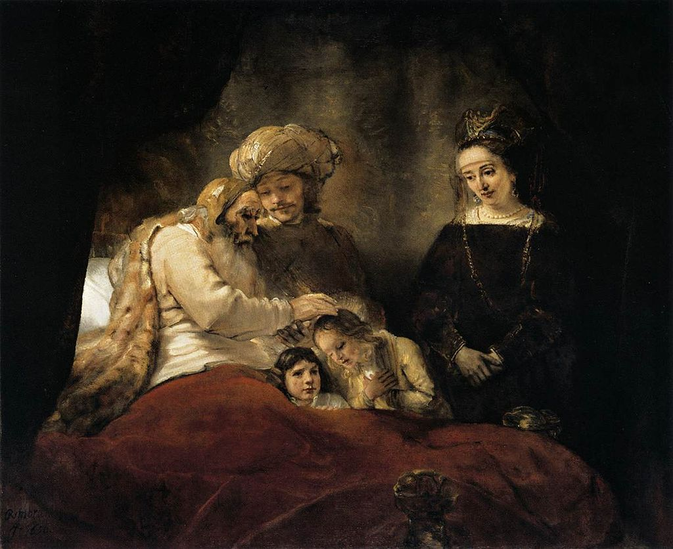
Rembrandt,
Jacob Blessing the Sons of Joseph,
1656
Oil on canvas
68 × 82 in
Museums-landschaft Hessen Kassel

Slide 33
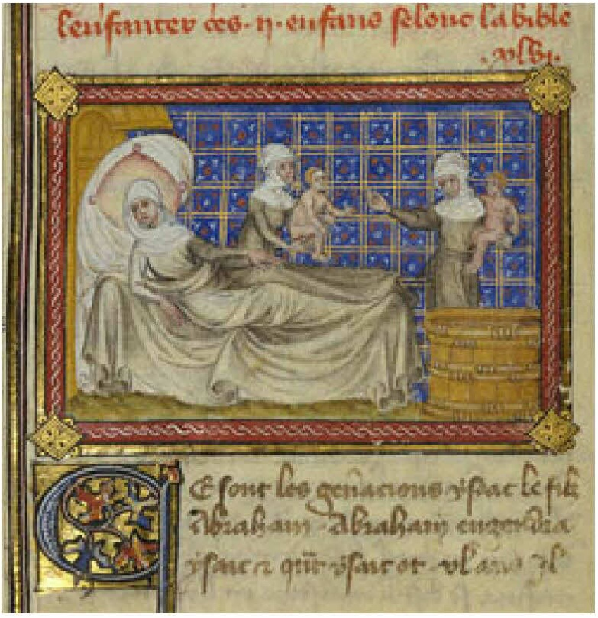
Master of Jean de Mandeville.
The Birth of Esau and Jacob
French, Paris, about 1360 - 1370

Slide 34
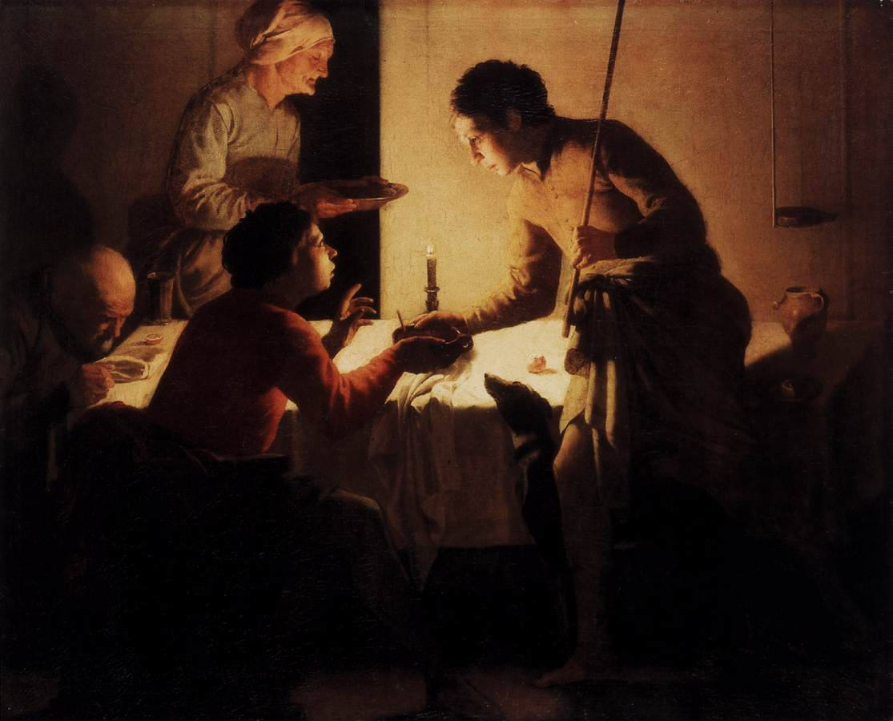
Hendrick Terbrugghen: Esau Selling His Birthright, c. 1625
Oil on canvas, 95 x 116 cm, Staatliche Museen, Berlin

Slide 35
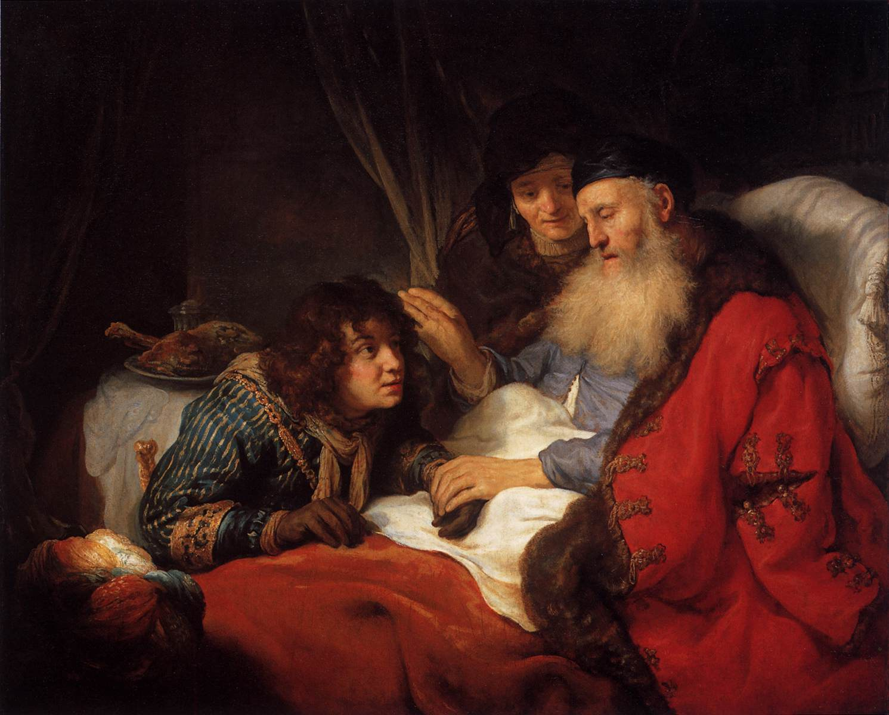
Govert Teunisz. Flinck: Isaac Blessing Jacob, 1639
Oil on canvas, 117 x 141 cm, Rijksmuseum, Amsterdam

Slide 36
Genesis 26 Isaac inherits Abraham’s Blessing
The story of Isaac is largely told through that of his children, with little devoted to his own life history.
There is a parallel event in which Isaac claims that Rebekah is his sister; King Abimelech discovers she is his wife and orders his people not to harm them.
Isaac is likewise blessed with his father's ability to find water and dig wells.
The point is that Isaac has inherited his father's blessing and has the right to pass it on to one of his sons.
Notes:
The New Oxford Annotated Bible (c) Oxford University Press, 1996. All rights reserved.
26.1–33: Interlude on Isaac. Whereas the surrounding sections focus primarily on Isaac’s descendants, this chapter focuses on Isaac apart from his children. Although relatively little is told about Isaac, it is signiﬁcant that each element makes him parallel to his father Abraham: the initial note linking his trip to Gerar with Abraham’s initial journey to Egypt (v. 1; cf. 12.10), the travel command and promise (vv. 2–5; see 12.1–3n.; 22.18n.), the story of endangerment of the matriarch (vv. 6–11; cf. 12.10–13.1 and 20.1–18), the manifestation of blessing on Isaac (vv. 12–14; cf. 12.16; 20.14), the recognition of that blessing by Abimelech (v. 28; cf. 21.22), and the well stories (vv. 17–33; see 21.22–34n.). The narratives of Abraham and Isaac have clearly influenced one another. By the end of the chapter it is clear that Isaac has successfully inherited Abraham’s blessing and is thus prepared to pass it on to one of his sons (see ch 27). 8: Fondling, Heb “metsah ˙ eq,” another reference to Isaac’s name; see 18.12n. 33: Another explanation of the name “Beer-sheba”; see 21.22–34n. 26.34–28.4: The transfer of blessing to Jacob and not Esau. 26.34–35 (cf. 28.8–9 and 36.2–3): This Priestly note on Esau’s diﬃcult marriages was originally connected with 27.46–28.9 (P). Now, however, it helps legitimate the following story about how he was tricked out of his father’s blessing.

