Slide 1
Lesson 9
Notes:
This PowerPoint is intended as an aid for the leader of an adult Christian Education group. All sources are footnoted and from easily available materials. Please respect the sacred nature of the scriptures covered. Use these materials as a way to start and sustain a lively discussion and consideration of a marvelous gift to us for a richer experience of life.
J B Cross
www.episcopalchristianeducation.com

Slide 2
Genesis 27 The deceitfully gained blessing
Jacob having secured his brother birth right with a pot of stew, now through his mother Rebekah, secures his father’s blessing.
The blessing was important in the ancient world and once given was irrevocable.
Now Jacob in disguise tricks his father rather than his brother and secures the blessing meant for Esau.
Perhaps atticipating Esau’s reaction convinces Issac that Jacob should have a wife from his homeland and not from the Hittites as Esau had done.
Notes:
The New Oxford Annotated Bible (c) Oxford University Press, 1996. All rights reserved.
27.1–45: This non-Priestly story of Rebekah and Jacob’s cunning resembles “trickster” traditions in other cultures, where a culture hero flourishes through underhanded tactics (cf. 29.23–25; 31.19–35; 34.1–31; 38.1–30). Women had little power and often had to use unconventional means to accomplish their goals. 4: Deathbed blessings (and curses) were important in the life and literature of ancient peoples (e.g., 48.8–20; 49.1–28). It was believed that such blessings irrevocably released a tangible power that determined the character and destiny of the recipient. Ch 27 itself focuses exclusively on Isaac’s blessing, but the preceding chapter (ch 26) makes clear that this is Isaac’s transfer of a divine blessing first given to Abraham (12.1–3; etc.). 11: See 25.25n. 34–35: The blessing was believed to release a power that could not be retracted (see v. 4n.). 36: See 25.26n.; 25.29–34. There is a wordplay in the Heb words for my birthright (“bekorati”) and my blessing (“birkati”). 39: An inversion of the same words in v. 28. 40: See 25.31–34n. Edom repeatedly revolted from subjection by Judah (1 Kings 11.14–22; 2 Kings 8.20–22). 43: See 24.4,29. Haran was the home of Abraham’s brother Nahor, whose son was Laban. Like Isaac, Jacob will marry within the extended family; see 24.4,10n.,29; 29. 46: See 26.34–35n. 27.46–28.2: On intermarriage, see 24.3n. 28.1–4: A Priestly parallel to the preceding story (27.27–29) where Isaac was not tricked into blessing Jacob, but intended from the outset to bless him in the process of sending him away to find a proper wife (see 26.34–35n.). Compare with P in 17.1–8; 35.11–12; 48.3–4. 3: God Almighty, see 17.1n.

Slide 3
Genesis 28 The Blessing given again
In the prior chapter in an elaborate trick Jacob is blessed. In this chapter Jacob is sent to obtain his wife with his father’s blessing.

Slide 4
Genesis 28:10-19a
Jacob left Beer-sheba and went toward Haran. He came to a certain place and stayed there for the night, because the sun had set. Taking one of the stones of the place, he put it under his head and lay down in that place. And he dreamed that there was a ladder set up on the earth, the top of it reaching to heaven; and the angels of God were ascending and descending on it. And the LORD stood beside him and said, "I am the LORD, the God of Abraham your father and the God of Isaac; the land on which you lie I will give to you and to your offspring; and your offspring shall be like the dust of the earth,

Slide 5
Genesis 28:10-19a
and you shall spread abroad to the west and to the east and to the north and to the south; and all the families of the earth shall be blessed in you and in your offspring. Know that I am with you and will keep you wherever you go, and will bring you back to this land; for I will not leave you until I have done what I have promised you." Then Jacob woke from his sleep and said, "Surely the LORD is in this place-- and I did not know it!"

Slide 6
Genesis 28:10-19a
And he was afraid, and said, "How awesome is this place! This is none other than the house of God, and this is the gate of heaven."
So Jacob rose early in the morning, and he took the stone that he had put under his head and set it up for a pillar and poured oil on the top of it. He called that place Bethel.

Slide 7

The Story Line
Esau is furious at being cheated of his birthright and plans revenge.
Rebekah advises her son to go to her brother, then she gets Isaac's agreement saying that Jacob should not have a Canaanite wife.
Esau wishing to please his father takes another wife from Ishmael's children.
Jacob heads on his way . . .

Slide 8
Jacob's departure for Aram and his dream at Bethel
According to ancient belief, oracles could be received by sleeping in a holy place.
The Angels in a company suggest a view of a retinue surrounding the heavenly King.
In this dream God renews the promise to Jacob, perhaps a way to confirm that the covenant continues through Jacob even though obtained by trickery.
The “gate of heaven” suggests the ancient view that a sanctuary was a place where God came down to meet the people.
The pillar was a sacred stone, often found at ancient sanctuaries and anointing the stone made it holy, that is, set it apart for the Deity.
The story explains the origin of the northern sanctuary at Bethel which flourished for a time.
Notes:
The New Oxford Annotated Bible (c) Oxford University Press, 1996. All rights reserved.
Genesis 28
27.46-28.22: Jacob's departure for Aram and his dream at Bethel.
27.46: Hittite women, i.e. Canaanites (see Genesis 23.3 n. and Genesis 24.3 n.).
28.2: Paddan-aram, see Genesis 11.31 n. 3: God Almighty, see Genesis 17.1 n. 11: Bethel was at this time unsettled. According to ancient belief, oracles could be received by sleeping in a holy place (1 Samuel 3).
28.12: Angels in a company are mentioned here and in Genesis 32.1-2 (compare Genesis 16.7; Genesis 21.17), suggesting the view of a retinue surrounding the heavenly King. 13-15: The Deity, identified as the God of Abraham and the God of Isaac (see Genesis 26.24 n.), renews the promise (Genesis 12.2-3; Genesis 12.7). 17: An explanation of the name of Beth-el (house of God). The gate of heaven suggests the ancient view that a sanctuary was a place where God came down to meet the people, like Babel or "gate of God" (Genesis 11.1-9).
28.18: The pillar was a sacred stone, often found at ancient sanctuaries (Joshua 24.26). Anointing the stone made it holy, that is, set it apart for the Deity (Genesis 28.22). 21: The personal relationship with God indicated in the expression my God, is characteristic of the religion of Israel's ancestors. The family leader chooses God in response to a personal revelation. 22: The story explains the origin of the northern sanctuary at Bethel which flourished from the time of Jeroboam I (1 Kings 12.26-29) to its destruction by Josiah (2 Kings 23.15).
The New Oxford Annotated Bible (c) Oxford University Press, 1996. All rights reserved.

Slide 9
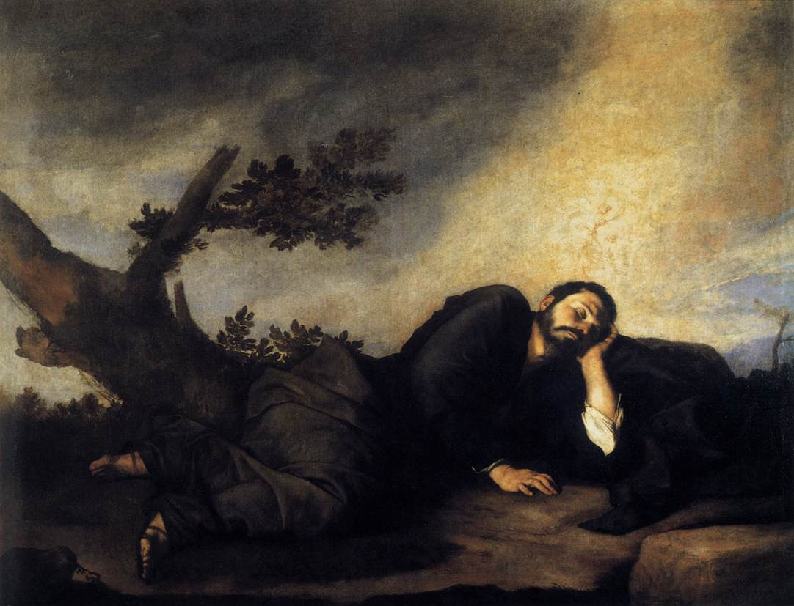
Jusepe de Ribera, Jacob's Dream, 1639 Oil on canvas, 179 x 233 cm Museo del Prado, Madrid

Slide 10
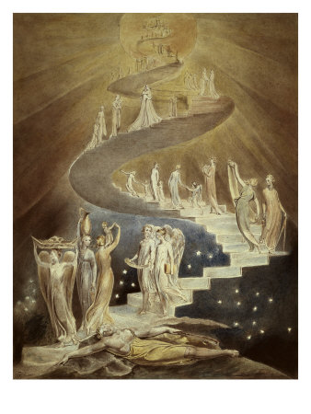
William Blake, Jacob’s Ladder, c. 1800

Slide 11
Genesis 29:15-28
Laban said to Jacob, "Because you are my kinsman, should you therefore serve me for nothing? Tell me, what shall your wages be?" Now Laban had two daughters; the name of the elder was Leah, and the name of the younger was Rachel. Leah's eyes were lovely, and Rachel was graceful and beautiful. Jacob loved Rachel; so he said, "I will serve you seven years for your younger daughter Rachel." Laban said, "It is better that I give her to you than that I should give her to any other man; stay with me." So Jacob served seven years for Rachel, and they seemed to him but a few days because of the love he had for her.

Slide 12
Genesis 29:15-28
Then Jacob said to Laban, "Give me my wife that I may go in to her, for my time is completed." So Laban gathered together all the people of the place, and made a feast. But in the evening he took his daughter Leah and brought her to Jacob; and he went in to her. (Laban gave his maid Zilpah to his daughter Leah to be her maid.) When morning came, it was Leah! And Jacob said to Laban, "What is this you have done to me? Did I not serve with you for Rachel? Why then have you deceived me?" Laban said, "This is not done in our country-- giving the younger before the firstborn. Complete the week of this one, and we will give you the other also in return for serving me another seven years." Jacob did so, and completed her week; then Laban gave him his daughter Rachel as a wife.

Slide 13
Turn About Is Fair Play
Jacob the trickster, is himself tricked.
The footnotes suppose that this deception was possible as the bride was brought veiled to the bridegroom.
The week refers to the complete bridal festivities that lasted one week.
The reading omits an introduction and a postlude about the children born to Leah while Rachel was without children.
Notes:
The New Oxford Annotated Bible (c) Oxford University Press, 1996. All rights reserved.
Genesis 29
29.1-31.55: Jacob's success in Haran.
29.1: The people of the east, a general expression (Genesis 11.2), is applied here to the Arameans. 8: Local custom prevented use of the well until all rightful parties could be there to get their fair share; thus the stone covering was bigger than one person could lift (Genesis 29.2-3).
29.18: Jacob asks for Rachel as a reward for service (compare Joshua 15.16-17; 1 Samuel 17.25; 1 Samuel 18.17) instead of paying the usual marriage price (Exodus 22.16-17; Deuteronomy 22.29). 23–25: The exchange could be made because the bride was brought veiled to the bridegroom (Genesis 24.65). 27: The week refers to the week of marriage festivity (Judges 14.12).
29.31-30.24: Jacob's eleven sons (for Benjamin's birth, see Genesis 35.16-18). The fanciful name-explanations, based on Hebrew word-plays (see translators’ notes to Genesis 29.32-30.24), reflect the rivalry of the two wives for Jacob's affection. The story assumes the traditional twelve-tribe pattern of the Israelite confederacy.
30.2-3: See Genesis 16.2 n. 6: God has judged me, i.e. has gotten justice for me.
30.14: In antiquity mandrakes, roots of a potato-like plant, were thought to have aphrodisiac properties that stimulated conception.
30.32-36: Since striped or speckled coloration was unusual, Laban seemingly had nothing to lose. 37-40: Ancient cattle-breeders believed that the female, at the time of conception, was influenced by visual impressions which affect the color of the offspring. Jacob produced striped animals by putting striped sticks before the females' eyes while they were breeding.
31.4-16: Jacob discusses the situation with his wives because in ancient society they legally belonged to their father's house (Genesis 31.14), and were part of the property (Ruth 4.5; Ruth 4.10).
31.19: Possession of the household gods (1 Samuel 19.13-17), according to ancient custom, insured leadership of the family and legitimated any claim on the property.
31.35: The narrator ridicules the idols upon which Rachel sat in her time of "uncleanness" (Leviticus 15.19-23). 42: The Fear of Isaac (perhaps, the "Kinsman" of Isaac), an old epithet for the God of the ancestors that was appropriated as a title for Israel's God.
31.43: Laban's argument presupposes the legality of a type of marriage in which the wife stays in her father's household and the husband must leave his family (Judges 14.2-3; Judges 15.1). 44: The story reflects a boundary covenant between Arameans and Israelites, both of whom laid claim to the area in Transjordan (Genesis 31.52). 46: They ate there, a reference to the covenant meal (Genesis 31.54) at which, it was believed, the Deity was present. 47: The stone-heap is given two names (see translators' notes to this verse), one in Laban's language (Aramaic) and one in Jacob's (Hebrew). 49: The "Mizpah benediction" is a prayer that the Deity would oversee the treaty (since neither Jacob nor Laban could trust each other) and guarantee that both parties live up to the contract.
The New Oxford Annotated Bible (c) Oxford University Press, 1996. All rights reserved.

Slide 14

Rachel
Rachel’s name meant “ewe,” a young lamb.
The story is a love story, succinctly told.
Rachel, after a long wait, will become the mother of Joseph and Benjamin.
For a love story it is rather one-sided. The actors are Jacob and Laban.
We don’t know whether Rachel or Leah cared for Jacob, or most interesting, what was Rachel’s reaction when Leah was taken.
Notes:
The New Oxford Annotated Bible (c) Oxford University Press, 1996. All rights reserved.
Rachel
Rachel. Rachel, whose name means "ewe," was the younger daughter of Laban (brother of Rebekah) and the wife of Jacob. The account of the meeting and subsequent marriage of Rachel and Jacob is a love story, succinct in its narration. Jacob was charged by his father Isaac to find a wife among his mother's people at Haran in Mesopotamia (Genesis 27.46-28.5). At the end of his journey, he came to a well where shepherds gathered to water their flocks. When he learned that they were from Haran, he asked them if they knew Laban; the shepherds pointed out to Jacob that Laban's daughter Rachel was approaching with her father's sheep. As soon as Jacob saw Rachel, he rolled the stone from the mouth of the well and watered the flock of Laban, his uncle. He kissed Rachel and made himself known to her as a relative. She then returned home and gave her father the news of the arrival of Jacob. Laban went to Jacob, greeted him, and brought him to his house, where he stayed a month helping with the daily chores. At the end of this time, his uncle suggested that even as a relative he should not serve for nothing. When he asked Jacob what his wages should be, Jacob, who loved Rachel, said, "I will serve you seven years for your younger daughter Rachel" (Genesis 29.18); this was agreed upon. At the end of the term, which passed quickly for him because of his love, he asked Laban for her hand in marriage.
A feast was prepared and Jacob received his wife who according to custom was veiled. In the morning he discovered that he had been deceived into accepting Rachel's elder sister, Leah. When he confronted Laban, he was told that in that country the younger daughter was not given in marriage before the elder; disappointed but undaunted, Jacob worked another seven years for Rachel. Needless to say, she was his favorite wife and eventually became the mother of Joseph and Benjamin.
Some time later after a quarrel between Laban and Jacob, in which Rachel took her husband's part and then stole her father's household gods (See Teraphim), the entire clan departed stealthily on the long journey to Canaan (Genesis 31.14-21), where she died at Ephrath giving birth to her younger son Benjamin (Genesis 35.19).
See Also Ancestors, The; Genesis, The Book of.
ISOBEL MACKAY METZGER
The Oxford Companion to the Bible (c) Oxford University Press, 1996. All rights reserved.

Slide 15
The trick [first trick]
If Jacob had not tricked his brother out of the birthright, he would not have needed to depart.
Jacob otherwise might not have been so willing to stay the first and then second seven years - out of his brother reach.
We see an example of what looked bad at first, but that ends working for good.

Slide 16
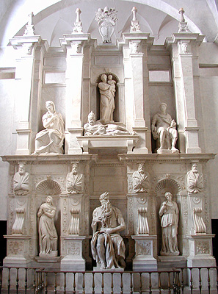
The two statues were created for the final version of the tomb of Julius II.
Michelangelo Buonarroti, Rachel and Leah, 1545
Marble, S. Pietro in Vincoli, Rome. Rachel is the symbol of contemplative life, and Leah that of the active life.

Slide 17
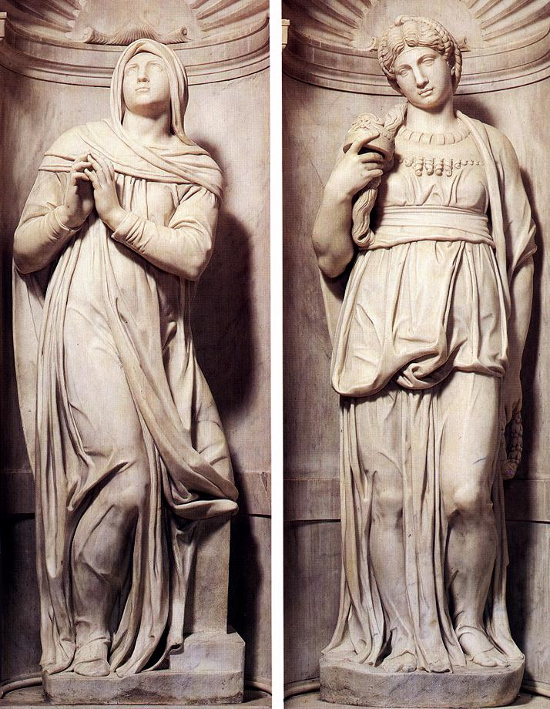

Slide 18
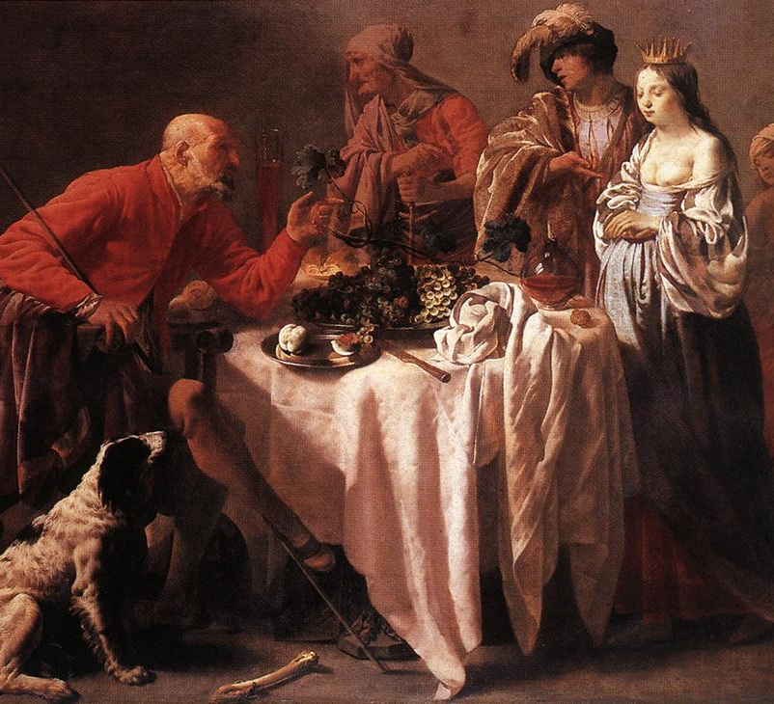
Hendrick Terbrugghen, Jacob Reproaching Laban, 1628
Oil on canvas, 123,5 x 157,5 cm
Wallraf-Richartz Museum, Cologne

Slide 19
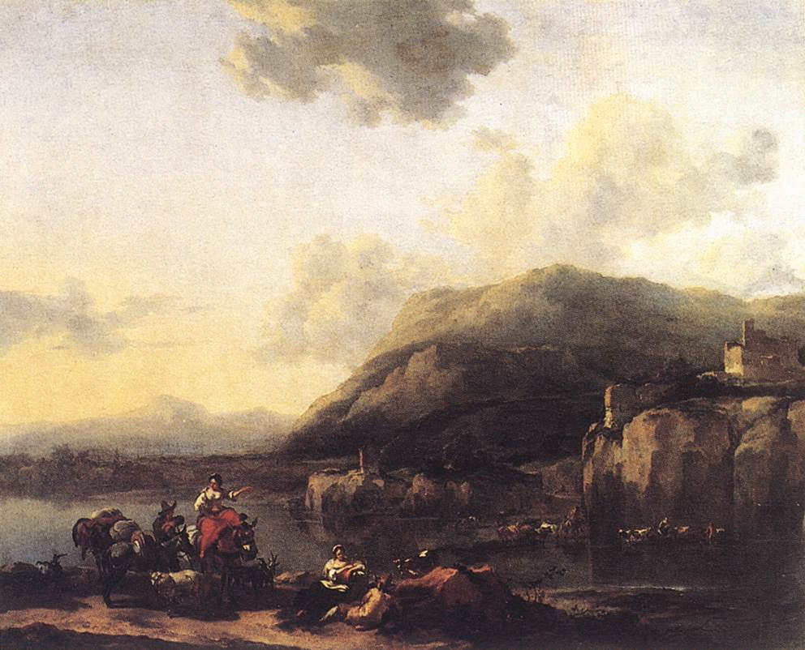
Nicolaes Berchem, Landscape with Jacob, Rachel, and Leah, 1643 Oil on canvas, 166 x 138 cm, Musée du Louvre, Paris

Slide 20
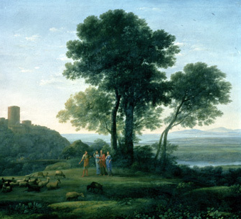
Claude Lorrain, Jacob, Laban, and His Daughters, c. 1676
Dulwich Picture Gallery, London

Slide 21
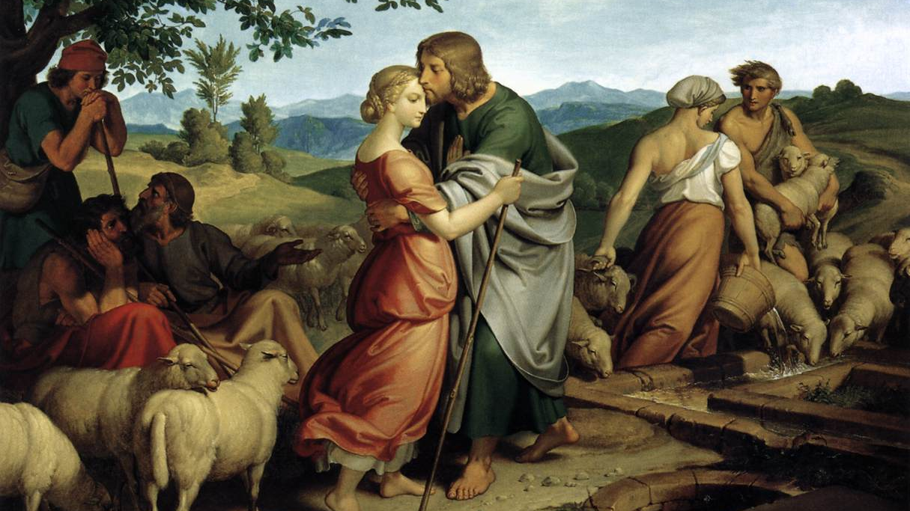

Slide 22

Genesis 30 Another trick
Leah and Rachel continue their efforts as wives to bear children. Finally even Rachel gave birth to Joseph.
Jacob continued to tend Laban’s flocks and they multiplied exceedingly.
Jacob asked Laban if he could return to his home. Laban did not wish him to go because of the increase in his flocks under Jacob’s care.
They did agree that Jacob could return home taking only the striped or speckled animals. Laban secretly removed the striped and speckled animals. Jacob outsmarted him and many striped and speckled animals were produced for Jacob’s flock.

Slide 23
Genesis 31 – Jacob’s departure
As Jacob’s herds grew, the sons of Laban became jealous and Jacob realized that he would have to leave.
Jacob took his wives and sons and all his possessions and left Laban. As they departed Rachel took the household gods of Laban.
Laban followed them and confronted Jacob about the household gods, but Rachel fooled her father and they were not found.
Ultimately Laban blesses his daughters and grandchildren and departs, leaving Jacob to return to his homeland.

Slide 24
Genesis 32 – Jacob’s Return
Is Jacob returns to his Homeland he sends out emissaries to Esau with gifts.
Word reaches Jacob that his brother Esau is coming to greet him with 400 men Fearing the worst Jacob divides his company. They proceed ahead of him and he is left alone In the night time.

Slide 25
Genesis 32:22-31
The same night Jacob got up and took his two wives, his two maids, and his eleven children, and crossed the ford of the Jabbok. He took them and sent them across the stream, and likewise everything that he had. Jacob was left alone; and a man wrestled with him until daybreak. When the man saw that he did not prevail against Jacob, he struck him on the hip socket; and Jacob's hip was put out of joint as he wrestled with him.

Slide 26
Genesis 32:22-31
Then he said, "Let me go, for the day is breaking." But Jacob said, "I will not let you go, unless you bless me." So he said to him, "What is your name?" And he said, "Jacob." Then the man said, "You shall no longer be called Jacob, but Israel, for you have striven with God and with humans, and have prevailed." Then Jacob asked him, "Please tell me your name." But he said, "Why is it that you ask my name?" And there he blessed him. So Jacob called the place Peniel, saying, "For I have seen God face to face, and yet my life is preserved." The sun rose upon him as he passed Penuel, limping because of his hip.

Slide 27
Context - Jacob's reconciliation with Esau
Jacob after 20 years prepares to meet his brother.
Jacob’s messengers return to say that Esau will greet him with 400 men.
Jacob prays and reminds God that the return home was God’s idea.
Although uncertain how his brother felt toward him after twenty years, the resourceful Jacob believed that he could get the situation into hand, either by saving half of his camp or by winning Esau over with impressive gifts.
His camps are divided and sent across the river, the gifts sent, Jacob remains behind.
Notes:
The New Oxford Annotated Bible (c) Oxford University Press, 1996. All rights reserved.
Genesis 32
32.1-33.20: Jacob's reconciliation with Esau. Before re-entering the promised land, Jacob underwent a struggle which chastened his self-confidence and prepared him for a new relation with Esau.
32.1-2: Angels, see Genesis 28.12 n. Mahanaim, here explained by a wordplay (God's camp), was important in later Israelite history (2 Samuel 2.8-9; 2 Samuel 17.24-29; 1 Kings 4.14). 3: Seir, the region of Edom in which apparently Esau had already settled (see Genesis 25.25 n.; Genesis 36.8). 3-21: Although uncertain how his brother felt toward him after twenty years, the resourceful Jacob believed that he could get the situation into hand, either by saving half of his camp (Genesis 32.6-8) or by winning Esau over with impressive gifts (Genesis 32.13-21).
32.25: Owing to his Herculean strength (Genesis 29.10; compare Genesis 28.18), Jacob was winning the contest until his opponent sprained Jacob's hip. 26: The divine being had to vanish before sunrise—a mark of the antiquity of the tradition. 27: In antiquity it was believed that selfhood was expressed in the name given a person (compare Genesis 32.29). 28: Jacob's new name signified a new self: no longer was he the Supplanter (Genesis 25.26; Genesis 27.36) but Israel (Genesis 35.10), which probably means "God rules." This name, which later designated the tribal confederacy (see Genesis 33.20 n.), is interpreted to mean "The one who strives with God" (Hosea 12.3-4). And with humans refers to Jacob's strife with Esau and Laban. 29: The divine being refuses lest Jacob, by possessing the name, gain power over him (compare Exodus 3.13-14; Judges 13.17). 30: Jacob had feared to see Esau's face (Genesis 32.20; Genesis 33.10), but instead he saw God face to face and was allowed to live (Genesis 16.13; Exodus 33.20). 32: An explanation of the Israelite taboo against eating the corresponding muscle of an animal.
33.10: Like seeing the face of God, who at Penuel (or Peniel) also proved to be gracious (Genesis 32.30; Genesis 32.31). 18: Shechem, see Genesis 12.6 n. 19: The sons of Hamor were the ruling clan of the city (Judges 9.28), of Hivite (perhaps Horite or Hurrian) extraction (see Genesis 36.20 n.). The plot of land later became the traditional burial place of Joseph (Joshua 24.32). 20: The worship of El-Elohe-Israel (see translators’ note to this verse) apparently preceded the later establishment of an Israelite tribal confederacy, presumably at Shechem (Joshua 24), when El (the Semitic word for "God") was succeeded by the LORD (Yahweh), the God of Israel.
The New Oxford Annotated Bible (c) Oxford University Press, 1996. All rights reserved.

Slide 28
The Angel
Initially depicted as a quiet man of the camp in comparison to Esau, Jacob is now said to have Herculean strength; the footnote points to his ability to alone move the rock at the well to water Rachel’s sheep.
Jacob was winning the contest until his opponent sprained Jacob's hip.
The divine being had to vanish before sunrise—a mark of the antiquity of the tradition.
Notes:
The New Oxford Annotated Bible (c) Oxford University Press, 1996. All rights reserved.
Genesis 32
32.1-33.20: Jacob's reconciliation with Esau. Before re-entering the promised land, Jacob underwent a struggle which chastened his self-confidence and prepared him for a new relation with Esau.
32.1-2: Angels, see Genesis 28.12 n. Mahanaim, here explained by a wordplay (God's camp), was important in later Israelite history (2 Samuel 2.8-9; 2 Samuel 17.24-29; 1 Kings 4.14). 3: Seir, the region of Edom in which apparently Esau had already settled (see Genesis 25.25 n.; Genesis 36.8). 3-21: Although uncertain how his brother felt toward him after twenty years, the resourceful Jacob believed that he could get the situation into hand, either by saving half of his camp (Genesis 32.6-8) or by winning Esau over with impressive gifts (Genesis 32.13-21).
32.25: Owing to his Herculean strength (Genesis 29.10; compare Genesis 28.18), Jacob was winning the contest until his opponent sprained Jacob's hip. 26: The divine being had to vanish before sunrise—a mark of the antiquity of the tradition. 27: In antiquity it was believed that selfhood was expressed in the name given a person (compare Genesis 32.29). 28: Jacob's new name signified a new self: no longer was he the Supplanter (Genesis 25.26; Genesis 27.36) but Israel (Genesis 35.10), which probably means "God rules." This name, which later designated the tribal confederacy (see Genesis 33.20 n.), is interpreted to mean "The one who strives with God" (Hosea 12.3-4). And with humans refers to Jacob's strife with Esau and Laban. 29: The divine being refuses lest Jacob, by possessing the name, gain power over him (compare Exodus 3.13-14; Judges 13.17). 30: Jacob had feared to see Esau's face (Genesis 32.20; Genesis 33.10), but instead he saw God face to face and was allowed to live (Genesis 16.13; Exodus 33.20). 32: An explanation of the Israelite taboo against eating the corresponding muscle of an animal.
33.10: Like seeing the face of God, who at Penuel (or Peniel) also proved to be gracious (Genesis 32.30; Genesis 32.31). 18: Shechem, see Genesis 12.6 n. 19: The sons of Hamor were the ruling clan of the city (Judges 9.28), of Hivite (perhaps Horite or Hurrian) extraction (see Genesis 36.20 n.). The plot of land later became the traditional burial place of Joseph (Joshua 24.32). 20: The worship of El-Elohe-Israel (see translators’ note to this verse) apparently preceded the later establishment of an Israelite tribal confederacy, presumably at Shechem (Joshua 24), when El (the Semitic word for "God") was succeeded by the LORD (Yahweh), the God of Israel.
The New Oxford Annotated Bible (c) Oxford University Press, 1996. All rights reserved.

Slide 29
a new name
In antiquity it was believed that selfhood was expressed in the name given a person
Jacob's new name signified a new self: no longer was he the Supplanter but Israel, which probably means "God rules."
This name, which later designated the nation of Israel, was interpreted to mean “The one who strives with God.”
The divine being refuses to state his name lest Jacob, by possessing the name, gain power over him.
The irony is that Jacob had feared to see Esau's face, but instead he saw ‘God’ face to face and was allowed to live
Notes:
The New Oxford Annotated Bible (c) Oxford University Press, 1996. All rights reserved.
Genesis 32
32.1-33.20: Jacob's reconciliation with Esau. Before re-entering the promised land, Jacob underwent a struggle which chastened his self-confidence and prepared him for a new relation with Esau.
32.1-2: Angels, see Genesis 28.12 n. Mahanaim, here explained by a wordplay (God's camp), was important in later Israelite history (2 Samuel 2.8-9; 2 Samuel 17.24-29; 1 Kings 4.14). 3: Seir, the region of Edom in which apparently Esau had already settled (see Genesis 25.25 n.; Genesis 36.8). 3-21: Although uncertain how his brother felt toward him after twenty years, the resourceful Jacob believed that he could get the situation into hand, either by saving half of his camp (Genesis 32.6-8) or by winning Esau over with impressive gifts (Genesis 32.13-21).
32.25: Owing to his Herculean strength (Genesis 29.10; compare Genesis 28.18), Jacob was winning the contest until his opponent sprained Jacob's hip. 26: The divine being had to vanish before sunrise—a mark of the antiquity of the tradition. 27: In antiquity it was believed that selfhood was expressed in the name given a person (compare Genesis 32.29). 28: Jacob's new name signified a new self: no longer was he the Supplanter (Genesis 25.26; Genesis 27.36) but Israel (Genesis 35.10), which probably means "God rules." This name, which later designated the tribal confederacy (see Genesis 33.20 n.), is interpreted to mean "The one who strives with God" (Hosea 12.3-4). And with humans refers to Jacob's strife with Esau and Laban. 29: The divine being refuses lest Jacob, by possessing the name, gain power over him (compare Exodus 3.13-14; Judges 13.17). 30: Jacob had feared to see Esau's face (Genesis 32.20; Genesis 33.10), but instead he saw God face to face and was allowed to live (Genesis 16.13; Exodus 33.20). 32: An explanation of the Israelite taboo against eating the corresponding muscle of an animal.
33.10: Like seeing the face of God, who at Penuel (or Peniel) also proved to be gracious (Genesis 32.30; Genesis 32.31). 18: Shechem, see Genesis 12.6 n. 19: The sons of Hamor were the ruling clan of the city (Judges 9.28), of Hivite (perhaps Horite or Hurrian) extraction (see Genesis 36.20 n.). The plot of land later became the traditional burial place of Joseph (Joshua 24.32). 20: The worship of El-Elohe-Israel (see translators’ note to this verse) apparently preceded the later establishment of an Israelite tribal confederacy, presumably at Shechem (Joshua 24), when El (the Semitic word for "God") was succeeded by the LORD (Yahweh), the God of Israel.
The New Oxford Annotated Bible (c) Oxford University Press, 1996. All rights reserved.

Slide 30
Eugène Delacroix,
Jacob Wrestling with the Angel, 1854-61
Oil and wax on plaster, Detail of larger wall painting
Saint-Sulpice, Paris
Eugène Delacroix is one of the great French painters of the Romantic era.
This image of Jacob and the angel is from the end of his career and part of a large series of wall paintings for a Paris church.
He was inspired by earlier artists such as Michelangelo and Rubens.
Some see an autobiographical quality in the subject as the artist “wrestled” with finding a balance between classic and romantic qualities.

Slide 31
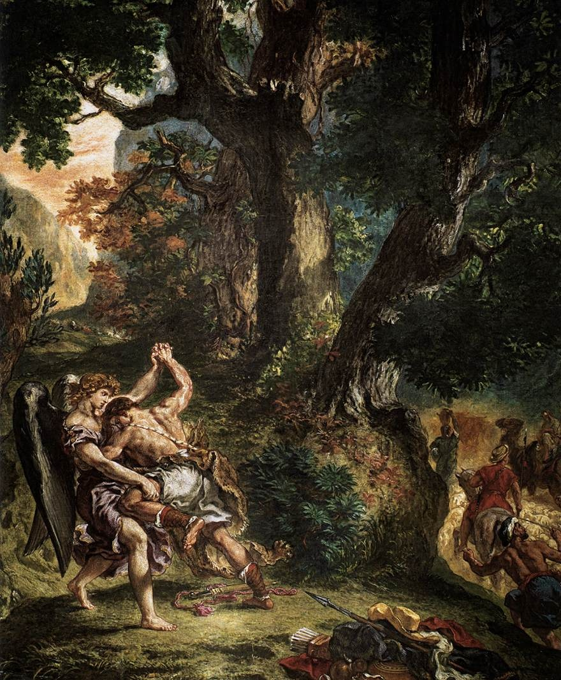

Slide 32
The Vision After the Sermon (Jacob Wrestling with the Angel), 1888 Oil on canvas, 28 3/4 x 36 1/4 in
National Galleries of Scotland, Edinburgh
Paul Gauguin was a pioneer, like Vincent van Gogh, in the use of color for expressive purposes.
Here he uses the color red to suggest the fervent nature of the women’s imaginations after hearing a sermon about Jacob and the angel.
The priest is at the lower left; he bridges the “real” space of the women, and the imaginary space of the wrestlers.
Gauguin went to Brittany to paint because he thought he could find a simpler way of life than Paris of the day. The women are in regional costumes; they are not nuns!
Gauguin was very interested in Japanese art and the wrestling figures are exactly based on a famous Japanese print (except for the wings); similarly the tree branch cutting through the middle is a familiar Japanese motif.

Slide 33
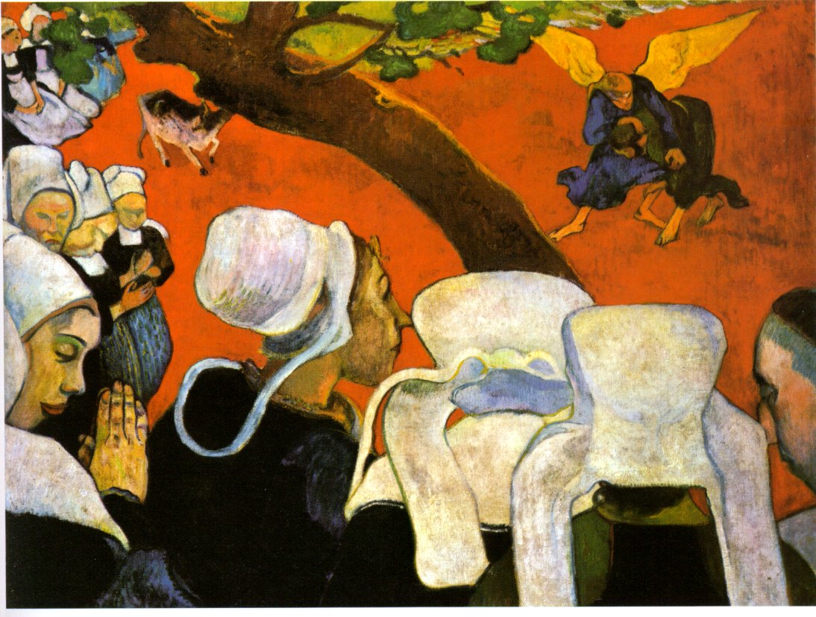

Slide 34
Genesis 33 1 - 17
33 Now Jacob looked up and saw Esau coming, and four hundred men with him. So he divided the children among Leah and Rachel and the two maids. ² He put the maids with their children in front, then Leah with her children, and Rachel and Joseph last of all. ³ He himself went on ahead of them, bowing himself to the ground seven times, until he came near his brother.
⁴ But Esau ran to meet him, and embraced him, and fell on his neck and kissed him, and they wept. ⁵ When Esau looked up and saw the women and children, he said, “Who are these with you?” Jacob said, “The children whom God has graciously given your servant.” ⁶ Then the maids drew near, they and their children, and bowed down; ⁷ Leah likewise and her children drew near and bowed down; and finally Joseph and Rachel drew near, and they bowed down. ⁸ Esau said, “What do you mean by all this company that I met?”

Slide 35
Genesis 33 1 - 17
Jacob answered, “To find favor with my lord.” ⁹ But Esau said, “I have enough, my brother; keep what you have for yourself.” ¹⁰ Jacob said, “No, please; if I find favor with you, then accept my present from my hand; for truly to see your face is like seeing the face of God—since you have received me with such favor. ¹¹ Please accept my gift that is brought to you, because God has dealt graciously with me, and because I have everything I want.” So he urged him, and he took it. ¹² Then Esau said, “Let us journey on our way, and I will go alongside you.” ¹³ But Jacob said to him, “My lord knows that the children are frail and that the flocks and herds, which are nursing, are a care to me; and if they are overdriven for one day, all the flocks will die. ¹⁴ Let my lord pass on ahead of his servant, and I will lead on slowly, according to the pace of the cattle that are before me and according to the pace of the children, until I come to my lord in Seir.” ¹⁵ So Esau said, “Let me leave with you some of the people who are with me.” But he said, “Why should my lord be so kind to me?” ¹⁶ So Esau returned that day on his way to Seir. ¹⁷ But Jacob journeyed to Succoth, and built himself a house, and made booths for his cattle; therefore the place is called Succoth.

Slide 36
Genesis 33 The legacy of deceit
Jacob now Israel has lived a life enriched through his trickery of others. Over the years since Jacob's departure from his brother he has grown as a person.
Now we see that Esau, the victim of two of Jacob’s most troublesome tricks has also grown as a person.
Esau greets Jacob has a brother and twice offers his protection, but which Jacob refuses.
Jacob the trickster is unable to accept honesty from others, because he himself is not honest. Jacob’s deceitful nature has robbed him of the pleasure of accepting his brother’s love even when freely offered.
The proof of Esau's honesty is that when his offers were refused he left his brother in peace.
Notes:
The New Oxford Annotated Bible (c) Oxford University Press, 1996. All rights reserved.
33.1–17: Partial reunion with Esau. 10: Like seeing the face of God, who at Penuel (or Peniel) also proved to be gracious (32.30–31). 12–17: Esau proposes to stay with Jacob, but Jacob sends him ahead, promising to join with him (v. 14). Jacob does not join him, however (v. 17), perhaps noting that Esau had always planned to wait to kill him until their father died (27.41; cf. 35.29). 17: Succoth means “booths.” Its precise location is uncertain. 33.18–35.5: The stay in Shechem and the rape of Dinah. 33.18: Shechem, see 12.6–8n., was an important town in early Israel and one of the first capitals of the Northern Kingdom (1 Kings 12.25). 19: Here and in ch 34 Shechem is a personal name. As elsewhere in Genesis, the story portrays, in the guise of individuals, relations between Israel and non-Israelite groups. 20: The name of the altar (“El is the God of Israel”) may be another reflection of the worship of El in early Israel (see 28.16–17n.; 32.28,31–32n.). 34.1–31: In its broader context, this story explains why Simeon and Levi, two of Jacob’s elder sons, did not receive his highest blessing; see 49.1–28n. 2: See 33.19n. Lay with her by force, raped her, though some scholars interpret the Hebrew verbs as suggesting illicit sexual intercourse rather than rape. 7: Committed an outrage in Israel is an old expression for ultimate offenses, such as violations of the sexual honor of the tribal group (here), the ban on booty in holy war (Josh 7.15), and the sanctity of hospitality (Judg 19.23–24; 20.6,10). 8–12: Israelite law stipulates that a man who has sex with an unbetrothed woman must retroactively marry her by paying her father a high marriage price (Ex 22.16–17; Deut 22.28–29). This narrative either does not recognize this law, or assumes that it does not apply outside the people of Israel. 13–17: Jacob’s sons now are the tricksters (see 27.1–45n.). On circumcision see 17.9–14n. 21–23: In contrast to Hamor’s proposal to the Israelites of intermarriage and acquisition of land (vv. 8–10), his speech to his countrymen here betrays an interest in impoverishing the Israelites through assimilating them. On concern about intermarriage, see 24.3n. 25–26: Simeon and Levi lead the killing and recapture of Dinah because, as older full brothers of Dinah (29.33–34; 30.21), they were responsible for avenging the violation of the family’s honor through her. 27–29: In a reversal of what the Shechemites had planned for them (vv. 21–23), the Israelites take all the Shechemites’ possessions. 30–31: Jacob is depicted here as less concerned about family honor than about good relations with the Canaanites (see 35.5). His sons’ question is left unanswered at the end of the story (cf. Jon 4.11), but is ultimately addressed in 49.5–7. 35.1–4: The present narrative reflects a later judgment on non-Yahwistic ritual objects. Like its parallels (Josh 24.23; Judg 10.16; 1 Sam 7.3), it may presuppose, however, a more ancient practice of burial of divine images in sacred places, i.e., by a sacred tree (see 12.6–8n.). 5: Jacob’s fears (see 34.30) prove to be unfounded.

Slide 37
Genesis 33 The Seed of Greatness
Notice in the entourage of Jacob that the last two people were Rachel and Joseph. Joseph is at this time a young boy.
But Joseph has just observed how a brother even when wronged In the past can forgive.
Luckily for Jacob and the nation of Israel, as we will see, many years from this meeting, Joseph will chose Esau as his model and not his father.
Notes:
The New Oxford Annotated Bible (c) Oxford University Press, 1996. All rights reserved.
33.1–17: Partial reunion with Esau. 10: Like seeing the face of God, who at Penuel (or Peniel) also proved to be gracious (32.30–31). 12–17: Esau proposes to stay with Jacob, but Jacob sends him ahead, promising to join with him (v. 14). Jacob does not join him, however (v. 17), perhaps noting that Esau had always planned to wait to kill him until their father died (27.41; cf. 35.29). 17: Succoth means “booths.” Its precise location is uncertain. 33.18–35.5: The stay in Shechem and the rape of Dinah. 33.18: Shechem, see 12.6–8n., was an important town in early Israel and one of the first capitals of the Northern Kingdom (1 Kings 12.25). 19: Here and in ch 34 Shechem is a personal name. As elsewhere in Genesis, the story portrays, in the guise of individuals, relations between Israel and non-Israelite groups. 20: The name of the altar (“El is the God of Israel”) may be another reflection of the worship of El in early Israel (see 28.16–17n.; 32.28,31–32n.). 34.1–31: In its broader context, this story explains why Simeon and Levi, two of Jacob’s elder sons, did not receive his highest blessing; see 49.1–28n. 2: See 33.19n. Lay with her by force, raped her, though some scholars interpret the Hebrew verbs as suggesting illicit sexual intercourse rather than rape. 7: Committed an outrage in Israel is an old expression for ultimate offenses, such as violations of the sexual honor of the tribal group (here), the ban on booty in holy war (Josh 7.15), and the sanctity of hospitality (Judg 19.23–24; 20.6,10). 8–12: Israelite law stipulates that a man who has sex with an unbetrothed woman must retroactively marry her by paying her father a high marriage price (Ex 22.16–17; Deut 22.28–29). This narrative either does not recognize this law, or assumes that it does not apply outside the people of Israel. 13–17: Jacob’s sons now are the tricksters (see 27.1–45n.). On circumcision see 17.9–14n. 21–23: In contrast to Hamor’s proposal to the Israelites of intermarriage and acquisition of land (vv. 8–10), his speech to his countrymen here betrays an interest in impoverishing the Israelites through assimilating them. On concern about intermarriage, see 24.3n. 25–26: Simeon and Levi lead the killing and recapture of Dinah because, as older full brothers of Dinah (29.33–34; 30.21), they were responsible for avenging the violation of the family’s honor through her. 27–29: In a reversal of what the Shechemites had planned for them (vv. 21–23), the Israelites take all the Shechemites’ possessions. 30–31: Jacob is depicted here as less concerned about family honor than about good relations with the Canaanites (see 35.5). His sons’ question is left unanswered at the end of the story (cf. Jon 4.11), but is ultimately addressed in 49.5–7. 35.1–4: The present narrative reflects a later judgment on non-Yahwistic ritual objects. Like its parallels (Josh 24.23; Judg 10.16; 1 Sam 7.3), it may presuppose, however, a more ancient practice of burial of divine images in sacred places, i.e., by a sacred tree (see 12.6–8n.). 5: Jacob’s fears (see 34.30) prove to be unfounded.

Slide 38
Genesis 34 Dinah
Dinah, Jacob’s daughter, ‘goes to visit’ the local women, but is seen and seized by Shechem, the son of a local leader. Shechem ‘laid with her by force.’ However, he becomes infatuated by her and entreats his father to get her from Jacob as his wife.
Jacob, enraged by Dinah’s violation, nevertheless keeps silence as the man’s father negotiates for her as wife.
Eventually a bride price is agreed and a pact made that Shechem, his father and his men will be circumcised and the two groups will be allies.
But while Shechem’s group is still ‘sore’ Levi and Simeon, kill them all and take their wives, children and possessions.
Jacob objects but his sons stand on their right of revenge.
Notes:
The New Oxford Annotated Bible (c) Oxford University Press, 1996. All rights reserved.
34 Now Dinah the daughter of Leah, whom she had borne to Jacob, went out to visit the women of the region. ² When Shechem son of Hamor the Hivite, prince of the region, saw her, he seized her and lay with her by force. ³ And his soul was drawn to Dinah daughter of Jacob; he loved the girl, and spoke tenderly to her. ⁴ So Shechem spoke to his father Hamor, saying, “Get me this girl to be my wife.” ⁵ Now Jacob heard that Shechem had defiled his daughter Dinah; but his sons were with his cattle in the field, so Jacob held his peace until they came. ⁶ And Hamor the father of Shechem went out to Jacob to speak with him, ⁷ just as the sons of Jacob came in from the field. When they heard of it, the men were indignant and very angry, because he had committed an outrage in Israel by lying with Jacob’s daughter, for such a thing ought not to be done. ⁸ But Hamor spoke with them, saying, “The heart of my son Shechem longs for your daughter; please give her to him in marriage. ⁹ Make marriages with us; give your daughters to us, and take our daughters for yourselves. ¹⁰ You shall live with us; and the land shall be open to you; live and trade in it, and get property in it.” ¹¹ Shechem also said to her father and to her brothers, “Let me find favor with you, and whatever you say to me I will give. ¹² Put the marriage present and gift as high as you like, and I will give whatever you ask me; only give me the girl to be my wife.” ¹³ The sons of Jacob answered Shechem and his father Hamor deceitfully, because he had defiled their sister Dinah. ¹⁴ They said to them, “We cannot do this thing, to give our sister to one who is uncircumcised, for that would be a disgrace to us. ¹⁵ Only on this condition will we consent to you: that you will become as we are and every male among you be circumcised. ¹⁶ Then we will give our daughters to you, and we will take your daughters for ourselves, and we will live among you and become one people. ¹⁷ But if you will not listen to us and be circumcised, then we will take our daughter and be gone.” ¹⁸ Their words pleased Hamor and Hamor’s son Shechem. ¹⁹ And the young man did not delay to do the thing, because he was delighted with Jacob’s daughter. Now he was the most honored of all his family. ²⁰ So Hamor and his son Shechem came to the gate of their city and spoke to the men of their city, saying, ²¹ “These people are friendly with us; let them live in the land and trade in it, for the land is large enough for them; let us take their daughters in marriage, and let us give them our daughters. ²² Only on this condition will they agree to live among us, to become one people: that every male among us be circumcised as they are circumcised. ²³ Will not their livestock, their property, and all their animals be ours? Only let us agree with them, and they will live among us.” ²⁴ And all who went out of the city gate heeded Hamor and his son Shechem; and every male was circumcised, all who went out of the gate of his city. ²⁵ On the third day, when they were still in pain, two of the sons of Jacob, Simeon and Levi, Dinah’s brothers, took their swords and came against the city unawares, and killed all the males. ²⁶ They killed Hamor and his son Shechem with the sword, and took Dinah out of Shechem’s house, and went away. ²⁷ And the other sons of Jacob came upon the slain, and plundered the city, because their sister had been defiled. ²⁸ They took their flocks and their herds, their donkeys, and whatever was in the city and in the field. ²⁹ All their wealth, all their little ones and their wives, all that was in the houses, they captured and made their prey. ³⁰ Then Jacob said to Simeon and Levi, “You have brought trouble on me by making me odious to the inhabitants of the land, the Canaanites and the Perizzites; my numbers are few, and if they gather themselves against me and attack me, I shall be destroyed, both I and my household.” ³¹ But they said, “Should our sister be treated like a whore?”

Slide 39
Genesis 34 Context
These two full brothers of Dinah, will later be denied Jacob’s full blessing.
Later the Law will specify that a man who has violated a woman is required to marry her and pay the bridal price as proper recompense.
This later custom apparently did not apply outside of the tribal unit.
Jacob’s concern is that this will interfere with his relation with the Canaanites rather than his family honor.
The tricksters here are his sons and not Jacob.
The rough treatment of people outside the family group is tolerated.
Notes:
The New Oxford Annotated Bible (c) Oxford University Press, 1996. All rights reserved.
34.1–31: In its broader context, this story explains why Simeon and Levi, two of Jacob’s elder sons, did not receive his highest blessing; see 49.1–28n. 2: See 33.19n. Lay with her by force, raped her, though some scholars interpret the Hebrew verbs as suggesting illicit sexual intercourse rather than rape. 7: Committed an outrage in Israel is an old expression for ultimate offenses, such as violations of the sexual honor of the tribal group (here), the ban on booty in holy war (Josh 7.15), and the sanctity of hospitality (Judg 19.23–24; 20.6,10). 8–12: Israelite law stipulates that a man who has sex with an unbetrothed woman must retroactively marry her by paying her father a high marriage price (Ex 22.16–17; Deut 22.28–29). This narrative either does not recognize this law, or assumes that it does not apply outside the people of Israel. 13–17: Jacob’s sons now are the tricksters (see 27.1–45n.). On circumcision see 17.9–14n. 21–23: In contrast to Hamor’s proposal to the Israelites of intermarriage and acquisition of land (vv. 8–10), his speech to his countrymen here betrays an interest in impoverishing the Israelites through assimilating them. On concern about intermarriage, see 24.3n. 25–26: Simeon and Levi lead the killing and recapture of Dinah because, as older full brothers of Dinah (29.33–34; 30.21), they were responsible for avenging the violation of the family’s honor through her. 27–29: In a reversal of what the Shechemites had planned for them (vv. 21–23), the Israelites take all the Shechemites’ possessions. 30–31: Jacob is depicted here as less concerned about family honor than about good relations with the Canaanites (see 35.5). His sons’ question is left unanswered at the end of the story (cf. Jon 4.11), but is ultimately addressed in 49.5–7.

Slide 40
Genesis 35 Life Continues
Jacob is told by God to move to new area. After the trip, all in Jacob’s group are required to turn in all of their foreign gods.
Jacob is again renamed Israel.
Deborah, nurse of Rebekah dies, later Rachel dies in childbirth.
Jacob finally encounters his father Isaac, now age 180. When Isaac dies Jacob, now Israel, and his brother Esau bury him.
Notes:
The New Oxford Annotated Bible (c) Oxford University Press, 1996. All rights reserved.
35 God said to Jacob, “Arise, go up to Bethel, and settle there. Make an altar there to the God who appeared to you when you fled from your brother Esau.” ² So Jacob said to his household and to all who were with him, “Put away the foreign gods that are among you, and purify yourselves, and change your clothes; ³ then come, let us go up to Bethel, that I may make an altar there to the God who answered me in the day of my distress and has been with me wherever I have gone.” ⁴ So they gave to Jacob all the foreign gods that they had, and the rings that were in their ears; and Jacob hid them under the oak that was near Shechem. ⁵ As they journeyed, a terror from God fell upon the cities all around them, so that no one pursued them. ⁶ Jacob came to Luz (that is, Bethel), which is in the land of Canaan, he and all the people who were with him, ⁷ and there he built an altar and called the place El-bethel, because it was there that God had revealed himself to him when he fled from his brother. ⁸ And Deborah, Rebekah’s nurse, died, and she was buried under an oak below Bethel. So it was called Allon-bacuth. ⁹ God appeared to Jacob again when he came from Paddan-aram, and he blessed him. ¹⁰ God said to him, “Your name is Jacob; no longer shall you be called Jacob, but Israel shall be your name.” So he was called Israel. ¹¹ God said to him, “I am God Almighty: be fruitful and multiply; a nation and a company of nations shall come from you, and kings shall spring from you. ¹² The land that I gave to Abraham and Isaac I will give to you, and I will give the land to your offspring after you.” ¹³ Then God went up from him at the place where he had spoken with him. ¹⁴ Jacob set up a pillar in the place where he had spoken with him, a pillar of stone; and he poured out a drink offering on it, and poured oil on it. ¹⁵ So Jacob called the place where God had spoken with him Bethel. ¹⁶ Then they journeyed from Bethel; and when they were still some distance from Ephrath, Rachel was in childbirth, and she had hard labor. ¹⁷ When she was in her hard labor, the midwife said to her, “Do not be afraid; for now you will have another son.” ¹⁸ As her soul was departing (for she died), she named him Ben-oni;b but his father called him Benjamin.c ¹⁹ So Rachel died, and she was buried on the way to Ephrath (that is, Bethlehem), ²⁰ and Jacob set up a pillar at her grave; it is the pillar of Rachel’s tomb, which is there to this day. ²¹ Israel journeyed on, and pitched his tent beyond the tower of Eder. ²² While Israel lived in that land, Reuben went and lay with Bilhah his father’s concubine; and Israel heard of it. Now the sons of Jacob were twelve. ²³ The sons of Leah: Reuben (Jacob’s firstborn), Simeon, Levi, Judah, Issachar, and Zebulun. ²⁴ The sons of Rachel: Joseph and Benjamin. ²⁵ The sons of Bilhah, Rachel’s maid: Dan and Naphtali. ²⁶ The sons of Zilpah, Leah’s maid: Gad and Asher. These were the sons of Jacob who were born to him in Paddan-aram. ²⁷ Jacob came to his father Isaac at Mamre, or Kiriath-arba (that is, Hebron), where Abraham and Isaac had resided as aliens. ²⁸ Now the days of Isaac were one hundred eighty years. ²⁹ And Isaac breathed his last; he died and was gathered to his people, old and full of days; and his sons Esau and Jacob buried him.

Slide 41
Genesis 36
The chapter is a largely a listing of the decedents of Esau and the lands where they settle.
Because their possessions were so great Israel and Esau separate to find pastures for the large herds of each.
The story of Israel now continues
Notes:
The New Oxford Annotated Bible (c) Oxford University Press, 1996. All rights reserved.
36 These are the descendants of Esau (that is, Edom). ² Esau took his wives from the Canaanites: Adah daughter of Elon the Hittite, Oholibamah daughter of Anah son of Zibeon the Hivite, ³ and Basemath, Ishmael’s daughter, sister of Nebaioth. ⁴ Adah bore Eliphaz to Esau; Basemath bore Reuel; ⁵ and Oholibamah bore Jeush, Jalam, and Korah. These are the sons of Esau who were born to him in the land of Canaan. ⁶ Then Esau took his wives, his sons, his daughters, and all the members of his household, his cattle, all his livestock, and all the property he had acquired in the land of Canaan; and he moved to a land some distance from his brother Jacob. ⁷ For their possessions were too great for them to live together; the land where they were staying could not support them because of their livestock. ⁸ So Esau settled in the hill country of Seir; Esau is Edom. ⁹ These are the descendants of Esau, ancestor of the Edomites, in the hill country of Seir. ¹⁰ These are the names of Esau’s sons: Eliphaz son of Adah the wife of Esau; Reuel, the son of Esau’s wife Basemath. ¹¹ The sons of Eliphaz were Teman, Omar, Zepho, Gatam, and Kenaz. ¹² (Timna was a concubine of Eliphaz, Esau’s son; she bore Amalek to Eliphaz.) These were the sons of Adah, Esau’s wife. ¹³ These were the sons of Reuel: Nahath, Zerah, Shammah, and Mizzah. These were the sons of Esau’s wife, Basemath. ¹⁴ These were the sons of Esau’s wife Oholibamah, daughter of Anah son of Zibeon: she bore to Esau Jeush, Jalam, and Korah. ¹⁵ These are the clansof the sons of Esau. The sons of Eliphaz the firstborn of Esau: the clansTeman, Omar, Zepho, Kenaz, ¹⁶ Korah, Gatam, and Amalek; these are the clansof Eliphaz in the land of Edom; they are the sons of Adah. ¹⁷ These are the sons of Esau’s son Reuel: the clansNahath, Zerah, Shammah, and Mizzah; these are the clansof Reuel in the land of Edom; they are the sons of Esau’s wife Basemath. ¹⁸ These are the sons of Esau’s wife Oholibamah: the clansJeush, Jalam, and Korah; these are the clans born of Esau’s wife Oholibamah, the daughter of Anah. ¹⁹ These are the sons of Esau (that is, Edom), and these are their clans. ²⁰ These are the sons of Seir the Horite, the inhabitants of the land: Lotan, Shobal, Zibeon, Anah, ²¹ Dishon, Ezer, and Dishan; these are the clansof the Horites, the sons of Seir in the land of Edom. ²² The sons of Lotan were Hori and Heman; and Lotan’s sister was Timna. ²³ These are the sons of Shobal: Alvan, Manahath, Ebal, Shepho, and Onam. ²⁴ These are the sons of Zibeon: Aiah and Anah; he is the Anah who found the springs in the wilderness, as he pastured the donkeys of his father Zibeon. ²⁵ These are the children of Anah: Dishon and Oholibamah daughter of Anah. ²⁶ These are the sons of Dishon: Hemdan, Eshban, Ithran, and Cheran. ²⁷ These are the sons of Ezer: Bilhan, Zaavan, and Akan. ²⁸ These are the sons of Dishan: Uz and Aran. ²⁹ These are the clansof the Horites: the clansLotan, Shobal, Zibeon, Anah, ³⁰ Dishon, Ezer, and Dishan; these are the clansof the Horites, clan by clan in the land of Seir. ³¹ These are the kings who reigned in the land of Edom, before any king reigned over the Israelites. ³² Bela son of Beor reigned in Edom, the name of his city being Dinhaba. ³³ Bela died, and Jobab son of Zerah of Bozrah succeeded him as king. ³⁴ Jobab died, and Husham of the land of the Temanites succeeded him as king. ³⁵ Husham died, and Hadad son of Bedad, who defeated Midian in the country of Moab, succeeded him as king, the name of his city being Avith. ³⁶ Hadad died, and Samlah of Masrekah succeeded him as king. ³⁷ Samlah died, and Shaul of Rehoboth on the Euphrates succeeded him as king. ³⁸ Shaul died, and Baal-hanan son of Achbor succeeded him as king. ³⁹ Baal-hanan son of Achbor died, and Hadar succeeded him as king, the name of his city being Pau; his wife’s name was Mehetabel, the daughter of Matred, daughter of Me-zahab. ⁴⁰ These are the names of the clans of Esau, according to their families and their localities by their names: the clansTimna, Alvah, Jetheth, ⁴¹ Oholibamah, Elah, Pinon, ⁴² Kenaz, Teman, Mibzar, ⁴³ Magdiel, and Iram; these are the clansof Edom (that is, Esau, the father of Edom), according to their settlements in the land that they held.

Slide 209
The Joseph Saga

