Slide 1
Lesson 10
The Joseph Saga
Notes:
This PowerPoint is intended as an aid for the leader of an adult Christian Education group. All sources are footnoted and from easily available materials. Please respect the sacred nature of the scriptures covered. Use these materials as a way to start and sustain a lively discussion and consideration of a marvelous gift to us for a richer experience of life.
J B Cross
www.episcopalchristioneducation.com

Slide 2

Genesis 37:1-4
Jacob settled in the land where his father had lived as an alien, the land of Canaan. This is the story of the family of Jacob.
Joseph, being seventeen years old, was shepherding the flock with his brothers; he was a helper to the sons of Bilhah and Zilpah, his father's wives; and Joseph brought a bad report of them to their father.

Slide 3
Genesis 37: 5 - 11
5 Once Joseph had a dream, and when he told it to his brothers, they hated him even more. 6 He said to them, “Listen to this dream that I dreamed. 7 There we were, binding sheaves in the field. Suddenly my sheaf rose and stood upright; then your sheaves gathered around it, and bowed down to my sheaf.” 8 His brothers said to him, “Are you indeed to reign over us? Are you indeed to have dominion over us?” So they hated him even more because of his dreams and his words.

Slide 4
Genesis 37: 5 - 11
9 He had another dream, and told it to his brothers, saying, “Look, I have had another dream: the sun, the moon, and eleven stars were bowing down to me.” 10 But when he told it to his father and to his brothers, his father rebuked him, and said to him, “What kind of dream is this that you have had? Shall we indeed come, I and your mother and your brothers, and bow to the ground before you?” 11 So his brothers were jealous of him, but his father kept the matter in mind.

Slide 5
Genesis 37:1-4
Now Israel loved Joseph more than any other of his children, because he was the son of his old age; and he had made him a long robe with sleeves. But when his brothers saw that their father loved him more than all his brothers, they hated him, and could not speak peaceably to him.
Now his brothers went to pasture their father's flock near Shechem. And Israel said to Joseph, "Are not your brothers pasturing the flock at Shechem? Come, I will send you to them."

Slide 6
Genesis 37:1-4
He answered, "Here I am." So he said to him, "Go now, see if it is well with your brothers and with the flock; and bring word back to me." So he sent him from the valley of Hebron.
He came to Shechem, and a man found him wandering in the fields; the man asked him, "What are you seeking?" "I am seeking my brothers," he said; "tell me, please, where they are pasturing the flock." The man said, "They have gone away, for I heard them say, `Let us go to Dothan.'"

Slide 7
Genesis 37:1-4
So Joseph went after his brothers, and found them at Dothan. They saw him from a distance, and before he came near to them, they conspired to kill him. They said to one another, "Here comes this dreamer. Come now, let us kill him and throw him into one of the pits; then we shall say that a wild animal has devoured him, and we shall see what will become of his dreams." But when Reuben heard it, he delivered him out of their hands, saying, "Let us not take his life."

Slide 8
Genesis 37:1-4
Reuben said to them, "Shed no blood; throw him into this pit here in the wilderness, but lay no hand on him" -- that he might rescue him out of their hand and restore him to his father. So when Joseph came to his brothers, they stripped him of his robe, the long robe with sleeves that he wore; and they took him and threw him into a pit. The pit was empty; there was no water in it.

Slide 9
Genesis 37:1-4
Then they sat down to eat; and looking up they saw a caravan of Ishmaelites coming from Gilead, with their camels carrying gum, balm, and resin, on their way to carry it down to Egypt. Then Judah said to his brothers, "What profit is it if we kill our brother and conceal his blood? Come, let us sell him to the Ishmaelites, and not lay our hands on him, for he is our brother, our own flesh." And his brothers agreed.

Slide 10
Genesis 37:12-28
When some Midianite traders passed by, they drew Joseph up, lifting him out of the pit, and sold him to the Ishmaelites for twenty pieces of silver. And they took Joseph to Egypt.

Slide 11
The Joseph Saga
This is the beginning of the Joseph saga which will eventually result in the Israelites entering Egypt.
The entry into Egypt of course will save them from a great famine.
Ultimately it will lead to the Exodus one of the great events of Old Testament history.

Slide 12
Bad Things
The event depicted in this reading by itself can be seen as nothing other than a bad thing.
Joseph’s brothers whether for good or bad reasons have extracted a particularly cruel revenge.
Joseph will no longer be the beloved son but has become property in a foreign land.

Slide 13
God’s Purpose
We know from the story as a whole that the outcome will ultimately be good, according to God’s purpose.
Even though one of the brothers tries to rescue Joseph, that rescue fails.
This failure may simply be an illustration that human intervention will not thwart God’s ultimate purpose.

Slide 14
Authorship?
This section is also interesting in that it exposes one of the more curious things about the ancient writings – that different versions of the same stories, were combined.
O.T. scholars noted that if you marked off the sections of Genesis which use Elohim to refer to God and those using Yahweh you seemed to have two different documents that were woven together by an editor to make one document.
These were called the E writer for Elohimist writer.
In German the word Yahweh is spelled with a J and the second was called the J Writer.
Later, two more ‘points of view’ were discerned in the Yahweh sections.
  The first was concerned about the Temple and worship and the duties of Priests. The P Document.
  The Second was basically concerned with the Law see Deuteronomy. The D Document.
The E, J, P and D ‘authors’ each have a different view point.
Notes:
The New Oxford Annotated Bible (c) Oxford University Press, 1996. All rights reserved.
8. Other O.T. scholars noted that if you marked off the sections using Elohim and those using Yahweh you seemed to have two different documents that were woven together by an editor to make one document. Page 18. These were called the E writer for Elohimist writer. In German the word Yahweh is spelled with a J and the second was called the J Writer. Later, it was discovered that were sections using Yahweh that were different than the other sections using Yahweh and that these different documents seemed to concern things about the Temple and worship and the duties of Priests [these were sections with the long genealogies] these were called the P Document - or the Priestly Document. A fourth writer or D was discovered and is basically referring to the new Law supposedly found in the Temple in 621 BC under King Josiah. This material is mostly in Deuteronomy but also elsewhere, this is referred to as the D Document. Page 18

Slide 15
Time line.
J - was written sometime after the reign of King David 950 BC. This is thought to be so because much of this material seems to be attempting to show that the Reign of King David was the fulfillment of the promises of God to Abraham.
E - was written perhaps 100 years later or 850 BC. Because writings must have been well known by 750 BC since the Prophet Hosea quotes it.
Sometime after E was written a “Redactor” wove J and E together.
Then in 621 BC “The Law” was found in the temple.
Sometime after 586 BC another redactor took the existing J/E and wove the D into it.
After the return from The Exile, Ezra [about 400 BC] appeared and persuaded the people to accept the “Priestly Code” and this document was then woven into the JED Document. The P Document was probably not a separate document but was a frame work for the “Pentateuch”
Notes:
The New Oxford Annotated Bible (c) Oxford University Press, 1996. All rights reserved.
So there are at least 4 source documents [there are others] which are J, E, D and P, it seems that D and P are more likely revisions rather than new materials from Oral traditions. Page 18
10. J - was written some time after the reign of King David 950 BC. This is thought to be so because much of this material seems to be attempting to show that the Reign of King David was the fulfillment of the promises of God to Abraham. Page 18 - 19
11. E - was written perhaps 100 years later or 850 BC. Page 18 These writings must have been well known by 750BC since the Prophet Hosea quotes from it
12. Sometime after E was written a Redactor wove J and E together. Page 19
13. Then in 621 BC The Law was found in the temple. Sometime after 586 BC another redactor took the existing J/E and wove the D into it. Page 19
14. After the return from The Exile, Ezra [about 400 BC] appeared and persuaded the people to accept the Priestly Code and this document was then woven into the JED Document. The P Document was probably not a separate document but was a frame work for the Pentateuch
15. J and E - both Anthropomorphize God which is to say they describe Him using anger, compassion and speaking directly to people. Js approach is more direct. The E writer does not like this since no one can see God so he uses intermediaries such as angels for the Divine appearance to people. Page 19 Both J and E deal with God's use of natural phenomena such as plagues. For instance for in J and E materials it was a strong East Wind that divided the Red Sea. For P the supernatural was emphasized and so that the Red Sea was parted by the rod of Moses. Page 19 The P source is inclined to use miracles to describe things. Pages 19-20 While J and E use natural forces to explain events.
16. J is interested in how or why places were named while P is more interested in the Law and Temple Ritual. Page 20.
17. J and P call the Mountain Sinai while E calls it Mt Horeb.
18. J calls the inhabitants of Palestine Canaanites while E calls them Amorites
19. The importance of these concepts of different sources, J, E, D and P is that there are contradictions and repetitions in the text that are very troubling if we assume that it was one document written one time dictated from God, but that are no trouble if you know that it was from several writers over time with different concerns. Page 20
20. The contradictions were not removed because the editors did not feel that they could alter traditional writings and they recognized the value of differing points of view. Page 20

Slide 16
Points of View
J and E - both Anthropomorphize God which is to say they describe Him using anger, compassion and speaking to people.
In E God uses intermediaries such as angels for the Divine appearance to people.
J is interested in how or why places were named while P is more interested in the Law and Temple Ritual.
The importance of these concepts of different sources, J, E, D and P is that there are contradictions and repetitions in the text that are very troubling if we assume that it was one document written at one time dictated by God, but that are no trouble if you know there were several writers over time with different concerns.
Notes:
The New Oxford Annotated Bible (c) Oxford University Press, 1996. All rights reserved.
So there are at least 4 source documents [there are others] which are J, E, D and P, it seems that D and P are more likely revisions rather than new materials from Oral traditions. Page 18
10. J - was written some time after the reign of King David 950 BC. This is thought to be so because much of this material seems to be attempting to show that the Reign of King David was the fulfillment of the promises of God to Abraham. Page 18 - 19
11. E - was written perhaps 100 years later or 850 BC. Page 18 These writings must have been well known by 750BC since the Prophet Hosea quotes from it
12. Sometime after E was written a Redactor wove J and E together. Page 19
13. Then in 621 BC The Law was found in the temple. Sometime after 586 BC another redactor took the existing J/E and wove the D into it. Page 19
14. After the return from The Exile, Ezra [about 400 BC] appeared and persuaded the people to accept the Priestly Code and this document was then woven into the JED Document. The P Document was probably not a separate document but was a frame work for the Pentateuch
15. J and E - both Anthropomorphize God which is to say they describe Him using anger, compassion and speaking directly to people. Js approach is more direct. The E writer does not like this since no one can see God so he uses intermediaries such as angels for the Divine appearance to people. Page 19 Both J and E deal with God's use of natural phenomena such as plagues. For instance for in J and E materials it was a strong East Wind that divided the Red Sea. For P the supernatural was emphasized and so that the Red Sea was parted by the rod of Moses. Page 19 The P source is inclined to use miracles to describe things. Pages 19-20 While J and E use natural forces to explain events.
16. J is interested in how or why places were named while P is more interested in the Law and Temple Ritual. Page 20.
17. J and P call the Mountain Sinai while E calls it Mt Horeb.
18. J calls the inhabitants of Palestine Canaanites while E calls them Amorites
19. The importance of these concepts of different sources, J, E, D and P is that there are contradictions and repetitions in the text that are very troubling if we assume that it was one document written one time dictated from God, but that are no trouble if you know that it was from several writers over time with different concerns. Page 20
20. The contradictions were not removed because the editors did not feel that they could alter traditional writings and they recognized the value of differing points of view. Page 20

Slide 17
Joseph’s Sale
  The story of Joseph’s sale into slavery has both J and E sources.
  The J calls Joseph’s father Israel and the buyers as Ishmaelites.
  E calls him Jacob and the buyers as Midianites.
The end is the same. In J the motivation is jealousy over the coat. In E the motivation is Joseph’s dreams of ruling.
J is the more cruel as they sit down for a meal after tossing Joseph into the pit. In E they conspire to kill but then only sell Joseph.
Notes:
The New Oxford Annotated Bible (c) Oxford University Press, 1996. All rights reserved.
The Joseph Saga Begins; J and E Versions Compared
Jacob settled in the land where his father had lived as an alien, the land of Canaan. This is the story of the family of Jacob.
Joseph, being seventeen years old, was shepherding the flock with his brothers; he was a helper to the sons of Bilhah and Zilpah, his father's wives; and Joseph brought a bad report of them to their father. Now Israel loved Joseph more than any other of his children, because he was the son of his old age; and he had made him a long robe with sleeves. But when his brothers saw that their father loved him more than all his brothers, they hated him, and could not speak peaceably to him.
[5 Once Joseph had a dream, and when he told it to his brothers, they hated him even more. 6 He said to them, “Listen to this dream that I dreamed. 7 There we were, binding sheaves in the field. Suddenly my sheaf rose and stood upright; then your sheaves gathered around it, and bowed down to my sheaf.” 8 His brothers said to him, “Are you indeed to reign over us? Are you indeed to have dominion over us?” So they hated him even more because of his dreams and his words.
9 He had another dream, and told it to his brothers, saying, “Look, I have had another dream: the sun, the moon, and eleven stars were bowing down to me.” 10 But when he told it to his father and to his brothers, his father rebuked him, and said to him, “What kind of dream is this that you have had? Shall we indeed come, I and your mother and your brothers, and bow to the ground before you?” 11 So his brothers were jealous of him, but his father kept the matter in mind.]
Now his brothers went to pasture their father's flock near Shechem. And Israel said to Joseph, "Are not your brothers pasturing the flock at Shechem? Come, I will send you to them." He answered, "Here I am." So he said to him, "Go now, see if it is well with your brothers and with the flock; and bring word back to me." So he sent him from the valley of Hebron.
He came to Shechem, and a man found him wandering in the fields; the man asked him, "What are you seeking?" "I am seeking my brothers," he said; "tell me, please, where they are pasturing the flock." The man said, "They have gone away, for I heard them say, `Let us go to Dothan.'" So Joseph went after his brothers, and found them at Dothan. They saw him from a distance, and before he came near to them, they conspired to kill him. They said to one another, "Here comes this dreamer. Come now, let us kill him and throw him into one of the pits; then we shall say that a wild animal has devoured him, and we shall see what will become of his dreams." But when Reuben heard it, he delivered him out of their hands, saying, "Let us not take his life." Reuben said to them, "Shed no blood; throw him into this pit here in the wilderness, but lay no hand on him" -- that he might rescue him out of their hand and restore him to his father. So when Joseph came to his brothers, they stripped him of his robe, the long robe with sleeves that he wore; and they took him and threw him into a pit. The pit was empty; there was no water in it.
Then they sat down to eat; and looking up they saw a caravan of Ishmaelites coming from Gilead, with their camels carrying gum, balm, and resin, on their way to carry it down to Egypt. Then Judah said to his brothers, "What profit is it if we kill our brother and conceal his blood? Come, let us sell him to the Ishmaelites, and not lay our hands on him, for he is our brother, our own flesh." And his brothers agreed. When some Midianite traders passed by, they drew Joseph up, lifting him out of the pit, and sold him to the Ishmaelites for twenty pieces of silver. And they took Joseph to Egypt.
J
Now Israel loved Joseph more than any other of his children, because he was the son of his old age; and he had made him a long robe with sleeves. But when his brothers saw that their father loved him more than all his brothers, they hated him, and could not speak peaceably to him.
Now his brothers went to pasture their father's flock near Shechem. And Israel said to Joseph, "Are not your brothers pasturing the flock at Shechem? Come, I will send you to them." He answered, "Here I am." So he said to him, "Go now, see if it is well with your brothers and with the flock; and bring word back to me." So he sent him from the valley of Hebron.
He came to Shechem, and a man found him wandering in the fields; the man asked him, "What are you seeking?" "I am seeking my brothers," he said; "tell me, please, where they are pasturing the flock." The man said, "They have gone away, for I heard them say, `Let us go to Dothan.'" So Joseph went after his brothers, and found them at Dothan. They saw him from a distance, and before he came near to them, they conspired to kill him. [The Pit may be the common element.]
Then they sat down to eat; and looking up they saw a caravan of Ishmaelites coming from Gilead, with their camels carrying gum, balm, and resin, on their way to carry it down to Egypt. Then Judah said to his brothers, "What profit is it if we kill our brother and conceal his blood? Come, let us sell him to the Ishmaelites, and not lay our hands on him, for he is our brother, our own flesh." And his brothers agreed.
E
Jacob settled in the land where his father had lived as an alien, the land of Canaan. This is the story of the family of Jacob.
Joseph, being seventeen years old, was shepherding the flock with his brothers; he was a helper to the sons of Bilhah and Zilpah, his father's wives; and Joseph brought a bad report of them to their father.
[5 Once Joseph had a dream, and when he told it to his brothers, they hated him even more. 6 He said to them, “Listen to this dream that I dreamed. 7 There we were, binding sheaves in the field. Suddenly my sheaf rose and stood upright; then your sheaves gathered around it, and bowed down to my sheaf.” 8 His brothers said to him, “Are you indeed to reign over us? Are you indeed to have dominion over us?” So they hated him even more because of his dreams and his words.
9 He had another dream, and told it to his brothers, saying, “Look, I have had another dream: the sun, the moon, and eleven stars were bowing down to me.” 10 But when he told it to his father and to his brothers, his father rebuked him, and said to him, “What kind of dream is this that you have had? Shall we indeed come, I and your mother and your brothers, and bow to the ground before you?” 11 So his brothers were jealous of him, but his father kept the matter in mind.]
So Joseph went after his brothers, and found them at Dothan. They saw him from a distance, and before he came near to them, they conspired to kill him. They said to one another, "Here comes this dreamer. Come now, let us kill him and throw him into one of the pits; then we shall say that a wild animal has devoured him, and we shall see what will become of his dreams." But when Reuben heard it, he delivered him out of their hands, saying, "Let us not take his life." Reuben said to them, "Shed no blood; throw him into this pit here in the wilderness, but lay no hand on him" -- that he might rescue him out of their hand and restore him to his father. So when Joseph came to his brothers, they stripped him of his robe, the long robe with sleeves that he wore; and they took him and threw him into a pit. The pit was empty; there was no water in it. When some Midianite traders passed by, they drew Joseph up, lifting him out of the pit, and sold him to the Ishmaelites for twenty pieces of silver. And they took Joseph to Egypt.

Slide 18
Andrea del Sarto: Stories of Joseph, c. 1520 Panels, each 98,3 x 135 cm Galleria Palatina (Palazzo Pitti), Florence
The pair of paintings was commissioned by Pier Francesco Borgherini.
In the first there are depicted the following episodes of the Bible, beginning from the left: Joseph relates his dreams to his father Jacob; Jacob and Rachel order Joseph to join his brothers; further on, Joseph journeying towards his brothers; the brothers let down Joseph into the well; one of the brothers shows Jacob the blood-stained garments of Joseph, who, he says, is dead.
In the second are represented, beginning from the left: Pharaoh under his tent has the dreams of the full and empty ears of corn and of the fat and lean cattle; Joseph receives the golden collar which the Pharaoh gives him in gratitude for the interpretation of the dreams (he explains them on the right before the palace on the short flights of steps); in the background on the staircase Joseph is seen being carried off as a prisoner.

Slide 19
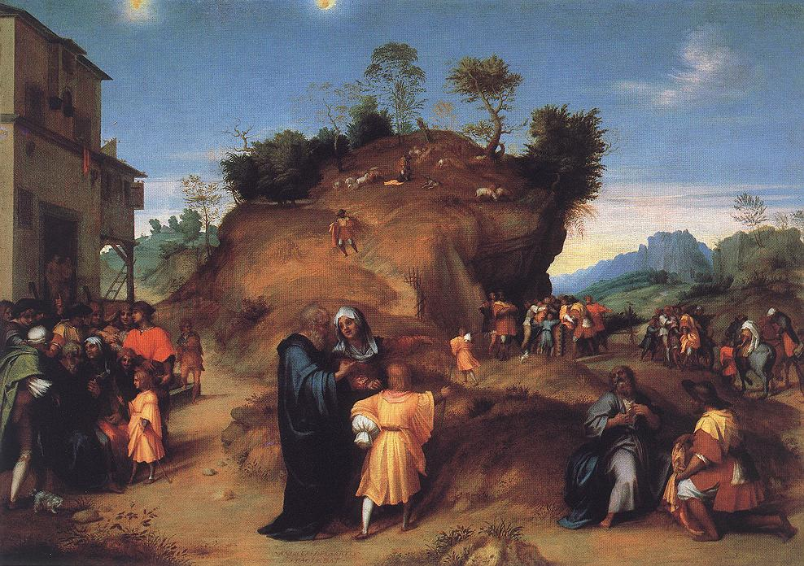

Slide 20
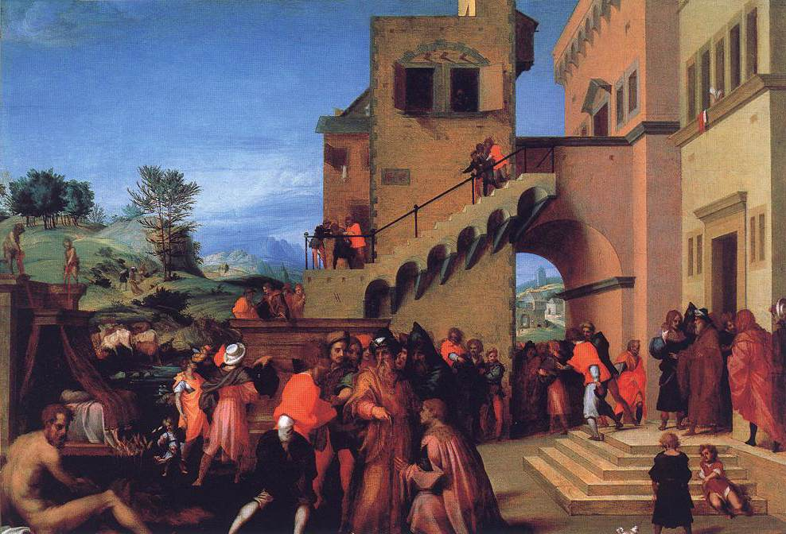

Slide 21
Johann Friedrich Overbeck, Joseph sold into slavery, 1816
Alte Nationalgalerie, Berlin
Overbeck was part of a group of German artists who worked in Rome in the early 19th century, living in an old monastery and calling themselves “The Nazarenes.”
They intentionally worked in an old-fashioned style, imitating Renaissance artists like Raphael.
This is a fresco work, another example of being intentionally old-fashioned. The work was moved to Berlin later in the 19th century.

Slide 22
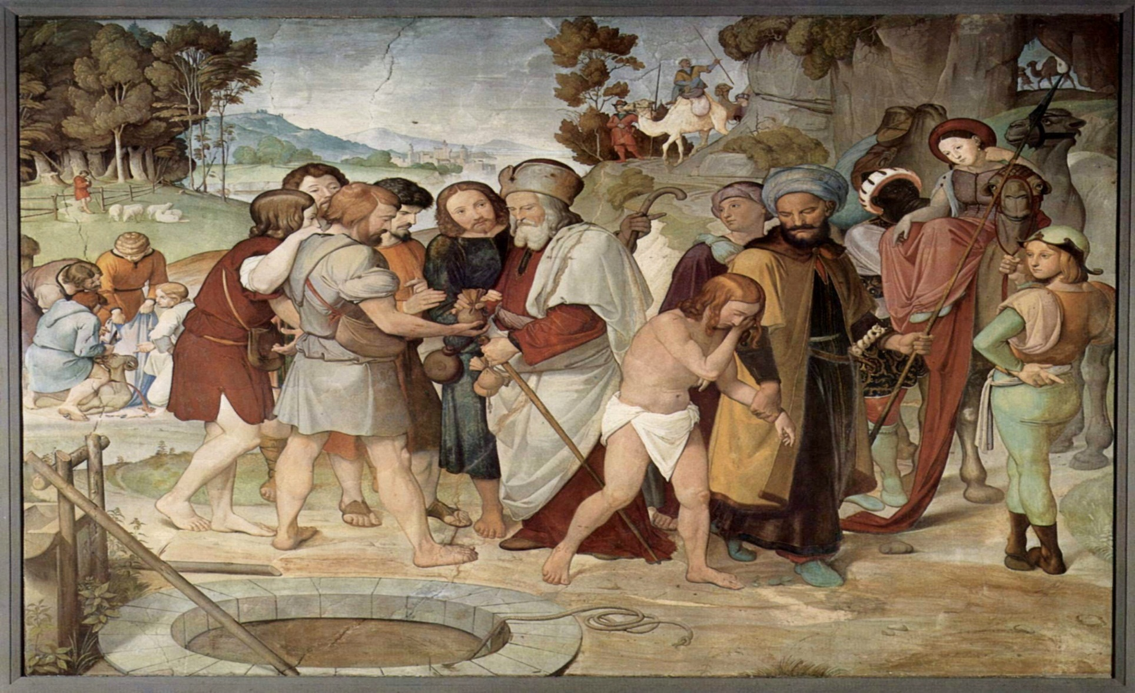

Slide 23
Chapter 38: An Interlude — Tamar and Judah
It happened at that time that Judah went down from his brothers and settled near a certain Adullamite whose name was Hirah. 2 There Judah saw the daughter of a certain Canaanite whose name was Shua; he married her and went in to her. 3 She conceived and bore a son; and he named him Er. 4 Again she conceived and bore a son whom she named Onan. 5 Yet again she bore a son, and she named him Shelah. She was in Chezib when she bore him. 6 Judah took a wife for Er his firstborn; her name was Tamar. 7 But Er, Judah’s firstborn, was wicked in the sight of the Lord, and the Lord put him to death. 8 Then Judah said to Onan, “Go in to your brother’s wife and perform the duty of a brother-in-law to her; raise up offspring for your brother.” 9 But since Onan knew that the offspring would not be his, he spilled his semen on the ground whenever he went in to his brother’s wife, so that he would not give offspring to his brother.

Slide 24
Chapter 38: An Interlude — Tamar and Judah
10 What he did was displeasing in the sight of the Lord, and he put him to death also. 11 Then Judah said to his daughter-in-law Tamar, “Remain a widow in your father’s house until my son Shelah grows up”—for he feared that he too would die, like his brothers. So Tamar went to live in her father’s house. 12 In course of time the wife of Judah, Shua’s daughter, died; when Judah’s time of mourning was over, he went up to Timnah to his sheepshearers, he and his friend Hirah the Adullamite. 13 When Tamar was told, “Your father-in-law is going up to Timnah to shear his sheep,” 14 she put off her widow’s garments, put on a veil, wrapped herself up, and sat down at the entrance to Enaim, which is on the road to Timnah. She saw that Shelah was grown up, yet she had not been given to him in marriage. 15 When Judah saw her, he thought her to be a prostitute, for she had covered her face. 16 He went over to her at the roadside, and said

Slide 25
Chapter 38: An Interlude — Tamar and Judah
“Come, let me come in to you,” for he did not know that she was his daughter-in-law. She said, “What will you give me, that you may come in to me?” 17 He answered, “I will send you a kid from the flock.” And she said, “Only if you give me a pledge, until you send it.” 18 He said, “What pledge shall I give you?” She replied, “Your signet and your cord, and the staff that is in your hand.” So he gave them to her, and went in to her, and she conceived by him. 19 Then she got up and went away, and taking off her veil she put on the garments of her widowhood. 20 When Judah sent the kid by his friend the Adullamite, to recover the pledge from the woman, he could not find her. 21 He asked the townspeople, “Where is the temple prostitute who was at Enaim by the wayside?” But they said, “No prostitute has been here.” 22 So he returned to Judah, and said, “I have not found her; moreover the townspeople said, ‘No prostitute has been here.’”

Slide 26
Chapter 38: An Interlude — Tamar and Judah
23 Judah replied, “Let her keep the things as her own, otherwise we will be laughed at; you see, I sent this kid, and you could not find her.” 24 About three months later Judah was told, “Your daughter-in-law Tamar has played the whore; moreover she is pregnant as a result of whoredom.” And Judah said, “Bring her out, and let her be burned.” 25 As she was being brought out, she sent word to her father-in-law, “It was the owner of these who made me pregnant.” And she said, “Take note, please, whose these are, the signet and the cord and the staff.” 26 Then Judah acknowledged them and said, “She is more in the right than I, since I did not give her to my son Shelah.” And he did not lie with her again. 27 When the time of her delivery came, there were twins in her womb. 28 While she was in labor, one put out a hand; and the midwife took and bound on his hand a crimson thread, saying, “This one came out first.” 29 But just then he drew back his hand, and out came his brother; and she said, “What a breach you have made for yourself!” Therefore he was named Perez. 30 Afterward his brother came out with the crimson thread on his hand; and he was named Zerah

Slide 27
This is a connecting interlude
Judah is one of the two brothers who did not want to kill Joseph, and he is the one who suggests selling him into slavery instead.
Through the twins born of this interlude, and later through Ruth, Judah becomes an ancestor of David.
The story parallels David and Bathsheba in topic, and Judah’s wife, the daughter of Shua (‘Bat Shu’a’), anticipates the name ‘Bathsheba.’
Like David, Judah ultimately corrects himself.
Notes:
Oxford Annotated Bible Footnotes for Chapter 38
38.1–30: Judah and Tamar. Though an apparent interlude in the Joseph story, this chapter echoes elements of ch 37 and anticipates themes from the upcoming Joseph story. Yet this story contrasts with most of this part of Genesis in its focus on Judah, not Joseph. Moreover, it has striking parallels with later narratives about David (see 38.1–2n., 6n.). Both elements—the focus on Judah and anticipation of David—link 38.1–30 with a sequence of episodes, starting in 30.21; 34.1–31; 35.22, that prepare for Jacob’s blessing of Judah and prediction of the Davidic dynasty in 49.8–12. See 49.1–28n. and 8–12n. 1–2: Adullam, a town where David later built up his mercenary army (1 Sam 22.1; 2 Sam 23.13). The locales in this narrative are appropriately in the territory of the tribe of Judah. Judah’s wife, the daughter of Shua (Heb “Bat Shu‘a,” v. 12), anticipates the later “Bathsheba” of the David and Solomon narratives (2 Sam 11; cf. 1 Chr 3.5). 6: Links to the David and Solomon story continue with mention of “Tamar” (see 2 Sam 13). 8–10: According to the ancient custom of levirate marriage (Deut 25.5–10), the duty of a brother-in-law was to father a male descendant for his deceased brother and thus perpetuate his name and inheritance. Onan’s death is attributed to his refusal to perform this duty (thus endangering Judah’s line), probably by coitus interruptus (rather than “onanism,” masturbation). 11: Judah apparently fears that the death of his sons resulted from Tamar’s sinister power. 12–19: Tamar tricks Judah into playing the role of the brother in-law by dressing as a prostitute and allowing him to hire her to have sex (see 27.1–45n.). 18: The signet was a seal, often suspended from the neck with a cord, used to “sign” documents. 20–22: Though some interpret the Hebrew here for “holy woman” (“qedeshah”) as referring to a temple prostitute (so NRSV), it is unlikely that there was an institution of sacred prostitution in ancient Israel. Some commentators propose that Judah’s Adullamite friend is just delicately referring to the missing “prostitute” as a similarly unattached “holy woman.” 24: Stoning was the usual punishment for adultery (Deut 22.23–24; cf. Jn 8.5), although burning was prescribed for
exceptional cases (Lev 21.9). 25–26: The presentation of evidence to Judah here echoes the presentation of the bloody robe to Jacob in 37.32–33. 27–30: The birth of Judah’s twins is depicted in terms similar to that of Jacob and Esau (25.24–26). The final link of this chapter to the David narrative (see 38.1–2,6n.) occurs with Perez, the firstborn and ancestor of David (Ruth 4.18–22; see 49.1–28 and 8–12n.).

Slide 28
The rules of the day
This story makes no sense unless you know the rules of that day, which were vastly different from what one might think.
A levirate marriage was a custom by which a brother-in-law was obligated to father a son for his deceased brother, to carry on the name and inheritance.
Adultery was committed when a married woman had relations with a man who was not her husband; a married man with a woman who was not his wife did not commit adultery.
Notes:
The New Oxford Annotated Bible (c) Oxford University Press, 1996. All rights reserved.
Oxford Annotated Bible Footnotes for Chapter 38
38.1–30: Judah and Tamar. Though an apparent interlude in the Joseph story, this chapter echoes elements of ch 37 and anticipates themes from the upcoming Joseph story. Yet this story contrasts with most of this part of Genesis in its focus on Judah, not Joseph. Moreover, it has striking parallels with later narratives about David (see 38.1–2n., 6n.). Both elements—the focus on Judah and anticipation of David—link 38.1–30 with a sequence of episodes, starting in 30.21; 34.1–31; 35.22, that prepare for Jacob’s blessing of Judah and prediction of the Davidic dynasty in 49.8–12. See 49.1–28n. and 8–12n. 1–2: Adullam, a town where David later built up his mercenary army (1 Sam 22.1; 2 Sam 23.13). The locales in this narrative are appropriately in the territory of the tribe of Judah. Judah’s wife, the daughter of Shua (Heb “Bat Shu‘a,” v. 12), anticipates the later “Bathsheba” of the David and Solomon narratives (2 Sam 11; cf. 1 Chr 3.5). 6: Links to the David and Solomon story continue with mention of “Tamar” (see 2 Sam 13). 8–10: According to the ancient custom of levirate marriage (Deut 25.5–10), the duty of a brother-in-law was to father a male descendant for his deceased brother and thus perpetuate his name and inheritance. Onan’s death is attributed to his refusal to perform this duty (thus endangering Judah’s line), probably by coitus interruptus (rather than “onanism,” masturbation). 11: Judah apparently fears that the death of his sons resulted from Tamar’s sinister power. 12–19: Tamar tricks Judah into playing the role of the brother in-law by dressing as a prostitute and allowing him to hire her to have sex (see 27.1–45n.). 18: The signet was a seal, often suspended from the neck with a cord, used to “sign” documents. 20–22: Though some interpret the Hebrew here for “holy woman” (“qedeshah”) as referring to a temple prostitute (so NRSV), it is unlikely that there was an institution of sacred prostitution in ancient Israel. Some commentators propose that Judah’s Adullamite friend is just delicately referring to the missing “prostitute” as a similarly unattached “holy woman.” 24: Stoning was the usual punishment for adultery (Deut 22.23–24; cf. Jn 8.5), although burning was prescribed for
exceptional cases (Lev 21.9). 25–26: The presentation of evidence to Judah here echoes the presentation of the bloody robe to Jacob in 37.32–33. 27–30: The birth of Judah’s twins is depicted in terms similar to that of Jacob and Esau (25.24–26). The final link of this chapter to the David narrative (see 38.1–2,6n.) occurs with Perez, the firstborn and ancestor of David (Ruth 4.18–22; see 49.1–28 and 8–12n.).

Slide 29
The rules of the day
This is a story about Judah and Tamar, not about the brothers Er and Onan.
The only important detail about Er and Onan is that they died.
Tamar was owed a husband by Judah.
Judah’s reluctance came from having lost two sons who were married to this woman.
Judah’s hiring of a prostitute was socially acceptable.
Tamar, unjustly denied her rights even though she kept her part of the bargain by waiting, sought to claim her right through trickery.

Slide 30
Balance - “She is more in the right than I, since I did not give her to my son Shelah.”
The lesson here is that justice was not based on absolutes – both had violated the rules. Both had understandable excuses.
The law even today recognizes the defense of justification.
Judah recognized this – ‘more in the right’ concept as did the Lord.
Tamar and Judah has not one but two sons from this interlude, one the ancestor of David.

