Slide 1
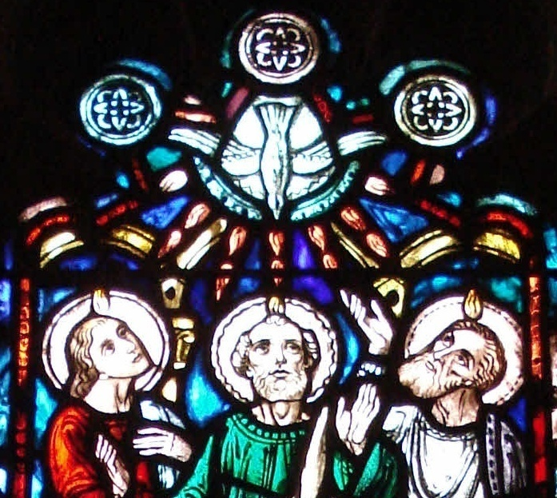
Twenty-Second Sunday After Pentecost
Proper Twenty-Seven
Sunday Closest to November 9
Year A RCL

Slide 2
Readings for the Day
Joshua 24:1–3a, 14–25 / Psalm 78:1–7
Wisdom of Solomon 6:12–16 or Amos 5:18–24 / Wisdom of Solomon 6:17–20 / Psalm 70
1 Thessalonians 4:13–18
Matthew 25:1–13

Slide 3
The Collect, Proper 27
O God, whose blessed Son came into the world that he might destroy the works of the devil and make us children of God and heirs of eternal life: Grant that, having this hope, we may purify ourselves as he is pure; that, when he comes again with power and great glory, we may be made like him in his eternal and glorious kingdom; where he lives and reigns with you and the Holy Spirit, one God, for ever and ever. Amen.
Notes:
Source: The Book of Common Prayer (1979), Proper 27.

Slide 4
The Collect, Proper 27
The collect starts with an observation and then makes two petitions. The observation is that Jesus “came into the world that he might destroy the works of the devil and make us children of God and heirs of eternal life …”
Both petitions relate to this observation. The first is that “we may purify ourselves as he is pure” and the second is for salvation “when he comes again with power and great glory, we may be made like him in his eternal and glorious kingdom.”
Notes:
The collect starts with an observation and then makes two petitions. The observation is that Jesus “came into the world that he might destroy the works of the devil and make us children of God and heirs of eternal life …” Both petitions relate to this observation. The first is that “we may purify ourselves as he is pure” and the second is for salvation “when he comes again with power and great glory, we may be made like him in his eternal and glorious kingdom.”
While the readings for this week do not closely relate, the timing is appropriate. The year is ending, and Advent is fast approaching. The collect’s emphasis on the role of Jesus in the universe starts to bring our attention to Advent.
RCL A
1 Thessalonians 4:17–18 (NRSV): Then we who are alive, who are left, will be caught up in the clouds together with them to meet the Lord in the air; and so we will be with the Lord forever. Therefore encourage one another with these words.
RCL B
Hebrews 9:28 (NRSV): Christ, having been offered once to bear the sins of many, will appear a second time, not to deal with sin, but to save those who are eagerly waiting for him.
RCL C
Job 19:25–26 (NRSV): For I know that my Redeemer lives, and that at the last he will stand upon the earth; and after my skin has been thus destroyed, then in my flesh I shall see God,
Source for the collect: The Book of Common Prayer (1979), Proper 27.

Slide 5
The Collect, Proper 27
While the readings for this week do not closely relate, the timing is appropriate. The year is ending, and Advent is fast approaching. The collect’s emphasis on the role of Jesus in the universe starts to bring our attention to Advent.
Notes:
The collect starts with an observation and then makes two petitions. The observation is that Jesus “came into the world that he might destroy the works of the devil and make us children of God and heirs of eternal life:..” Both petitions relate to this observation The first is that “we may purify ourselves as he is pure” and the second for salvation “when he comes again with power and great glory, we may be made like him in his eternal and glorious kingdom.”
While the readings for this week do not closely relate, the timing is appropriate. The year is ending, and Advent is fast approaching. The collect’s emphasis on the role of Jesus in the universe starts to bring our attention to Advent.
RCL A
1 Thessalonians 4:17–18 (NRSV): Then we who are alive, who are left, will be caught up in the clouds together with them to meet the Lord in the air; and so we will be with the Lord forever. Therefore encourage one another with these words.
RCL B
Hebrews 9:28 (NRSV): Christ, having been offered once to bear the sins of many, will appear a second time, not to deal with sin, but to save those who are eagerly waiting for him.
RCL C
Job 19:25–26 (NRSV): For I know that my Redeemer lives, and that at the last he will stand upon the earth; and after my skin has been thus destroyed, then in my flesh I shall see God,
Source for the collect: The Book of Common Prayer (1979), Proper 27.

Slide 6
The common theme today
“when he comes again with power and great glory, we may be made like him in his eternal and glorious kingdom….”
What happens in the end, the real capital E end.
Appropriate for the period right before Advent.

Slide 7
Joshua 24:1-3a, 14-25
Joshua gathered all the tribes of Israel to Shechem, and summoned the elders, the heads, the judges, and the officers of Israel; and they presented themselves before God. And Joshua said to all the people, “Thus says the LORD, the God of Israel:

Slide 8
Joshua 24:1-3a, 14-25 (cont.)
Long ago your ancestors—Terah and his sons Abraham and Nahor-- lived beyond the Euphrates and served other gods. Then I took your father Abraham from beyond the River and led him through all the land of Canaan and made his offspring many.

Slide 9
Joshua 24:1-3a, 14-25
“Now therefore revere the LORD, and serve him in sincerity and in faithfulness; put away the gods that your ancestors served beyond the River, and in Egypt, and serve the LORD. Now if you are unwilling to serve the LORD, choose this day whom you will serve, whether the gods your ancestors served in the region beyond the River, or the gods of the Amorites in whose land you are living; but as for me and my household, we will serve the LORD.”

Slide 10
Joshua 24:1-3a, 14-25
Then the people answered, “Far be it from us that we should forsake the LORD to serve other gods; for it is the LORD our God who brought us and our ancestors up from the land of Egypt, out of the house of slavery, and who did those great signs in our sight.

Slide 11
Joshua 24:1-3a, 14-25 (cont.)
He protected us along all the way that we went, and among all the peoples through whom we passed; and the LORD drove out before us all the peoples, the Amorites who lived in the land. Therefore we also will serve the LORD, for he is our God.”

Slide 12
Joshua 24:1-3a, 14-25
But Joshua said to the people, “You cannot serve the LORD; for he is a holy God. He is a jealous God; he will not forgive your transgressions or your sins. If you forsake the LORD and serve foreign gods, then he will turn and do you harm, and consume you, after having done you good.” And the people said to Joshua, “No, we will serve the LORD!”

Slide 13
Joshua 24:1-3a, 14-25
Then Joshua said to the people, “You are witnesses against yourselves that you have chosen the LORD, to serve him.” And they said, “We are witnesses.” He said, “Then put away the foreign gods that are among you, and incline your hearts to the LORD, the God of Israel.” The people said to Joshua, “The LORD our God we will serve, and him we will obey.” So Joshua made a covenant with the people that day, and made statutes and ordinances for them at Shechem.

Slide 14
Introduction to Joshua
The book of Joshua is part of the larger story of Israel's life in its land.
The book of Joshua falls into three parts.
(a) Joshua 1–12: a successful military campaign led by Joshua against the Canaanites.
Notes:
The book of Joshua is part of the larger story of Israel's life in its land. Optimism pervades the opening scenes of that story as told in this book: the successful settlement of Canaan by the Israelite tribes under Joshua. It takes on a more ominous character as it continues in the book of Judges, and reaches its climax with the founding of the Israelite monarchy in the books of Samuel. It comes to its tragic end with the books of Kings that narrate the fall of the Israelite kingdoms. Because the theological perspectives of the book of Deuteronomy undergird this narrative, the books of Joshua to 2 Kings are known as the Deuteronomistic History of Israel (see "Introduction to the Historical Books").
The book of Joshua simplifies what was the long and complex process by which the Israelite tribes came to settle in Canaan. The story does not reflect the actual course of events. Some details are missing; others are rearranged. Archaeological excavations, supplemented by sociological analysis, have helped reconstruct the history of the settlement period. All this has made it clear that the book of Joshua, using an idealized historical narrative, intends to describe Israel, past and future, its relationship with God, and the kind of society it wished to be.
The Canaan that the Israelite tribes entered following the Exodus was in a state of social and political turmoil. Their entrance into the region west of the Jordan river was a catalyst that brought a new social reality into being. The socio-economic system of the Canaanite city-states concentrated power in the upper classes to the detriment of the peasants. That system began to disintegrate under the pressure brought to bear by the new immigrants. The Israelite tribes that experienced a great liberation in Egypt entered Canaan as harbingers of a new society. The book of Joshua is the story of how an obedient Israel under God's chosen leader can bring into existence a society based on justice and freedom.
The book of Joshua falls into three parts. (a) Joshua 1–12 describes the settlement of the Israelite tribes in Canaan as the result of a successful military campaign led by Joshua against the Canaanites. The bulk of this narrative deals with central Canaan, followed by stories about campaigns in the south in Joshua 10.25-43, while Joshua 11.1-15 covers victories in the north. (b) Joshua 13–21 reports the distribution of the land among the victorious tribes. These geographical lists probably come from the period of the Israelite monarchy. Here they serve to describe the extent of the Israelite occupation of Canaan. (c) The book concludes with three stories (Joshua 22-24) that focus on the loyalty that Israelite tribes owe to their God who has given them the land they now occupy.
The violence described in Joshua 1-12 has led some readers to ignore or spiritualize this book. There have been attempts to explain away the harshness of these stories by showing that they do not reflect the actual historical circumstances of Israelite tribes' conflicts with the Canaanites. Still it is true that ancient Israel did acquire the land, in part, through violent means; the violence that took place during the settlement period was evil. What the book of Joshua affirms is that God's purpose for Israel was served even by this evil. The aim of the book was not to edify but to move its readers to obedience. For ancient Israel this obedience was an act of faith in the God who brings good out of evil.
The New Oxford Annotated Bible © Oxford University Press, 1996. All rights reserved.

Slide 15
Introduction to Joshua (cont.)
(b) Joshua 13–21 lists the distribution of the land among the victorious tribes.
(c) Joshua 22–24 concludes with three stories, including our reading, that focus on the loyalty that Israelite tribes owe to their God who has given them the land they now occupy.

Slide 16
Shechem
Abraham had a theophany near Shechem and built an altar there (Genesis 12.6–7)
Jacob also built an altar there (Genesis 33.18–20).
Genesis 34: Simeon and Levi kill the inhabitants of Shechem and plunder it in retaliation for the rape of their sister Dinah by Shechem.
Joseph’s body was brought back from Egypt and buried at Shechem (Joshua 24.32; cf. Acts 7.16).
Notes:
Shechem. A major Canaanite and Israelite city in the hill country of Ephraim (Map 1:X4), Shechem first appears in the historical record as an enemy of Egypt in an execration text and on a stele of the nineteenth century bce. During the Amarna period (fourteenth century), Shechem, under its ruler, Labayu, and his sons, asserted itself against the other Canaanite city-states and, hence, against the weakening Egyptian hegemony in Canaan.
Shechem appears prominently in the ancestral narratives. Abraham had a theophany near Shechem and built an altar there (Genesis 12.6–7), as did Jacob (Genesis 33.18–20). In Genesis 34, Simeon and Levi kill the inhabitants of Shechem and plunder it in retaliation for the rape of their sister Dinah by Shechem, son of Hamor (cf. Genesis 49.5–7). Joseph’s body was brought back from Egypt and buried at Shechem (Joshua 24.32; see also the somewhat erroneous Acts 7.16), and Joshua’s great covenant renewal ceremony took place there (Joshua 24). The first abortive Israelite attempt at kingship under Abimelech was centered at Shechem, but Abimelech exacted a terrible revenge in the city after a mutual falling out (Judges 9). It was to Shechem that Jeroboam I went to be crowned first king of Israel (1 Kings 12.1), and it served as his first capital (1 Kings 12.25).
Shechem has been located at the site of Tell Balatah, guarding the pass between Mount Ebal to the north and Mount Gerizim to the south, near modern Nablus. After earlier village occupation of the site in the Chalcolithic period, a large and well-fortified urban center developed at Shechem in the Middle Bronze Age (ca. 1850–1550 bce). Of particular interest are the temples found at the site, including one designated the “fortress temple” because of its massive walls. After a violent destruction at the end of the Middle Bronze Age, presumably by one of the early pharaohs of Dynasty XVIII, Shechem lay uninhabited for close to a century. Completely rebuilt, probably with Egyptian consent, the city prospered during the first part of the Late Bronze Age, only to suffer destruction at the hands of Labayu’s enemies, whether Egyptian or Canaanite or both. The subsequent Late Bronze Age city was not as prosperous, yet it managed to survive into the early Iron Age, when it probably passed peacefully into Israelite hands. The destruction of Shechem in the late twelfth century is generally attributed to Abimelech. Shechem recovered to some extent during the following centuries, becoming a town of some importance, until it was once again destroyed, this time by the Assyrians in their campaign of conquest of the northern kingdom Israel (724–722 bce). The habitation of Shechem remained poor and sparse throughout the remainder of the Iron Age and the first part of the Persian period. During the Hellenistic period (as of ca. 330 bce) Shechem regained some of its ancient importance and glory as the Samaritan rival of Jerusalem. The city was finally destroyed in 107 bce by the Hasmonean John Hyrcanus.
Carl S. Ehrlich

Slide 17
Shechem (cont.)
Joshua’s great covenant renewal ceremony took place there (Joshua 24).
The first and failed Israelite attempt at kingship under Abimelech was centered at Shechem (Judges 9).
Jeroboam I was crowned first king of Israel and it was his first capital (1 Kings 12.1, 25)

Slide 18
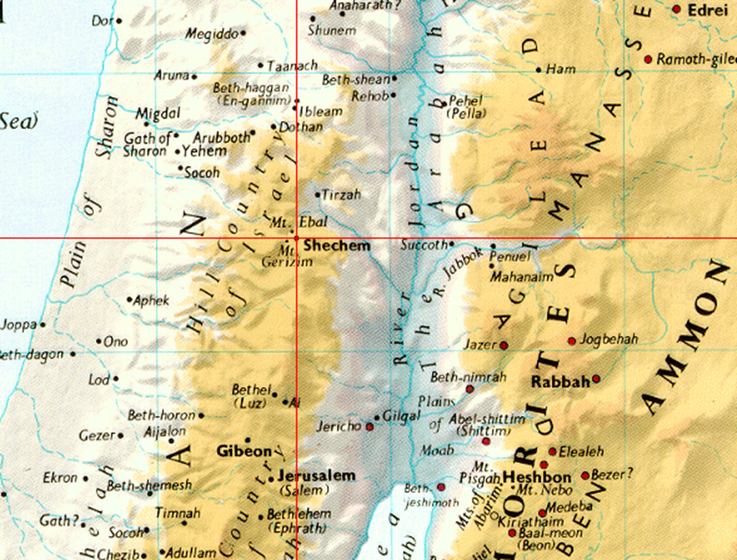

Slide 19
Context
Since last week the rest of the land has been conquered and divided among the tribes, and cities of refuge have been set (Joshua 13–21).
All are circumcised (Joshua 5.2–9); apparently this had not been done for those born in the wilderness after the departure from Egypt.

Slide 20
Context (cont.)
The book then states that Israel was at peace and that Joshua is now old and ready for the end (Joshua 23.1–2); he dies at 110 (Joshua 24.29).
This is the point where we now join the story.

Slide 21
Omitted: God’s Wonders (Joshua 24:3b–13)
I gave him Isaac; 4 and to Isaac I gave Jacob and Esau. I gave Esau the hill country of Seir to possess, but Jacob and his children went down to Egypt. 5 Then I sent Moses and Aaron, and I plagued Egypt with what I did in its midst; and afterwards I brought you out. 6 When I brought your ancestors out of Egypt, you came to the sea; and the Egyptians pursued your ancestors with chariots and horsemen to the Red Sea.

Slide 22
Omitted: God’s Wonders (Joshua 24:3b–13) (cont.)
7 When they cried out to the Lord, he put darkness between you and the Egyptians, and made the sea come upon them and cover them; and your eyes saw what I did to Egypt. Afterwards you lived in the wilderness a long time. 8 Then I brought you to the land of the Amorites, who lived on the other side of the Jordan; they fought with you, and I handed them over to you, and you took possession of their land, and I destroyed them before you.

Slide 23
Omitted: God’s Wonders (Joshua 24:3b–13) (cont.)
9 Then King Balak son of Zippor of Moab, set out to fight against Israel. He sent and invited Balaam son of Beor to curse you, 10 but I would not listen to Balaam; therefore he blessed you; so I rescued you out of his hand. 11 When you went over the Jordan and came to Jericho, the citizens of Jericho fought against you, and also the Amorites, the Perizzites, the Canaanites, the Hittites, the Girgashites, the Hivites, and the Jebusites; and I handed them over to you.

Slide 24
Omitted: God’s Wonders (Joshua 24:3b–13)
12 I sent the hornet ahead of you, which drove out before you the two kings of the Amorites; it was not by your sword or by your bow. 13 I gave you a land on which you had not labored, and towns that you had not built, and you live in them; you eat the fruit of vineyards and oliveyards that you did not plant.

Slide 25
Notice
That incident with Balaam is slightly different.
And the destruction of Jericho is different.
Notes:
Balaam (annotations to Numbers 22–24)
22.1–40: Balak and Balaam. Fearful of the triumphant Israelites, the Moabite king invited a Mesopotamian diviner to put a curse on the invaders. 4: On Moab’s league with Midian, see Numbers 31.
22.5–20: Balak’s two missions to obtain the services of Balaam who was in Pethor, located south of Carchemish which is on the Euphrates. In antiquity Babylonia was famed for the art of divination. 6: In antiquity it was believed that the curse—the opposite of the blessing (see Genesis 27.4 n.)—releases a negative power that shapes future events. 8: Throughout Numbers 22–24 the conviction is expressed that a foreign priest-diviner, though not a member of the covenant community, was obedient to the Lord’s will and that nothing could prevent the fulfillment of the divine purpose for Israel. 13: It is implied that the Lord spoke to him in a dream (Numbers 22.8; Numbers 22.19–20).
22.21–35: The folk-story of Balaam’s donkey, with its miraculously talking animal and unsophisticated, humorous irony, is apparently another tradition. 22: Note the contrast between this verse and the previous permission for Balaam to go (Numbers 22.15–20). The angel of the Lord, see Genesis 16.7 n. 23: Joshua 5.13.
22.34–35: The incident serves to remind Balaam that he must speak only what the Lord bids him (compare 1 Kings 22.14), regardless of gifts or honors (Numbers 22.38).
22.41–24.25: The four oracles of Balaam, probably dating in their present form from the early Israelite monarchy (Numbers 24.17–19).
23.1–6: Babylonian diviners resorted to this kind of sacrificial ceremony to obtain an omen. 7–10: The first oracle. 7: Aram, i.e. “Aram of the Two Rivers” or Mesopotamia (Genesis 24.10). 9: Israel is not a nation like other nations (compare 1 Samuel 8.4–22) but a people set apart for a special destiny. 10: Balaam prays that, by not cursing God’s people, he may come to the end of his days as a righteous man.
23.11–12: See Numbers 22.20. The narrative is written with a touch of humor. 13: Not wishing to defy God, Balak supposes that the oracle may be different if Balaam views the people from another perspective. 14: Pisgah, see Deuteronomy 34.1 n.
23.18–24: The second oracle. 19: God’s change of mind displays consistency of purpose, unlike human beings who manifest deceit and caprice (see Exodus 32.14 n.). 21: The Lord’s kingship is an ancient poetic motif (Exodus 15.18). 22: The horns of a wild ox, a symbol of brute strength. 23: Since Israel’s God cannot be coerced by magical techniques, divination is ineffective in altering Israel’s destiny. 28: Peor, see Numbers 25.3 n.
24.1: Balaam begins to abandon his technique of divination. 3–9: The third oracle. 3–4: These verses portray the ecstasy during which the oracle was received. The Almighty, see Genesis 17.1 n. 7: If Agag refers to the Amalekite king of Saul’s time (1 Samuel 15.8), the poem must have been composed in the early monarchy. 9b: Genesis 12.3.
24.10: Striking the hands together was a gesture of anger and reproach (Job 27.23). 14: Balaam not only defies Balak’s command to get out but gives his last oracle without the preparatory rites of divination (Numbers 23.1–6; Numbers 24.1 n.).
Jericho (Joshua 6:1–27, NRSV)
Jericho Taken and Destroyed
6 Now Jericho was shut up inside and out because of the Israelites; no one came out and no one went in. 2 The Lord said to Joshua, “See, I have handed Jericho over to you, along with its king and soldiers. 3 You shall march around the city, all the warriors circling the city once. Thus you shall do for six days, 4 with seven priests bearing seven trumpets of rams’ horns before the ark. On the seventh day you shall march around the city seven times, the priests blowing the trumpets. 5 When they make a long blast with the ram’s horn, as soon as you hear the sound of the trumpet, then all the people shall shout with a great shout; and the wall of the city will fall down flat, and all the people shall charge straight ahead.” 6 So Joshua son of Nun summoned the priests and said to them, “Take up the ark of the covenant, and have seven priests carry seven trumpets of rams’ horns in front of the ark of the Lord.” 7 To the people he said, “Go forward and march around the city; have the armed men pass on before the ark of the Lord.”
8 As Joshua had commanded the people, the seven priests carrying the seven trumpets of rams’ horns before the Lord went forward, blowing the trumpets, with the ark of the covenant of the Lord following them. 9 And the armed men went before the priests who blew the trumpets; the rear guard came after the ark, while the trumpets blew continually. 10 To the people Joshua gave this command: “You shall not shout or let your voice be heard, nor shall you utter a word, until the day I tell you to shout. Then you shall shout.” 11 So the ark of the Lord went around the city, circling it once; and they came into the camp, and spent the night in the camp.
12 Then Joshua rose early in the morning, and the priests took up the ark of the Lord. 13 The seven priests carrying the seven trumpets of rams’ horns before the ark of the Lord passed on, blowing the trumpets continually. The armed men went before them, and the rear guard came after the ark of the Lord, while the trumpets blew continually. 14 On the second day they marched around the city once and then returned to the camp. They did this for six days.
15 On the seventh day they rose early, at dawn, and marched around the city in the same manner seven times. It was only on that day that they marched around the city seven times. 16 And at the seventh time, when the priests had blown the trumpets, Joshua said to the people, “Shout! For the Lord has given you the city. 17 The city and all that is in it shall be devoted to the Lord for destruction. Only Rahab the prostitute and all who are with her in her house shall live because she hid the messengers we sent. 18 As for you, keep away from the things devoted to destruction, so as not to covet † and take any of the devoted things and make the camp of Israel an object for destruction, bringing trouble upon it. 19 But all silver and gold, and vessels of bronze and iron, are sacred to the Lord; they shall go into the treasury of the Lord.” 20 So the people shouted, and the trumpets were blown. As soon as the people heard the sound of the trumpets, they raised a great shout, and the wall fell down flat; so the people charged straight ahead into the city and captured it. 21 Then they devoted to destruction by the edge of the sword all in the city, both men and women, young and old, oxen, sheep, and donkeys.
22 Joshua said to the two men who had spied out the land, “Go into the prostitute’s house, and bring the woman out of it and all who belong to her, as you swore to her.” 23 So the young men who had been spies went in and brought Rahab out, along with her father, her mother, her brothers, and all who belonged to her—they brought all her kindred out—and set them outside the camp of Israel. 24 They burned down the city, and everything in it; only the silver and gold, and the vessels of bronze and iron, they put into the treasury of the house of the Lord. 25 But Rahab the prostitute, with her family and all who belonged to her, Joshua spared. Her family † has lived in Israel ever since. For she hid the messengers whom Joshua sent to spy out Jericho.
26 Joshua then pronounced this oath, saying,
“Cursed before the Lord be anyone who tries
to build this city—this Jericho!
At the cost of his firstborn he shall lay its foundation,
and at the cost of his youngest he shall set up its gates!”
27 So the Lord was with Joshua; and his fame was in all the land.
Sources: annotations to Numbers 22–24 from The New Oxford Annotated Bible; Joshua 6 from the NRSV.

Slide 26
The Text
This incident is known as the Covenant at Shechem.
It represents the fulfillment by Joshua of Moses’ commands (see Deuteronomy 11; 27; 31).
Shechem then became a cultic and political center.
Notes:
24.1–28: The covenant at Shechem. Joshua fulfills the commands of Moses in Deuteronomy 11; Deuteronomy 27; Deuteronomy 31. All Israel unite under Joshua’s leadership in the service of the Lord. 1: Shechem (Tell Balata) became an important Israelite cultic and political center. It was one of the few major cities in Canaan not described as destroyed by the Israelites. Apparently it was incorporated into Israel peacefully. Early Israel then was a confederation of originally disparate groups unrelated by blood or common experience. 2–13: This summary of God’s actions on Israel’s behalf does not mention Sinai or the divine guidance in the wilderness.
24.9–11: This text reflects a different memory of the Balaam incident (Numbers 22) and the fall of Jericho (Joshua 6).
24.29–33: Final notes. 29–31: Joshua’s death and burial. 32: Joseph was reburied (see Genesis 33.19; Genesis 50.25; Exodus 13.19). 33: The burial of Eleazar, a priest associated with Joshua (Joshua 14.1).
Source: The New Oxford Annotated Bible, annotations to Joshua 24.

Slide 27
The Text (cont.)
After a generation of war (and the circumcision of the new generation, Joshua 5), the people now consolidate and rededicate themselves to God.
The writer sets up the people’s repeated promises in order to show later that God was just in punishing their violations.

Slide 28
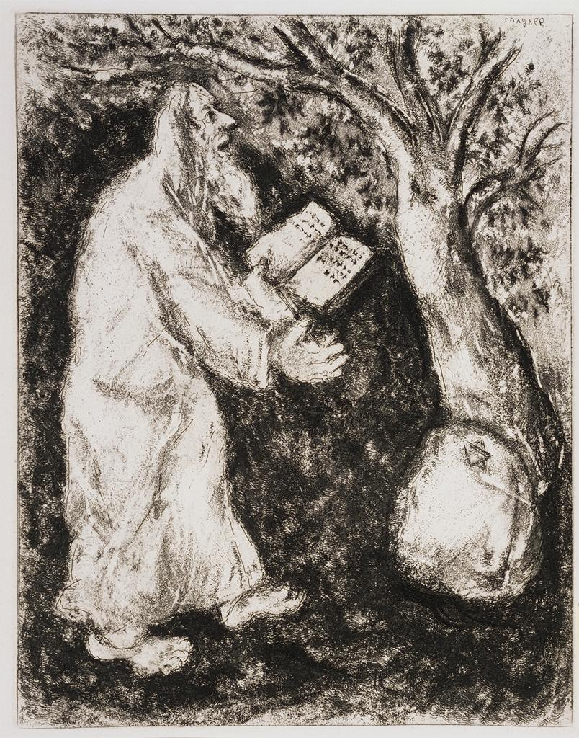
Marc Chagall, Joshua and the Rock of Shechem, from the Bible, 1956
Etching and drypoint, 17 1/2 x 13 in.; Smith College Museum of Art

Slide 29
Psalm 78:1-7, Page 694, BCP: Attendite, popule
1 Hear my teaching, O my people; *
incline your ears to the words of my mouth.
2 I will open my mouth in a parable; *
I will declare the mysteries of ancient times.

Slide 30
Psalm 78:1-7, Page 694, BCP: Attendite, popule (cont.)
3 That which we have heard and known,
and what our forefathers have told us, *
we will not hide from their children.
4 We will recount to generations to come
the praiseworthy deeds and the power of the LORD, *
and the wonderful works he has done.

Slide 31
Psalm 78:1-7, Page 694, BCP: Attendite, popule
5 He gave his decrees to Jacob
and established a law for Israel, *
which he commanded them to teach their children;
6 That the generations to come might know,
and the children yet unborn;

Slide 32
Psalm 78:1-7, Page 694, BCP: Attendite, popule (cont.)
*
that they in their turn might tell it to their children;
7 So that they might put their trust in God, *
and not forget the deeds of God,
but keep his commandments;

Slide 33
Psalm 78:1-7, Page 694, BCP: Attendite, popule
This is one of a group of psalms (Psalm 105; Psalm 106; Psalm 135; Psalm 136), composed for use at the major festivals, which recite the history of God’s dealings with Israel.
This psalm emphasizes the disobedience and ingratitude of the people.
The entire psalm is 72 verses; we mercifully have only the introduction.
Notes:
Psalm 78: The story of God’s great deeds and his people’s faithlessness. One of a group of psalms (Psalm 105; Psalm 106; Psalm 135; Psalm 136), composed for use at the major festivals, which simply recite the history of God’s dealings with Israel. This psalm emphasizes the disobedience and ingratitude of the people, especially noting the defection of the Ephraimites (Psalm 78.9–11) which led God to reject them in favor of Judah (Psalm 78.67–69). 1–4: The poet addresses the congregation in the style of the wisdom writers (compare Psalm 49.1–4). 2: Quoted in Matthew 13.35. 5–8: The giving of the law. 6: Deuteronomy 6.7.
78.9–11: It is uncertain what incident is referred to. 12–53: God’s miraculous care for his people during the Exodus and the wilderness wanderings, a review of events in Exodus and Numbers, Psalm 78.17–20 and Psalm 32–41 being interludes which describe the characteristic faithlessness of Israel. 12: Zoan, a royal Egyptian store city, is identical with the Rameses of Exodus 1.11. 15–16: Exodus 17.6; Numbers 20.10–13. 21–31: Exodus 16; Numbers 11. 24: Quoted in John 6.31. 25: The manna is fancifully interpreted as the bread of the angels.
78.44–51: The plagues, Exodus 7–12. 51: Ham, a poetic synonym for Egypt (Genesis 10.6).
78.54–64: God’s care for his people during the conquest and in the days of the Judges; their continued faithlessness. 55: Nations, Deuteronomy 7.1. 60–64: The destruction of the temple at Shiloh is mentioned elsewhere only in Jeremiah 7.12–14 and Jeremiah 26.6; the period was that of the events related in 1 Samuel 4.1–7.2. 65–66: Victories over the Philistines in the time of Saul and David. 67–72: The building of the temple and the establishment of the Davidic dynasty. The passage reflects the tension between North and South which led to the division of the nation into Judah and Israel (Ephraim) and the eventual schism between Jews and Samaritans.
Source: The New Oxford Annotated Bible, annotations to Psalm 78.

Slide 34
Wisdom of Solomon 6:12-16
Wisdom is radiant and unfading, and she is easily discerned by those who love her and is found by those who seek her. She hastens to make herself known to those who desire her. One who rises early to seek her will have no difficulty, for she will be found sitting at the gate.

Slide 35
Wisdom of Solomon 6:12-16 (cont.)
To fix one’s thought on her is perfect understanding, and one who is vigilant on her account will soon be free from care, because she goes about seeking those worthy of her, and she graciously appears to them in their paths, and meets them in every thought.

Slide 36
The Apocrypha – What’s that?
The word “apocrypha” is used in a variety of confusing ways. The word means “things that are hidden.”
The word applies to a set of 15 books of the Bible between the Old and New Testaments.
In ancient times some believed these were books too profound to be shared with anyone without special knowledge.
Notes:
MEANINGS AND USAGE OF THE TERMS “APOCRYPHAL” AND “DEUTEROCANONICAL”
The word “apocrypha” is used in a variety of ways that can be confusing to the general reader. Confusion arises partly from the ambiguity of the ancient usage of the word, and partly from the modern application of the term to different groups of books. Etymologically the word means “things that are hidden,” but why it was chosen to describe certain books is not clear. Some have suggested that the books were “hidden” or withdrawn from common use because they were deemed to contain mysterious or esoteric lore, too profound to be communicated to any except the initiated (compare 2 Esdras 14.45–46). Others have suggested that the term was employed by those who held that such books deserved to be “hidden” because they were spurious or heretical. Thus it appears that in antiquity the term had an honorable significance as well as a derogatory one, depending upon the point of view of those who made use of the word.
According to traditional usage “Apocrypha” has been the designation applied to the fifteen books, or portions of books, listed below. (In many earlier editions of the Apocrypha, the Letter of Jeremiah is incorporated as the final chapter of the Book of Baruch; hence in these editions there are fourteen books.)
Tobit
Judith
The Additions to the Book of Esther (contained in the Greek version of Esther)
The Wisdom of Solomon
Ecclesiasticus, or the Wisdom of Jesus son of Sirach
Baruch
The Letter of Jeremiah
The Prayer of Azariah and the Song of the Three Jews
Susanna
Bel and the Dragon
1 Maccabees
2 Maccabees
1 Esdras
The Prayer of Manasseh
2 Esdras
In addition, the present expanded edition includes the following three texts that are of special interest to Eastern Orthodox readers (see below):
None of these books is included in the Hebrew canon of Holy Scripture. All of them, however, with the exception of 2 Esdras, are present in copies of the Greek version of the Old Testament known as the Septuagint. The Old Latin translations of the Old Testament, made from the Septuagint, also include them, along with 2 Esdras. As a consequence, many of the early Church Fathers quoted most of these books as authoritative Scripture (see “DIVERGENT ATTITUDES IN THE CHRISTIAN CHURCH”).
At the end of the fourth century Pope Damasus commissioned Jerome, the most learned biblical scholar of his day, to prepare a standard Latin version of the Scriptures (the Latin Vulgate). In the Old Testament Jerome followed the Hebrew canon and by means of prefaces called the reader’s attention to the separate category of the apocryphal books. Subsequent copyists of the Latin Bible, however, were not always careful to transmit Jerome’s prefaces, and during the medieval period the Western Church generally regarded these books as part of the holy Scriptures. In 1546 the Council of Trent decreed that the canon of the Old Testament includes them (except the Prayer of Manasseh and 1 and 2 Esdras). Subsequent editions of the Latin Vulgate text, officially approved by the Roman Catholic Church, contain these books incorporated within the sequence of the Old Testament books. Thus Tobit and Judith stand after Nehemiah; the Wisdom of Solomon and Ecclesiasticus stand after the Song of Solomon; Baruch (with the Letter of Jeremiah as chapter 6) stands after Lamentations; and 1 and 2 Maccabees conclude the books of the Old Testament. An appendix after the New Testament contains the Prayer of Manasseh and 1 and 2 Esdras, without implying canonical status.
Editions of the Bible prepared by Protestants have followed the Hebrew canon. The disputed books have generally been placed in a separate section, usually bound between the Old and New Testaments, but occasionally placed after the close of the New Testament.
Modern Roman Catholic scholars commonly employ a distinction introduced by Sixtus of Siena in 1566 to designate the two groups of books. The terms “protocanonical” and “deuterocanonical” are used to signify respectively those books of Scripture that were received by the entire Church from the beginning as inspired, and those whose inspiration came to be recognized later, after the matter had been disputed by certain Fathers and local churches. Thus Roman Catholics accept as fully canonical those books and parts of books that Protestants call the Apocrypha (except the Prayer of Manasseh and 1 and 2 Esdras, which both groups regard as apocryphal). In short, as a popular Roman Catholic Catechism puts it, “Deuterocanonical does not mean Apocryphal, but simply ‘later added to the canon.’ ”
The Eastern Orthodox Churches recognize several other books as authoritative. Editions of the Old Testament approved by the Holy Synod of the Greek Orthodox Church contain, besides the Deuterocanonical books, 1 Esdras, Psalm 151, the Prayer of Manasseh, and 3 Maccabees, while 4 Maccabees stands in an appendix. Slavonic Bibles approved by the Russian Orthodox Church contain, besides the Deuterocanonical books, 1 and 2 Esdras (called 2 and 3 Esdras), Psalm 151, and 3 Maccabees.
Besides the books that are included in the present edition, many other Jewish and Jewish-Christian works have survived from the period between about 200 b.c. to about a.d. 200. Since most of these profess to have been written by ancient worthies of Israel, who lived long before the books were actually composed, they are generally called “pseudepigrapha,” meaning writings “falsely ascribed.” (For a description of several of the more noteworthy pseudepigrapha, see “OTHER APOCRYPHAL AND PSEUDEPIGRAPHICAL LITERATURE.”)
Source: The New Oxford Annotated Bible with the Apocrypha, “Meanings and Usage of the Terms ‘Apocryphal’ and ‘Deuterocanonical.’”

Slide 37
The Apocrypha – What’s that? (cont.)
Still others believed these books were either heretical or too spurious to be included.
The Church in the fourth century drew a distinction between the 15, but this was lost in the Middle Ages.
In the Protestant Reformation, Protestants again set the 15 apart, while Catholics continued to include them. Catholic scholars call them “deuterocanonical”

Slide 38
The Apocrypha – What’s that? (cont.)
and regard them as part of the Old Testament (except the Prayer of Manasseh and 1 and 2 Esdras). The Wisdom of Solomon is a part of the 15 books.

Slide 39
The Wisdom of Solomon
This book is attributed to Solomon, although his name never appears in the text.
The work is not by Solomon. It was composed in Greek by an unknown Hellenistic Jew, probably in Alexandria and probably in the latter part of the first century BC.
Chapters 6–9 address the “judges” of the earth (in reality, the Jews) about Wisdom, a personified spirit who, in chapter 10, is the savior of Israel’s ancestors.
Notes:
The Wisdom of Solomon
This book is attributed to Solomon, though his name never appears (even in Wisdom of Solomon 9.8). But Wisdom of Solomon 7.1–14 and Wisdom of Solomon 8.17–9.18 deliberately reflect his prayer for wisdom as found in 1 Kings 3.6–9 and 2 Chronicles 1.8–10. The work was composed in Greek by an unknown Hellenistic Jew, probably at Alexandria, the largest Jewish center in the Diaspora (the “dispersion,” the name for the Jewish communities outside the land of Israel). The date is uncertain, probably the latter part of the first century b.c. The literary genre is generally described as protreptic, a form of didactic exhortation. It is clearly a product of Hellenistic culture, as indicated by the mention of the four cardinal virtues in Wisdom of Solomon 8.7 and the philosophical treatment of the knowledge of God in Wisdom of Solomon 13.1–9. There is also a wide range of Greek vocabulary in the work. At the same time, it is intensely Jewish. The author has borrowed phraseology from the Septuagint, the Greek translation that would have been the Bible of his Jewish compatriots, and it is written in the poetic parallelism characteristic of the Hebrew Bible.
Wisdom of Solomon 1–5 deal with the gift of immortality, and this constitutes a breakthrough in biblical thought (see also Daniel 12.2–3); righteousness is undying (Wisdom of Solomon 1.15; see also Wisdom of Solomon 3.1–5). When the wicked behold the just person before the throne of God, they realize their mistake; the just one is numbered among the children of God and given the portion of the holy ones in the heavenly court (Wisdom of Solomon 5.5). In Wisdom of Solomon 6–9 pseudo-Solomon speaks to the “judges” of the earth (in reality to the Jews) concerning Wisdom (a spirit and personified as in Proverbs 8; Sirach 24) and her attributes. Unlike other wisdom books, which usually leave the sacred history unmentioned, this work portrays wisdom as a savior of Israel’s ancestors (Wisdom of Solomon 10.1–21). In Wisdom of Solomon 11–19 there is presented an elaborate system of contrasts between God’s treatment of the Israelites and of the Egyptians at the time of the plagues. The theme is spelled out in Wisdom of Solomon 11.5: Israel was benefited through the very things that punished their enemies (thus, water from the rock, instead of the plague of the Nile, for instance); in the same way, “one is punished by the very things by which one sins” (Wisdom of Solomon 11.16). Interspersed in this meditation on the Egyptian plagues are several digressions about God’s power and mercy (Wisdom of Solomon 11.17–12.22), false worship (Wisdom of Solomon 13.1–15.17), and other matters.
To the Jews of the dispersion the Wisdom of Solomon offered strength and consolation. Theirs was a true wisdom, which surpassed even that of the Greeks. Theirs was immortality (a gift of God to the righteous, not the result of having an immortal or spiritual “soul”). Their Lord was the “author of beauty” (Wisdom of Solomon 13.3); to know him was complete righteousness and to know his power was the root of immortality (Wisdom of Solomon 15.3), for his immortal spirit was in all things (Wisdom of Solomon 12.1).
Source: The New Oxford Annotated Bible with the Apocrypha, introduction to the Wisdom of Solomon.

Slide 40
Wisdom Is the Guide to Happiness and Immortality
The section as a whole is an exhortation for all to seek wisdom.
In verses 12-16 Wisdom is personified as a woman, easily found, who seeks those who desire her.
The one seeking to be like Solomon will then seek her as a bridegroom seeks his bride.
[that is the actual footnote]
Notes:
Wisdom of Solomon 6:1–25 (NRSV): Kings Should Seek Wisdom
6 Listen therefore, O kings, and understand;
learn, O judges of the ends of the earth.
2 Give ear, you that rule over multitudes,
and boast of many nations.
3 For your dominion was given you from the Lord,
and your sovereignty from the Most High;
he will search out your works and inquire into your plans.
4 Because as servants of his kingdom you did not rule rightly,
or keep the law,
or walk according to the purpose of God,
5 he will come upon you terribly and swiftly,
because severe judgment falls on those in high places.
6 For the lowliest may be pardoned in mercy,
but the mighty will be mightily tested.
7 For the Lord of all will not stand in awe of anyone,
or show deference to greatness;
because he himself made both small and great,
and he takes thought for all alike.
8 But a strict inquiry is in store for the mighty.
9 To you then, O monarchs, my words are directed,
so that you may learn wisdom and not transgress.
10 For they will be made holy who observe holy things in holiness,
and those who have been taught them will find a defense.
11 Therefore set your desire on my words;
long for them, and you will be instructed.
Description of Wisdom
12 Wisdom is radiant and unfading,
and she is easily discerned by those who love her,
and is found by those who seek her.
13 She hastens to make herself known to those who desire her.
14 One who rises early to seek her will have no difficulty,
for she will be found sitting at the gate.
15 To fix one’s thought on her is perfect understanding,
and one who is vigilant on her account will soon be free from care,
16 because she goes about seeking those worthy of her,
and she graciously appears to them in their paths,
and meets them in every thought.
17 The beginning of wisdom † is the most sincere desire for instruction,
and concern for instruction is love of her,
18 and love of her is the keeping of her laws,
and giving heed to her laws is assurance of immortality,
19 and immortality brings one near to God;
20 so the desire for wisdom leads to a kingdom.
21 Therefore if you delight in thrones and scepters, O monarchs over the peoples,
honor wisdom, so that you may reign forever.
22 I will tell you what wisdom is and how she came to be,
and I will hide no secrets from you,
but I will trace her course from the beginning of creation,
and make knowledge of her clear,
and I will not pass by the truth;
23 nor will I travel in the company of sickly envy,
for envy † does not associate with wisdom.
24 The multitude of the wise is the salvation of the world,
and a sensible king is the stability of any people.
25 Therefore be instructed by my words, and you will profit.
1.1–6.25: Commendation of wisdom as guide to happiness and immortality. 1.1–5: Rulers (compare Wisdom of Solomon 6.1) are urged to love righteousness and seek God. Wisdom dwells only in a sincere, holy, and disciplined soul.
6.1–25: Exhortation to seek wisdom. 1–11: Further admonition to rulers (see Wisdom of Solomon 1.1), who receive their authority from God and must answer for lawless, godless acts; God treats alike lowly and mighty, . . . small and great (Wisdom of Solomon 6.6–7). Monarchs need wisdom and will receive it if they desire it (Wisdom of Solomon 6.9–11).
6.12–16: Wisdom is personified as a woman, as in Proverbs 8. She is easily found, for she seeks out those who desire her, and pseudo-Solomon will seek her out as a bride (Wisdom of Solomon 8.2).
6.17–21: The steps from the love of wisdom to immortality; a sorites (a form of logic much used by the Stoics), tracing the path from desire for wisdom to its results in immortality and being near to God. 20: A kingdom, God’s eternal kingdom, in which rulers and others who truly desire wisdom participate. 21–25: An invitation to learn of wisdom from Solomon. As in Wisdom of Solomon 1.1 and Wisdom of Solomon 6.1, kings are addressed, but the real audience is the Jewish community.
Source: Wisdom of Solomon 6 from the NRSV; annotations from The New Oxford Annotated Bible with the Apocrypha.

Slide 41
Amos 5:18-24
Alas for you who desire the day of the LORD! Why do you want the day of the LORD? It is darkness, not light; as if someone fled from a lion, and was met by a bear; or went into the house and rested a hand against the wall, and was bitten by a snake. Is not the day of the LORD darkness, not light, and gloom with no brightness in it?

Slide 42
Amos 5:18-24 (cont.)
I hate, I despise your festivals, and I take no delight in your solemn assemblies. Even though you offer me your burnt offerings and grain offerings, I will not accept them; and the offerings of well-being of your fatted animals I will not look upon. Take away from me the noise of your songs; I will not listen to the melody of your harps. But let justice roll down like waters, and righteousness like an everflowing stream.

Slide 43
Introduction to Amos 1 of 3
During the long and peaceful reign of Jeroboam II (786–746 B.C.) Israel attained a height of territorial expansion and national prosperity never again reached.
The military security and economic affluence which characterized this age were taken by many Israelites as signs of the Lord’s special favor that they felt they deserved because of their extravagant support of the official shrines.
Notes:
Introduction to Amos
During the long and peaceful reign of Jeroboam II (786–746 B.C.) Israel attained a height of territorial expansion and national prosperity never again reached. The military security and economic affluence which characterized this age were taken by many Israelites as signs of the LORD’s special favor that they felt they deserved because of their extravagant support of the official shrines.
Into this scene stepped the prophet Amos, probably sometime during the decade 760–750 B.C.
A native of the small Judean village of Tekoa, Amos was called by God from a shepherd's task (Amos 7.14–15) to the difficult mission of preaching harsh words in a smooth season. He denounced Israel, as well as its neighbors, for reliance upon military might, and for grave injustice in social dealings, abhorrent immorality, and shallow, meaningless piety. Amos's forceful, uncompromising preaching brought him into conflict with the religious authorities of his day. His personal confrontation with the priest Amaziah (Amos 7.10–17) remains one of the unforgettable scenes in Hebrew prophecy.
Expelled from the royal sanctuary at Bethel and commanded not to prophesy there again, Amos perhaps returned to Judah and wrote down the essence of his public preaching in substantially its present form. The book falls into three parts: Amos 1-2, oracles against Israel's neighbors; Amos 3-6, indictment of Israel itself for sin and injustice; and Amos 7-9, visions of Israel's coming doom. Amos became the first in a brilliant succession of prophets whose words, now preserved in written form, have left their indelible stamp on later thought about God and human history.
The New Oxford Annotated Bible © Oxford University Press, 1996. All rights reserved.

Slide 44
Introduction to Amos 2 of 3
Into this scene stepped the prophet Amos, probably sometime during the decade 760–750 B.C.
Amos was called by God from a shepherd’s task (Amos 7.14–15) to the difficult mission of preaching harsh words in a smooth season.
Notes:
Introduction to Amos
During the long and peaceful reign of Jeroboam II (786–746 B.C.) Israel attained a height of territorial expansion and national prosperity never again reached. The military security and economic affluence which characterized this age were taken by many Israelites as signs of the LORD’s special favor that they felt they deserved because of their extravagant support of the official shrines.
Into this scene stepped the prophet Amos, probably sometime during the decade 760–750 B.C.
A native of the small Judean village of Tekoa, Amos was called by God from a shepherd's task (Amos 7.14–15) to the difficult mission of preaching harsh words in a smooth season. He denounced Israel, as well as its neighbors, for reliance upon military might, and for grave injustice in social dealings, abhorrent immorality, and shallow, meaningless piety. Amos's forceful, uncompromising preaching brought him into conflict with the religious authorities of his day. His personal confrontation with the priest Amaziah (Amos 7.10–17) remains one of the unforgettable scenes in Hebrew prophecy.
Expelled from the royal sanctuary at Bethel and commanded not to prophesy there again, Amos perhaps returned to Judah and wrote down the essence of his public preaching in substantially its present form. The book falls into three parts: Amos 1-2, oracles against Israel's neighbors; Amos 3-6, indictment of Israel itself for sin and injustice; and Amos 7-9, visions of Israel's coming doom. Amos became the first in a brilliant succession of prophets whose words, now preserved in written form, have left their indelible stamp on later thought about God and human history.
The New Oxford Annotated Bible © Oxford University Press, 1996. All rights reserved.

Slide 45
Introduction to Amos 3 of 3
Amos denounced Israel, as well as its neighbors, for reliance upon military might, and for grave injustice in social dealings, abhorrent immorality, and shallow, meaningless piety.
Amos's forceful, uncompromising preaching brought him into conflict with the religious authorities of his day. He was expelled from the royal sanctuary at Bethel and commanded not to prophesy there again (Amos 7.10–17).
Notes:
Introduction to Amos
During the long and peaceful reign of Jeroboam II (786–746 B.C.) Israel attained a height of territorial expansion and national prosperity never again reached. The military security and economic affluence which characterized this age were taken by many Israelites as signs of the LORD’s special favor that they felt they deserved because of their extravagant support of the official shrines.
Into this scene stepped the prophet Amos, probably sometime during the decade 760–750 B.C.
A native of the small Judean village of Tekoa, Amos was called by God from a shepherd's task (Amos 7.14–15) to the difficult mission of preaching harsh words in a smooth season. He denounced Israel, as well as its neighbors, for reliance upon military might, and for grave injustice in social dealings, abhorrent immorality, and shallow, meaningless piety. Amos's forceful, uncompromising preaching brought him into conflict with the religious authorities of his day. His personal confrontation with the priest Amaziah (Amos 7.10–17) remains one of the unforgettable scenes in Hebrew prophecy.
Expelled from the royal sanctuary at Bethel and commanded not to prophesy there again, Amos perhaps returned to Judah and wrote down the essence of his public preaching in substantially its present form. The book falls into three parts: Amos 1-2, oracles against Israel's neighbors; Amos 3-6, indictment of Israel itself for sin and injustice; and Amos 7-9, visions of Israel's coming doom. Amos became the first in a brilliant succession of prophets whose words, now preserved in written form, have left their indelible stamp on later thought about God and human history.
The New Oxford Annotated Bible © Oxford University Press, 1996. All rights reserved.

Slide 46
A Warning in a Time of Plenty
This section is part of a warning to Israel of the consequences of unfaithfulness.
Amos here turns the ‘day of the Lord,’ which Israel expected to be a day of vindication, into a day of gloomy judgment.
Amos contrasts the value of elaborate festivals and liturgy with that of justice and righteousness.
Notes:
3.1–6.14: Israel’s sinfulness and God’s punishment. Three sections, each with the same opening exhortation (Amos 3.1; Amos 4.1; Amos 5.1).
5.1–6.14: The horror and finality of Israel’s deserved punishment. 5.1–3: A lament for the fallen and forsaken nation. Marched out a thousand, a reference to military forces.
5.4–7, 14–15: There is yet time to seek the Lord and live. 8–9: The second doxology (see Amos 4.13 n.).
5.10–13, 16–17: Amos warns Israel again about the nature and effect of its transgressions. 18–20: The day of the Lord, in which Israelites piously expected to be vindicated against their enemies, will be darkness and gloom (Amos 8.9–14; see Zephaniah 1.14–18 n.). Amos’s profound reinterpretation of this popular concept is among his most significant contributions.
5.21–27: The Lord delights not in an abundance of festivals and sacrifices but in justice and righteousness. Amos 5.24 expresses the heart of Amos’s preaching. 25: In the desert Israel had a pure, direct relation with God which rendered sacrifices unnecessary (Jeremiah 2.2–3; Hosea 2.14–20; Hosea 9.10). 26: Sakkuth and Kaiwan designate known Assyrian deities (Acts 7.42–43).
6.1–7: The Israelites, who feel themselves secure in their false confidence and lie upon beds of ivory in luxurious self-indulgence, will be the first of those whom God will send into exile.
Source: The New Oxford Annotated Bible, annotations to Amos 3–6.

Slide 47
A Warning in a Time of Plenty (cont.)
The next verse (Amos 5.25) reminds them that in the 40 years in the desert, when they were closest to God, they did not offer sacrifices.
The point is a good one, even if the details are a bit inconvenient.

Slide 48
Wisdom of Solomon 6:17-20
The beginning of wisdom is the most sincere desire for instruction, and concern for instruction is love of her, and love of her is the keeping of her laws, and giving heed to her laws is assurance of immortality, and immortality brings one near to God; so the desire for wisdom leads to a kingdom.

Slide 49
The Apocrypha – What’s that?
The word “apocrypha” is used in a variety of confusing ways. The word means “things that are hidden.”
The word applies to a set of 15 books of the Bible between the Old and New Testaments.
In ancient times some believed these were books too profound to be shared with anyone without special knowledge.
Notes:
MEANINGS AND USAGE OF THE TERMS “APOCRYPHAL” AND “DEUTEROCANONICAL”
The word “apocrypha” is used in a variety of ways that can be confusing to the general reader. Confusion arises partly from the ambiguity of the ancient usage of the word, and partly from the modern application of the term to different groups of books. Etymologically the word means “things that are hidden,” but why it was chosen to describe certain books is not clear. Some have suggested that the books were “hidden” or withdrawn from common use because they were deemed to contain mysterious or esoteric lore, too profound to be communicated to any except the initiated (compare 2 Esdras 14.45–46). Others have suggested that the term was employed by those who held that such books deserved to be “hidden” because they were spurious or heretical. Thus it appears that in antiquity the term had an honorable significance as well as a derogatory one, depending upon the point of view of those who made use of the word.
According to traditional usage “Apocrypha” has been the designation applied to the fifteen books, or portions of books, listed below. (In many earlier editions of the Apocrypha, the Letter of Jeremiah is incorporated as the final chapter of the Book of Baruch; hence in these editions there are fourteen books.)
Tobit
Judith
The Additions to the Book of Esther (contained in the Greek version of Esther)
The Wisdom of Solomon
Ecclesiasticus, or the Wisdom of Jesus son of Sirach
Baruch
The Letter of Jeremiah
The Prayer of Azariah and the Song of the Three Jews
Susanna
Bel and the Dragon
1 Maccabees
2 Maccabees
1 Esdras
The Prayer of Manasseh
2 Esdras
In addition, the present expanded edition includes the following three texts that are of special interest to Eastern Orthodox readers (see below):
None of these books is included in the Hebrew canon of Holy Scripture. All of them, however, with the exception of 2 Esdras, are present in copies of the Greek version of the Old Testament known as the Septuagint. The Old Latin translations of the Old Testament, made from the Septuagint, also include them, along with 2 Esdras. As a consequence, many of the early Church Fathers quoted most of these books as authoritative Scripture (see “DIVERGENT ATTITUDES IN THE CHRISTIAN CHURCH”).
At the end of the fourth century Pope Damasus commissioned Jerome, the most learned biblical scholar of his day, to prepare a standard Latin version of the Scriptures (the Latin Vulgate). In the Old Testament Jerome followed the Hebrew canon and by means of prefaces called the reader’s attention to the separate category of the apocryphal books. Subsequent copyists of the Latin Bible, however, were not always careful to transmit Jerome’s prefaces, and during the medieval period the Western Church generally regarded these books as part of the holy Scriptures. In 1546 the Council of Trent decreed that the canon of the Old Testament includes them (except the Prayer of Manasseh and 1 and 2 Esdras). Subsequent editions of the Latin Vulgate text, officially approved by the Roman Catholic Church, contain these books incorporated within the sequence of the Old Testament books. Thus Tobit and Judith stand after Nehemiah; the Wisdom of Solomon and Ecclesiasticus stand after the Song of Solomon; Baruch (with the Letter of Jeremiah as chapter 6) stands after Lamentations; and 1 and 2 Maccabees conclude the books of the Old Testament. An appendix after the New Testament contains the Prayer of Manasseh and 1 and 2 Esdras, without implying canonical status.
Editions of the Bible prepared by Protestants have followed the Hebrew canon. The disputed books have generally been placed in a separate section, usually bound between the Old and New Testaments, but occasionally placed after the close of the New Testament.
Modern Roman Catholic scholars commonly employ a distinction introduced by Sixtus of Siena in 1566 to designate the two groups of books. The terms “protocanonical” and “deuterocanonical” are used to signify respectively those books of Scripture that were received by the entire Church from the beginning as inspired, and those whose inspiration came to be recognized later, after the matter had been disputed by certain Fathers and local churches. Thus Roman Catholics accept as fully canonical those books and parts of books that Protestants call the Apocrypha (except the Prayer of Manasseh and 1 and 2 Esdras, which both groups regard as apocryphal). In short, as a popular Roman Catholic Catechism puts it, “Deuterocanonical does not mean Apocryphal, but simply ‘later added to the canon.’ ”
The Eastern Orthodox Churches recognize several other books as authoritative. Editions of the Old Testament approved by the Holy Synod of the Greek Orthodox Church contain, besides the Deuterocanonical books, 1 Esdras, Psalm 151, the Prayer of Manasseh, and 3 Maccabees, while 4 Maccabees stands in an appendix. Slavonic Bibles approved by the Russian Orthodox Church contain, besides the Deuterocanonical books, 1 and 2 Esdras (called 2 and 3 Esdras), Psalm 151, and 3 Maccabees.
Besides the books that are included in the present edition, many other Jewish and Jewish-Christian works have survived from the period between about 200 b.c. to about a.d. 200. Since most of these profess to have been written by ancient worthies of Israel, who lived long before the books were actually composed, they are generally called “pseudepigrapha,” meaning writings “falsely ascribed.” (For a description of several of the more noteworthy pseudepigrapha, see “OTHER APOCRYPHAL AND PSEUDEPIGRAPHICAL LITERATURE.”)
Source: The New Oxford Annotated Bible with the Apocrypha, “Meanings and Usage of the Terms ‘Apocryphal’ and ‘Deuterocanonical.’”

Slide 50
The Apocrypha – What’s that? (cont.)
Still others believed these books were either heretical or too spurious to be included.
The Church in the fourth century drew a distinction, but this was lost in the Middle Ages.
In the Protestant Reformation, Protestants again set them apart, while Catholics continued to include them. Catholic scholars call them “deuterocanonical”

Slide 51
The Apocrypha – What’s that? (cont.)
and regard them as part of the Old Testament (except the Prayer of Manasseh and 1 and 2 Esdras). The Wisdom of Solomon is a part of the 15 books.

Slide 52
The Wisdom of Solomon
This book is attributed to Solomon, although his name never appears in the text.
The work is not by Solomon. It was composed in Greek by an unknown Hellenistic Jew, probably in Alexandria and probably in the latter part of the first century BC.
Chapters 6–9 address the “judges” of the earth (in reality, the Jews) about Wisdom, a personified spirit who, in chapter 10, is the savior of Israel’s ancestors.
Notes:
The Wisdom of Solomon
This book is attributed to Solomon, though his name never appears (even in Wisdom of Solomon 9.8). But Wisdom of Solomon 7.1–14 and Wisdom of Solomon 8.17–9.18 deliberately reflect his prayer for wisdom as found in 1 Kings 3.6–9 and 2 Chronicles 1.8–10. The work was composed in Greek by an unknown Hellenistic Jew, probably at Alexandria, the largest Jewish center in the Diaspora (the “dispersion,” the name for the Jewish communities outside the land of Israel). The date is uncertain, probably the latter part of the first century b.c. The literary genre is generally described as protreptic, a form of didactic exhortation. It is clearly a product of Hellenistic culture, as indicated by the mention of the four cardinal virtues in Wisdom of Solomon 8.7 and the philosophical treatment of the knowledge of God in Wisdom of Solomon 13.1–9. There is also a wide range of Greek vocabulary in the work. At the same time, it is intensely Jewish. The author has borrowed phraseology from the Septuagint, the Greek translation that would have been the Bible of his Jewish compatriots, and it is written in the poetic parallelism characteristic of the Hebrew Bible.
Wisdom of Solomon 1–5 deal with the gift of immortality, and this constitutes a breakthrough in biblical thought (see also Daniel 12.2–3); righteousness is undying (Wisdom of Solomon 1.15; see also Wisdom of Solomon 3.1–5). When the wicked behold the just person before the throne of God, they realize their mistake; the just one is numbered among the children of God and given the portion of the holy ones in the heavenly court (Wisdom of Solomon 5.5). In Wisdom of Solomon 6–9 pseudo-Solomon speaks to the “judges” of the earth (in reality to the Jews) concerning Wisdom (a spirit and personified as in Proverbs 8; Sirach 24) and her attributes. Unlike other wisdom books, which usually leave the sacred history unmentioned, this work portrays wisdom as a savior of Israel’s ancestors (Wisdom of Solomon 10.1–21). In Wisdom of Solomon 11–19 there is presented an elaborate system of contrasts between God’s treatment of the Israelites and of the Egyptians at the time of the plagues. The theme is spelled out in Wisdom of Solomon 11.5: Israel was benefited through the very things that punished their enemies (thus, water from the rock, instead of the plague of the Nile, for instance); in the same way, “one is punished by the very things by which one sins” (Wisdom of Solomon 11.16). Interspersed in this meditation on the Egyptian plagues are several digressions about God’s power and mercy (Wisdom of Solomon 11.17–12.22), false worship (Wisdom of Solomon 13.1–15.17), and other matters.
To the Jews of the dispersion the Wisdom of Solomon offered strength and consolation. Theirs was a true wisdom, which surpassed even that of the Greeks. Theirs was immortality (a gift of God to the righteous, not the result of having an immortal or spiritual “soul”). Their Lord was the “author of beauty” (Wisdom of Solomon 13.3); to know him was complete righteousness and to know his power was the root of immortality (Wisdom of Solomon 15.3), for his immortal spirit was in all things (Wisdom of Solomon 12.1).
Source: The New Oxford Annotated Bible with the Apocrypha, introduction to the Wisdom of Solomon.

Slide 53
Wisdom Is the Guide to Happiness and Immortality
The section as a whole is an exhortation for all to seek wisdom.
In verses 17-20 the author borrows a type of logic (a sorites) used by the Stoics: one seeks wisdom as a path to immortality. Here, though, immortality comes from being closer to God and not from some sort of unnatural individual life extension.
Notes:
Wisdom of Solomon 6:1–25 (NRSV): Kings Should Seek Wisdom
6 Listen therefore, O kings, and understand;
learn, O judges of the ends of the earth.
2 Give ear, you that rule over multitudes,
and boast of many nations.
3 For your dominion was given you from the Lord,
and your sovereignty from the Most High;
he will search out your works and inquire into your plans.
4 Because as servants of his kingdom you did not rule rightly,
or keep the law,
or walk according to the purpose of God,
5 he will come upon you terribly and swiftly,
because severe judgment falls on those in high places.
6 For the lowliest may be pardoned in mercy,
but the mighty will be mightily tested.
7 For the Lord of all will not stand in awe of anyone,
or show deference to greatness;
because he himself made both small and great,
and he takes thought for all alike.
8 But a strict inquiry is in store for the mighty.
9 To you then, O monarchs, my words are directed,
so that you may learn wisdom and not transgress.
10 For they will be made holy who observe holy things in holiness,
and those who have been taught them will find a defense.
11 Therefore set your desire on my words;
long for them, and you will be instructed.
Description of Wisdom
12 Wisdom is radiant and unfading,
and she is easily discerned by those who love her,
and is found by those who seek her.
13 She hastens to make herself known to those who desire her.
14 One who rises early to seek her will have no difficulty,
for she will be found sitting at the gate.
15 To fix one’s thought on her is perfect understanding,
and one who is vigilant on her account will soon be free from care,
16 because she goes about seeking those worthy of her,
and she graciously appears to them in their paths,
and meets them in every thought.
17 The beginning of wisdom † is the most sincere desire for instruction,
and concern for instruction is love of her,
18 and love of her is the keeping of her laws,
and giving heed to her laws is assurance of immortality,
19 and immortality brings one near to God;
20 so the desire for wisdom leads to a kingdom.
21 Therefore if you delight in thrones and scepters, O monarchs over the peoples,
honor wisdom, so that you may reign forever.
22 I will tell you what wisdom is and how she came to be,
and I will hide no secrets from you,
but I will trace her course from the beginning of creation,
and make knowledge of her clear,
and I will not pass by the truth;
23 nor will I travel in the company of sickly envy,
for envy † does not associate with wisdom.
24 The multitude of the wise is the salvation of the world,
and a sensible king is the stability of any people.
25 Therefore be instructed by my words, and you will profit.
1.1–6.25: Commendation of wisdom as guide to happiness and immortality. 1.1–5: Rulers (compare Wisdom of Solomon 6.1) are urged to love righteousness and seek God. Wisdom dwells only in a sincere, holy, and disciplined soul.
6.1–25: Exhortation to seek wisdom. 1–11: Further admonition to rulers (see Wisdom of Solomon 1.1), who receive their authority from God and must answer for lawless, godless acts; God treats alike lowly and mighty, . . . small and great (Wisdom of Solomon 6.6–7). Monarchs need wisdom and will receive it if they desire it (Wisdom of Solomon 6.9–11).
6.12–16: Wisdom is personified as a woman, as in Proverbs 8. She is easily found, for she seeks out those who desire her, and pseudo-Solomon will seek her out as a bride (Wisdom of Solomon 8.2).
6.17–21: The steps from the love of wisdom to immortality; a sorites (a form of logic much used by the Stoics), tracing the path from desire for wisdom to its results in immortality and being near to God. 20: A kingdom, God’s eternal kingdom, in which rulers and others who truly desire wisdom participate. 21–25: An invitation to learn of wisdom from Solomon. As in Wisdom of Solomon 1.1 and Wisdom of Solomon 6.1, kings are addressed, but the real audience is the Jewish community.
Source: Wisdom of Solomon 6 from the NRSV; annotations from The New Oxford Annotated Bible with the Apocrypha.

Slide 54
Psalm 70, Page 682, BCP: Deus, in adjutorium
1 Be pleased, O God, to deliver me; *
O LORD, make haste to help me.
2 Let those who seek my life be ashamed
and altogether dismayed; *
let those who take pleasure in my misfortune
draw back and be disgraced.

Slide 55
Psalm 70, Page 682, BCP: Deus, in adjutorium (cont.)
3 Let those who say to me “Aha!” and gloat over me turn back, *
because they are ashamed.

Slide 56
Psalm 70, Page 682, BCP: Deus, in adjutorium
4 Let all who seek you rejoice and be glad in you; *
let those who love your salvation say for ever,
“Great is the LORD!”
5 But as for me, I am poor and needy; *
come to me speedily, O God.
6 You are my helper and my deliverer; *
O LORD, do not tarry.

Slide 57
Psalm 70, Page 682, BCP: Deus, in adjutorium
Not much is known about this psalm other than its superscription, “To the leader. Of David, for the memorial offering.” (The Oxford annotated Bible heads it “Prayer for Deliverance from Enemies.”)
The notes state that it is practically identical with Psalm 40:13-17, whose note in turn says that passage is almost identical with Psalm 70.
Notes:
Psalm 70 Prayer for Deliverance from Enemies “To the leader. Of David, for the memorial offering.”
Psalm 70: Prayer for deliverance from personal enemies (a lament). This psalm is practically identical with Psalm 40.13–17.
Psalm 40: Thanksgiving for deliverance from trouble, together with a prayer for help. A composite psalm: Psalm 40.1–11 are a thanksgiving; Psalm 40.12–17, a lament. Perhaps two originally independent units have been combined into a liturgy. 1–3: The psalmist’s experience (compare Psalm 18.4–6). The nature of the trouble is not specified. 4–10: Fulfillment of the vow (see Psalm 7.17 n. and Psalm 22.22–31 n.).
40.6–8: Rather than offer a formal sacrifice of thanksgiving, the writer promises to do God’s will. Quoted in Hebrews 10.5–7. 6: Compare Psalm 50.8–13; Psalm 51.16; Psalm 51.17; Amos 5.21–24; Hosea 6.6. 7: Scroll of the book, compare Psalm 56.8; Psalm 139.16. 9: Compare Psalm 22.22. 11: Prayer for continuing help. 12–17: A lament. 12: The psalmist’s situation.
40.13–17: Prayer for deliverance. This passage is almost identical with Psalm 70.
Source: The New Oxford Annotated Bible, annotations to Psalms 70 and 40.

Slide 58
1 Thessalonians 4:13-18
We do not want you to be uninformed, brothers and sisters, about those who have died, so that you may not grieve as others do who have no hope. For since we believe that Jesus died and rose again, even so, through Jesus, God will bring with him those who have died.

Slide 59
1 Thessalonians 4:13-18 (cont.)
For this we declare to you by the word of the Lord, that we who are alive, who are left until the coming of the Lord, will by no means precede those who have died. For the Lord himself, with a cry of command, with the archangel's call and with the sound of God's trumpet, will descend from heaven, and the dead in Christ will rise first.

Slide 60
1 Thessalonians 4:13-18
Then we who are alive, who are left, will be caught up in the clouds together with them to meet the Lord in the air; and so we will be with the Lord forever. Therefore encourage one another with these words.

Slide 61
Introduction to The First Letter of Paul to the Thessalonians
This was a church planted by Paul and with which his relations were positive.
A main theme of 1 Thessalonians is a response to questions about the end times (eschatology) that were troubling the church. Some of the Thessalonians were perplexed by the deaths of believers, and wondered whether those who had died would be excluded from the life of the resurrection.
Notes:
The First Letter of Paul to the Thessalonians
Thessalonica was the capital of the Roman province of Macedonia, important for its location on both sea and land routes of travel. Paul founded the church in Thessalonica shortly after he left Philippi (1 Thessalonians 2.1–2; Acts 17.1–8). Although Acts tells us that his initial contact in Thessalonica was with the synagogue, 1 Thessalonians is addressed to Gentile believers (1 Thessalonians 1.9).
The letter reflects the life of a congregation that was devoted to its faith and strongly aware of its separation from the society in which its members had until recently found their standards and values. At the same time it was also a community that was threatened by social pressures and at times outright persecution to turn back to the life from which they had come.
Paul wrote to encourage the church, stressing that opposition is simply something to be expected (1 Thessalonians 3.3), and expressing appreciation for their steadfastness (1 Thessalonians 1.6; 1 Thessalonians 3.6–10); but he also wrote to defend himself against accusations about his character and motives (1 Thessalonians 2.1–12). He forcefully asserts his straightforwardness (1 Thessalonians 2.3–6) as well as his affectionate caring for them like a nurse or a parent (1 Thessalonians 2.7; 1 Thessalonians 2.11). Paul skillfully links his situation to theirs by telling of his sending Timothy to them and of his own response to Timothy’s encouraging report (1 Thessalonians 3.1–10). This is followed by ethical admonitions that emphasize holiness or belonging to God, as well as the need to act in such a way as to make an acceptable impression on outsiders (1 Thessalonians 4.1–12).
A further main theme of 1 Thessalonians is a response to questions about eschatology that were troubling the church, that is, questions about the end. Some of the Thessalonians were perplexed by the deaths of believers, and wondered whether those who had died would be excluded from the life of the resurrection. Paul replies with an apocalyptic narrative, a story of the events of the end-time, which makes clear that it would not be an advantage to be still living when Christ returns; all believers “will be with the Lord forever” (1 Thessalonians 4.13–18). This section shows that both Paul and his readers expected the end very soon. But Paul follows with another statement, also expressed in traditional apocalyptic language, which emphasizes that one cannot predict the time of the end (1 Thessalonians 5.1–11). These apocalyptic sections are to be compared with Paul’s most extensive statement about hope for the end, 1 Corinthians 15.
In one passage the difficulties of the Thessalonian church are compared to those of the churches of Judea (1 Thessalonians 2.13–16). This passage, so critical of the Jews, is held by many scholars to be a later addition to the letter, not only because the anti-Jewish language is not like what Paul writes elsewhere, but especially because the passage introduces an atypical second thanksgiving into the pattern of the letter.
Although Paul had sent Timothy to Thessalonica from Athens (1 Thessalonians 3.1–2), he was probably in Corinth when he wrote 1 Thessalonians, perhaps in the early 50s. This letter is probably the earliest of Paul’s extant correspondence and therefore the earliest of all New Testament writings.
Source: The New Oxford Annotated Bible, introduction to The First Letter of Paul to the Thessalonians.

Slide 62
Introduction to The First Letter of Paul to the Thessalonians (cont.)
Paul replies with an apocalyptic narrative, a story of the events of the end-time.
Paul was probably in Corinth when he wrote this letter, perhaps in the early 50s. This letter is probably the earliest of Paul’s extant correspondence and therefore the earliest of all New Testament writings.

Slide 63
The Text
Readings in this letter for the last several Sundays have dealt with various issues and greetings.
This section is in fact a main point of the letter.
Paul assures them that the departed will be saved along with the living when Jesus returns.
The imagery here is straightforward compared to Revelation, but remember this was written some 40 years or more before it.

Slide 64
Matthew 25:1-13
Jesus said, “Then the kingdom of heaven will be like this. Ten bridesmaids took their lamps and went to meet the bridegroom. Five of them were foolish, and five were wise. When the foolish took their lamps, they took no oil with them; but the wise took flasks of oil with their lamps.

Slide 65
Matthew 25:1-13 (cont.)
As the bridegroom was delayed, all of them became drowsy and slept. But at midnight there was a shout, ‘Look! Here is the bridegroom! Come out to meet him.’ Then all those bridesmaids got up and trimmed their lamps.

Slide 66
Matthew 25:1-13
The foolish said to the wise, ‘Give us some of your oil, for our lamps are going out.’ But the wise replied, ‘No! there will not be enough for you and for us; you had better go to the dealers and buy some for yourselves.’ And while they went to buy it, the bridegroom came, and those who were ready went with him into the wedding banquet;

Slide 67
Matthew 25:1-13 (cont.)
and the door was shut. Later the other bridesmaids came also, saying, ‘Lord, lord, open to us.’ But he replied, ‘Truly I tell you, I do not know you.’ Keep awake therefore, for you know neither the day nor the hour.”

Slide 68
Since Last Week
We have skipped Chapter 24 (Matthew 24:1–51)
The Destruction of the Temple Foretold
Signs of the End of the Age [wars, earthquakes, and famines]
Notes:
The Destruction of the Temple Foretold
24 As Jesus came out of the temple and was going away, his disciples came to point out to him the buildings of the temple. 2 Then he asked them, “You see all these, do you not? Truly I tell you, not one stone will be left here upon another; all will be thrown down.”
Signs of the End of the Age
3 When he was sitting on the Mount of Olives, the disciples came to him privately, saying, “Tell us, when will this be, and what will be the sign of your coming and of the end of the age?” 4 Jesus answered them, “Beware that no one leads you astray. 5 For many will come in my name, saying, ‘I am the Messiah!’ † and they will lead many astray. 6 And you will hear of wars and rumors of wars; see that you are not alarmed; for this must take place, but the end is not yet. 7 For nation will rise against nation, and kingdom against kingdom, and there will be famines † and earthquakes in various places: 8 all this is but the beginning of the birth pangs.
Persecutions Foretold
9 “Then they will hand you over to be tortured and will put you to death, and you will be hated by all nations because of my name. 10 Then many will fall away, † and they will betray one another and hate one another. 11 And many false prophets will arise and lead many astray. 12 And because of the increase of lawlessness, the love of many will grow cold. 13 But the one who endures to the end will be saved. 14 And this good news † of the kingdom will be proclaimed throughout the world, as a testimony to all the nations; and then the end will come.
The Desolating Sacrilege
15 “So when you see the desolating sacrilege standing in the holy place, as was spoken of by the prophet Daniel (let the reader understand), 16 then those in Judea must flee to the mountains; 17 the one on the housetop must not go down to take what is in the house; 18 the one in the field must not turn back to get a coat. 19 Woe to those who are pregnant and to those who are nursing infants in those days! 20 Pray that your flight may not be in winter or on a sabbath. 21 For at that time there will be great suffering, such as has not been from the beginning of the world until now, no, and never will be. 22 And if those days had not been cut short, no one would be saved; but for the sake of the elect those days will be cut short. 23 Then if anyone says to you, ‘Look! Here is the Messiah!’ † or ‘There he is!’—do not believe it. 24 For false messiahs † and false prophets will appear and produce great signs and omens, to lead astray, if possible, even the elect. 25 Take note, I have told you beforehand. 26 So, if they say to you, ‘Look! He is in the wilderness,’ do not go out. If they say, ‘Look! He is in the inner rooms,’ do not believe it. 27 For as the lightning comes from the east and flashes as far as the west, so will be the coming of the Son of Man. 28 Wherever the corpse is, there the vultures will gather.
The Coming of the Son of Man
29 “Immediately after the suffering of those days
the sun will be darkened,
and the moon will not give its light;
the stars will fall from heaven,
and the powers of heaven will be shaken.
30 Then the sign of the Son of Man will appear in heaven, and then all the tribes of the earth will mourn, and they will see ‘the Son of Man coming on the clouds of heaven’ with power and great glory. 31 And he will send out his angels with a loud trumpet call, and they will gather his elect from the four winds, from one end of heaven to the other.
The Lesson of the Fig Tree
32 “From the fig tree learn its lesson: as soon as its branch becomes tender and puts forth its leaves, you know that summer is near. 33 So also, when you see all these things, you know that he † is near, at the very gates. 34 Truly I tell you, this generation will not pass away until all these things have taken place. 35 Heaven and earth will pass away, but my words will not pass away.
The Necessity for Watchfulness
36 “But about that day and hour no one knows, neither the angels of heaven, nor the Son, † but only the Father. 37 For as the days of Noah were, so will be the coming of the Son of Man. 38 For as in those days before the flood they were eating and drinking, marrying and giving in marriage, until the day Noah entered the ark, 39 and they knew nothing until the flood came and swept them all away, so too will be the coming of the Son of Man. 40 Then two will be in the field; one will be taken and one will be left. 41 Two women will be grinding meal together; one will be taken and one will be left. 42 Keep awake therefore, for you do not know on what day † your Lord is coming. 43 But understand this: if the owner of the house had known in what part of the night the thief was coming, he would have stayed awake and would not have let his house be broken into. 44 Therefore you also must be ready, for the Son of Man is coming at an unexpected hour.
The Faithful or the Unfaithful Slave
45 “Who then is the faithful and wise slave, whom his master has put in charge of his household, to give the other slaves † their allowance of food at the proper time? 46 Blessed is that slave whom his master will find at work when he arrives. 47 Truly I tell you, he will put that one in charge of all his possessions. 48 But if that wicked slave says to himself, ‘My master is delayed,’ 49 and he begins to beat his fellow slaves, and eats and drinks with drunkards, 50 the master of that slave will come on a day when he does not expect him and at an hour that he does not know. 51 He will cut him in pieces † and put him with the hypocrites, where there will be weeping and gnashing of teeth.
Source: Matthew 24:1–51, NRSV.

Slide 69
Since Last Week (cont.)
When he was sitting on the Mount of Olives, the disciples came to him privately, saying, “Tell us, when will this be, and what will be the sign of your coming and of the end of the age?” (Matthew 24:3)
Persecutions Foretold [torture and execution; many will fall away, and false prophets will lead many astray]

Slide 70
Since Last Week (cont.)
The Desolating Sacrilege [more false messiahs and even the elect will be led astray]
The Coming of the Son of Man [darkness and gathering of the elect]
The Lesson of the Fig Tree [when it grows leaves you know summer is near]

Slide 71
Since Last Week (cont.)
The Necessity for Watchfulness [no one knows the day or hour; of two in the field, one is taken and one is left]
The Faithful or the Unfaithful Slave [a slave faithfully in charge is contrasted with one who ‘beats his fellow slaves, and eats and drinks with drunkards’]
Then today’s reading

Slide 72
After the reading
Today’s reading is known as “The Parable of the Ten Bridesmaids”
Following the reading comes:
The Parable of the Talents; and
The Judgment of the Nations
Notes:
The Parable of the Ten Bridesmaids
25 “Then the kingdom of heaven will be like this. Ten bridesmaids † took their lamps and went to meet the bridegroom. † 2 Five of them were foolish, and five were wise. 3 When the foolish took their lamps, they took no oil with them; 4 but the wise took flasks of oil with their lamps. 5 As the bridegroom was delayed, all of them became drowsy and slept. 6 But at midnight there was a shout, ‘Look! Here is the bridegroom! Come out to meet him.’ 7 Then all those bridesmaids † got up and trimmed their lamps. 8 The foolish said to the wise, ‘Give us some of your oil, for our lamps are going out.’ 9 But the wise replied, ‘No! there will not be enough for you and for us; you had better go to the dealers and buy some for yourselves.’ 10 And while they went to buy it, the bridegroom came, and those who were ready went with him into the wedding banquet; and the door was shut. 11 Later the other bridesmaids † came also, saying, ‘Lord, lord, open to us.’ 12 But he replied, ‘Truly I tell you, I do not know you.’ 13 Keep awake therefore, for you know neither the day nor the hour. †
The Parable of the Talents
14 “For it is as if a man, going on a journey, summoned his slaves and entrusted his property to them; 15 to one he gave five talents, † to another two, to another one, to each according to his ability. Then he went away. 16 The one who had received the five talents went off at once and traded with them, and made five more talents. 17 In the same way, the one who had the two talents made two more talents. 18 But the one who had received the one talent went off and dug a hole in the ground and hid his master’s money. 19 After a long time the master of those slaves came and settled accounts with them. 20 Then the one who had received the five talents came forward, bringing five more talents, saying, ‘Master, you handed over to me five talents; see, I have made five more talents.’ 21 His master said to him, ‘Well done, good and trustworthy slave; you have been trustworthy in a few things, I will put you in charge of many things; enter into the joy of your master.’ 22 And the one with the two talents also came forward, saying, ‘Master, you handed over to me two talents; see, I have made two more talents.’ 23 His master said to him, ‘Well done, good and trustworthy slave; you have been trustworthy in a few things, I will put you in charge of many things; enter into the joy of your master.’ 24 Then the one who had received the one talent also came forward, saying, ‘Master, I knew that you were a harsh man, reaping where you did not sow, and gathering where you did not scatter seed; 25 so I was afraid, and I went and hid your talent in the ground. Here you have what is yours.’ 26 But his master replied, ‘You wicked and lazy slave! You knew, did you, that I reap where I did not sow, and gather where I did not scatter? 27 Then you ought to have invested my money with the bankers, and on my return I would have received what was my own with interest. 28 So take the talent from him, and give it to the one with the ten talents. 29 For to all those who have, more will be given, and they will have an abundance; but from those who have nothing, even what they have will be taken away. 30 As for this worthless slave, throw him into the outer darkness, where there will be weeping and gnashing of teeth.’
The Judgment of the Nations
31 “When the Son of Man comes in his glory, and all the angels with him, then he will sit on the throne of his glory. 32 All the nations will be gathered before him, and he will separate people one from another as a shepherd separates the sheep from the goats, 33 and he will put the sheep at his right hand and the goats at the left. 34 Then the king will say to those at his right hand, ‘Come, you that are blessed by my Father, inherit the kingdom prepared for you from the foundation of the world; 35 for I was hungry and you gave me food, I was thirsty and you gave me something to drink, I was a stranger and you welcomed me, 36 I was naked and you gave me clothing, I was sick and you took care of me, I was in prison and you visited me.’ 37 Then the righteous will answer him, ‘Lord, when was it that we saw you hungry and gave you food, or thirsty and gave you something to drink? 38 And when was it that we saw you a stranger and welcomed you, or naked and gave you clothing? 39 And when was it that we saw you sick or in prison and visited you?’ 40 And the king will answer them, ‘Truly I tell you, just as you did it to one of the least of these who are members of my family, † you did it to me.’ 41 Then he will say to those at his left hand, ‘You that are accursed, depart from me into the eternal fire prepared for the devil and his angels; 42 for I was hungry and you gave me no food, I was thirsty and you gave me nothing to drink, 43 I was a stranger and you did not welcome me, naked and you did not give me clothing, sick and in prison and you did not visit me.’ 44 Then they also will answer, ‘Lord, when was it that we saw you hungry or thirsty or a stranger or naked or sick or in prison, and did not take care of you?’ 45 Then he will answer them, ‘Truly I tell you, just as you did not do it to one of the least of these, you did not do it to me.’ 46 And these will go away into eternal punishment, but the righteous into eternal life.”
The Parable of the Ten Bridesmaids
The Parable of the Talents
The Judgment of the Nations
Source: Matthew 25:1–46, NRSV.

Slide 73
The section is generally about the coming Kingdom
This story is based on a local wedding custom in which the groom comes to the bride’s home and fetches her to his own home.
Notes:
21.1–27.66: The last week (Mark 11.1–15.47; Luke 19.28–23.56).
25.1–46: Teachings on the coming of the kingdom.
1–13: The parable of the wise and foolish bridesmaids is based on the Palestinian custom that the bridegroom fetched his bride from her parents’ home to his own. 1: Luke 12.35–38; Mark 13.34. 2: Matthew 7.24–27. 10: Revelation 19.9. 11–12: Luke 13.25; Matthew 7.21–23. 13: Matthew 24.42; Mark 13.35; Luke 12.40.
25.14–30: Parable of the talents. Luke 19.12–27. 15: On the value of this talent see the translators' note to this verse. 21: Luke 16.10. 29: The statement, From those who have nothing . . . taken away, illustrates Jesus’ way of speaking in two settings at once: as the master’s servant had his original talent, yet had earned nothing by it, so individuals can have their earthly existence and all that derives from it, yet lack merit in the final judgment (Matthew 25.30). 30: Worthless, without value to his master.
25.31–46: The Great Judgment. 31: Matthew 16.27; Matthew 19.28. 32: Ezekiel 34.17. The nations, probably those who do not know the God of Israel (compare Romans 2.13–16). 34: Luke 12.32; Matthew 5.3; Revelation 13.8; Revelation 17.8. 35–36: Isaiah 58.7; James 1.27; James 2.15–16; Hebrews 13.2; 2 Timothy 1.16. 40: Matthew 10.42; Mark 9.41; Hebrews 6.10; Proverbs 19.17. 41: Mark 9.48; Revelation 20.10. 46: Daniel 12.2; John 5.29. Go away . . . into eternal life expresses the same idea as inherit the kingdom (Matthew 25.34).
Source: The New Oxford Annotated Bible, annotations to Matthew 25.

Slide 74
Context
Luke and Mark have similar warnings to stay alert for an unexpected arrival: Luke even uses a wedding (Luke 12.35–38), while Mark uses a master returning from a journey (Mark 13.32–37).

Slide 75
Luke 12:35-40
Watchful Slaves
35 “Be dressed for action and have your lamps lit; 36 be like those who are waiting for their master to return from the wedding banquet, so that they may open the door for him as soon as he comes and knocks. 37 Blessed are those slaves whom the master finds alert when he comes; truly I tell you, he will fasten his belt and have them sit down to eat, and he will come and serve them.

Slide 76
Luke 12:35-40 (cont.)
38 If he comes during the middle of the night, or near dawn, and finds them so, blessed are those slaves.
39 “But know this: if the owner of the house had known at what hour the thief was coming, he would not have let his house be broken into. 40 You also must be ready, for the Son of Man is coming at an unexpected hour.”

Slide 77
Mark 13:32-37
The Necessity for Watchfulness
32 “But about that day or hour no one knows, neither the angels in heaven, nor the Son, but only the Father. 33 Beware, keep alert; for you do not know when the time will come. 34 It is like a man going on a journey, when he leaves home and puts his slaves in charge, each with his work, and commands the doorkeeper to be on the watch.
Notes:
The Necessity for Watchfulness
32 “But about that day or hour no one knows, neither the angels in heaven, nor the Son, but only the Father. 33 Beware, keep alert; † for you do not know when the time will come. 34 It is like a man going on a journey, when he leaves home and puts his slaves in charge, each with his work, and commands the doorkeeper to be on the watch. 35 Therefore, keep awake—for you do not know when the master of the house will come, in the evening, or at midnight, or at cockcrow, or at dawn, 36 or else he may find you asleep when he comes suddenly. 37 And what I say to you I say to all: Keep awake.”
Source: Mark 13:32–37, NRSV.

Slide 78
Mark 13:32-37 (cont.)
35 Therefore, keep awake—for you do not know when the master of the house will come, in the evening, or at midnight, or at cockcrow, or at dawn, 36 or else he may find you asleep when he comes suddenly. 37 And what I say to you I say to all: Keep awake.”

Slide 79
So, who’s who
Identifying the groom is easy: Jesus
The wedding: The Kingdom of God
Who are the five wise bridesmaids?
Who are the five foolish ones?
Why are the wise ones such jerks?

Slide 80
The audience
The clue here may be that this was addressed to religious insiders – in Matthew’s setting, the Church. Remember the entire discourse was delivered to the disciples ‘privately’ (Matthew 24:3).
The bridesmaids were to escort the bride and all knew in advance that they needed the light.
Some tended the lamps and some did not.

Slide 81
Luke Timothy Johnson
Johnson views this parable as one aimed at insiders.
In his view this is a warning to those already in the Church that their decision for the kingdom requires constant renewal.
Notes:
Luke Timothy Johnson, The Writings of the New Testament: An Interpretation (Minneapolis: Fortress Press), 197.

Slide 82
So
The five ‘wise’ bridesmaids are those in the Church who tend the light properly and so can use the light [of the Gospel] to show the bride [us, the flock] to her new home [the Kingdom].

Slide 83
So (cont.)
The five foolish are not ‘false prophets’ but those in the Church who lose the light and thus deny it to the bride, leading her astray through foolishness.
So it’s the foolish, not the wise, who are the jerks [they lead us astray by lazy inadvertence]! Don’t feel sorry for them.

Slide 84
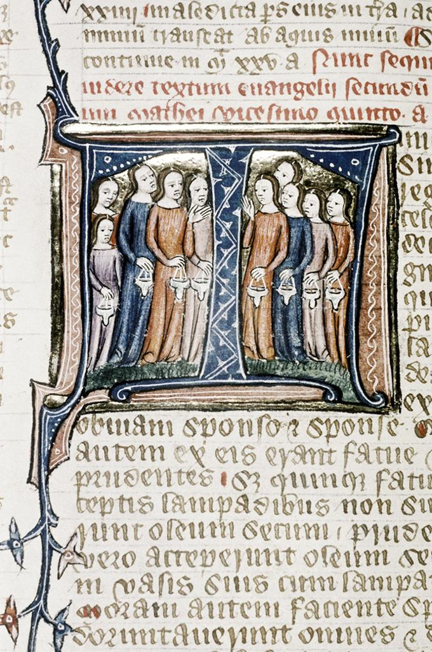
William of Nottingham, Commentary on the Gospels, after 1396
The parable of the virgins. The five foolish virgins, with unlit lamps, stand on the left. On the right are the five wise virgins, with lit lamps.
Bodleian Library, University of Oxford

Slide 85
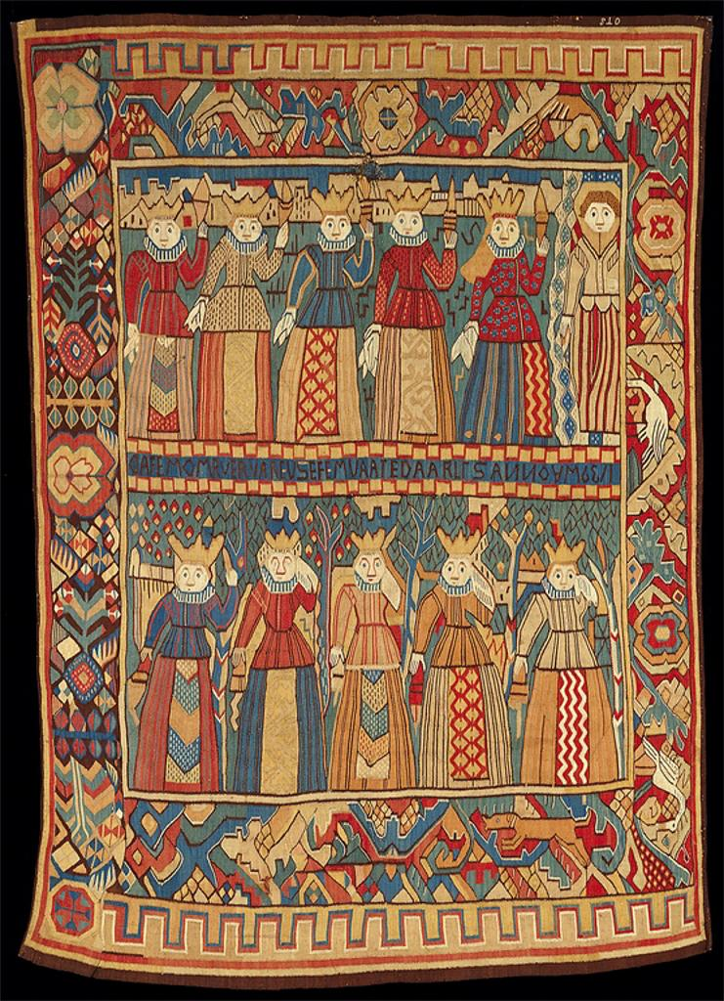
Unknown Norwegian Artist, active second half of the 17th century
The Wise and Foolish Virgins
Wool textile, H. 81 × W. 61 in.; Minneapolis Institute of Arts

Slide 86
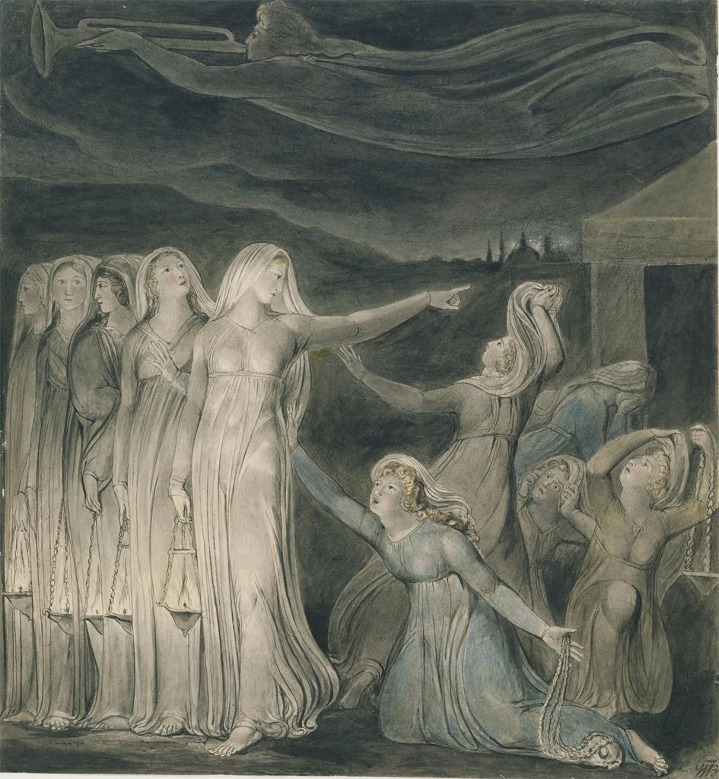
William Blake, The Parable of the Wise and Foolish Virgins, c. 1799–1800
Watercolor, pen and black ink over graphite, 14-1/8 x 13-1/16 in.
The Metropolitan Museum of Art

